Slide 1

Knowledge Distillation
Project Presentation
By
MITU20BTCS0016 Aditya Kumavat
MITU20BTCS0028 Aman Jha
MITU20BTCS0225 Raviraj Verma
MITU20BTCS0349 Yash Bora
Guided By
Prof. Abhishek Das
Department of Computer Science & Engineering, MITSoC, Loni Kalbhor

Slide 2
1. Introduction
Knowledge distillation refers to the process of transferring the knowledge from a large unwieldy model or set of models to a single smaller model that can be practically deployed under real-world constraints.
A knowledge distillation system consists of three principal components: the knowledge, the distillation algorithm, and the teacher-student architecture.
Department of Computer Science & Engineering, MITSoC, Loni Kalbhor

Slide 3
2. Problem Statement
The Problem Statement is to transfer the knowledge from the large unwieldy model or a set of models to a single smaller model that can practically be deployed under Real World Constraints.
To distill the given model and with help of same parameter we make another model which is in the close range of accuracy as of given model, to reduce the size of parent model maintaining same accuracy.
Department of Computer Science & Engineering, MITSoC, Loni Kalbhor

Slide 4
3. Objectives
To offer a useful tool that enables businesses to implement their massive, unwieldy models under actual restrictions.
To deploy a new model with an accuracy which will be in the supplied model's close range of accuracy.
To not manipulate the actual parameters of the given model.
To limit the loss as much as possible.
Department of Computer Science & Engineering, MITSoC, Loni Kalbhor

Slide 5
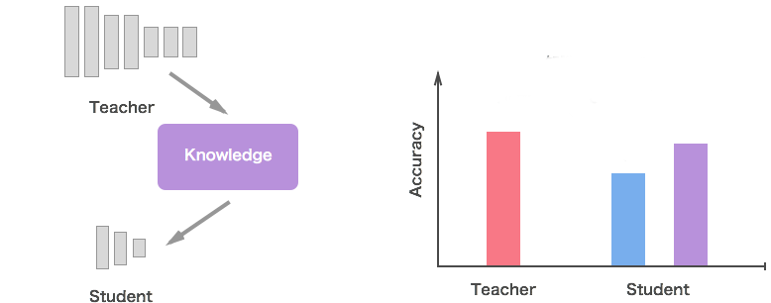
4. Concepts
Department of Computer Science & Engineering, MITSoC, Loni Kalbhor

Slide 6
5. Literature Survey
S.No | Research Paper Name | Link | Research Paper Author
1. | WELL-READ STUDENTS LEARN BETTER: ON THE IMPORTANCE OF PRE-TRAINING COMPACT MODELS. | https://arxiv.org/pdf/1908.08962.pdf | Iulia Turc, Ming-Wei Chang, Kenton Lee, Kristina Toutanova.
2. | Knowledge distillation: A good teacher is patient and consistent | https://arxiv.org/pdf/2106.05237.pdf | Lucas Beyer , Xiaohua Zhai , Amélie Royer , Larisa Markeeva, Rohan Anil, Alexander Kolesnikov.
3. | Does Knowledge Distillation Really Work? | https://arxiv.org/pdf/2106.05945.pdf | Samuel Stanton , Pavel Izmailov ,Polina Kirichenko, Alexander A. Alemi , Andrew Gordon Wilson.
4. | Efficient Net | https://arxiv.org/pdf/1905.11946.pdf | Mingxing Tan 1 Quoc V. Le
Department of Computer Science & Engineering, MITSoC, Loni Kalbhor

Slide 7






6. Tools and Languages
Department of Computer Science & Engineering, MITSoC, Loni Kalbhor

Slide 8
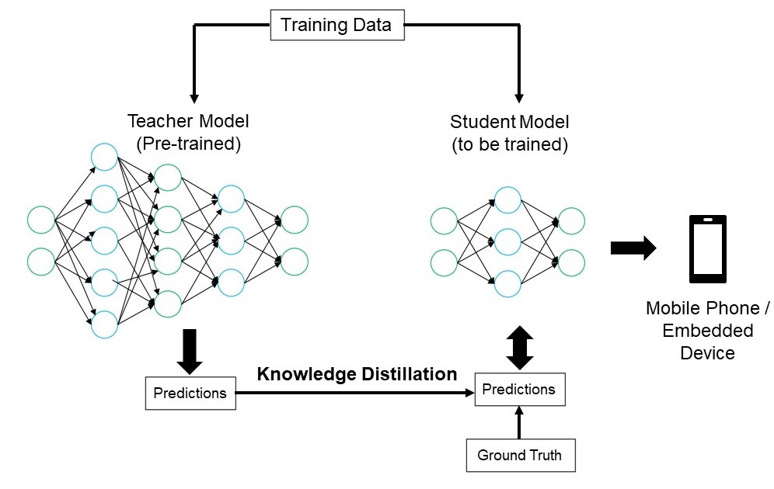
7. Process and Architecture
Department of Computer Science & Engineering, MITSoC, Loni Kalbhor

Slide 9
8. Technical Specification
Models used
Efficient Net B4 architecture (Teacher Scratch Model)
Efficient Net B4 with imagenet Weights(Teacher Transfer Learning model)
MobileNet V2
Distilled Mobile Net V2 with Teacher Scratch Model
Distilled Mobile Net V2 Teacher Transfer Learning Model
Department of Computer Science & Engineering, MITSoC, Loni Kalbhor

Slide 10
9. Dataset
The Dataset Used is Food 101 dataset
It contains 101 classes of Food
Dataset contain a total 101000 images.
Each Class Contains 1000 images with 750 images belongs to training set and 250 images belonging to testing set
Department of Computer Science & Engineering, MITSoC, Loni Kalbhor

Slide 11
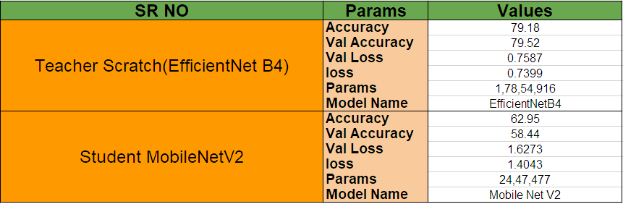
10. Result Analysis
Department of Computer Science & Engineering, MITSoC, Loni Kalbhor

Slide 12
11. Scope of Project
The Knowledge Distillation Technique can be used to improve the performance of Deep Learning Models on mobile device and embedded devices . It can used in various domains like :
1 . Computer Vision
2. Natural Language Processing
3. Speech Processing
Department of Computer Science & Engineering, MITSoC, Loni Kalbhor

Slide 13
12. References
https://arxiv.org/pdf/1908.08962.pdf
https://arxiv.org/pdf/2106.05945.pdf
https://arxiv.org/pdf/2106.05237.pdf
https://arxiv.org/pdf/1905.11946.pdf
https://arxiv.org/pdf/1704.04861.pdf
https://data.vision.ee.ethz.ch/cvl/datasets_extra/food101/static/bossard_eccv14_food101.pdf
Department of Computer Science & Engineering, MITSoC, Loni Kalbhor

Slide 14
Thank You
Department of Computer Science & Engineering, MITSoC, Loni Kalbhor

