Slide 1
REVERSE ENGINEERING
Harshit nayyar
sourcefire

Slide 2
DEMO
Mr. Calculator Demo
General Introductions

Slide 3
Introduction to Reverse Engineering
What is reverse engineering
Why reverse engineer software
Black hat (Ninja)
Understand to exploit
Crack software – use past license
Break protocols – Man In The Middle Communication.
White hat (Samurai)
Understand to learn
Crack software – malware
Break protocols – Write IDS rules
Why is it fun ?
What career options does it present
Antimalware Industry
Vulnerability/Security Research
Penn Testing
Notes:
Reverse engineering is a hard Jigsaw puzzle for the technically inclined.

Slide 4
Introduction to Reverse Engineering
Prerequisites
NONE
Almost* NONE
*
Operating System Internals
Assembly Language (x86)
Reversing Tools
Determination / Resilience

Slide 5
Scope
What is this course about:
Reversing Basics
Malware Analysis
Tools for Reversing And Malware Analysis
Rootkits Userland. (kernel - if time permits)
What we will not cover:
Vulnerability Research
Exploit Development
Reversing non-windows malware (Android, MacOSX)
Reversing x64 assembly
x86_64
IA64
Notes:
Discuss Terminology – Kernel Mode/Ring 0 and User-mode/Ring 3.

Slide 6
LAB SETUP
Windows XP Target VM.
Windows XP Host.
Debugger Symbols Setup.
Linux for Man In The Middle and fake servers.
LINUX SETUP
iface eth1 inet static
address 10.0.3.15
netmask 255.255.255.0
gateway 10.0.3.2
Notes:
Need a second Windows Virtual Machine for WinDBG.

Slide 7
LAB Setup
iface eth0 inet static
adddress 192.168.1.1
netmask 255.255.255.0
echo “1” > /proc/sys/net/ipv4/ip_forward
iptables –t nat –A POSTROUTING –s 192.168.1.3 –j MASQUERADE
How to save:
iptables-save > /etc/iptables_rules
How to restore:
Iptables-restore < /etc/iptables_rules
For windows:
Set ip-address to 192.168.1.3
Set gateway to 192.168.1.1
Set DNS to 8.8.8.8

Slide 8
Windows Operating System
History
Early beginnings
Windows (9X) And Windows NT
Aside : How to find Windows version in the registry?
Windows NT
32bit (now 64bit too)
Virtual Memory
Multi Threaded

Slide 9
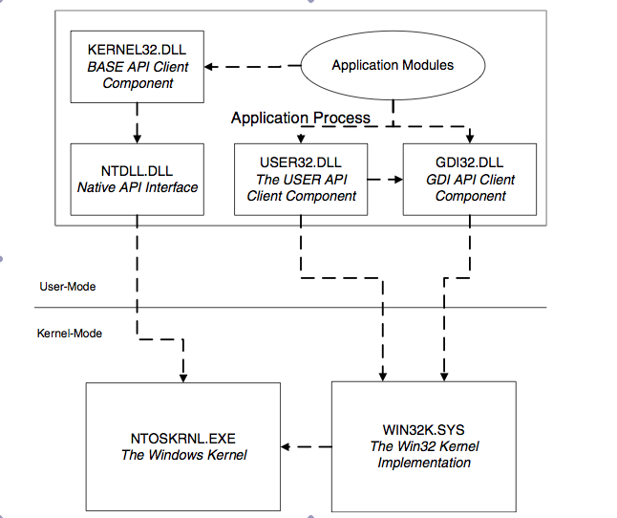
Windows Operating System Architecture

Slide 10
Virtual Memory
Concepts
Paging
Paging out
Page Faults and Page Fault Exceptions
Kernel/User Memory
Benefits
Transparency compared to available physical memory
Process Isolation

Slide 11
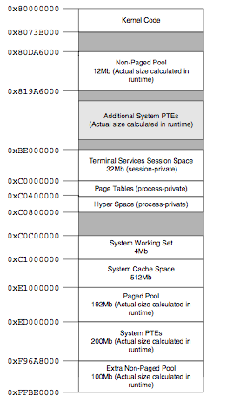
Basic Kernel Memory Layout

Slide 12
Userland Concepts
Files (MZ)
Processes (PEB)
Threads (TEB)
Mutexes
Stack / Heap

Slide 13
Windows PE File Format
MZ Header
PE Header
File Header
Optional Header
Size Of Image
Address of Entry Point
How a PE File is mapped into memory and executed.

Slide 14
SEH – Structured Exception Handling
C Code:
__try
{
int x,y;
x=1;
y=0;
return x/y;
}
__except(1)
{
MessageBoxA(NULL,"Exception","Exception",0);
}

Slide 15
SEH Hand On Demo
The Exception Handler is set at FS[0] i.e. start of TEB to be discussed.
_EXCEPTION_REGISTRATION_RECORD:
+0x000 Next : Ptr32 _EXCEPTION_REGISTRATION_RECORD
+0x004 Handler : Ptr32

Slide 16
TEB And PEB
Thread Environment Block
Contains Information About a thread
Starts at FS[0x00]
Linear Address is at FS[0x18]
PEB is at FS[0x30]
Process Environment Block
Contains information about a process

Slide 17
TEB Fields
dt nt!_TEB @$teb
+0x000 NtTib : _NT_TIB
…
+0x030 ProcessEnvironmentBlock : 0x7ffd5000 _PEB
+0x034 LastErrorValue : 0x36b7
…
+0xfb5 BooleanSpare : [3] "”
kd> dt nt!_NT_TIB @$teb
+0x000 ExceptionList : 0x0012ffb0 _EXCEPTION_REGISTRATION_RECORD
+0x004 StackBase : 0x00130000
+0x008 StackLimit : 0x0012d000
+0x00c SubSystemTib : (null)
+0x010 FiberData : 0x00001e00
+0x010 Version : 0x1e00
+0x014 ArbitraryUserPointer : (null)
+0x018 Self : 0x7ffdf000 _NT_TIB

Slide 18
PEB Fields
Demo. (WinDBG)
Important Ones:
+0x000 InheritedAddressSpace : 0 ''
+0x001 ReadImageFileExecOptions : 0 ''
+0x002 BeingDebugged : 0 ''
…
+0x008 ImageBaseAddress : 0x01000000
+0x00c Ldr : 0x00191e90 _PEB_LDR_DATA
....
+0x018 ProcessHeap : 0x00090000
…
+0x020 FastPebLockRoutine : 0x7c901000
+0x024 FastPebUnlockRoutine : 0x7c9010e0
…
+0x08c MaximumNumberOfHeaps : 0x10
+0x090 ProcessHeaps : 0x7c97cfc0 -> 0x00090000
…
+0x1f0 CSDVersion : _UNICODE_STRING "Service Pack 3”
Notes:
!process -1 0
!process 0 0
.process –I <PE>

Slide 19
Hands On Demo
Windows Registry
Virtual Memory

Slide 20
Basic C Programs
Initial Version
Hello World Program
Function Calls
Conditionals / Switches
Loops
LoadLibrary And GetProcAddress

Slide 21
Basic C++ Program
Virtual Functions Pointer Table
Name Decorations for symbols

Slide 22
Rootkits
Rootkit – misnomer
Practical definition
Most use hooking techniques
Rarely uses quirks in OS:
ADS
Reparse points
Can be user-land or kernel level or even lower (MBR, BIOS etc.)
Advantages of going lower – race to the bottom. Difficulty of cleanup.
Disadvantages:
System Stability Issues (Tidserv/Alureon)
Too specifically tied to some hardware
Example: http://blog.webroot.com/2011/09/13/mebromi-the-first-bios-rootkit-in-the-wild/

Slide 23
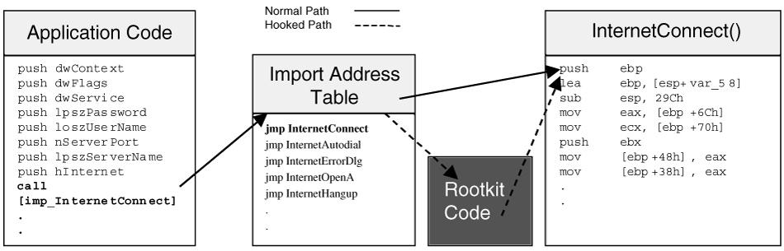
IAT Hooking

Slide 24
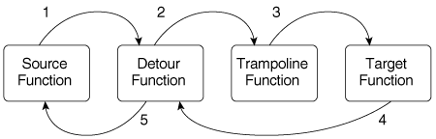
Inline Hooking

Slide 25
How to Hook - PART I
Inject Code:
Hollow Process Injection
Create a suspended process
Un-map its code
Map your own code – try to map it in the same address (Workaround).
Resume Thread

Slide 26
Hollow Process Injection Demo

Slide 27
How to Hook – Part II
DLL Injection:
AppInit_DLLs registry:
HKEY_LOCAL_MACHINE\Software\Microsoft\Windows NT\CurrentVersion\ Windows\AppInit_DLLs
SetWindowsHookEx API:
Example:
SetWindowsHookEx(WH_KEYBOARD, function_in_dll, hinstance_dll, 0)
thread_id is set to 0 => All threads running currently in same desktop. Only in that case will a DLL be loaded.
Make sure your DLL export ‘function_in_dll’
Don’t forget to call CallNextHookEx from ‘function_in_dll’

Slide 28
How to Hook – Part II cont.
Create Remote Thread Method:
Open the target process
Allocate some space in the target process for the DLL name.
Call CreateRemoteThread with LoadLibrary function passing the p0inter to the DLL name string in target process’ memory.
Notes:
Talk about ASLR if there is time.

Slide 29
Zbot Inline Patching Demo

Slide 30
Anti Debugging Techniques

Slide 31
AntiVirtualization
Generic – old techniques that do not work any more.
sidt
Gidt
VMWare specific backdoor technique
Detecting filesystem, process or registry artifacts.

