Slide 1
Date A Scientist
Machine Learning Fundamentals
Alberts REISONS
20.01.18

Slide 2
Table of Contents
Body type graph
Income graph
Questions
New columns
Body type prediction
Income prediction

Slide 3
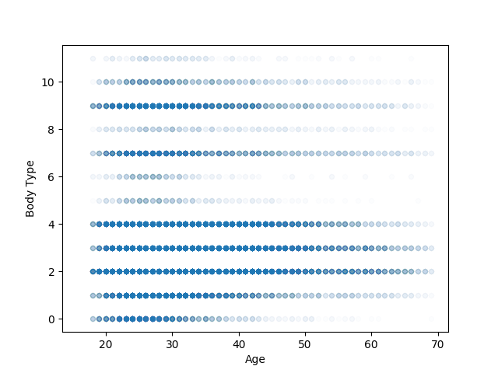
Body type vs age

Slide 4
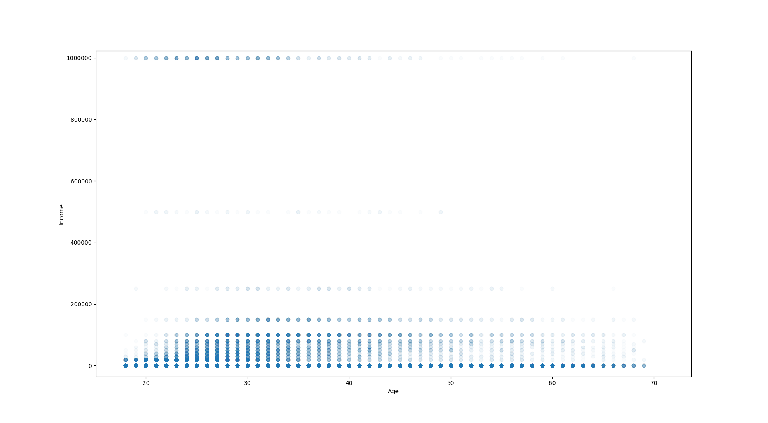
Age vs Income

Slide 5
Questions
Can we predict body type using the rest of our data ?
Can we predict income using the rest of our data ?

Slide 6
New columns
I created a new column representing body type using the following code:
I created a new column representing drinking habits using the following code:

Slide 7
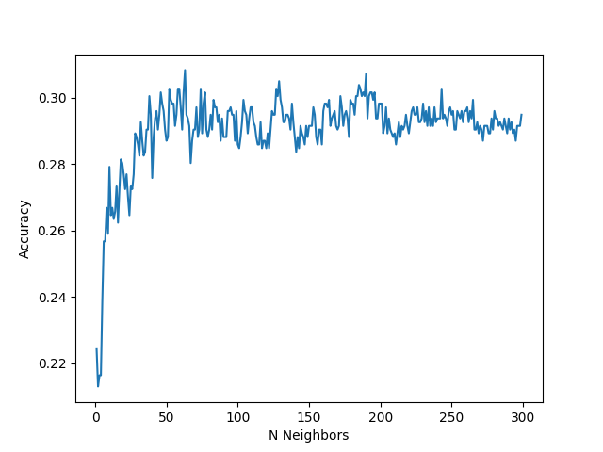
N Neighbors Accuracy

Slide 8
K_Neighbors vs Naive Bayes
Classifier | Accuracy | Runtime
K_Neighbors | 0.31 | 0.062
Naive Bayes | 0.26 | 0.0022

Slide 9
Linear Regression vs KNeighbors Regressor
Model | Score | Runtime
Linear Regression | 0.037 | 0.028
Kneighbors Regressor | 0.053 | 0.053

Slide 10
Conclusion
It is possible to predict body type somehow accurately using our data.
However, I could not predict income accurately.

