Slide 1
Activity
What is your role?
What is your level of accessibility knowledge/experience?
Answer questions in the poll
Notes:
Your job has to do with… code, design, content, user research, management, other
What is your level of accessibility knowledge/experience? novice 1 2 3 4 5 6 7 8 9 10 expert

Slide 2
Introduction to accessibility

Slide 3
Anika Henke
Senior Accessibility Specialist
Viktoria Westphalen
Accessibility Support Officer
Central Digital and Data Office

Slide 4
A definition of “digital accessibility”
Why accessibility matters
The principles of accessibility
A process for achieving accessibility
Resources
Q&A

Slide 5
Activity
What are your accessibility challenges?
Individually, write in the chat
[3 mins]

Slide 6
A definition of “digital accessibility”

Slide 7
Everyone needs to be able to use your service. Easily.
The people using your service are all different. And they’ll be using it in different ways.

Slide 8
People may:
be using a mobile in a noisy cafe
have a broken arm so they can’t use a mouse
be using a screen in direct sunlight

Slide 9
Or they may have a permanent disability affecting their sight, hearing, mobility, voice or understanding.
Accessibility means not excluding anyone.

Slide 10
Permanent
Deaf
Temporary
Infection
Situational
Noise
Notes:
Impairments aren’t always permanent
People sometimes temporarily do not have use of one or more of their senses
And people might not have full use of their senses because of the situation they’re in

Slide 11
Activity
Consider temporary and situational impairments
Individually or in small groups, come up with a temporary and situational impairment a user may have in each category [3 mins]
Notes:
motor, hearing, vision, speech, cognitive

Slide 12
Accessibility matters

Slide 13
Discussion
Why does accessibility matter?
Discuss in small groups in breakout rooms, one person writes notes
[4 mins]
Notes:
Each group read out your most important one [5 mins]
Anyone else have the same?
Next one

Slide 14
Can’t exclude people
Shouldn’t create barriers
People have no choice

Slide 15
Be kind
It's the right thing to do
Empower disabled people

Slide 16
Better experience for everyone
Part of better usability
It affects us all

Slide 17
Saves money
More people can use the service
Fewer support requests

Slide 18
It's the law
Part of government requirements

Slide 19
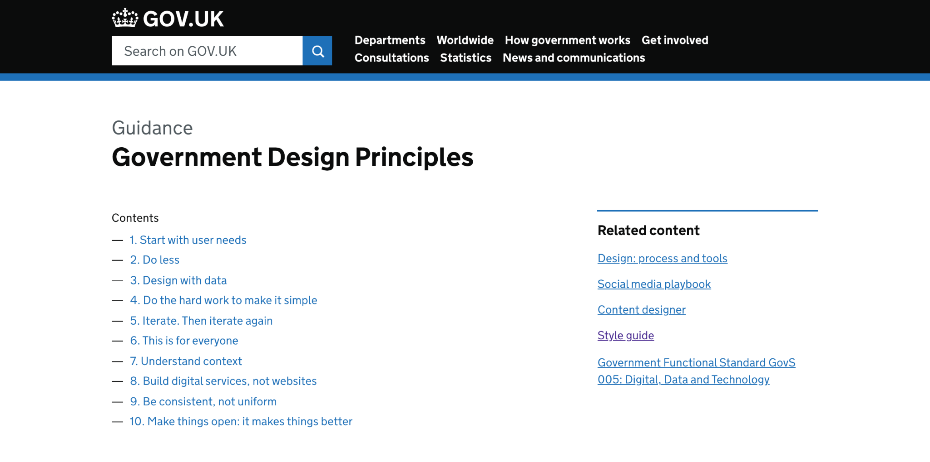
Notes:
Government Design Principles
https://www.gov.uk/guidance/government-design-principles
There’s a principle there that’s specifically about accessibility.
Which one do people think it is?

Slide 20
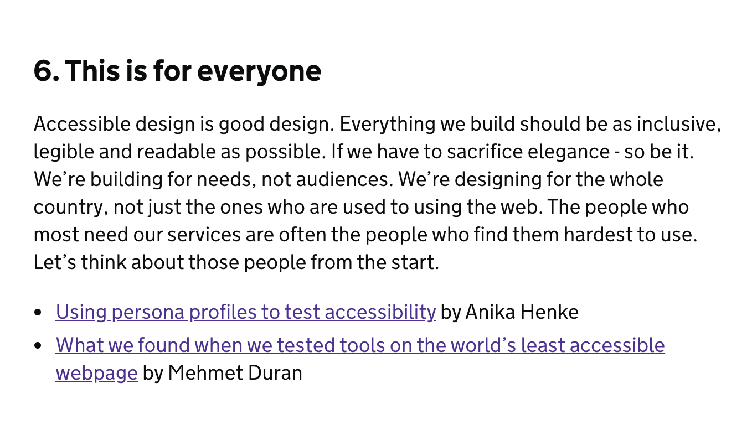
Notes:
It’s number 6: ‘This is for everyone’
As the principle says: ‘Accessible design is good design. Everything we build should be as inclusive, legible and readable as possible.’
As a public service provider we need to make sure that what we build works for everyone.

Slide 21
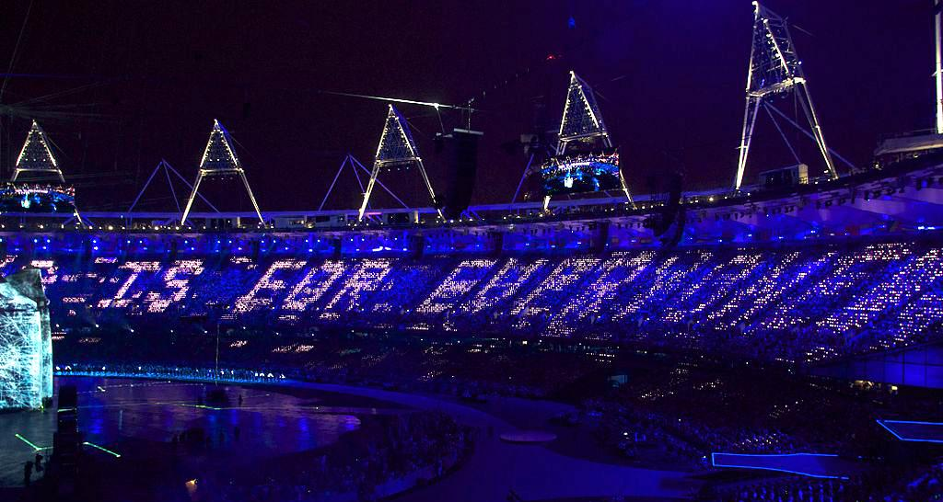
“This is for everyone”
Notes:
Tim Berners-Lee's tweet "This is for everyone" at the 2012 Summer Olympics opening ceremony
Ethos of the web that it is for everyone
It used to be more accessible in the early days (and simpler)
Source: https://commons.wikimedia.org/wiki/File:This_is_for_Everyone.jpg

Slide 22
Legal requirements

Slide 23
Equality Act 2010
We have a legal obligation to provide equal access to people with disabilities
Notes:
This is true of both public-facing services and non-public facing services
Government is both a service provider and an employer - and the Equality Act covers both service providers and employers
(It’s the Disability Discrimination Act for Northern Ireland)

Slide 24
Public Sector Equality Duty
We have a duty to be proactive in making things accessible
Notes:
Part of the Equality Act 2010

Slide 25
Public Sector Bodies Accessibility Regulations 2018
Makes the legal obligation more specific

Slide 26
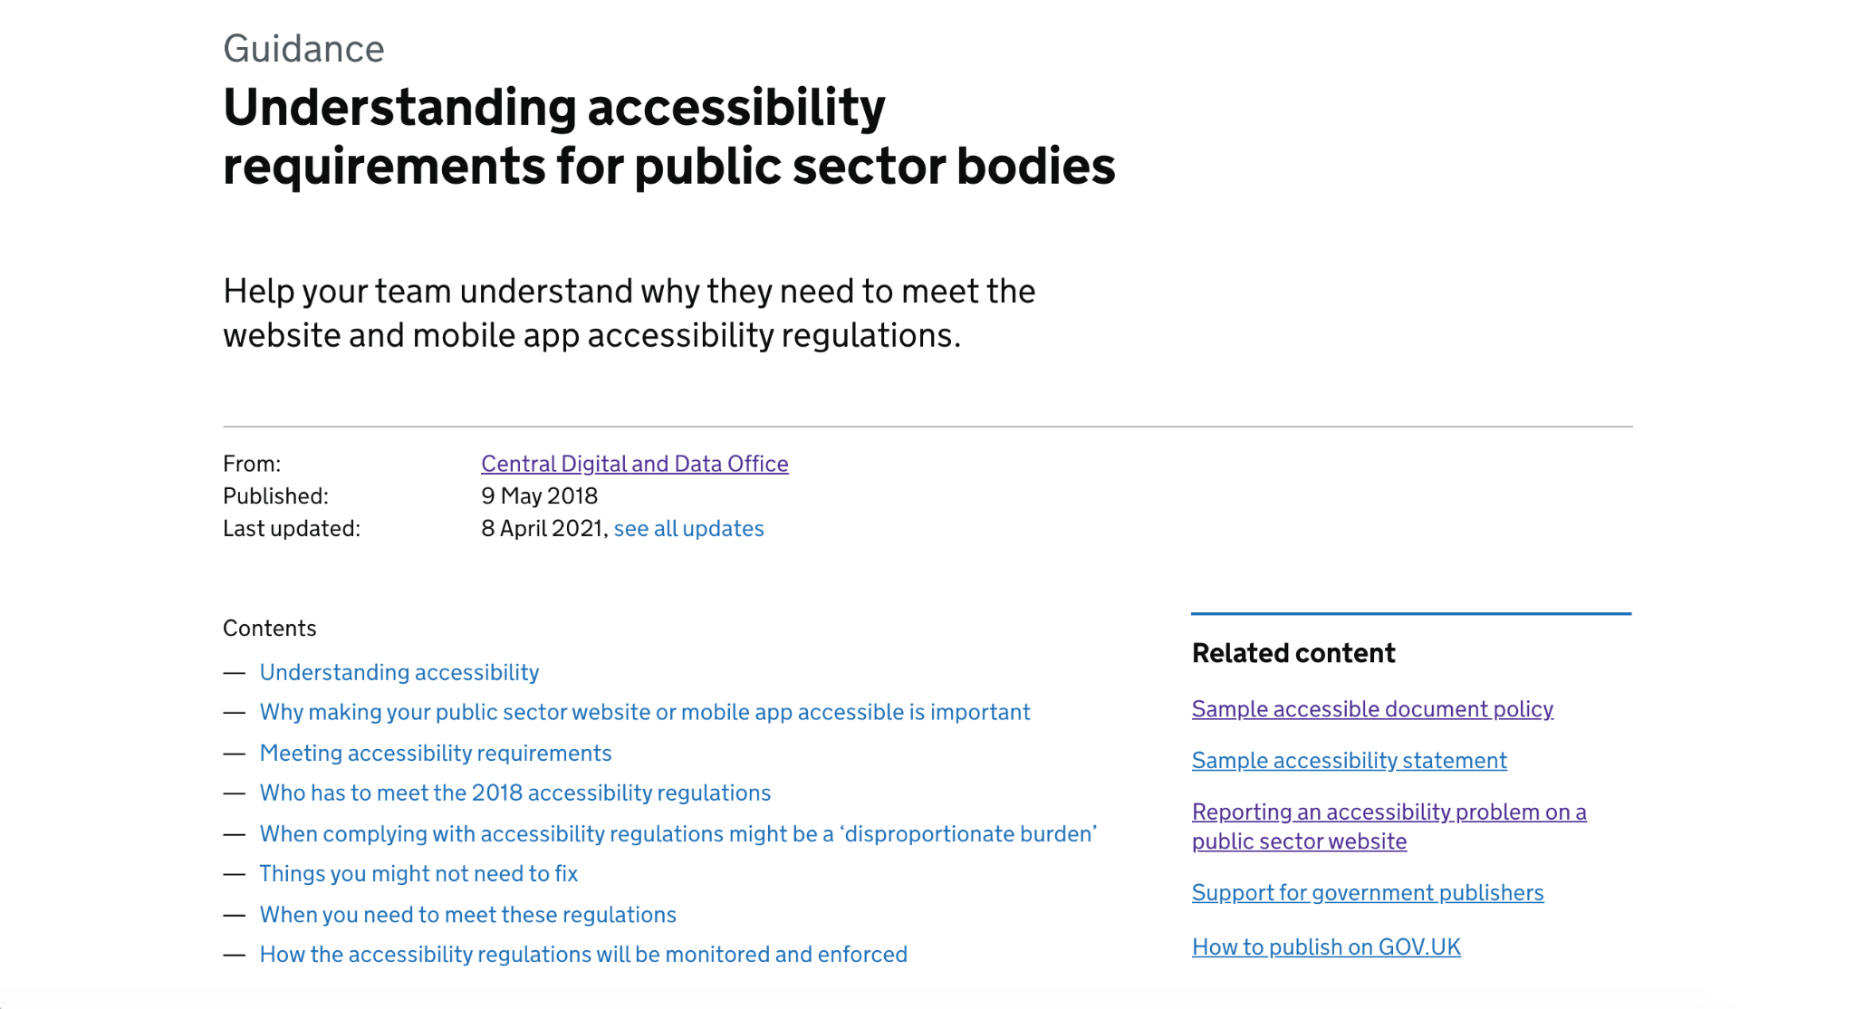
Notes:
https://www.gov.uk/guidance/accessibility-requirements-for-public-sector-websites-and-apps

Slide 27

Notes:
https://accessibility.campaign.gov.uk/

Slide 28
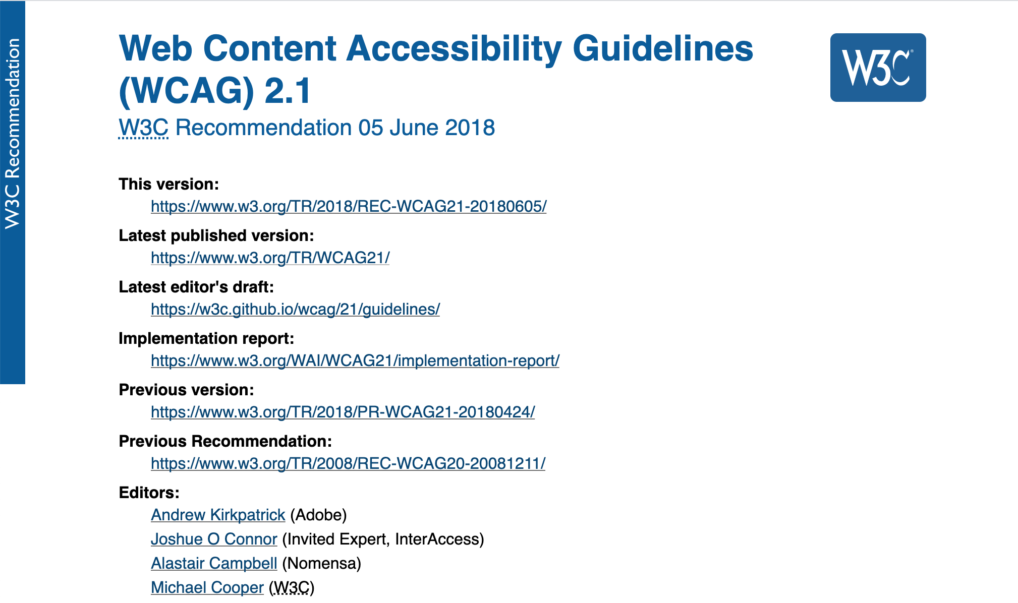
Notes:
most common and internationally accepted standard is the Web Content Accessibility Guidelines - WCAG
latest version 2.1 is referenced in the Public Sector Bodies Accessibility Regulations
technical standard, difficult to understand
12 guidelines organized under 4 principles
78 testable success criteria
three levels: A, AA, and AAA
https://www.w3.org/TR/WCAG21/

Slide 29
Government accessibility requirements

Slide 30
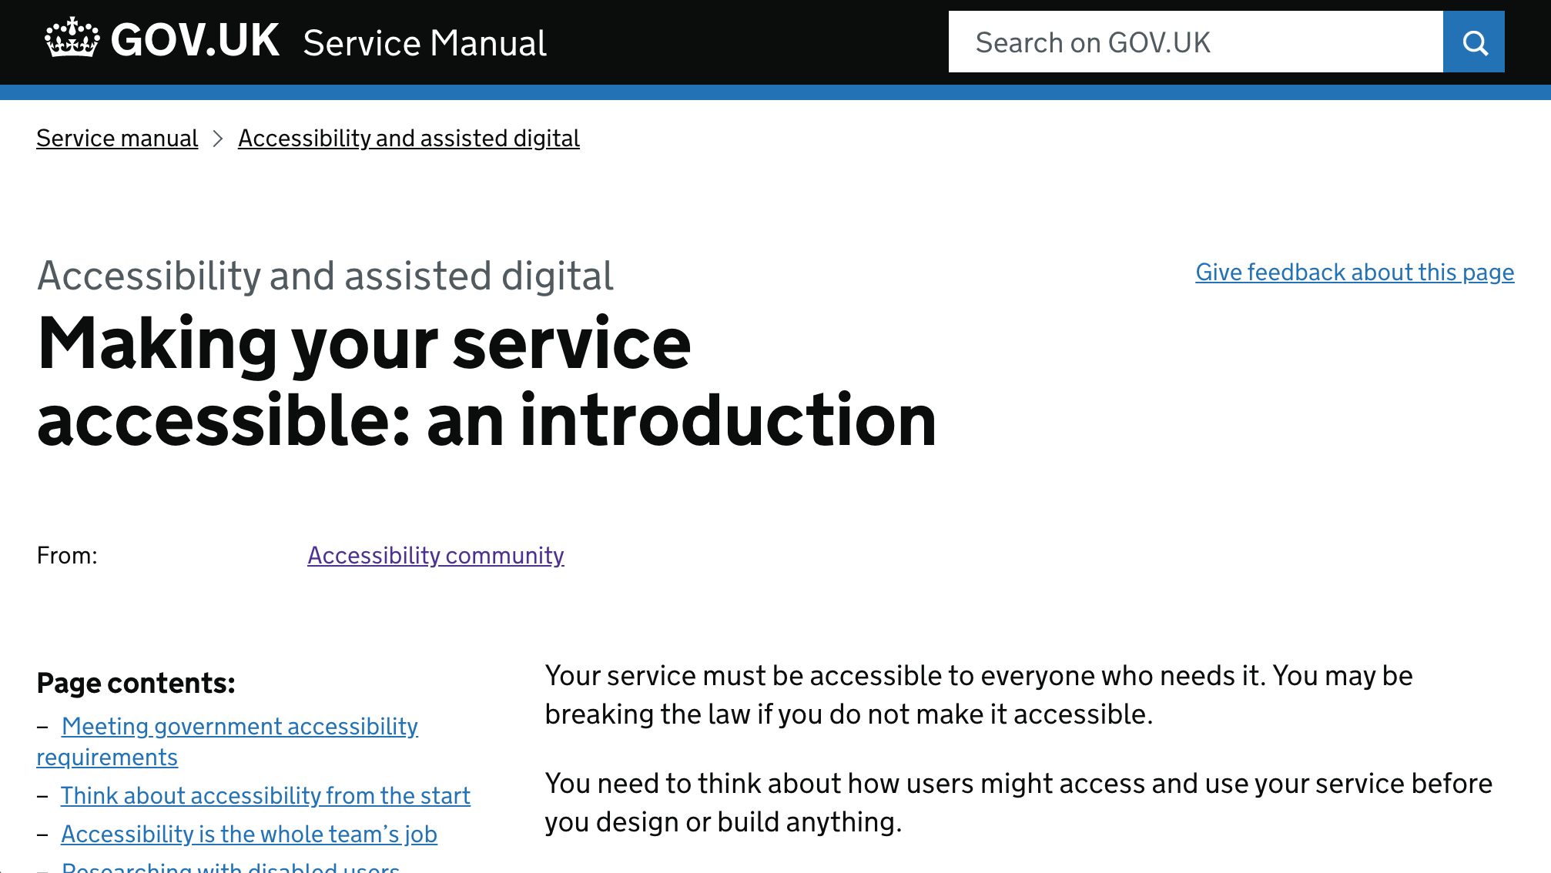
Notes:
https://www.gov.uk/service-manual/helping-people-to-use-your-service/making-your-service-accessible-an-introduction

Slide 31
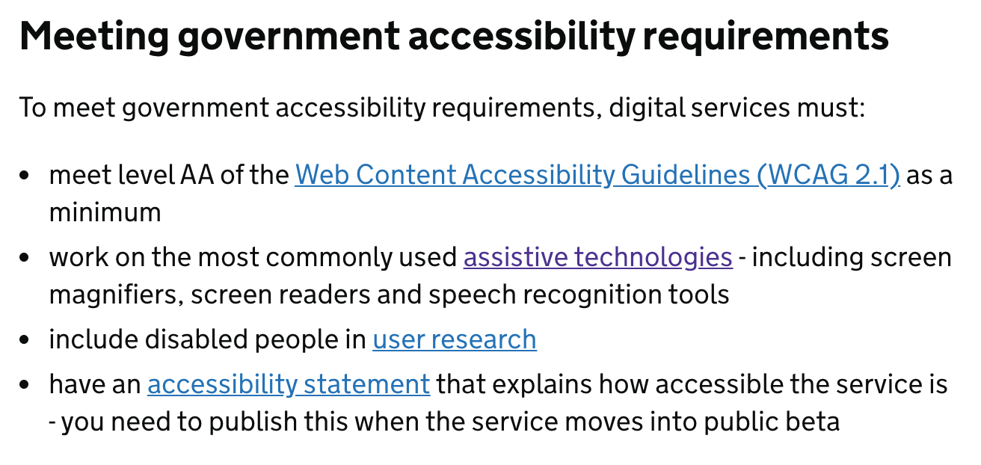

Slide 32
Accessibility = having no barriers
Assisted digital = getting support to use a service
Service assessments include both
Notes:
accessibility means having no barriers
it’s not quite the same as Assisted Digital
both are requirements for government digital services
Assisted Digital is about realising that some people can’t use a service independently due to lack of confidence, skill or trust - or they might not have a computer - and that they will need support to use digital government services

Slide 33
Accessibility numbers

Slide 34
Activity
Accessibility numbers quiz
Answer the multiple choice questions in the poll or on a piece of paper or in a document
Tip: The population of the UK is 65.6 million

Slide 35
1. How many people in the UK are sight impaired or severely sight impaired?
a) 120,000
b) 360,000
c) 520,000

Slide 36
2. How many people in the UK
live with sight loss?
a) 800,000
b) Over 1.5 million
c) Over 2 million

Slide 37
3. How many people in the UK
have hearing loss?
a) 3 million
b) 7 million
c) 11 million

Slide 38
4. How many people in the UK
have severe or profound hearing loss?
a) 900,000
b) 1 million
c) 2 million

Slide 39
5. How many people in the UK
are deafblind?
a) 70,000
b) 140,000
c) 390,000

Slide 40
6. What percentage of the UK population
are dyslexic?
a) 5%
b) 10%
c) 20%

Slide 41
7. How many people in the UK
are autistic?
a) 100,000
b) 400,000
c) 700,000

Slide 42
8. How many people in the UK
use a wheelchair?
a) 1.2 million
b) 2.3 million
c) 4.1 million

Slide 43
9. How many people in the UK
experience poor mental health each year?
a) 6 million
b) 11 million
c) 16 million

Slide 44
10. What percentage of people in the UK
aged 65 years and over have a disability?
a) 18%
b) 36%
c) 54%

Slide 45
1. How many people in the UK are sight impaired or severely sight impaired?
b) 360,000
Notes:
Source: RNIB

Slide 46
2. How many people in the UK
live with sight loss?
c) Over 2 million (about 1 in 30 people)
Notes:
Source: RNIB
It is predicted that by 2020 the number of people with sight loss will rise to over 2,250,000. And by 2050, the numbers of people with sight loss in the UK will double to nearly four million. This is because:
the UK population is ageing and as we get older we are increasingly likely to experience sight loss
there is a growing incidence in key underlying causes of sight loss, such as obesity and diabetes.
underestimated figure, age related sight loss is seen as normal occurrence so people don’t think of it as being disabled. Long/Short sightedness corrected by glasses = not vision impaired. It has to be a permanent thing that can’t be fixed.

Slide 47
3. How many people in the UK
have hearing loss?
c) 11 million
Notes:
Source: Action on hearing loss

Slide 48
4. How many people in the UK
have severe or profound hearing loss?
a) 900,000
Notes:
Source: Action on hearing loss

Slide 49
5. How many people in the UK
are deafblind?
c) 390,000
Notes:
Source: Sense

Slide 50
6. What percentage of the UK population
are dyslexic?
b) 10% (6.4 million people)

Slide 51
7. How many people in the UK
are autistic?
c) 700,000
Notes:
Source: National autistic society

Slide 52
8. How many people in the UK
use a wheelchair?
a) 1.2 million (less than 8%)
Notes:
Source: NHS
Also, the figure might be a bit fuzzy due to temporary use rather than full time / permanent usage. Mobility scooters count as wheelchairs
interesting how this number might be lower than expected because of the prevalence of the accessibility symbol being someone in a wheelchair

Slide 53
9. How many people in the UK
experience poor mental health each year?
c) 16 million (1 in 4 people)
Notes:
Source: Mental Health Foundation (check out More Or Less Podcast R4)

Slide 54
10. What percentage of people in the UK
aged 65 years and over have a disability?
c) 54%
Notes:
most disabilities are acquired and often not something people are born with

Slide 55
Ageing population
12 million people of state pension age
The number of people aged 60 or over is projected to rise by over 50 percent in the next 25 years

Slide 56
The prevalence of disability rises with age
6% of children are disabled
16% of working age adults
45% of adults over State Pension age
1 in 2 people will be disabled at some point in their lifetime
Notes:
By not designing with accessibility in mind we’re potentially excluding our friends, our families and our future selves
Source: https://www.gov.uk/government/statistics/disability-facts-and-figures/disability-facts-and-figures#disability-prevalence-estimates

Slide 57
Of those Civil Servants who declared their disability status, 10.0% were disabled
(ONS - Civil Service Statistics: 2018)
Notes:
Source: https://www.ons.gov.uk/employmentandlabourmarket/peopleinwork/publicsectorpersonnel/bulletins/civilservicestatistics/2018

Slide 58
Everyone is different
Don’t design for the fictional average user
Notes:
The perfect user is rare, with good vision, full hearing, good literacy skills and able to use both a mouse and a touch screen

Slide 59
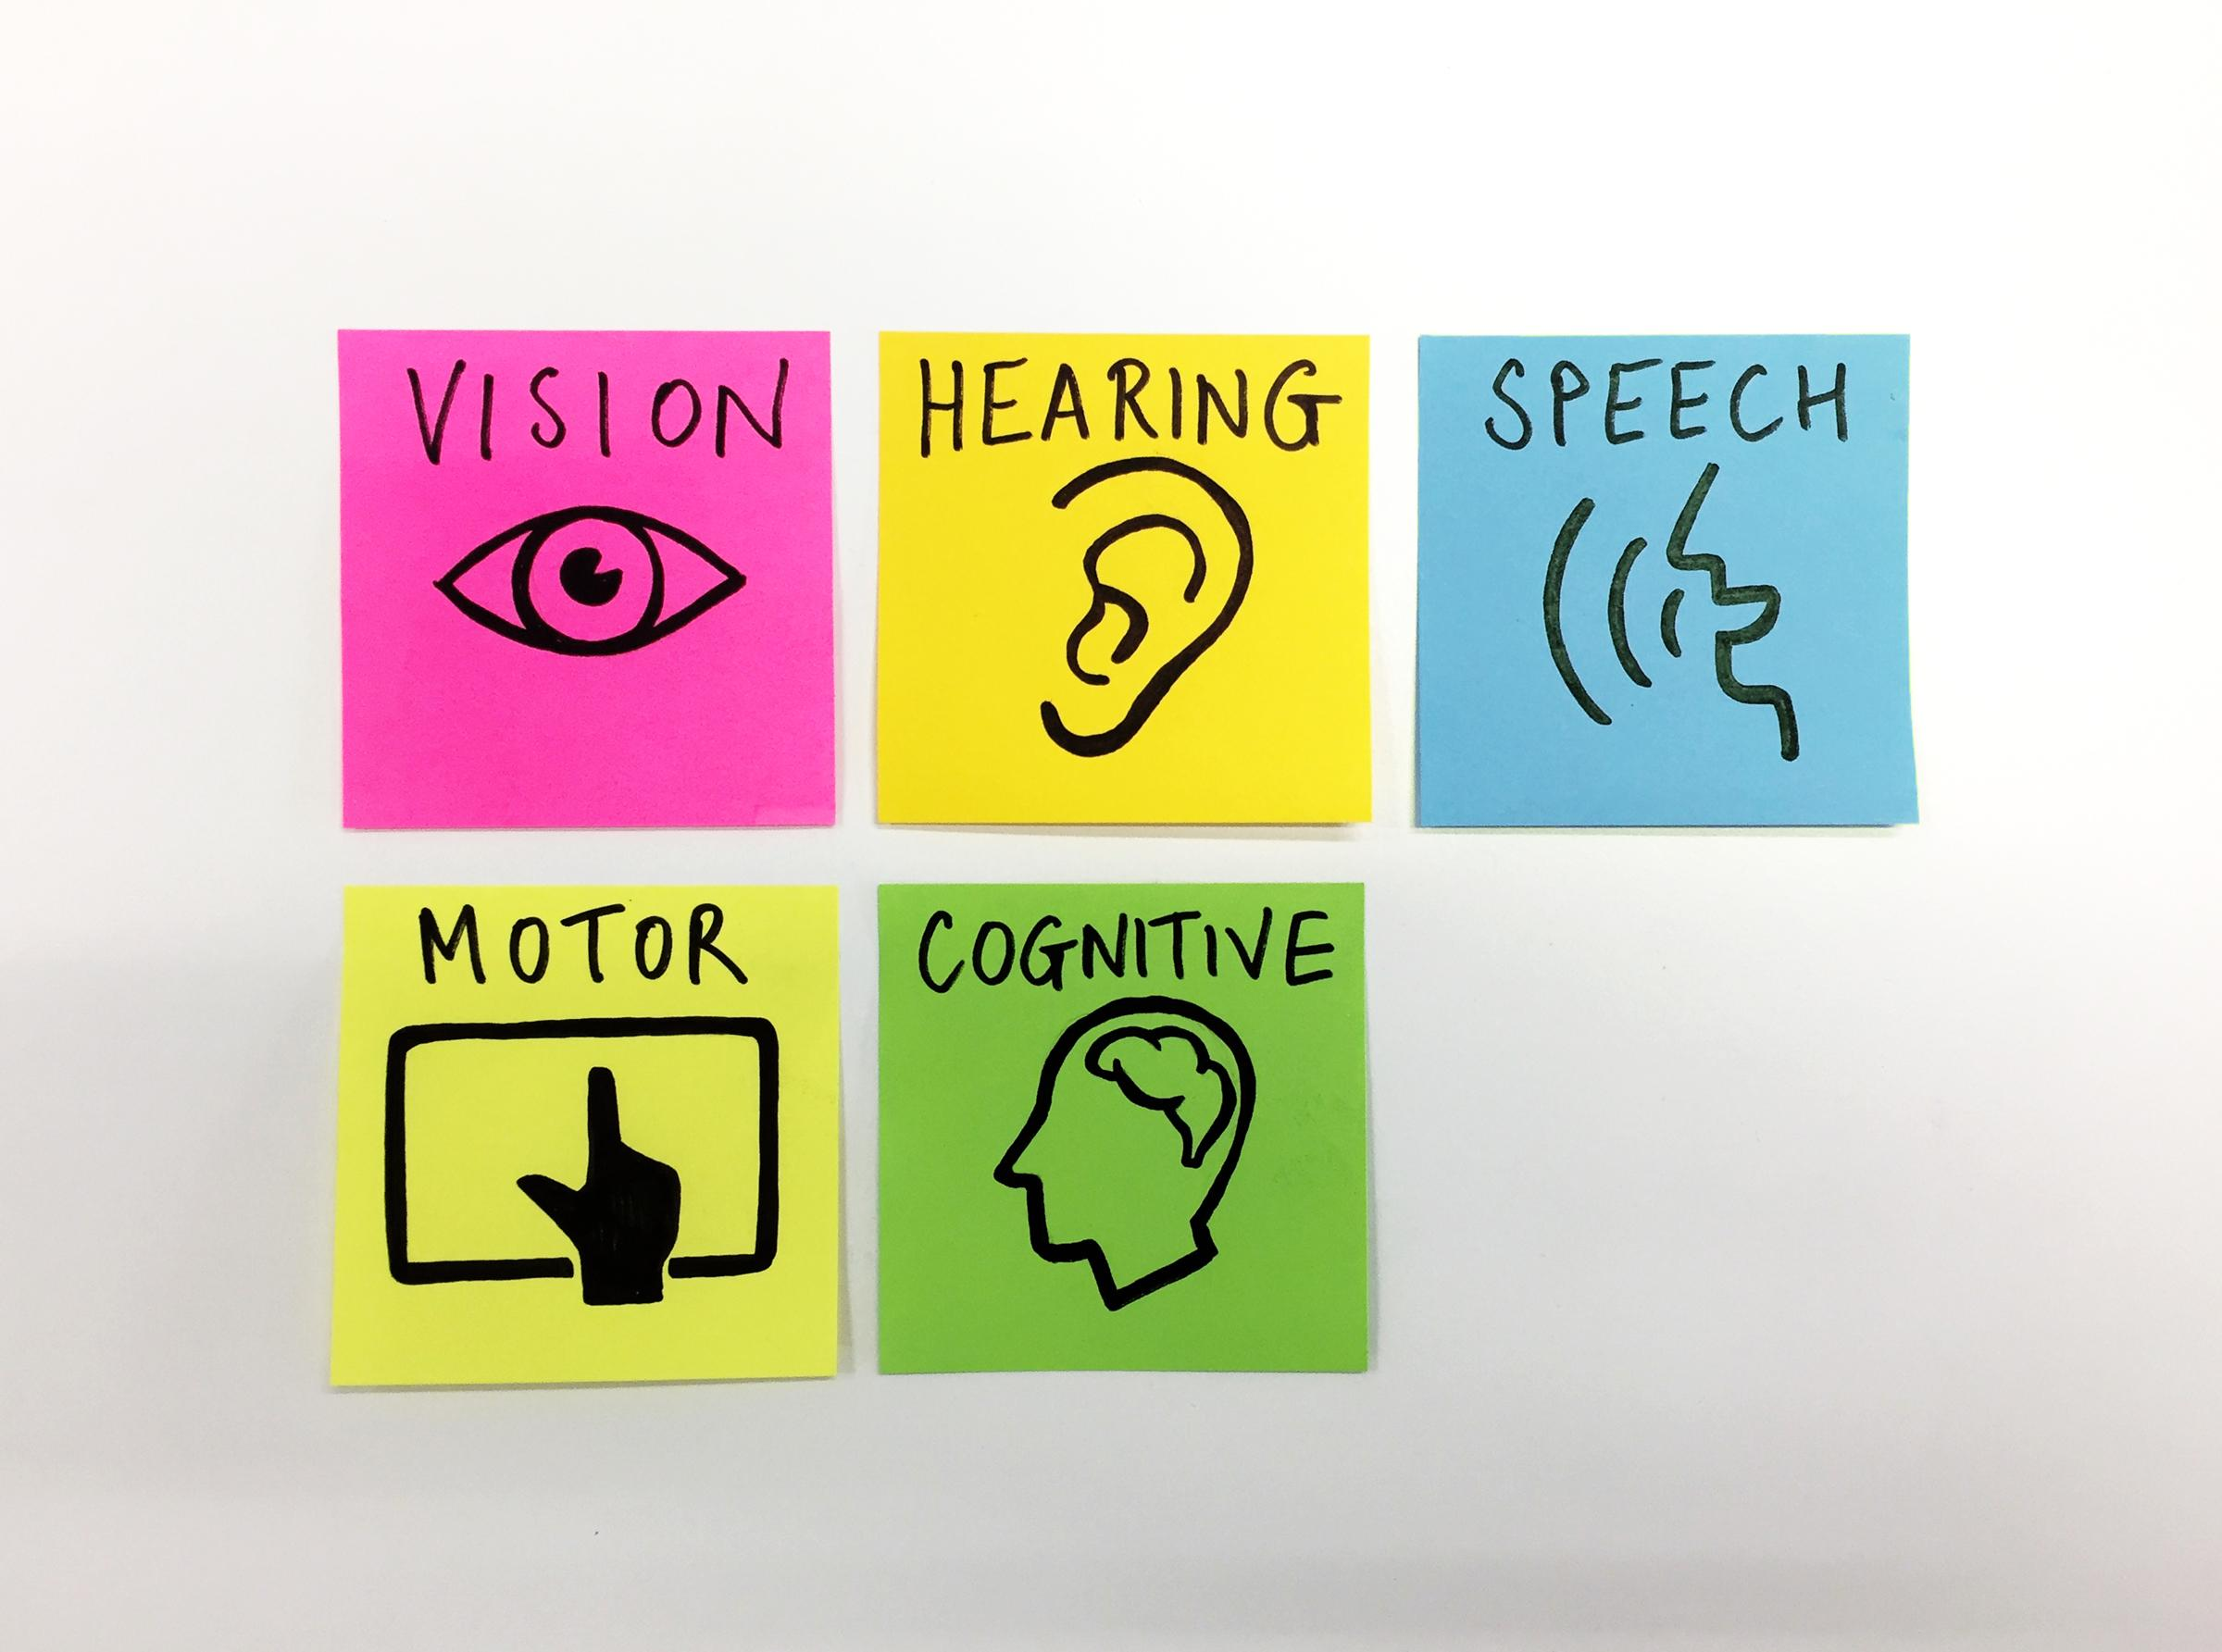
Design for the full range of human capability
Notes:
We need to design for the full range of human capability
Services that can be used by people with…
full vision, partial vision, without perception of colour or no vision
full hearing, partial hearing or no hearing
full and limited dexterity, cognition, speech
Image source: Stephen McCarthy

Slide 60
The principles of accessibility

Slide 61
Perceivable
Operable
Understandable
Robust

Slide 62
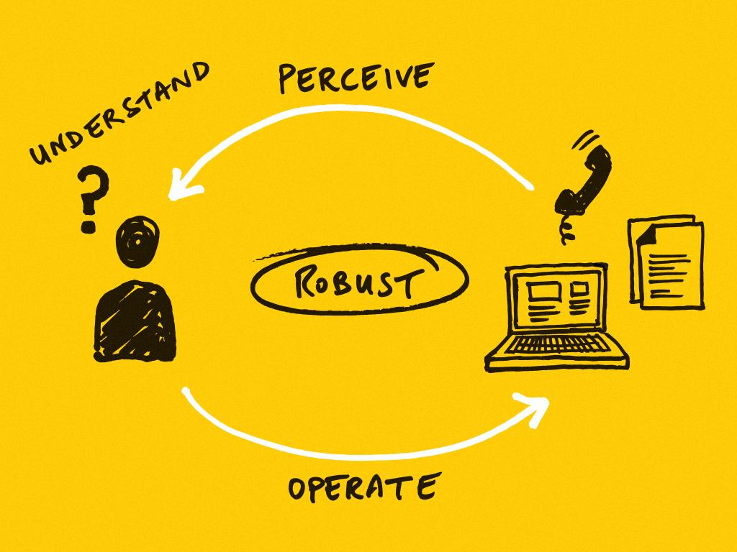
Notes:
To use something, you’ve got to to be able to perceive, understand and operate it. And the thing has to be robust.
Using a website in this example, but the principles apply to everything - not just websites.
A user needs to be able to perceive your content - which means your content has to be available to at least one of their senses.
So if a user can’t see something, they can still hear it. Or vice versa.
But it’s not enough just to perceive something, the user has to be able to understand it as well.
I could show you a Polish or Chinese website and you would be able to perceive it, but you might not be able to understand it.
People have different processing ability, for example someone with dyslexia might struggle with long passages of text, so we need to be conscious of this when designing and operating services.
And the user has to be able to operate the thing.
I imagine most people in this room use a mouse or a trackpad when they’re interacting with digital services - but these aren’t the only input devices people use.
Lots of people use a keyboard or speech recognition. Your service needs to work with whatever input device people are using.
And finally the service needs to be robust. That means it been implemented in such a way that it works with the technologies that people use - such as a screen reader.
These are the 4 key elements - if just one of these breaks down then the user won’t be able to do what they need to do.
We’re going to go through this in a bit more detail one-by-one.

Slide 63
Perceivable
Make content and controls perceivable by all users

Slide 64
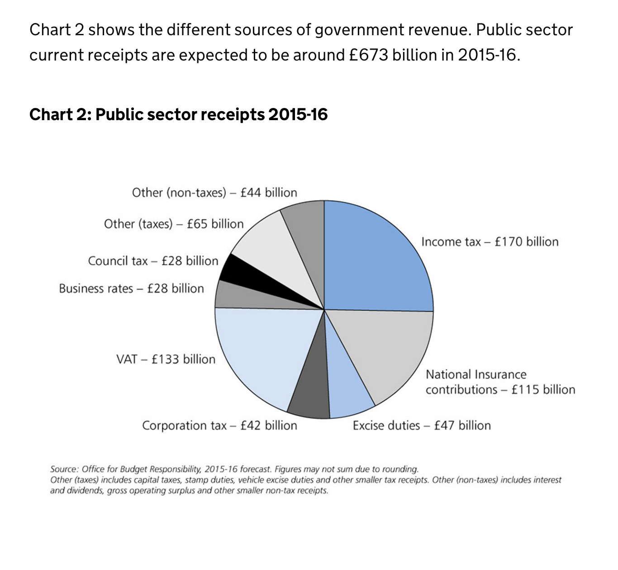
Provide appropriate text alternative for images
Notes:
screen readers cannot read text in images
sighted user will get a lot of information from the visual
a screen reader user will only get this information if it is also provided as text
example of a pie chart
alt text was simply the title (“Public sector receipts 2015-16”)
a screen reader user would miss all the information communicated by the image

Slide 65
Don’t communicate solely with colour
Notes:
colour-blindness or (colour vision deficiency) affects 1 in 12 men and 1 in 200 women
if you communicate something using colour alone, then someone with colour-blindness might not be able to perceive it and might be excluded from your content

Slide 66

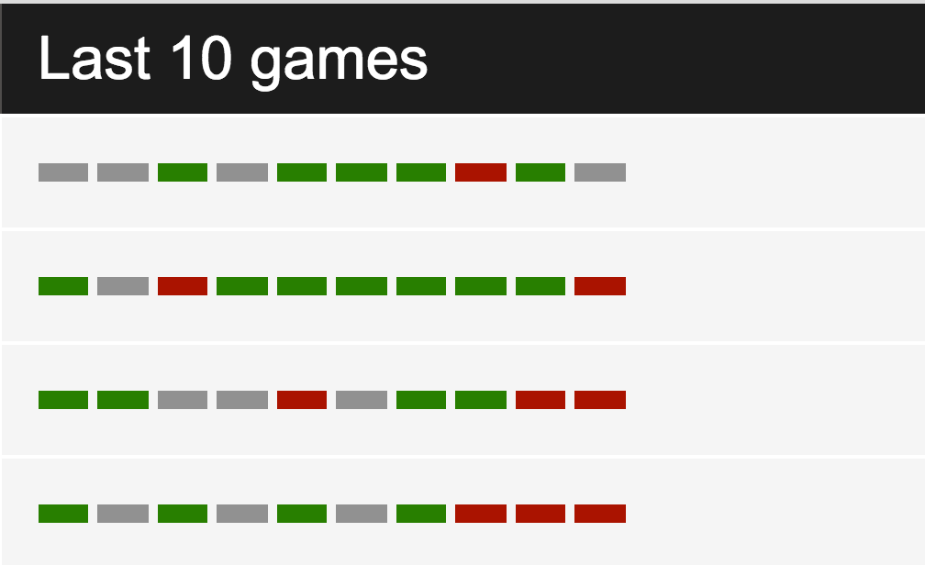
Notes:
example showing sports results
a win is indicated by green, a draw by grey and a loss by red

Slide 67

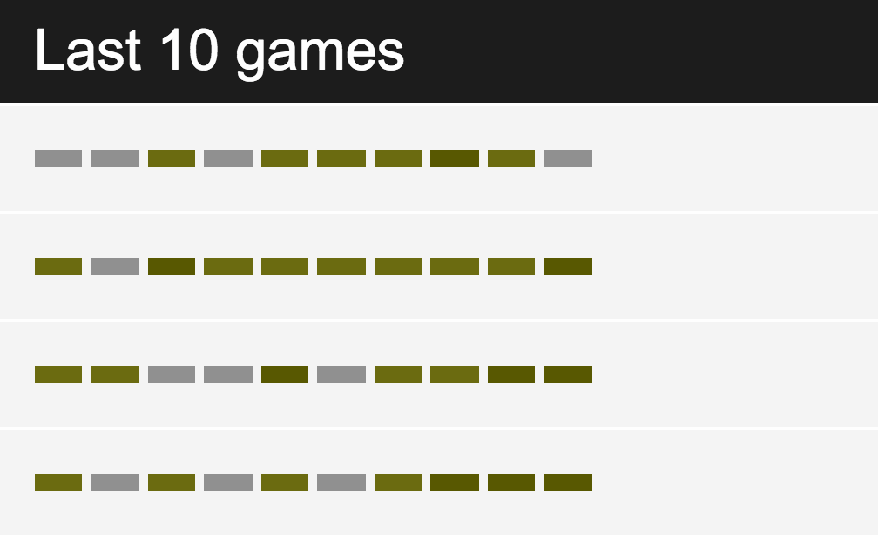
Notes:
to a user with red-green colour-blindness it’s very difficult to differentiate between a win and a loss
you can still use colour to indicate things, but not exclusively

Slide 68
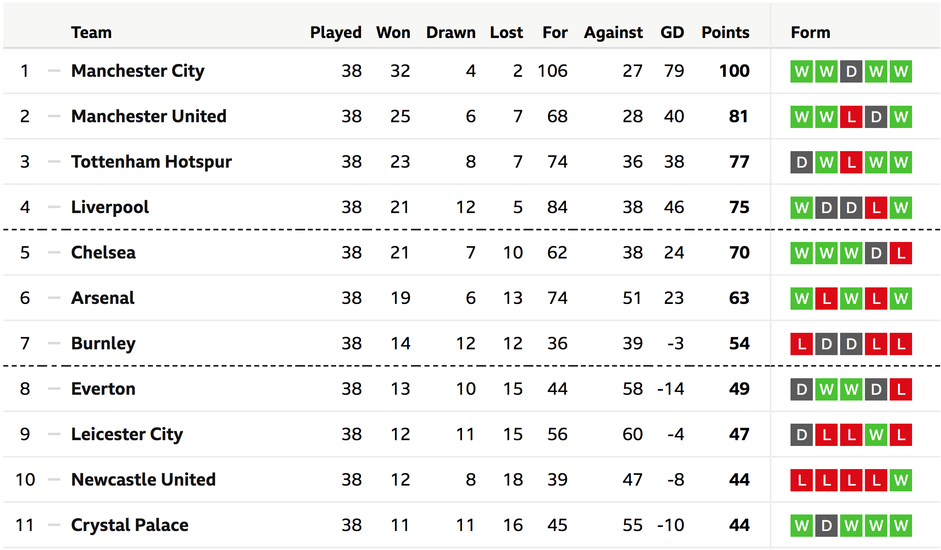
Notes:
fix: indicate a win by a W and a loss by an L
(in addition or instead of the green and red)

Slide 69
Allow users to change text size (and not just through browser zoom)

Slide 70
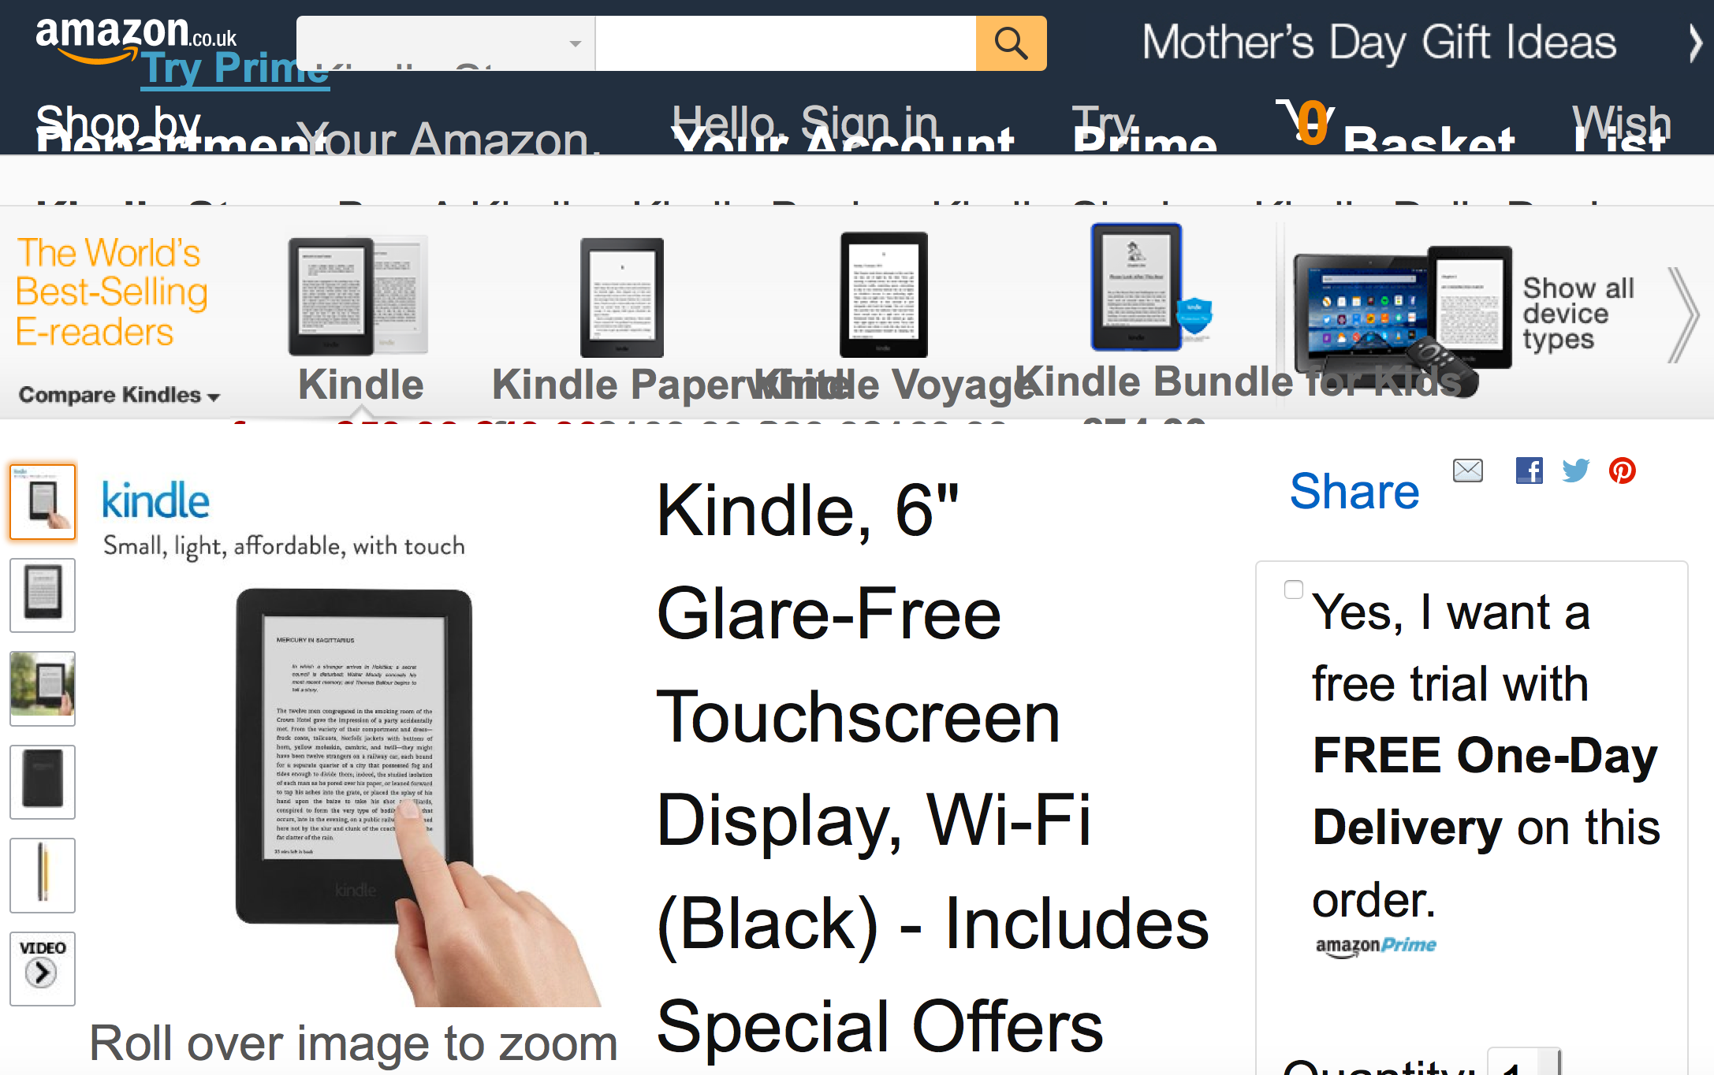
Notes:
if you enlarge the text on Amazon’s website the navigation becomes unreadable
private sector = bad business
public sector = excluding peopl

Slide 71
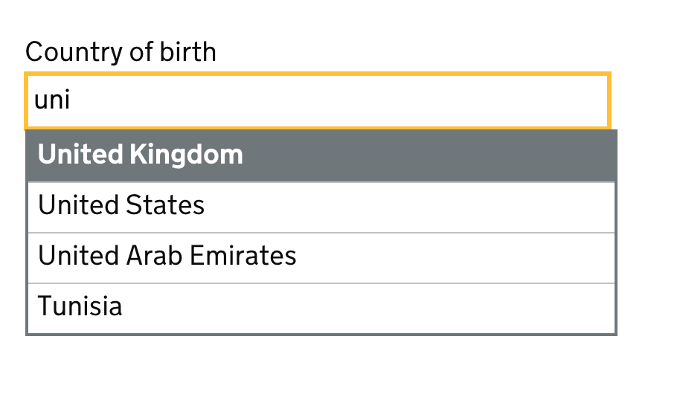
Users need to be made aware of new content
Notes:
dynamic content example: autocomplete
sighted user can see four suggestions
the same information needs to be made available to a screen reader user

Slide 72
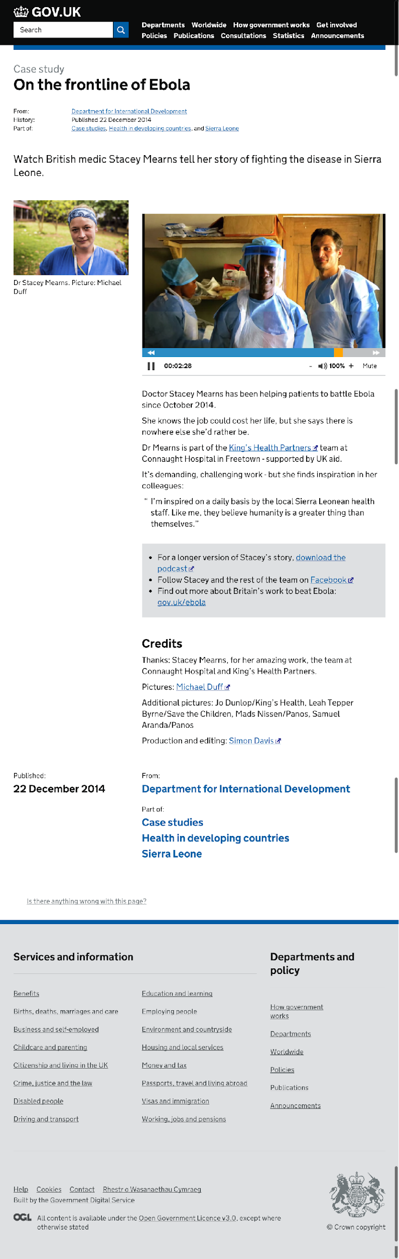
Videos need captions and transcripts
Notes:
videos without captions and/or transcripts exclude people with hearing impairments
by making something accessible, you’re improving the experience for everyone:
if the video fails to load, the user would still be able to get the content, through the text description
and search engines will be able to index it as well
https://www.gov.uk/government/case-studies/on-the-frontline-of-ebola
TODO: look for a different example as this video has captions now

Slide 73
Understandable
Make content and user interfaces understandable to all users

Slide 74
Write in plain English
Organise information into manageable chunks - using headings and bullet points
Only include content that meets a specific user need
Notes:
lots of people can struggle to understand complex language and walls of text

Slide 75
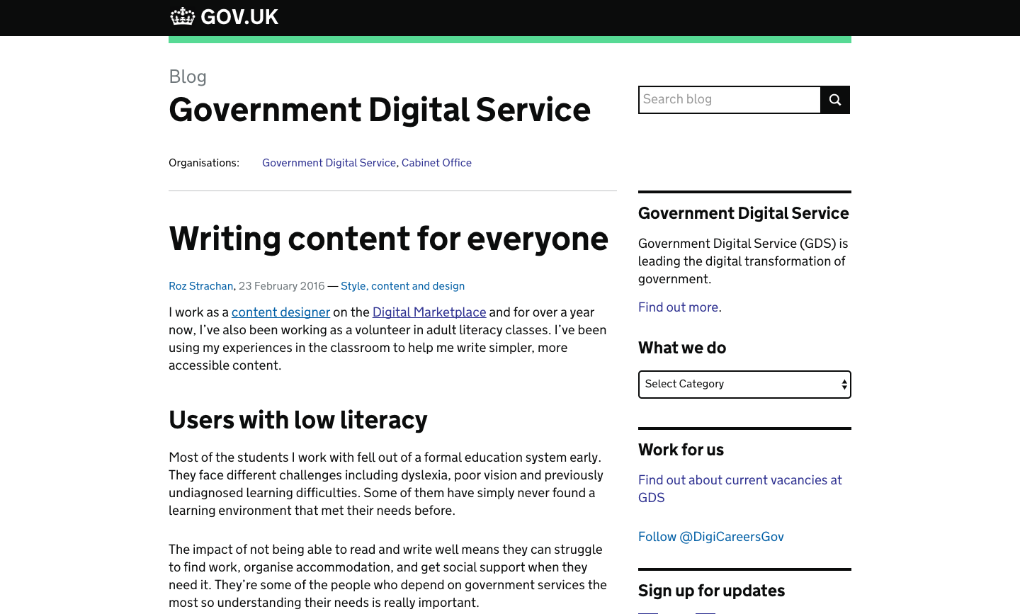
Notes:
https://gds.blog.gov.uk/2016/02/23/writing-content-for-everyone/

Slide 76
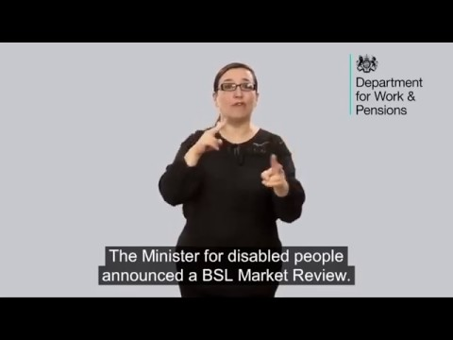
Notes:
example of BSL
not a 1-to-1 mapping between the signals and the words
Government isn’t currently supporting BSL as well as it should
DWP is using a Video Relay Service that lets people communicate using BSL over a video link

Slide 77
In English we’d say:
A person is on a ladder leaning against the house.

Slide 78
In British Sign Language (BSL) this would literally translate as
a person is hanging in the air
then there is a ladder which seems to be leaning against nothing
and then the house appears

Slide 79
BSL, as a visual language, has to have the context of the scene portrayed first.
There is a house, a ladder is leaning against it and there is a person on it.

Slide 80
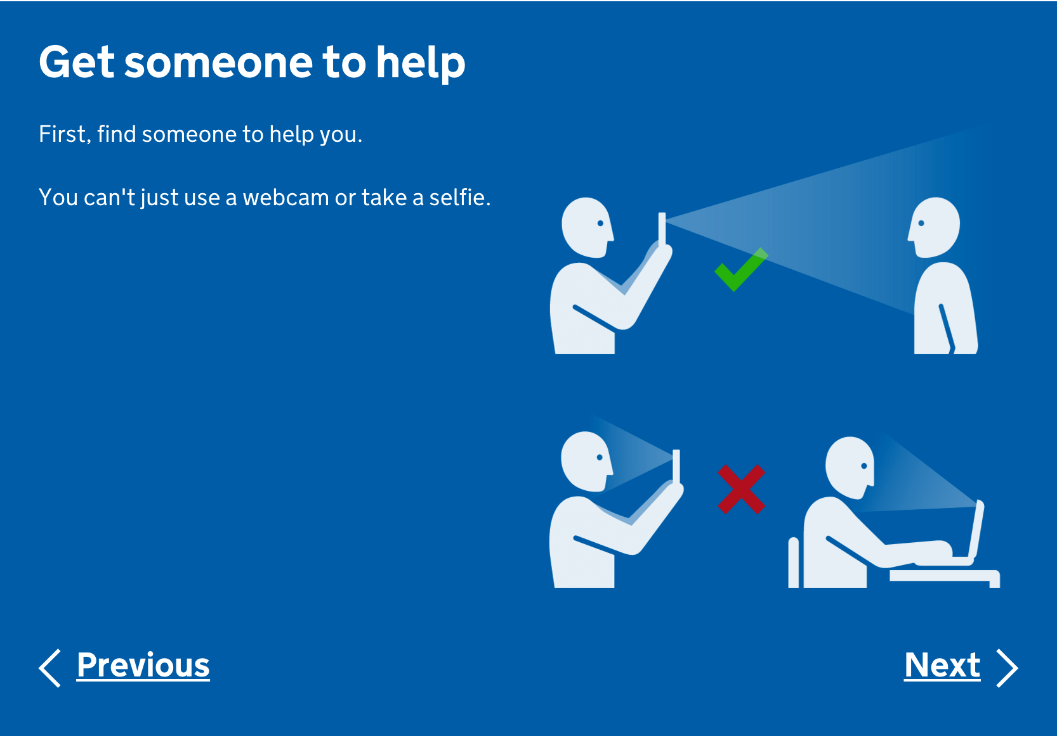
Notes:
myth that images and video are not accessible
graphics can be especially helpful for people who struggle to process text
video and graphics need to be accessible
example: passport renewal service found a graphic was the best way to describe to users what was needed from a passport photo

Slide 81
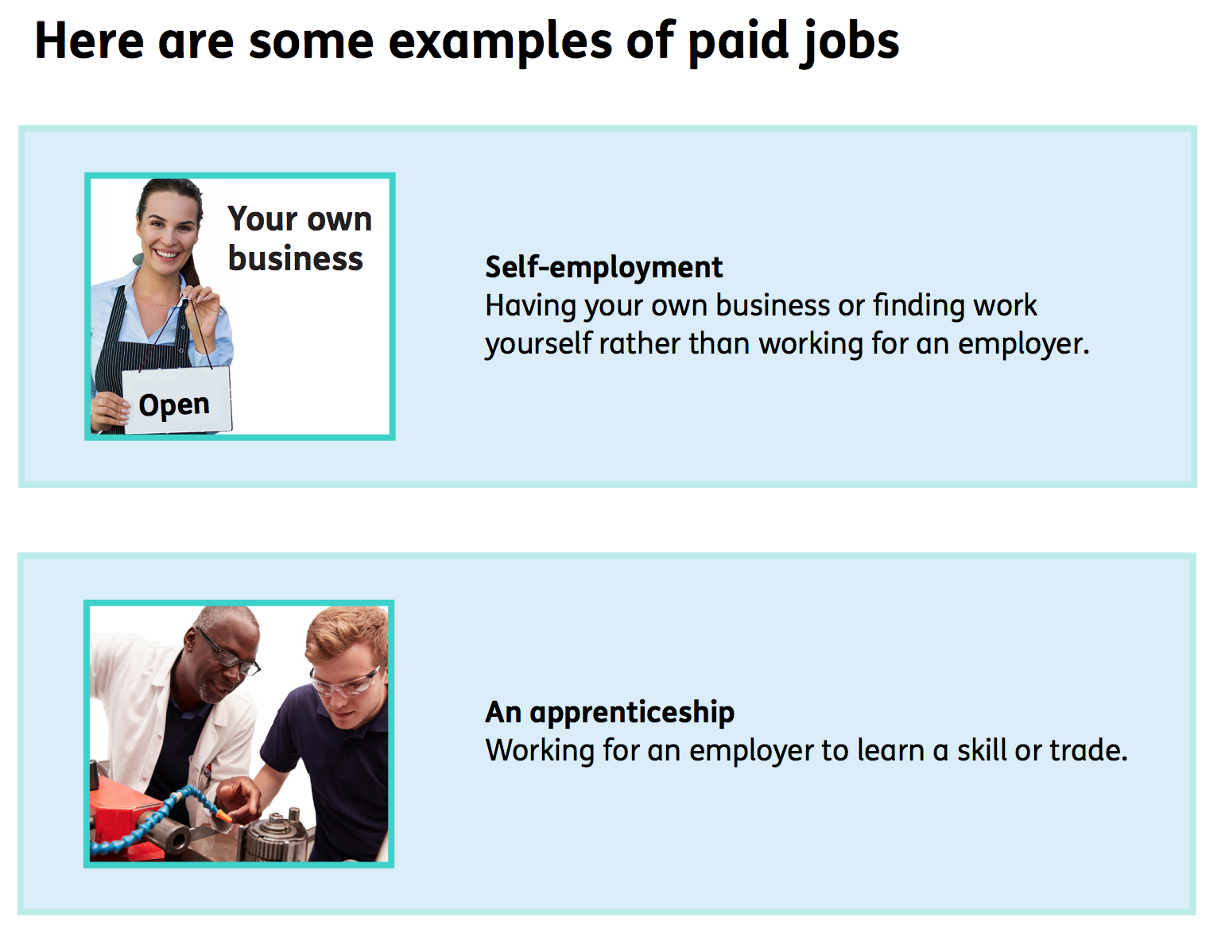
Notes:
Easy Read combines graphics, simple words and short sentences
for people who may struggle to read

Slide 82
Operable
Make content and controls operable by all users

Slide 83

Notes:
large hit areas for links, buttons and controls important for users with motor impairments, using a touch interface or have difficulty controlling a mouse
pagination links very close together might make it hard to select the correct link

Slide 84
Make all functionality available from a keyboard
Notes:
not all users use a mouse or a trackpad
testing with keyboard only also uncovers a lot of issues for screen reader and voice control users

Slide 85
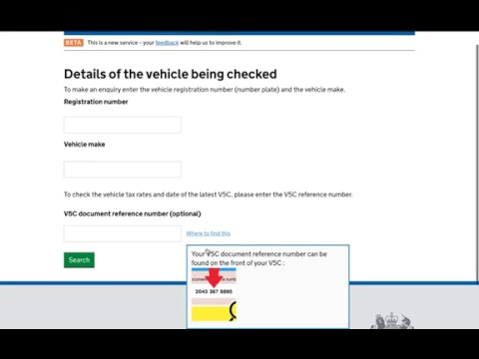
Notes:
example of a service where keyboard users are unable to access some content
anyone using a mouse can hover over the ‘Where to find this’ link to reveal more content
anyone relying on a keyboard to navigate is unable to get to this content
due to how it has been implemented in the code

Slide 86
Robust
Make content robust enough that it can be interpreted reliably by a wide variety of user agents, including assistive technologies

Slide 87
Your service needs to work with the technology that people use
Notes:
like screen readers, screen magnifiers and dictation software

Slide 88
Frontend developers need to write HTML, CSS and Javascript based on standards
Notes:
for these technologies to work

Slide 89
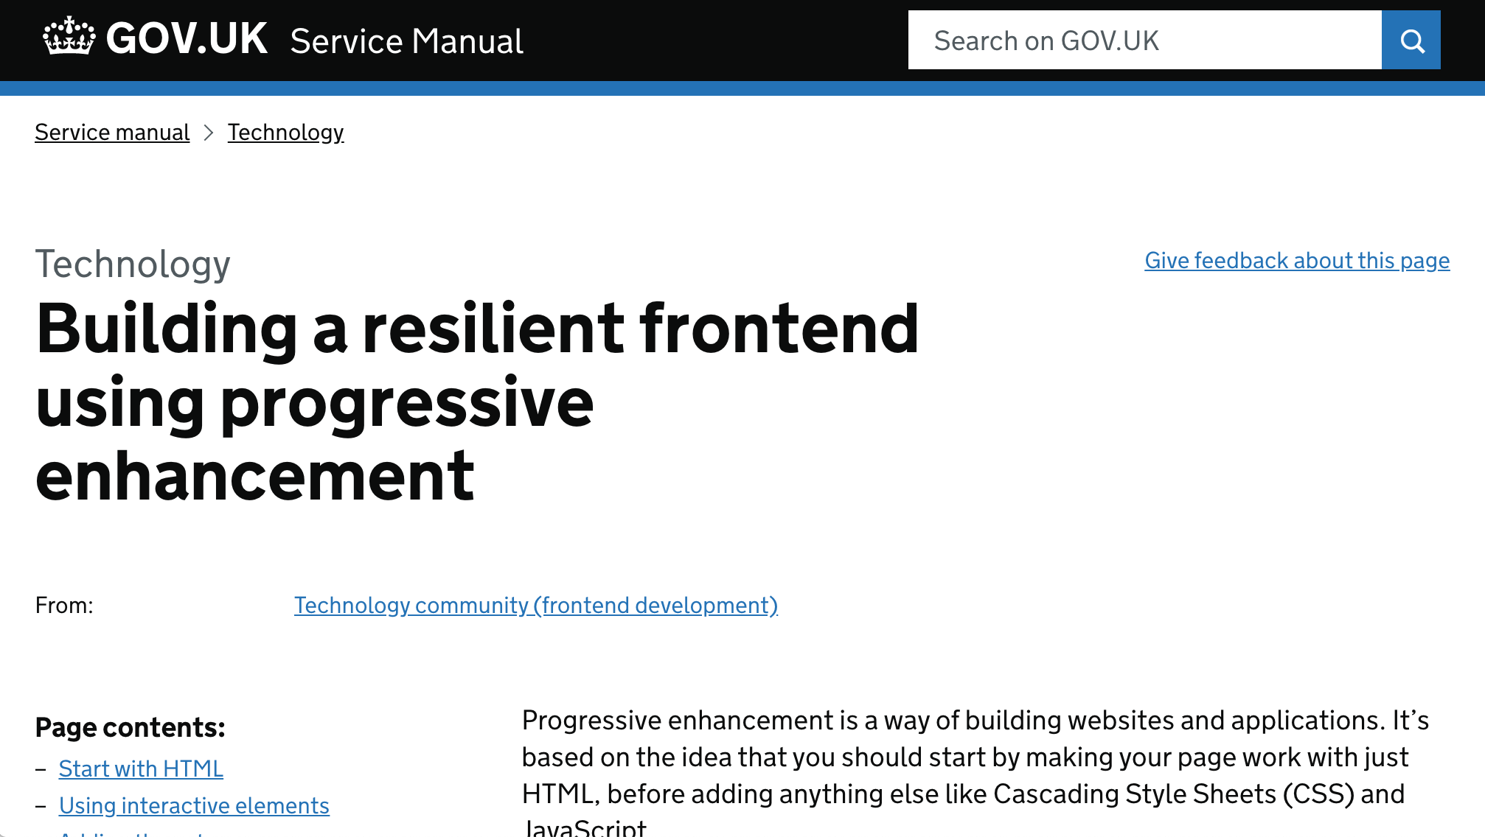
Notes:
your website needs to work with HTML alone,
presentation layer and enhanced interactions should be optional
so that if the CSS and the Javascript fail to load, the website will still work
https://www.gov.uk/service-manual/technology/using-progressive-enhancement

Slide 90
Test your service with a range of assistive technologies

Slide 91
BREAK

Slide 92
A process for achieving accessibility
Notes:
things you can do to make your service as accessible as possible

Slide 93
Think about accessibility from the start
Notes:
Don’t wait until just before you go live to start thinking about accessibility
Consider accessibility throughout

Slide 94
Run an automated accessibility testing tool
Notes:
various tools that help with low-hanging fruit

Slide 95
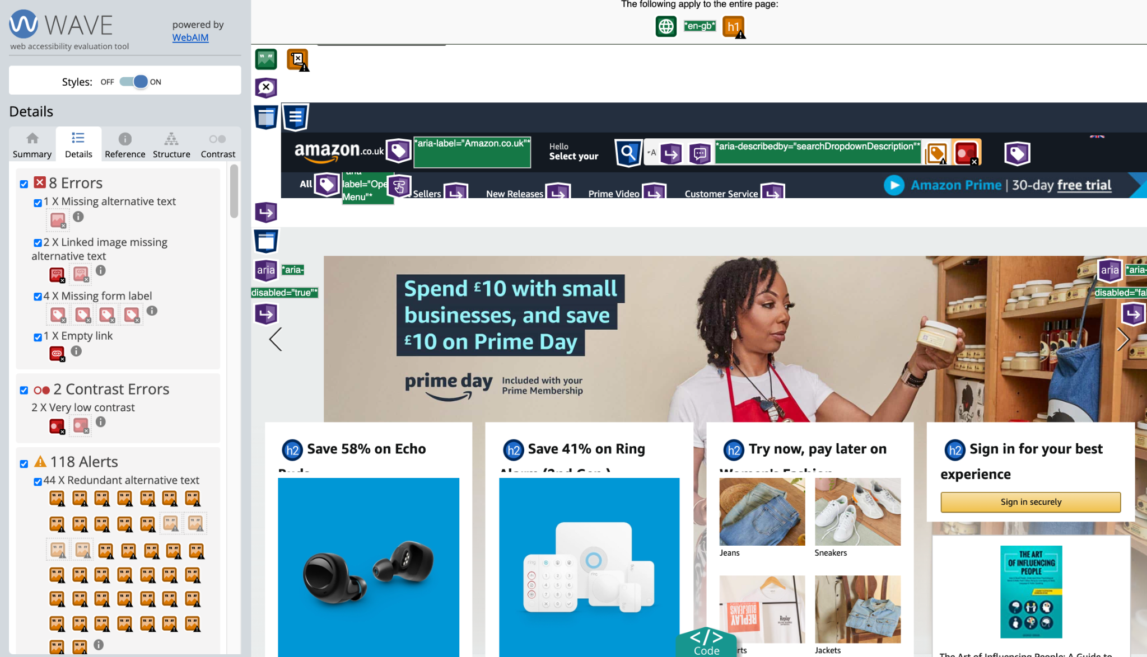
Notes:
For example:
Tenon
Axe
WAVE
Siteimprove

Slide 96
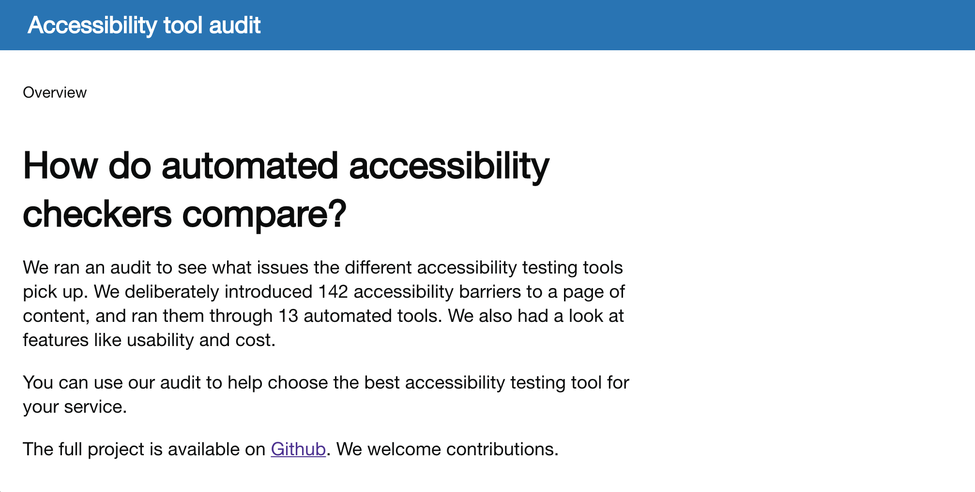
Notes:
https://alphagov.github.io/accessibility-tool-audit/
automated testing tools help find barriers quickly and cheaply
but only up to ca. 30%

Slide 97
Perform manual checks

Slide 98
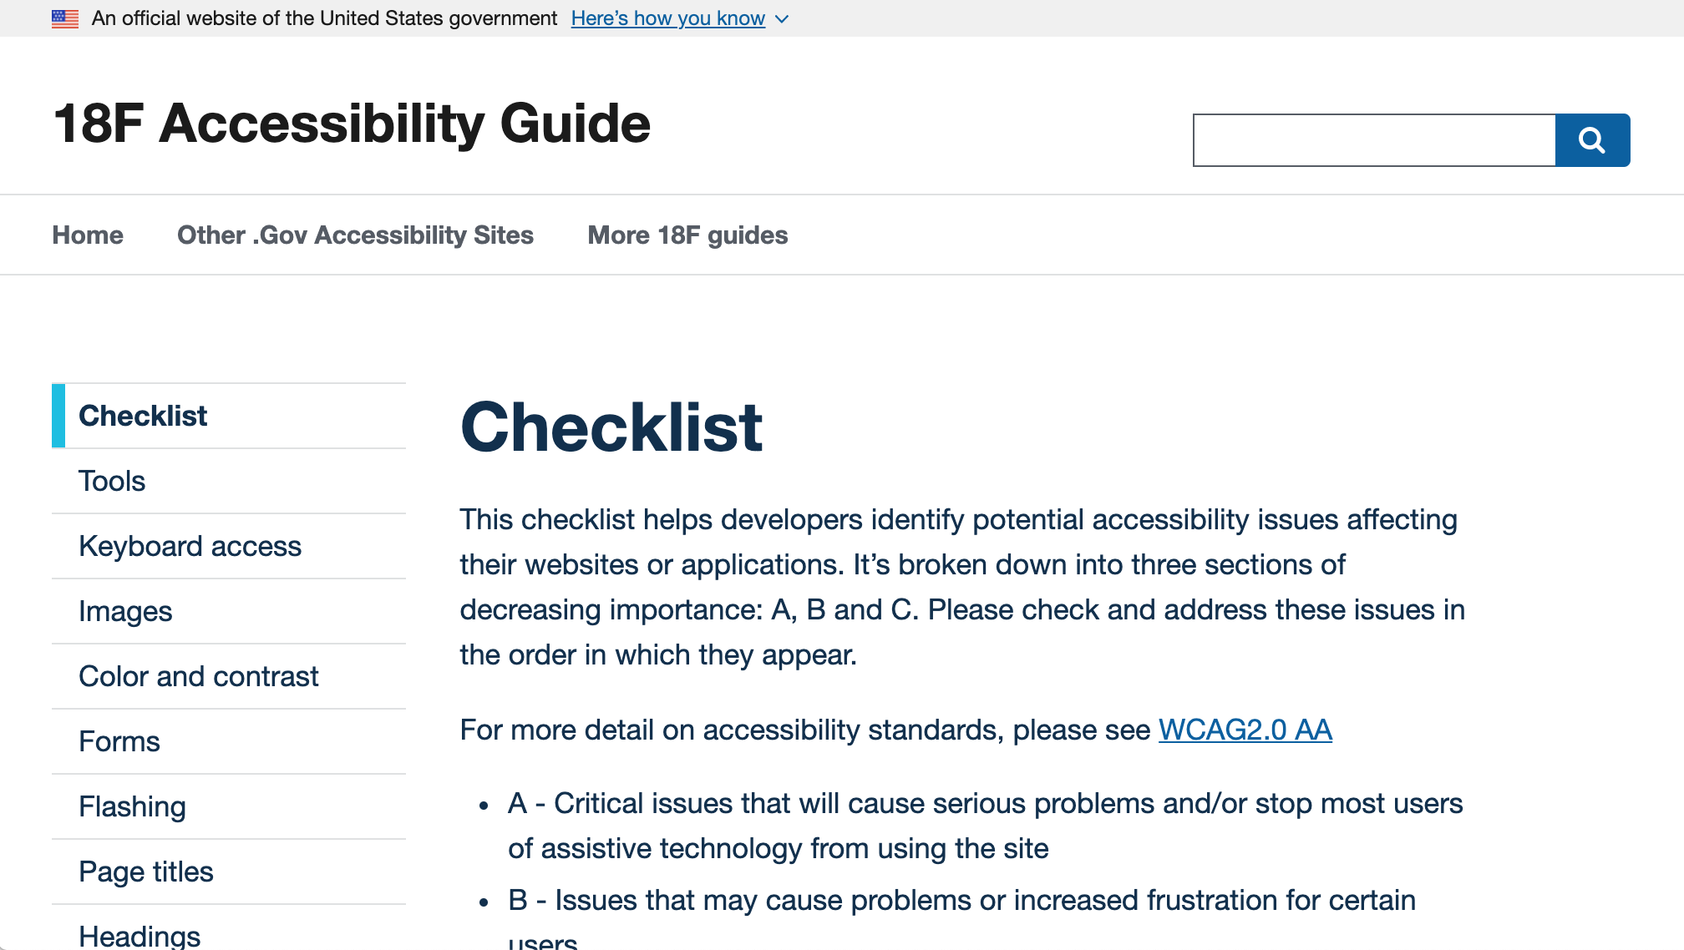
Notes:
best create your own checklist but here is a ready-made one:
https://accessibility.18f.gov/checklist/

Slide 99
Test with assistive technologies

Slide 100
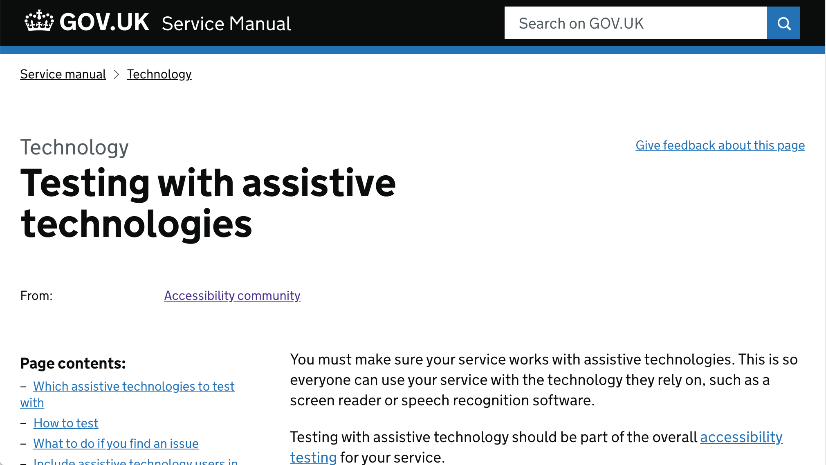
Notes:
https://www.gov.uk/service-manual/technology/testing-with-assistive-technologies

Slide 101
Check for compatibility in:
JAWS 18 or later and Chrome
NVDA and Firefox
VoiceOver on iOS and Safari
TalkBack on Android and Chrome
Dragon 11 or later and IE 11
Windows Magnifier or Apple Zoom

Slide 102
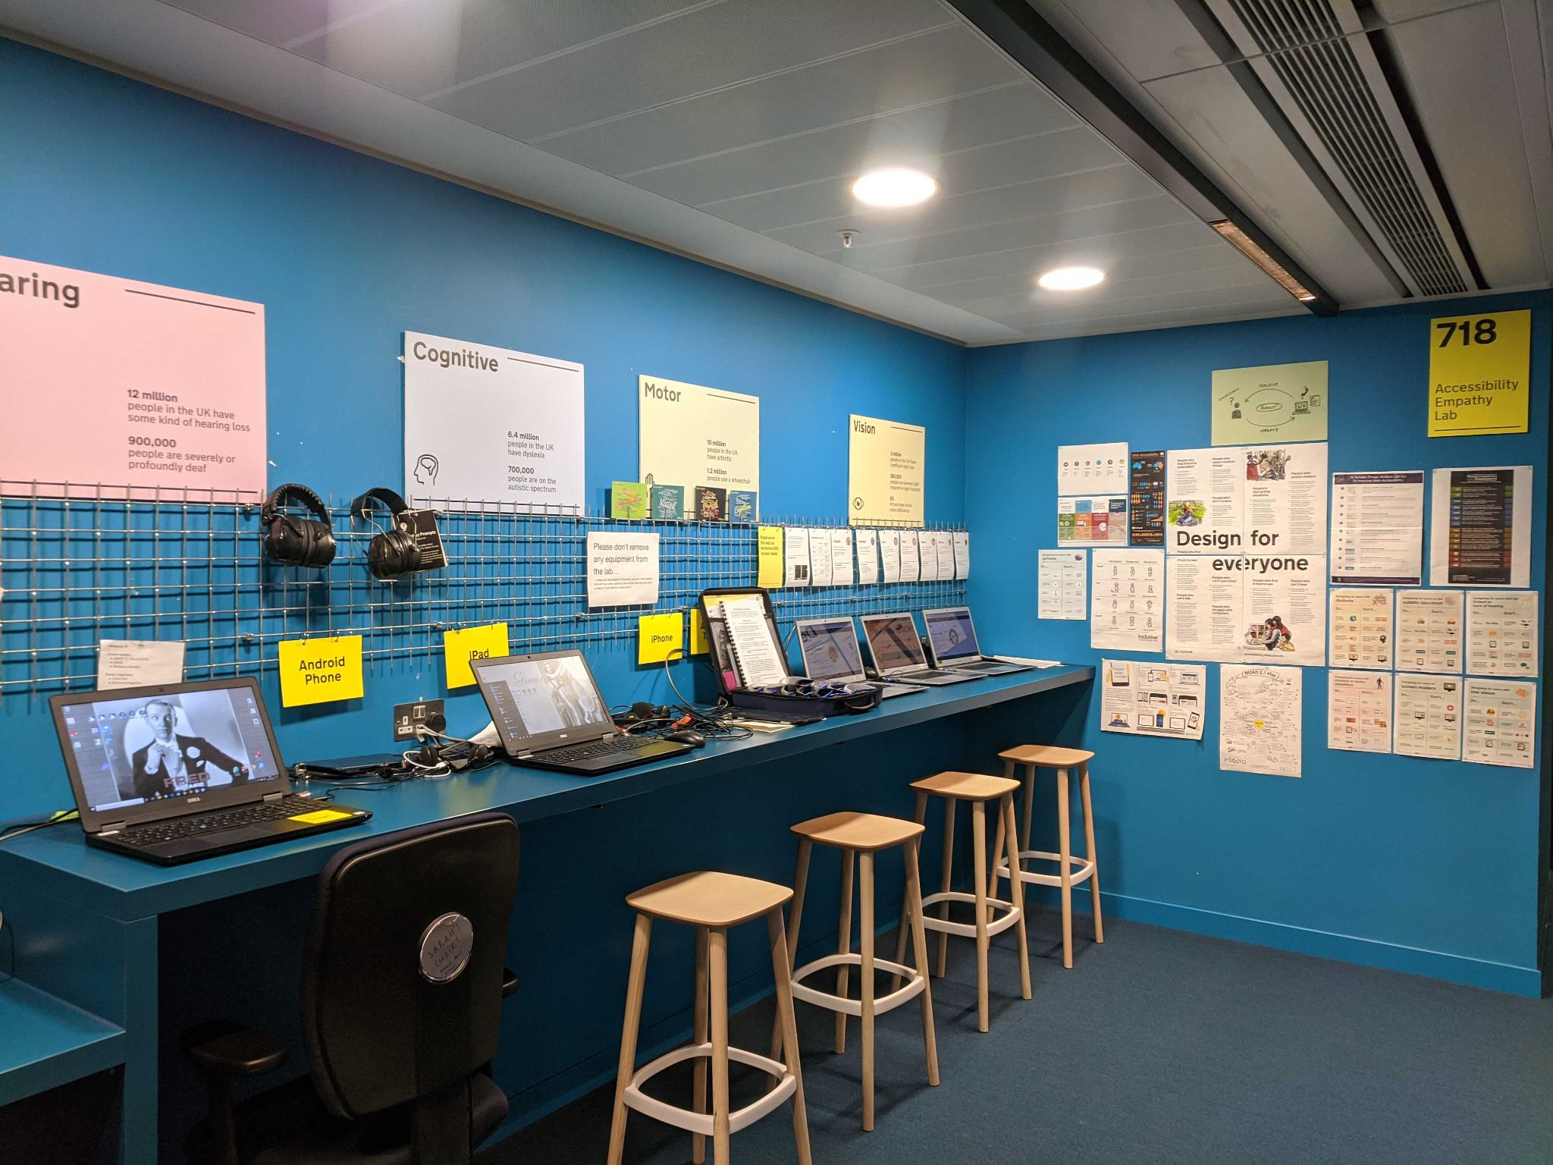
Notes:
Accessibility empathy lab in GDS office
Windows 10 laptops with various assistive tech on them, MacBook Air, iPhone, iPad, Android phone and Android tablet, Chromebooks, etc
https://gds.blog.gov.uk/2018/06/20/creating-the-uk-governments-accessibility-empathy-lab/

Slide 103
Pragmatic compatibility:
Test with a desktop screenreader
Test with a mobile/tablet screenreader
Test with voice recognition
Test with screen magnification

Slide 104
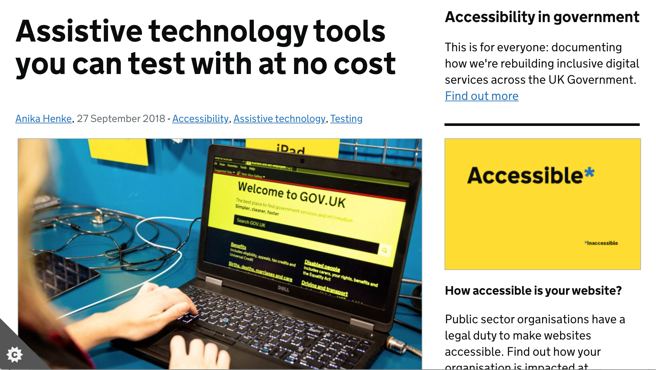
Notes:
https://accessibility.blog.gov.uk/2018/09/27/assistive-technology-tools-you-can-use-at-no-cost/

Slide 105
Include users with access needs in your user research throughout the project

Slide 106
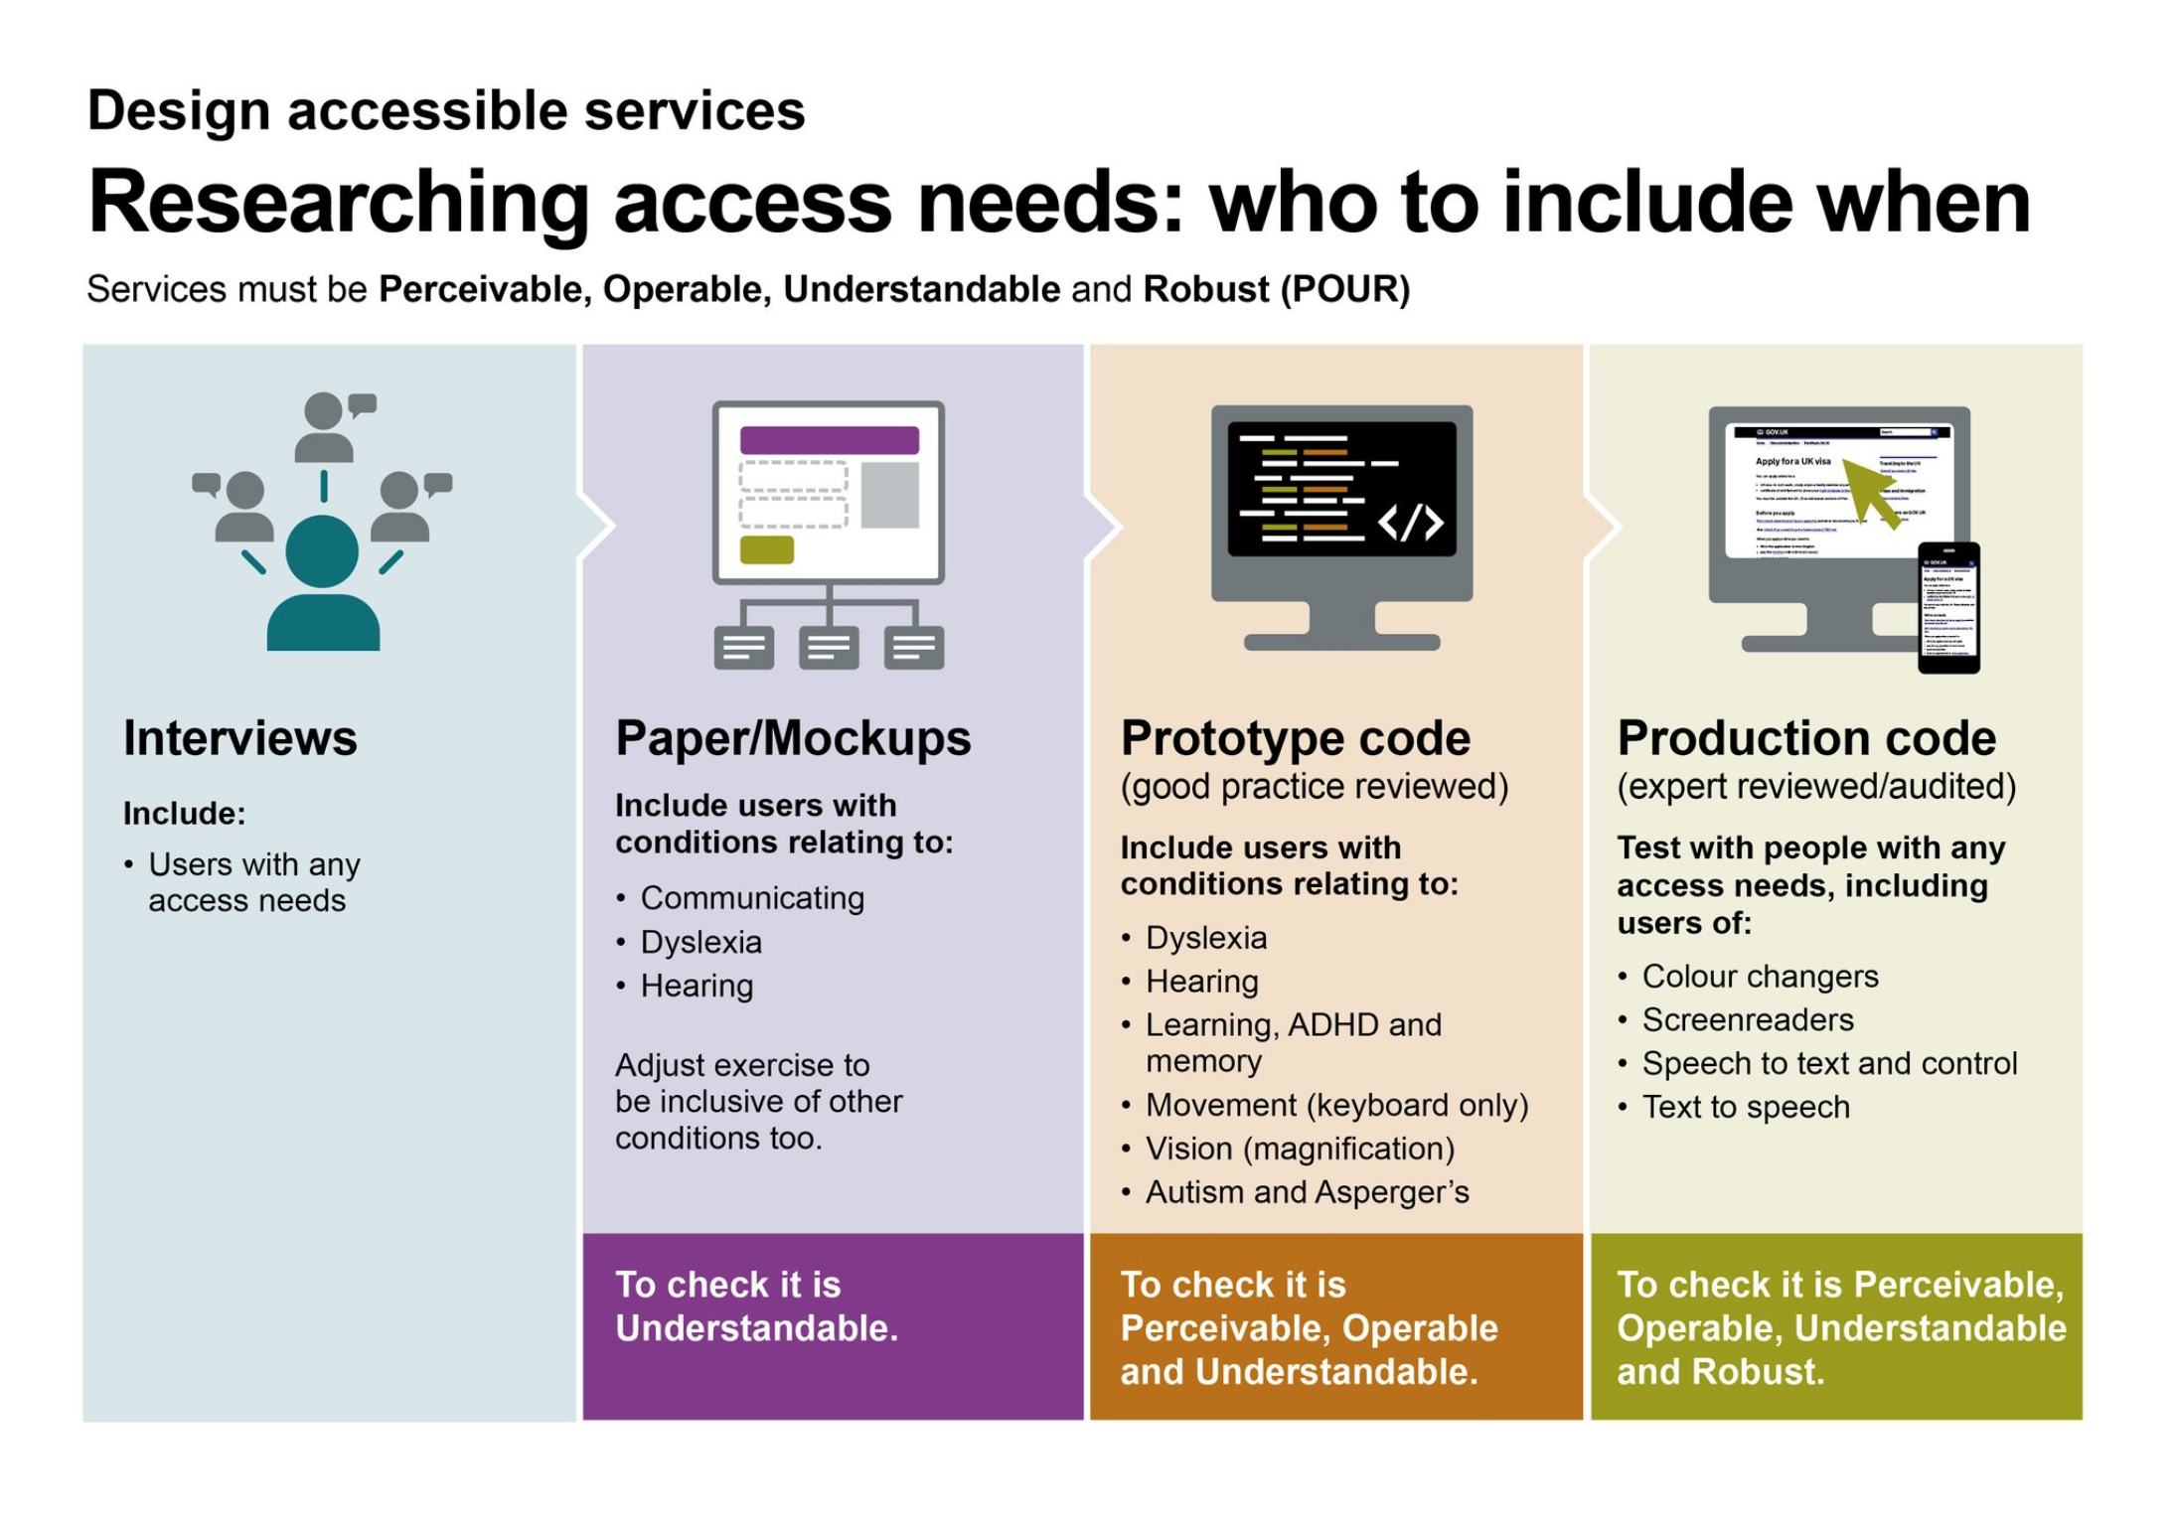
Notes:
https://github.com/UKHomeOffice/posters/blob/master/accessibility/researching-access-needs/Research-who_to_include_when%3F.pdf

Slide 107
Get an expert to audit the accessibility of your service
Notes:
People who do audits all the time are much quicker at finding the gotchas than people who do them occasionally

Slide 108
Assistive technology

Slide 109
Any object or system that increases or maintains the capabilities of people with disabilities

Slide 110
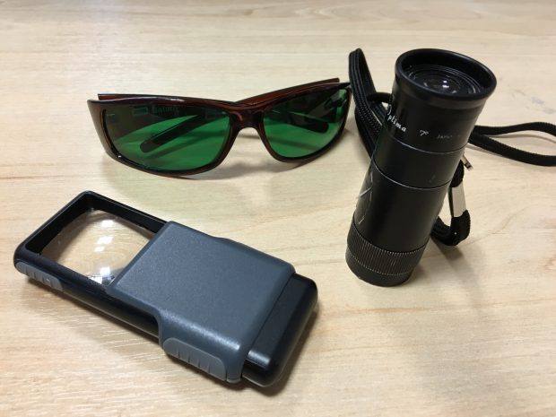
Notes:
Tinted glasses
Magnifier
Monocular (mini telescope)
source: https://accessibility.blog.gov.uk/2016/08/22/accessibility-and-me-james-buller/

Slide 111
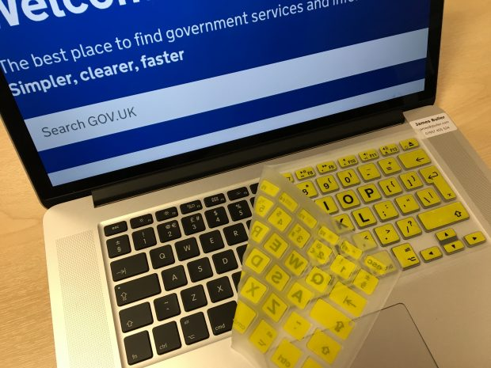
Notes:
High contrast keyboard overlay
source: https://accessibility.blog.gov.uk/2016/08/22/accessibility-and-me-james-buller/

Slide 112
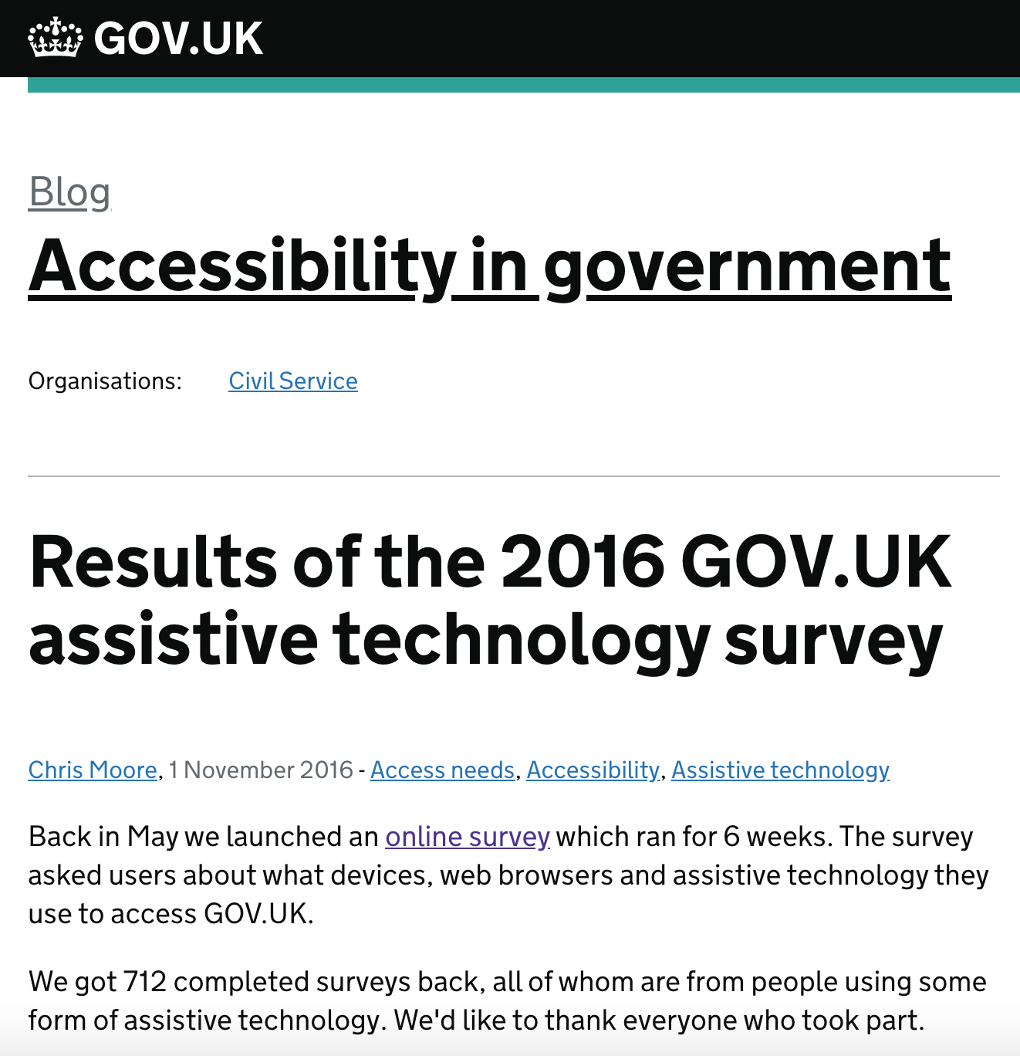
Most used assistive technology software:
30% screen magnifier
29% screen reader
18% voice control
15% readability
8% other
Notes:
source: https://accessibility.blog.gov.uk/2016/11/01/results-of-the-2016-gov-uk-assistive-technology-survey/

Slide 113
Assistive technology empowers people
Without it tasks can be very difficult or impossible and may require:
Direct assistance from another person
Phone, webchat or email support

Slide 114
Demo of various assistive technologies (screen reader, magnifier, voice control)
covered in another session
Sign up at v.gd/a11ylabcal

Slide 115
Who is responsible?

Slide 116
Designers
Developers
Content Designers / Authors / Editors
can introduce barriers into a service

Slide 117
User Researchers
Quality Assurers / Testers
can ensure things are accessible

Slide 118
Service Managers
Product Managers
Delivery Managers
are responsible for ensuring a service or product is accessible

Slide 119
Accessibility is the whole team’s responsibility

Slide 120
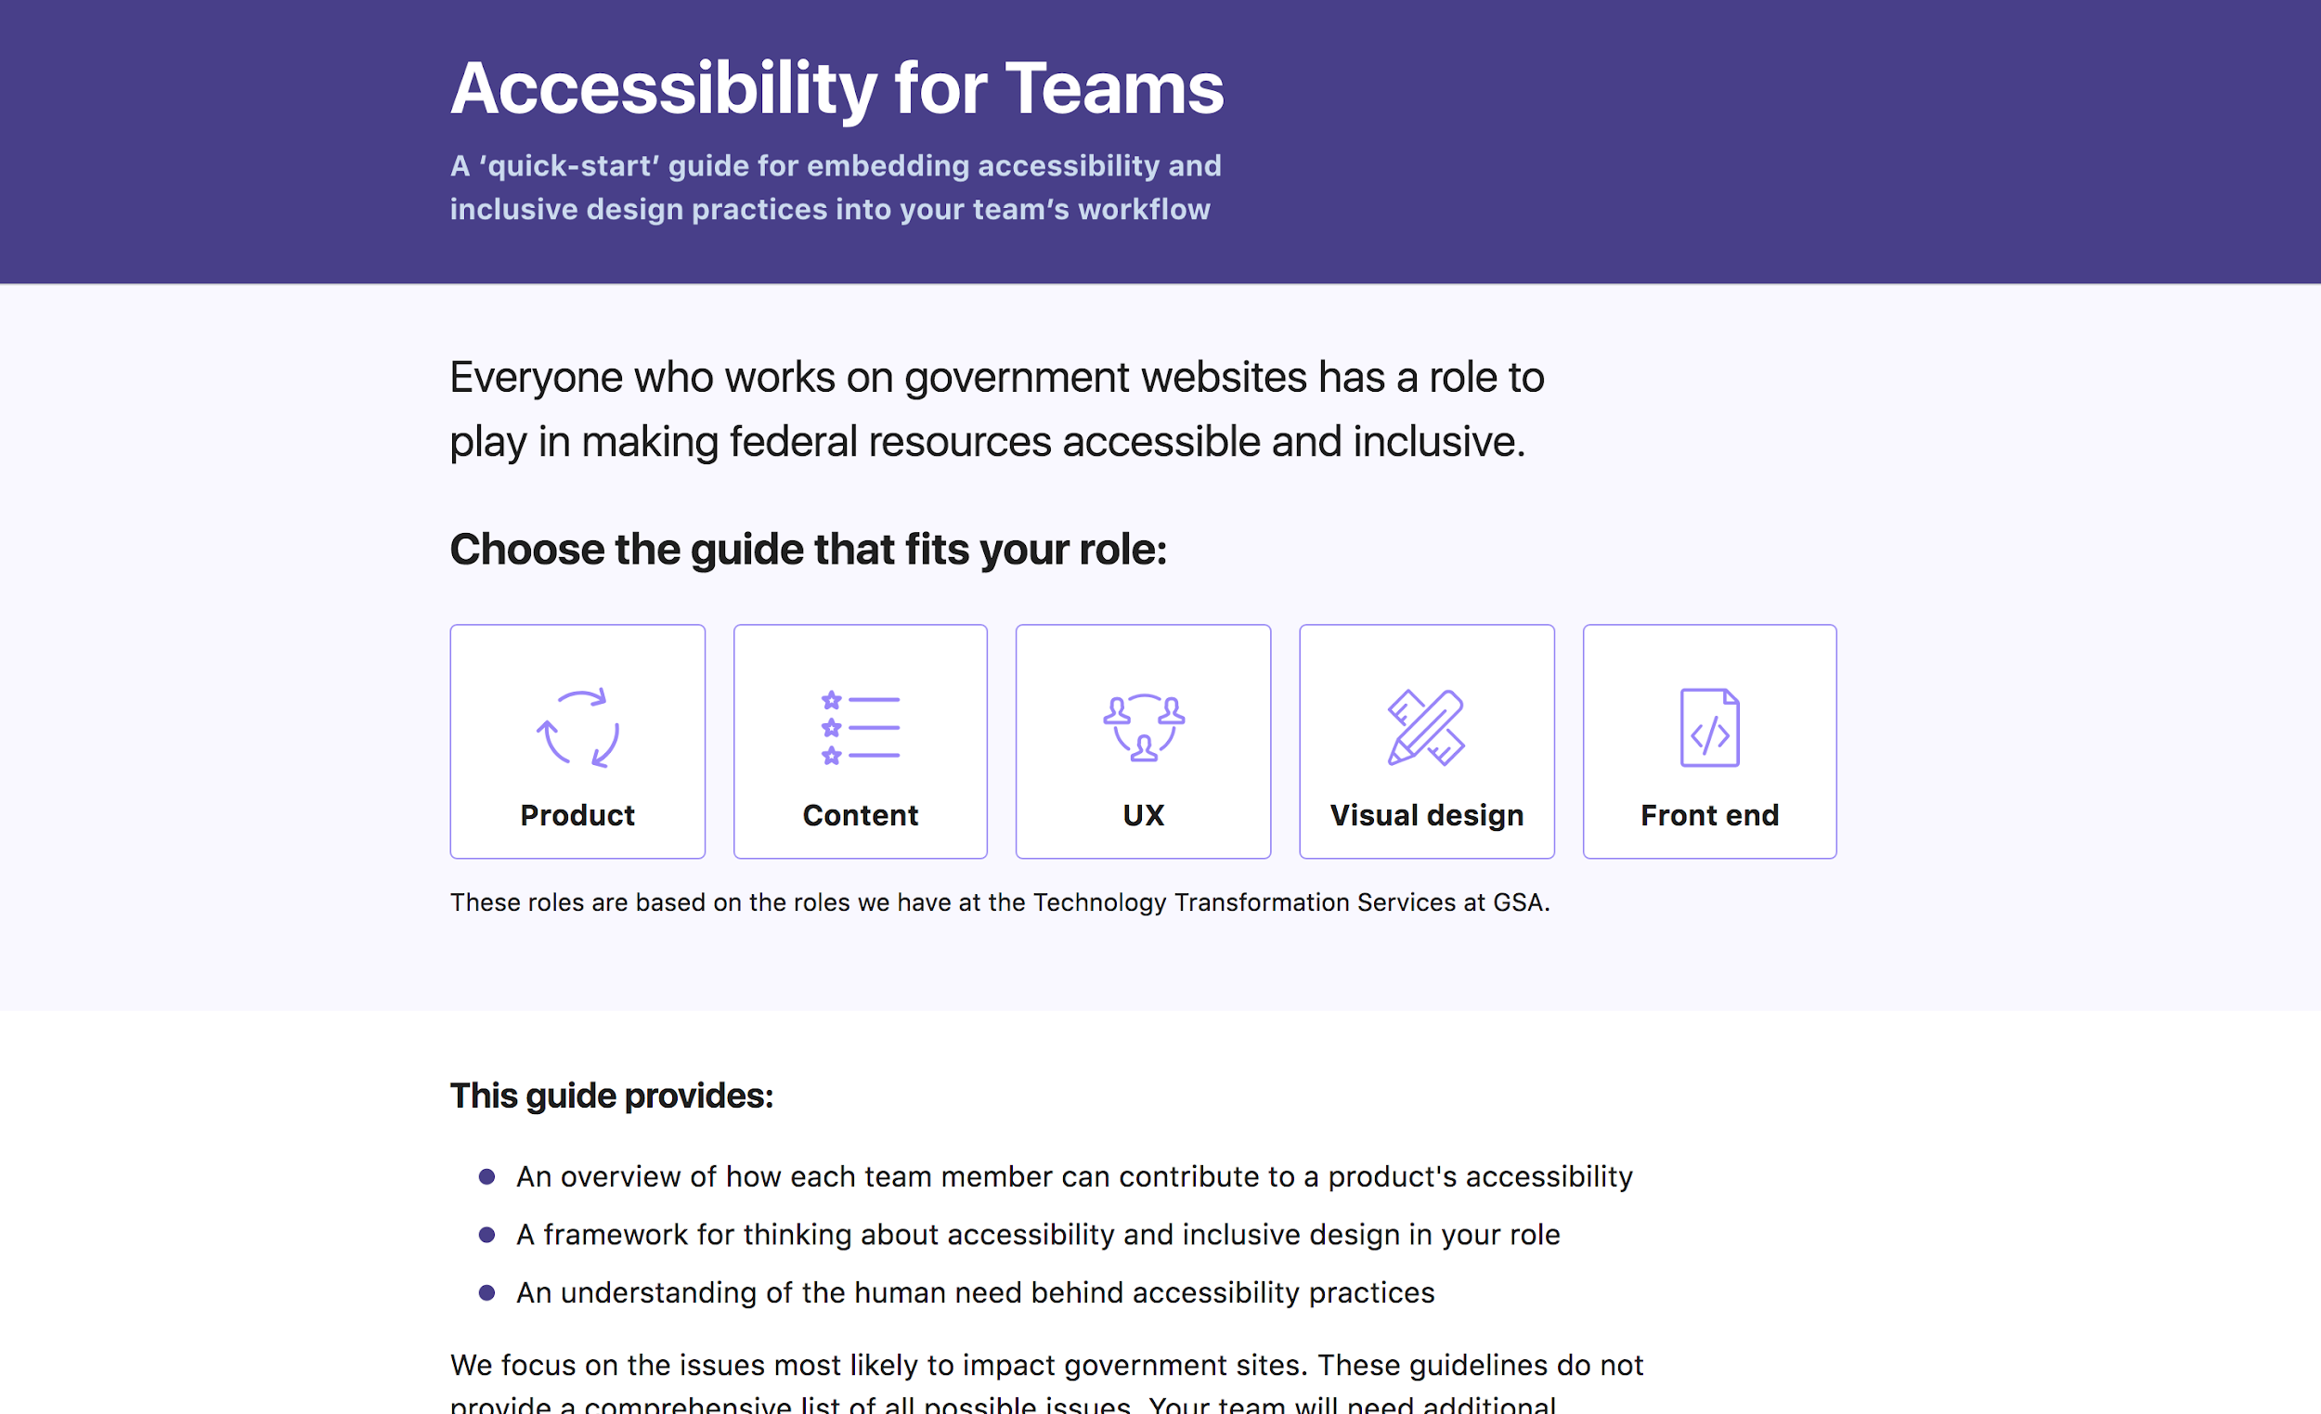
Notes:
Accessibility for Teams
A ‘quick-start’ guide for embedding accessibility and inclusive design practices into your team’s workflow
https://accessibility.digital.gov/

Slide 121
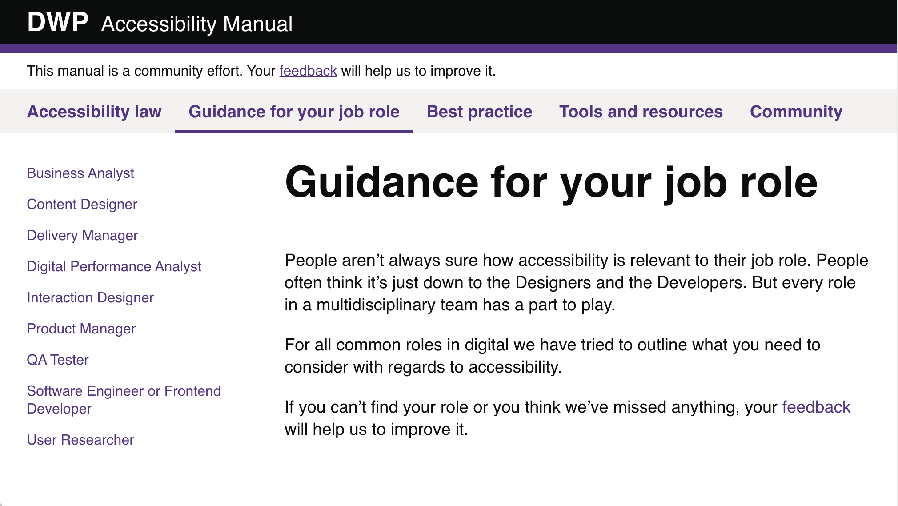
Notes:
https://accessibility-manual.dwp.gov.uk/guidance-for-your-job-role

Slide 122
Activity
Make something less accessible!
In groups in breakout rooms, look at the ‘Out of Syria, back into school’ page and discuss some ideas of things that would make it less accessible, one person writes notes
[5 mins]

Slide 123
Resources

Slide 124
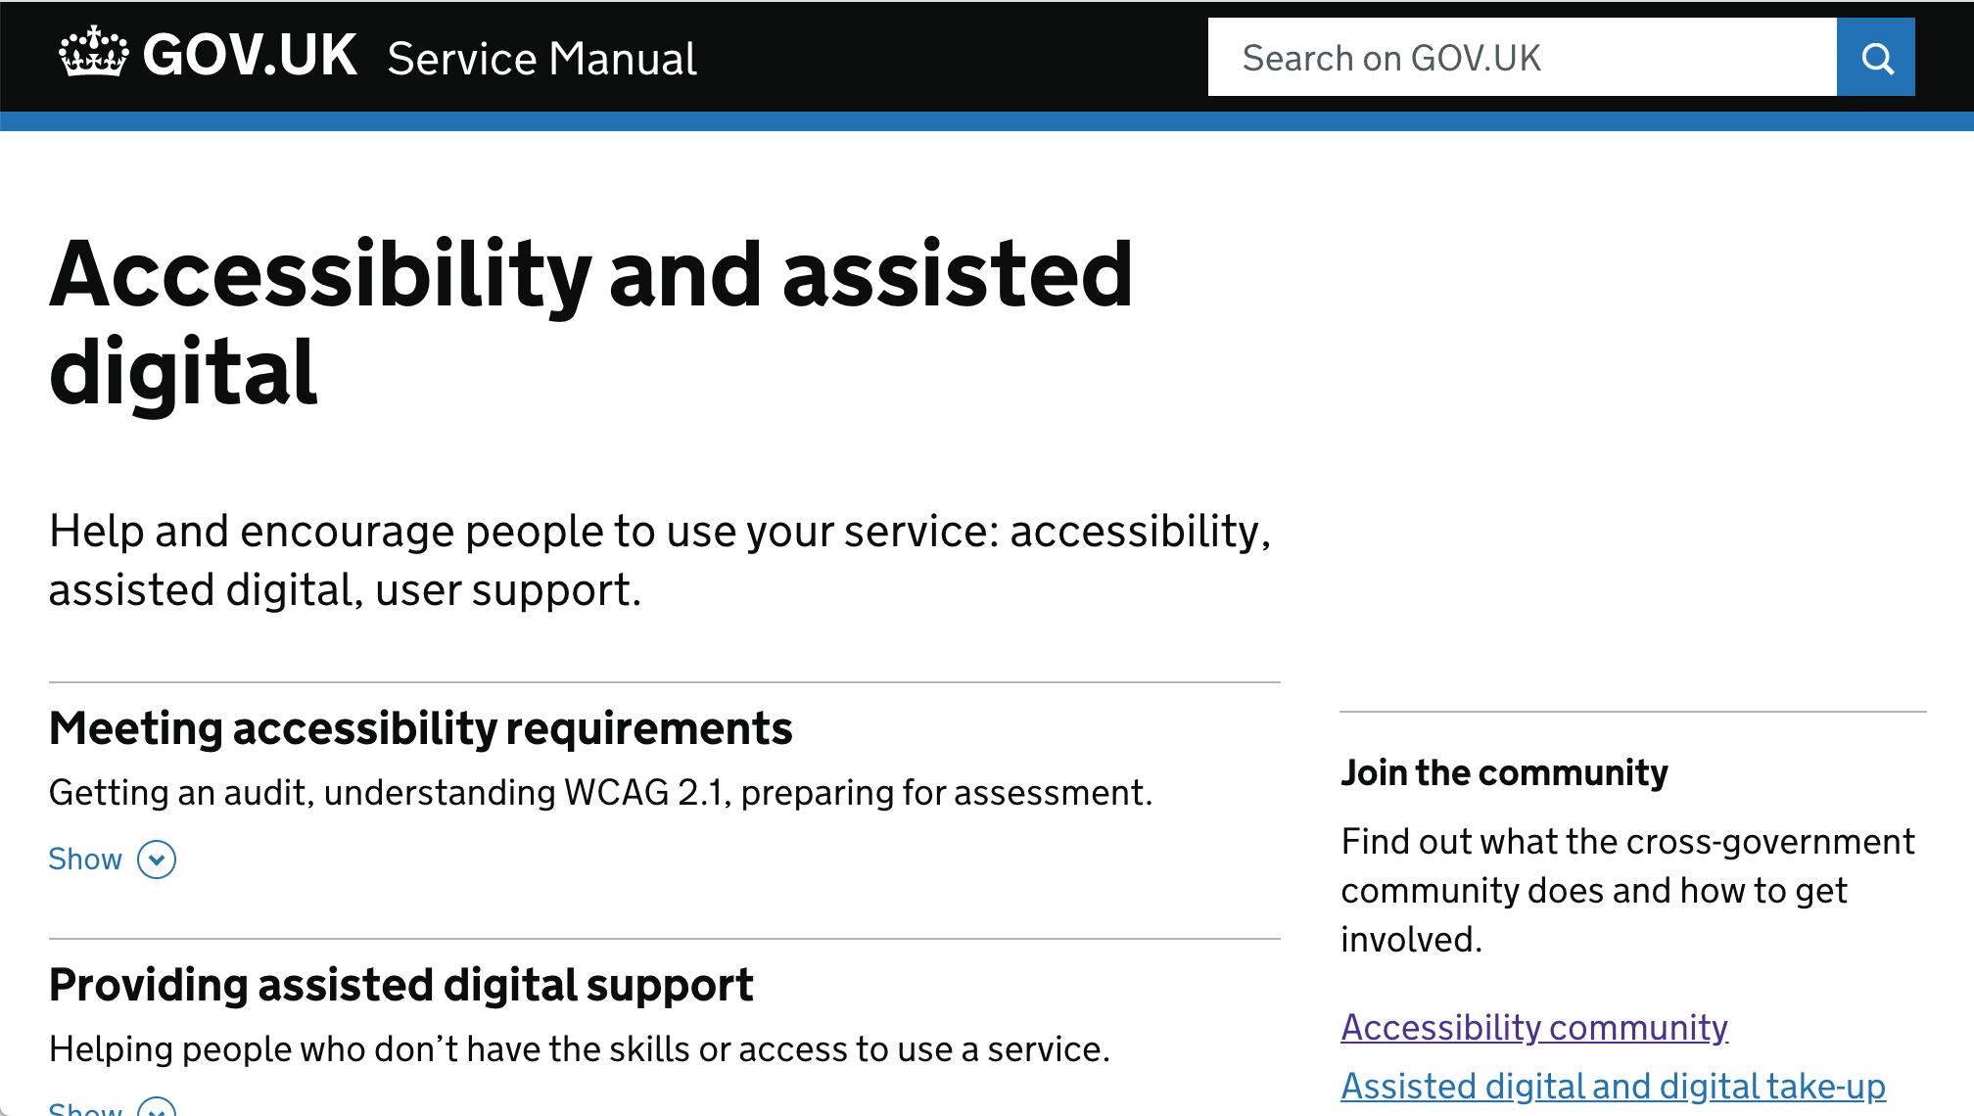
Notes:
Accessibility section in the Service Manual
https://www.gov.uk/service-manual/helping-people-to-use-your-service

Slide 125
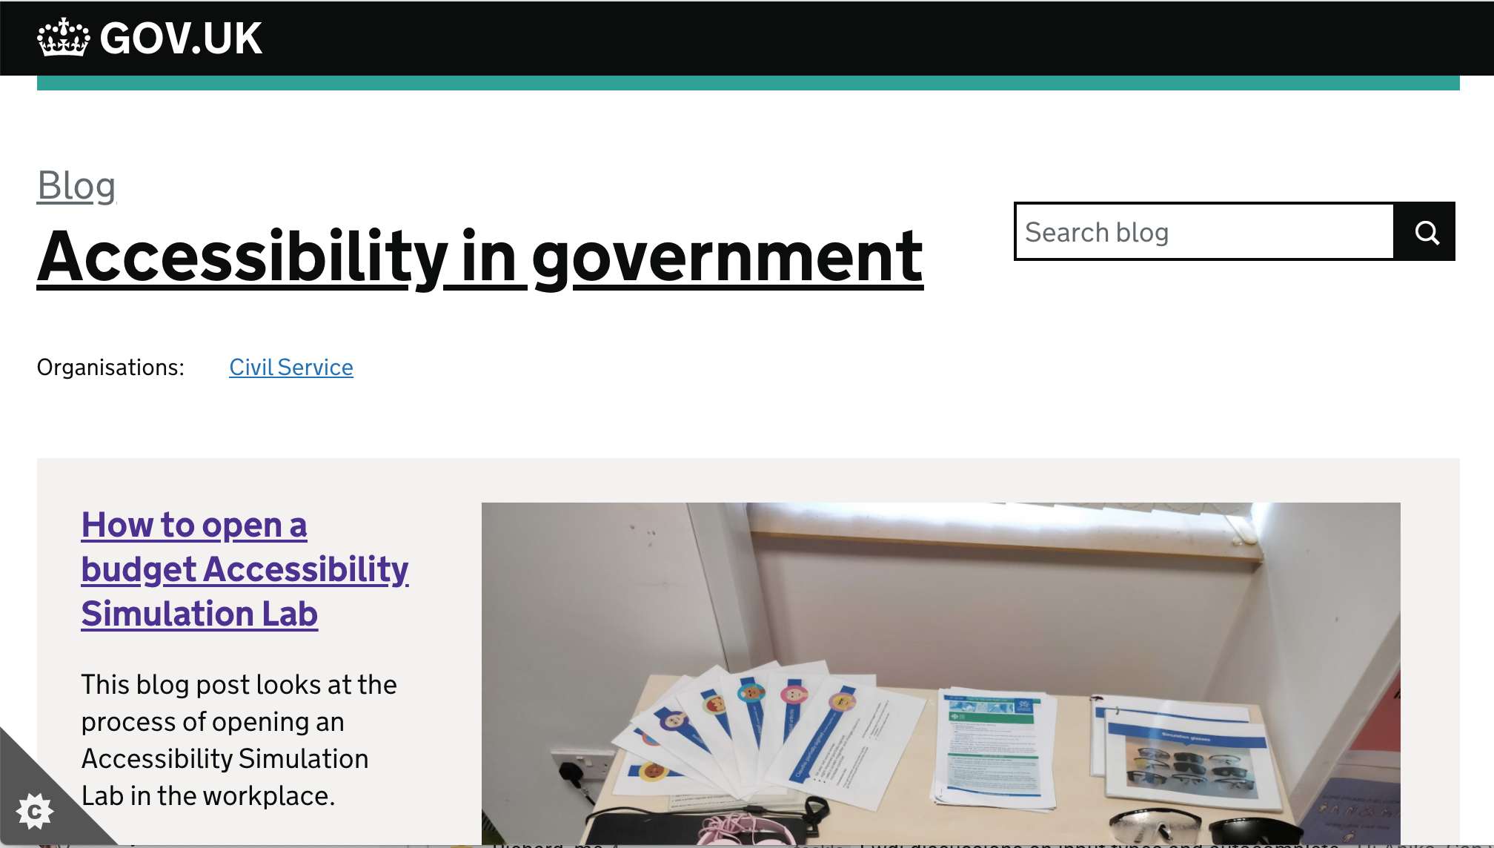
Notes:
Accessibility in government blog
https://accessibility.blog.gov.uk/

Slide 126
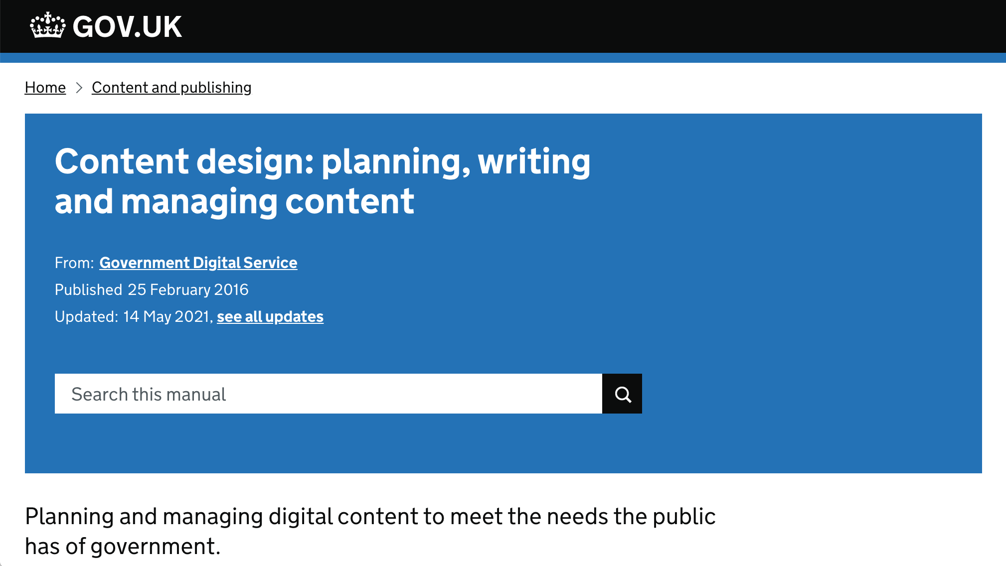
Notes:
The content guidelines help you to create text that’s easy to understand.
https://www.gov.uk/guidance/content-design

Slide 127
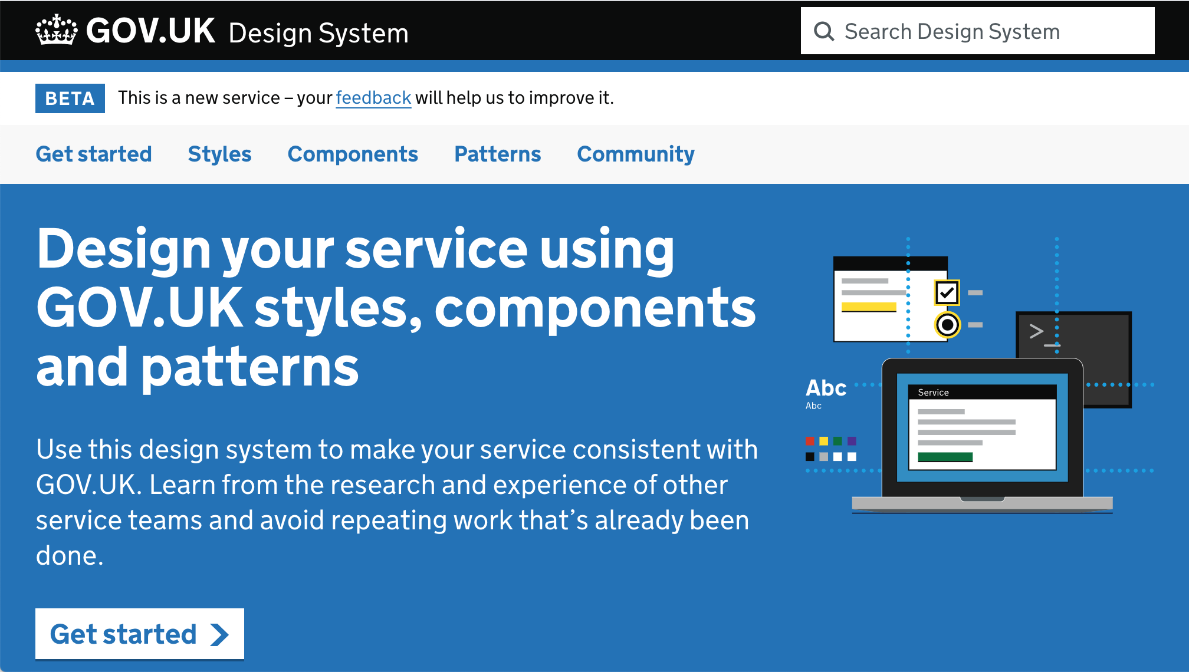
Notes:
GOV.UK Design System gives you an accessible foundation
They will show you how to create accessible forms and how to provide error messages, for example.
https://design-system.service.gov.uk/

Slide 128
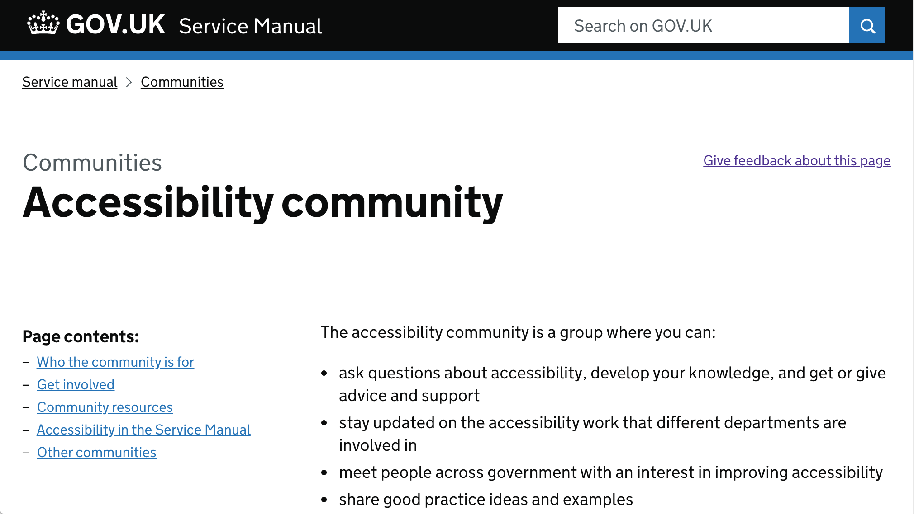
Notes:
Use the Government Accessibility Community Google Group for questions and to share lessons.
https://www.gov.uk/service-manual/communities/accessibility-community
This is a place where people can ask questions and share advice on accessibility.
The community includes:
the ‘accessibility’ channel in the cross-government Slack
a cross-government Google Group / mailinglist
cross-government meetups
events around Global Accessibility Awareness Day

Slide 129
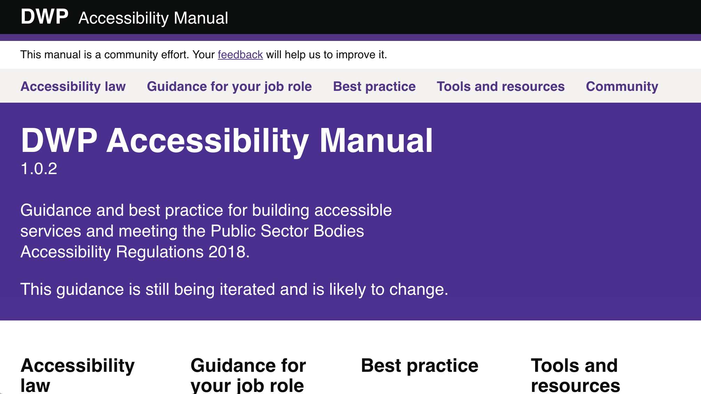
Notes:
https://accessibility-manual.dwp.gov.uk/

Slide 130
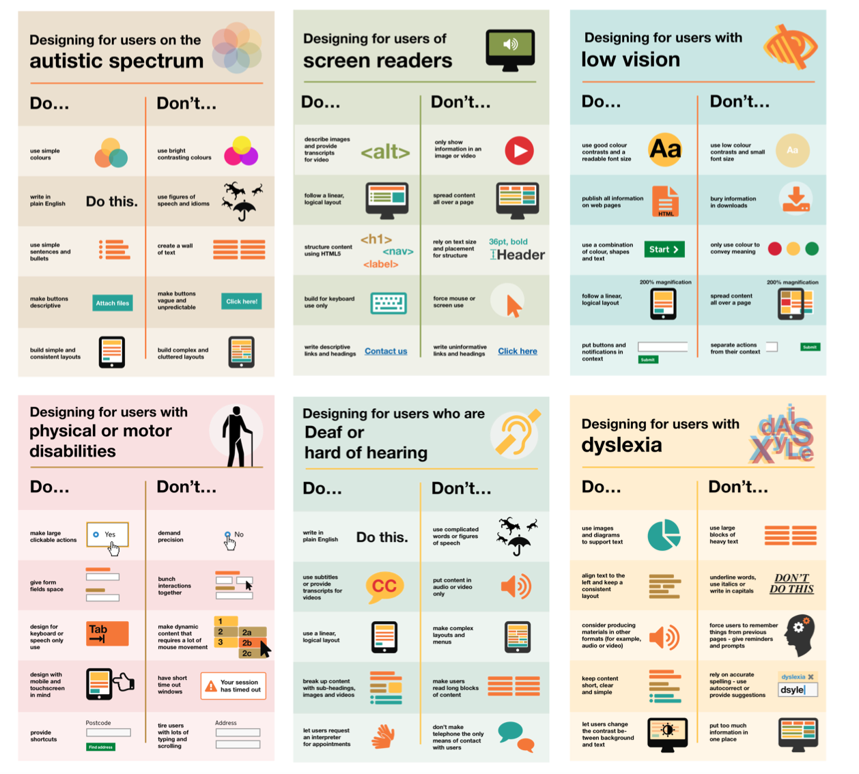
Notes:
https://github.com/UKHomeOffice/posters

Slide 131
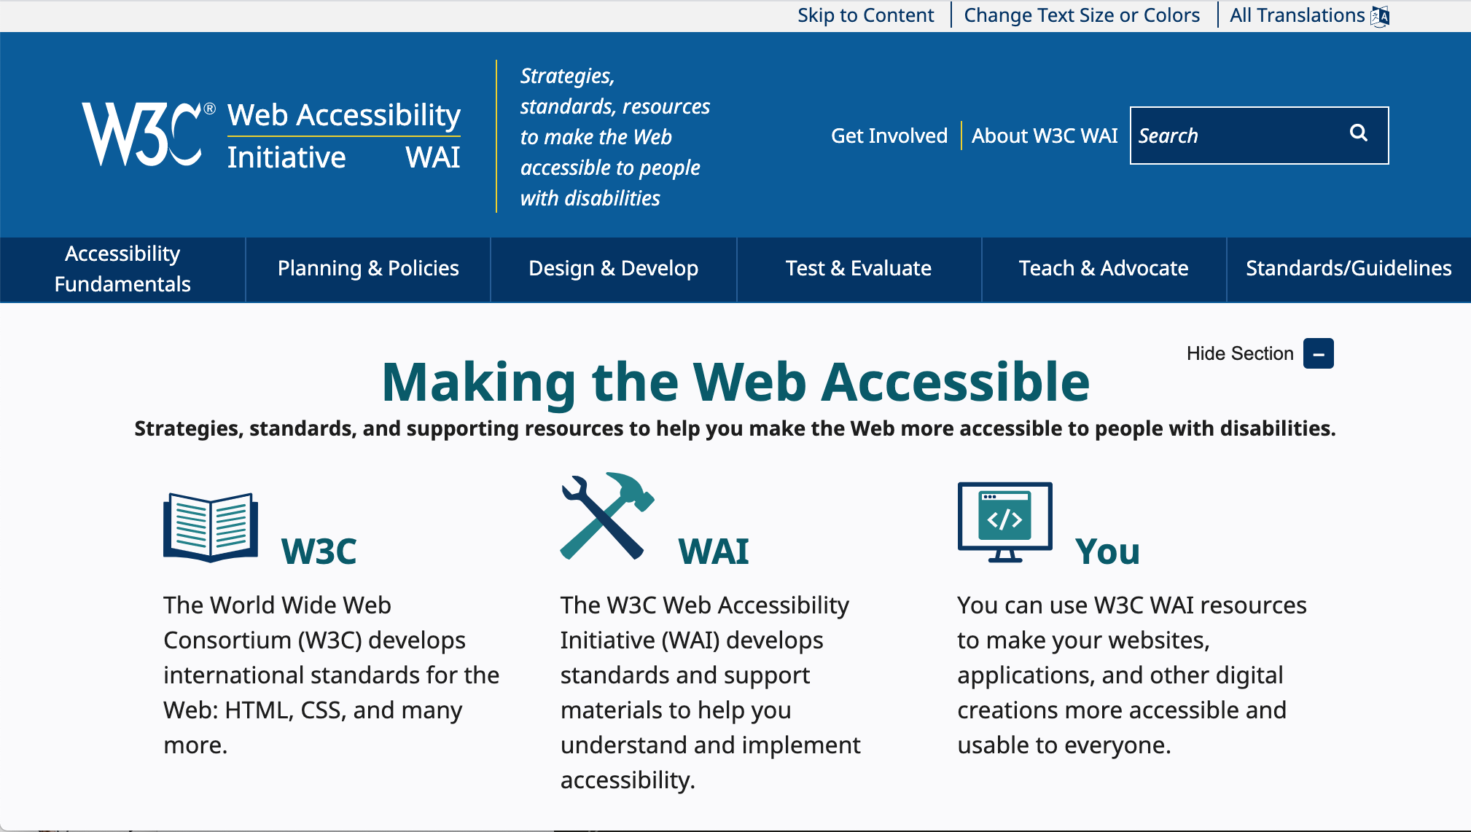
Notes:
https://www.w3.org/WAI/

Slide 132
Training from CDDO
Introduction to Accessibility:
Understanding Accessibility
Assistive Technology Demo
WCAG training (coming soon)
Notes:
Other training:
Quick checks (doesn’t work at scale)
Persona training (doesn’t work at scale)
Persona testing (doesn’t work at scale)
Accessibility Developer Workshop (currently defunct)
Accessibility Content Workshop (GDS)

Slide 133
Questions?

Slide 134
Retrospective
Please fill in the form at v.gd/a11yTrainingFeedback to tell us what we can improve and what went well

Slide 135
Thanks!
Anika Henke
Notes:
.

