Slide 1

Accessibility Intro
Christopher J – Defra Accessibility Team

Slide 2
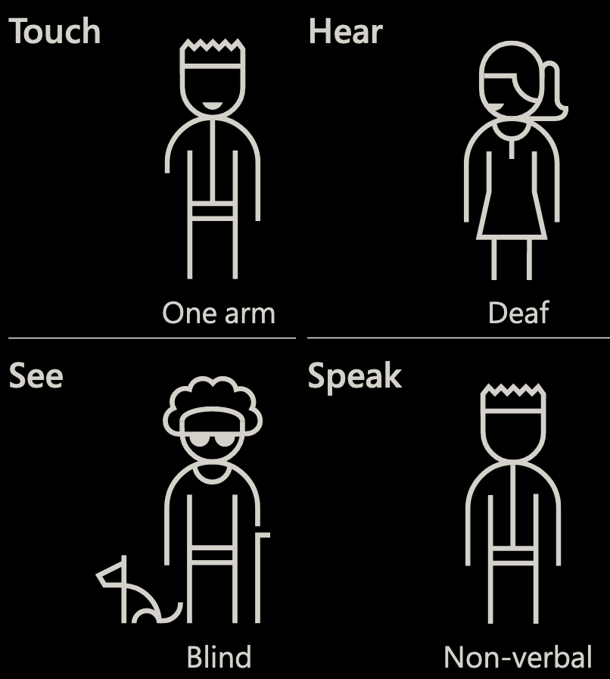
Tag Yourself

Slide 3
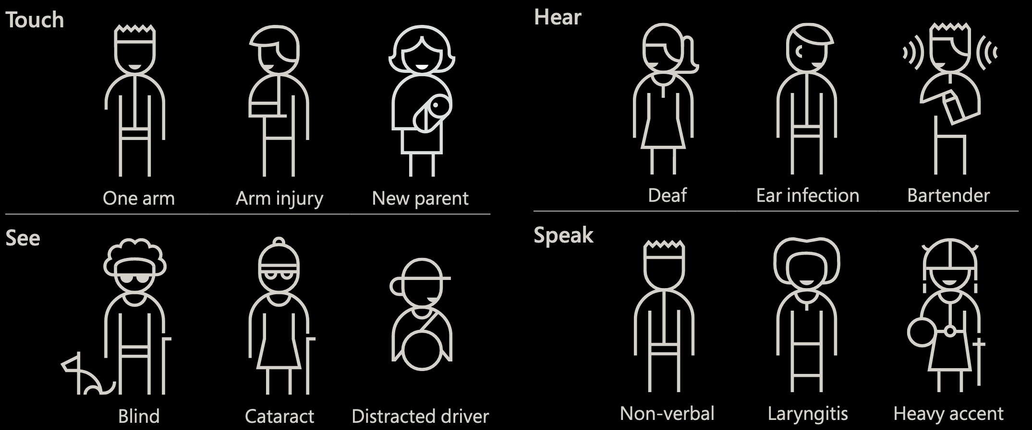
Tag Yourself – Now?

Slide 4
The 5,000 people who use your website might include
3,700
who need to wear glasses or contact lenses
1,050
who have any disability
800
who are deaf or hard of hearing
745
whose literacy is below level 1 and so struggle with tasks such as reading a timetable or writing a letter
450
who are dyslexic
225
have a colour vision deficiency (213 male, 12 female)
150
who are blind or partially sighted
50
who are autistic
10
British Sign Language (BSL) users
Almost all
of the 5,000 people who use your website may also experience temporary or situational disability at some time.
https://how-many.herokuapp.com

Slide 5
Remove barriers
Medical Model
Social Model

Slide 6
Regulations
Public Sector Bodies (Websites and Mobile Applications) (No. 2) Accessibility Regulations 2018.
Web Content Accessibility Guidelines 2.1 AA
Statements
Equality Act 2010 (or the Disability Discrimination Act 1995 in Northern Ireland)

Slide 7
Accessibility Team
Advice
Checks
Statements
Statistics
https://defra-design.github.io/accessibility
Accessibility@defra.gov.uk

