Slide 1

Accessibility Intro
Christopher J – Defra Accessibility Team

Slide 2
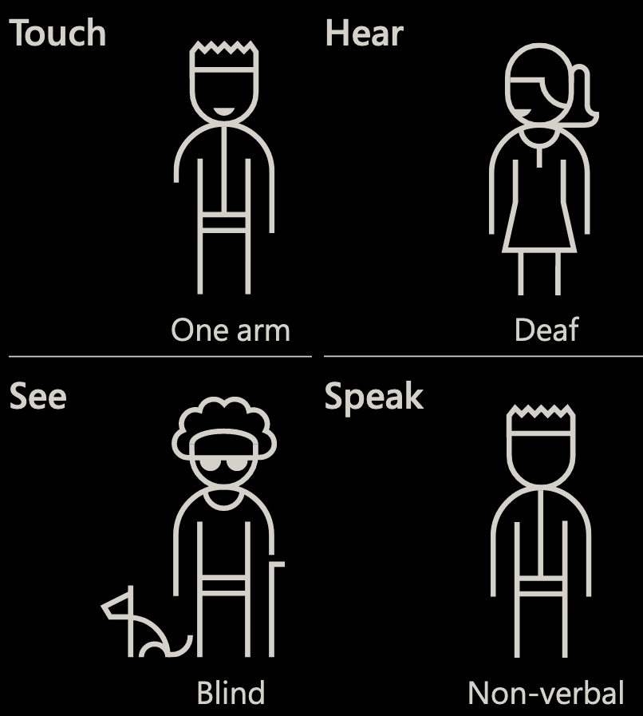
Tag Yourself

Slide 3
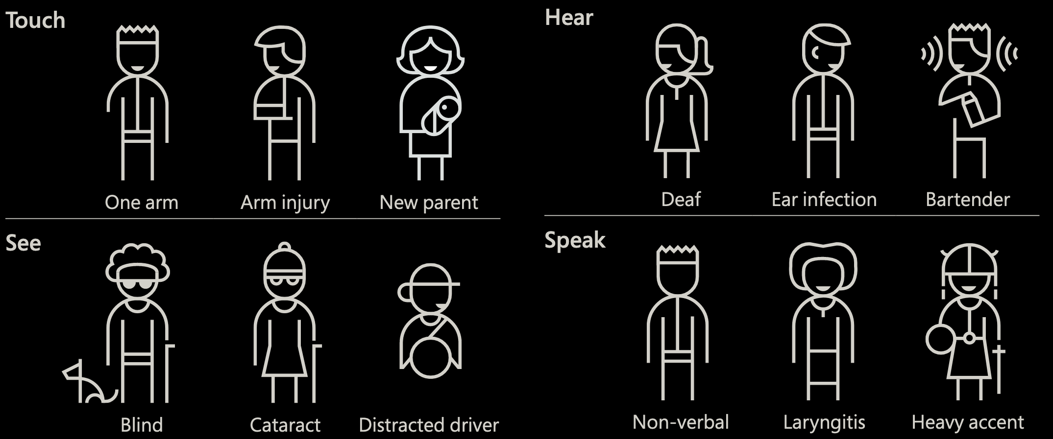
Tag Yourself – Now?

Slide 4
The 5,000 people who use your website might include
3,700 who need to wear glasses or contact lenses
1,050 who have any disability
800 who are deaf or hard of hearing
745 whose literacy is below level 1 and so struggle with tasks such as reading a timetable or writing a letter
450 who are dyslexic
225 have a colour vision deficiency (213 male, 12 female)
150 who are blind or partially sighted
50 who are autistic
10 British Sign Language (BSL) users
Almost all of the 5,000 people who use your website may also experience temporary or situational disability at some time.
https://how-many.herokuapp.com

Slide 5
Remove barriers
Medical Model
Social Model

Slide 6
Regulations
Public Sector Bodies (Websites and Mobile Applications) (No. 2) Accessibility Regulations 2018.
Web Content Accessibility Guidelines 2.1 AA
Statements
Equality Act 2010 (or the Disability Discrimination Act 1995 in Northern Ireland)

Slide 7
Accessibility Team
Advice
Checks
Statements
Statistics
https://defra-design.github.io/accessibility
Accessibility@defra.gov.uk

