Slide 1
The Roost Flow
Combining usability testing with exploratory research
Reference: LIT 17678
Version: 2.0
Published: June 2022
Classification: OFFICIAL

Slide 2
Contents
3 - Key Documents
4 - Research Aims
5 - Hypotheses
6 – Method
7 – Who did we speak to?
8 – Digital Inclusion
9 – Research limitations
10 – High level journey
12 – 4 Key takeaways
28 – The roost flow: A closer look
42 – Summary
43 – Suggestions / What Next
44 – Low impact findings
46 – Med impact findings
48 – High impact findings
49 – Unknown impact findings

Slide 3
Key Documents
Research plan
Discussion guide
Bat ER research planning board

Slide 4
Research aims
Validate Hypotheses listed in next slide.
Answer the following overarching questions:
How do ecologists collect and submit site registration (SR) and licencing data to NE?
How might Bat ER impact licencing for accredited ecologists? (cost, time etc)?
Is the roost flow intuitive to consultants with Bat ER accreditation?
Do accredited consultants under BAT ER have assisted digital or accessibility needs?

Slide 5
Hypotheses
It is only ecologists who will submit a SR.
Users of the SR form are familiar with licencing requirements (maps, reports etc) and will have the information they need before they start a SR application.
Users of the SR form have access to an internet enabled device at the time of submitting it.
Users of the SR form are unlikely to submit the information in one sitting.
Bat ER will have positive outcomes on the site registration process
Accredited consultants have enough knowledge about the accreditation process to realise the roost flow is dynamic to their accreditation level
The roost flow will be a faster, more accessible alternative to the interim Qualtrics form for accredited consultants.

Slide 6
Method
30 minutes semi structured interview with accredited ecologists exploring:
How and what information is collected to submit a successful site registration
Who is involved
Experiences of submitting site registration information to NE since gaining accreditation
Followed by a 30-minute usability test of the roost flow

Slide 7

Who did we speak to?
We spoke with 6 Accredited Bat ecologists with a mix of:
industry experience represented by accreditation level (AL) and annexes held.
experience submitting a SR in Bat ER.
AL1
AL2
AL3
Up to 4 Annexes (A, B, C, H)
8 and 13 SR submissions.
7 Annexes (A,B,C,D,H1, H2,H3)
1 and 9 SR submissions.
Annex A
5 and 7 SR submissions

Slide 8
Digital inclusion
A digital inclusion survey was sent to all 57 accredited ecologists.
This yielded 16 responses.
Of the 16 responses, only 1 ranked below 7 on the assisted digital scale.
Of the 6 participants we spoke with 1 user had dyslexia and used read and write software. This user found doing things online, without spellcheck challenging, pasting the information into another document to do a spellcheck. This became apparent when using the forms open text fields.

Slide 9
Research limitations
Users leveraged their familiarity with the existing Qualtrics form in their responses. We lack understanding of how these designs would work for first-time users.
Assessing various designs without up-front user research suggests undiscovered opportunities in the site registration process.
Testing the 'roost flow' in isolation prevented a comprehensive understanding of the complete user experience.
Users were asked to bring a survey report to the research session as opposed to a pre- site registration planning document which research identified some may have been more likely to use.
Knowledge about our users is still limited at this point. Further discovery style research is required to validate some of the identified themes.

Slide 10
High level journey
*requires more research
Conduct field study
Compose survey report
One site can consist of multiple surveys, spanning over multiple years.
Emergence, infrared, dusk and radio tracking.
Tools allow them to re-watch emergences if not on site.
Usually requires a team of ecologists, subcontractors, freelancers
Create own templates for ease of data collection
Data stored on a hard drive
Both digital and paper data collection
Full documentation of data collected from the surveys.
Contains development proposals, methods, results, recommendations, photos of the building/ plans, limitations.
More complex projects will have higher level of detail.
Information about large sets of roosts documented in tables.

Slide 11
High level journey
*requires more research
Communication with client & NE
Plan SR
Submit SR
Client is sent a copy of the report (this might be a simpler/ more condensed version)
Agreements made with the client – mitigation that works for both parties.
More complex projects might need regular consultation with NE advisors (this might trigger additional documentation)
BER ecologists might extract relevant information from the survey prior to submitting a SR.
Completed at a desk with access to internet
BER ecologist submits data they have collected themselves or data on behalf of colleagues working on other projects
Responsibility of the BER ecologist yet might involve assistance or oversight from other team members or clients.
Time constraints (complex sites) mean they might delegate to lesser experienced colleagues

Slide 12
4 Key themes
The contrasting experiences of lesser vs more experienced ecologists
A need for flexibility
The dynamic nature of construction work
When wildlife becomes difficult to measure
Reliance on effective communication with decision makers and outcomes.
What does flexibility look like in this context?
3. Tables: A universal format for documenting survey information.
4. The importance of 'other' when no project is the same.

Slide 13
A different perspective: lesser vs more experienced ecologists
A need for a more tailored experience?

Slide 14
AL1: 'Quick and easy'
Perceived ease of site registration form - completion within an hour.
May submit registrations on behalf of colleagues (projects not directly involved in.)
Positive views on Bat ER for efficiency.
Lack of evidence to support application led to views that accreditation level is not a true representation of experience.
AL1
"Because I'm doing little roosts, Its quite quick and easy"

Slide 15
AL2: A more methodical approach
Form completion time varies (1 hour to 4 days)
Completed in chunks due to added duties.
Extract information from survey before site registration (planning doc).
Appropriate accreditation perceived.
Introduced personal streamlining methods.
Mixed feelings on Bat ER for speed / challenges faced.
AL2
"I'll brain dump in a notebook"

Slide 16
AL3: 'Time-consuming' and complex
Site reg can take weeks, delayed by docs like HRAs and reason statements.
Issues when roosts exceed forms limits
Project nuances mean forms need flexibility
Relationships with NE staff boost confidence in consented projects.
Long surveys require prep.
More likely to pass SR to less experienced colleagues
Complex projects are a minority
AL3
"Can be a bit of a headache"

Slide 17
2. A need for flexibility
The dynamic nature of construction work​
When wildlife​ becomes difficult to measure
Reliance on effective communication with decision makers and outcomes.​
What does flexibility look like in this context?

Slide 18
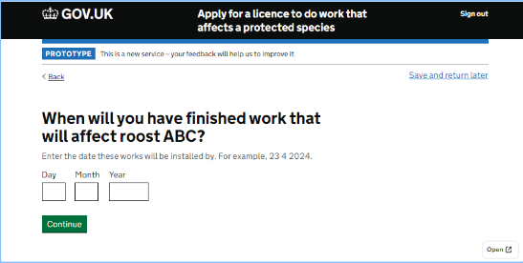
The dynamic nature of construction work
Mitigation dates are uncertain due to the dynamic nature of construction and the reliance on workers.
Planning and contractor choices to prioritise work over other can delay work further.
Flexibility is needed where completion times are unpredictable.
"clients don't know much about time scales" P2 AL2
"you'll have to accept it might not be the exact date" P6 AL3
Notes:
Dates for any planned mitigation work are often unknown by both ecologists and their clients. Ths is due to the dynamic nature of construction work and reliance on those that work within it.
Planning permission requirements means work can be pushed back
Construction work does not always begin on time.
Contractors might decide to do works on what they consider to be higher priority areas (as opposed to what is outlined in the mitigation plan.)
This means it can be hard to predict when the work is likely to be completed (particularly for more complex sites.) A level of flexibility in the site registration form is required in order to cater to these complexities.

Slide 19
When wildlife becomes difficult to measure
"On a site survey spanning 5 years' you're talking thousands and thousands of roosts. You follow bats around and some of them you find again others not, but you might also find them 3 km from where the roost could be impacted" P6 AL3
Measuring access points becomes difficult when there are many in one area (like a roof with tiles or a tree with multiple spots for bats).
Changes in bat movement can create variations in peak counts in complex projects tracked over many years.
"It's not always clear what they're accessing... you just measure the height and assume they can get into it." P4 AL3

Slide 20
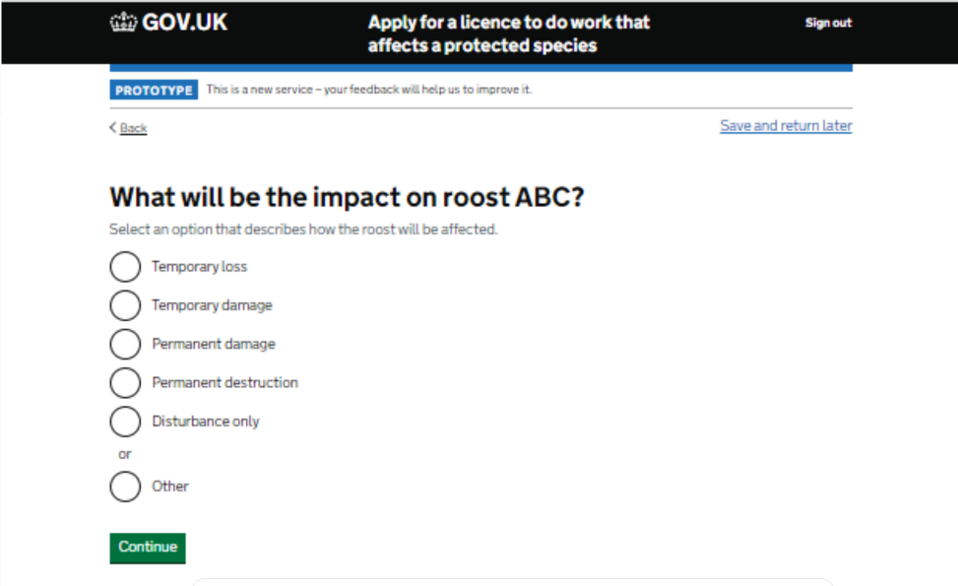
When wildlife becomes difficult to measure
Dealing with lots of roosts at once creates challenges within the site registration form. It is difficult to split roosts up, where they have multiple species, are near one another. Mitigation plans in these scenarios cover a set of roost collectively as opposed to individually.
"There's not enough flexibility in forms like this. Horseshoes are using the second floor and roof voids and the idea is to give the entire building over to them, so it'll be a mixture of destruction and temporary damage" P4 AL3

Slide 21
Reliance on planning / licence outcomes and effective communication with decision makers.
"It depends on the contractor. Depends how you get on with the rest of the clearance." P6 AL3
When planning the mitigating course of action, ecologists need to be pragmatic, with a plan that is adaptable to the needs of the client and those granting the licence.
Prioritizing SRs, managing multiple cases at once or extending the ability to work on a site registration is necessary.
"From a professional point of view, I'd want to do more than one site-registration at a time" P3 AL2

Slide 22
What does flexibility look like in this context
An experience that caters to a process where no project is the same.
Ability to easily make changes and adaptations
Ability to clearly communicate nuances
Ability to have a 'best fit' or prediction when there are unknowns.
Ability to see the form in its entirety (knowing what is coming next and foreseeing the impact of ones actions)
Ability to leave applications incomplete and prioritise others

Slide 23
3. A universal format for documenting survey information

Slide 24
Tables: A universal format for documenting survey information
"The survey form was created so that we wouldn't spend a lot of time looking at the form because the purpose of an emergence survey is to see the bats come out of the buildings" (P6, AL3)
Tables are frequently used to record survey data, especially details about roosts and where they are located.
Simpler to record real-time information, reducing the need to constantly refer to paper during emergence surveys.(1)
Consistent with the previous format of the site registration form, making it easy to transfer information over. (2)
Aids planning (quick extraction of relevant information into planning documentation set out by NE) before submitting a site registration.
1
"To make it more streamlined, we updated how we write our bat reports so that it follows the same table format as the traditional form" (P2, AL2)
2

Slide 25
Tables: A universal format for documenting survey information
" It can be tricky to navigate between the roost types" P3 AL2
"We have columns for different things seen not heard, head not seen, distraction by client noted so that we can rewatch points" (P3, AL2)
Allows all information about roosts, including reference codes and locations, to be seen together without having to flip through multiple survey pages (enhancing the readability of large sets of data.) (3)
Facilitates collaboration with colleagues or clients.(4)
Aids communication with assessors, especially for sites with roost locations that may be difficult to explain via usual methods (maps) (5)
3
"I put the codes in a table so that when the assessor picks up the drawing, they can see against the site reg where these where" P6 (AL3)
4
5

Slide 26
4. The importance of 'other' when no project is the same.

Slide 27
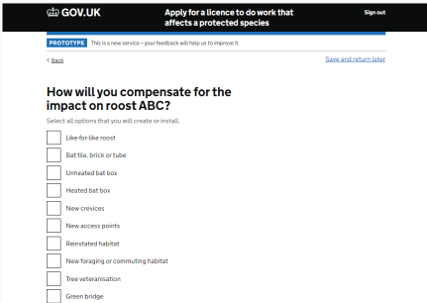
The importance of 'other' when no project is the same
Since projects differ, lists are unlikely to cover all cases. So, users often choose 'other' and describe accurately rather than forcing a match.
"it seems strange that there isn't a roof void on that list" P4 AL3
"It's good to have other as they sometimes turn up in unusual places" P1 AL1

Slide 28
The roost flow : A closer look
Round 1 usability testing

Slide 29
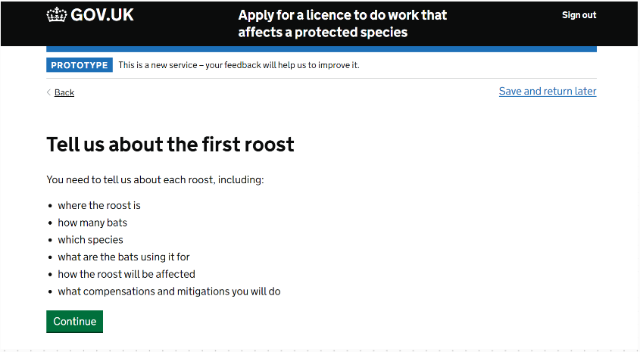
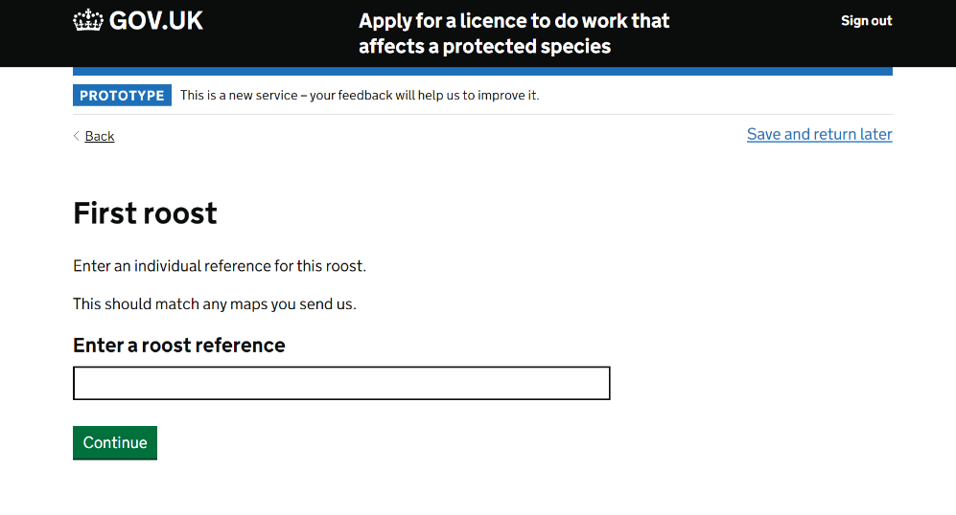
No one size fits all approach to naming roosts.
?
Ecologists have their own way of naming references – usually referring to the species and building number. According to assessors a lack of consistent approach has no impact on the ability to assess an application.
When there are multiple roosts/species within the same location (eg trees with multiple fishers), matching a roost reference to a map (as stated in the hint text) is not always clear

Slide 30
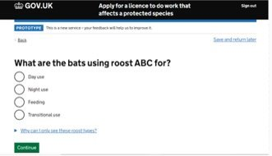
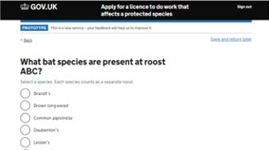
Ecologists are aware of the roost type / species that fall within their accreditation.
As per assumptions, If an expected species or roost type is not present on the list, users reach for the 'why can I only see these species link.'
"I can't do those so this is what I'd expect to see." P5 AL1

Slide 31
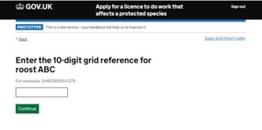
Gridreferencefinder.com is used to locate the 10-digit grid reference.
L
Locating finer details amonst long survey reports proved to be difficult and time consuming, highlighting the benefits of planning prior to submitting a site registration.
When copied from gridreference.com the 10-digit code contains spacing:
TQ 24810 85101
Users amend the code for it to align with the guidance.

Slide 32
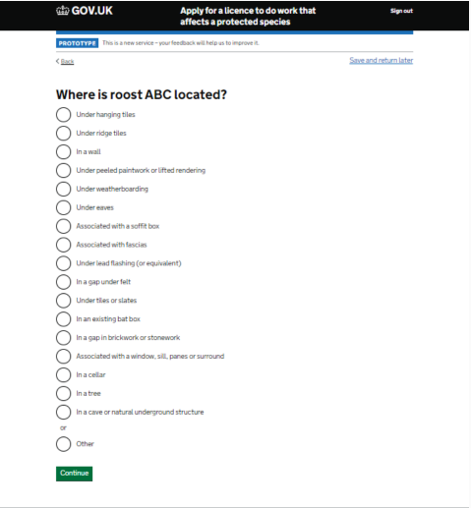
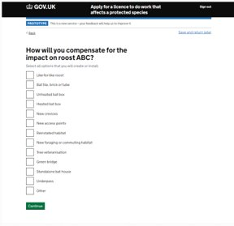
Time spent scrolling through lists does not always lead to a match.
M
Users sometimes struggle to find desired options in lists after scrolling. Some are overlooked (e.g.bat boxes,) or missing (e.g., gable, roof void, church).
Since projects differ, lists are unlikely to cover all cases Users often choose 'other' and describe rather than forcing a match.
Users make no reference to a bat box being heated or unheated when choosing a bat box compensation
Locations (e.g., wall cavities, gables) mean different things to different users, causing deliberation and inconsistencies in assignment.

Slide 33
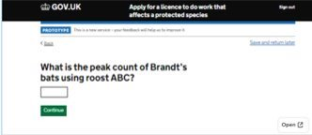
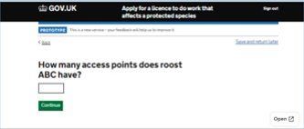
Access points can be difficult to measure
L
Ecologists mark up an extensive list of access points in their surveys.
Measuring becomes unclear when points are clustered, like tiles on a roof or spots on a tree. Some ecologists might interpret these access points differently to others.
Users familiar with the form might write '5+' or '>5' for unmeasurable points.
"Would be good to specify if you class an entire roof as an access point" P1 AL1
Notes:
Ecologists are likely to have marked up an extensive list of access points in their surveys.
Access points become difficult to measure when there are multiple access points in one place. For example, a whole roof with multiple tiles or a tree with multiple fishers. In this case, one ecologist might have a different interpretation of the number of access points to another.
Familiarity with the existing form lead users to write '5+' or '>5' when the number of points cannot be measured.

Slide 34
Some discrepancies over impact definitions.
M
It is not uncommon for users to look for guidance on impact definitions.
Varying scenarios and unclear roost impact meanings lead to different interpretations. For instance, re-roofing might be seen as permanent destruction by one and temporary loss by another.
It may be difficult to assign one impact type when there are multiple roosts with multiple species present
Low evidence: Users might use alternate language (re-roosting, demolition, modification) to describe impact.
"Would be good to specify if you class an entire roof as an access point" P1 AL1
Notes:
Users seek guidance on the impact definitions
With scenarios that differ so vastly and uncertainty over what the roost impacts mean, users may interpret these differently. Eg. One may place a re-roofing under perm destruction while another may consider it temporary loss.
While users gave a definition for temporary loss, they were unable to do the same for temporary damage.
WHen sites become more complex (multiple roosts in one spot, with multiple species) it becomes difficult to split impact types
Before reaching this step users use other language to describe impact type such as re-roosting, demolition, modification.

Slide 35
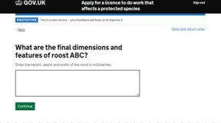
Ecologists don’t usually collect roost measurements on site.
M
There was some deliberation over how to answer the question, particularly when measuring complex things such as tiles or roof cavities.
Getting a measurement would require re-visiting technical drawings, imagery or having conversations with the client.
A cm/m first mindset means users spend time converting their measurements.
"That was a bit difficult to answer. Its limiting if you've just got tiles." P5 AL1
"I don't work in mm." P3 AL2

Slide 36
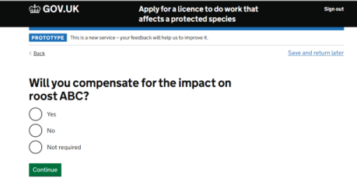
Compensation may not be required, yet users are likely to do it anyway.
L
Users select Yes, despite not requiring compensation.
The 'Not required' option adds complexity making users over think their answer.
"Generally, I like to incorporate compensation" P1 Al1
"Not required but we'd put up bat boxes" P5 AL1

Slide 37
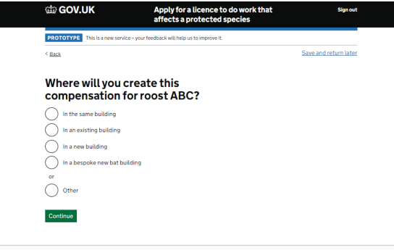
Users opt for 'other' when describing where they will create the compensation.
L
All responses were about trees as opposed to buildings

Slide 38
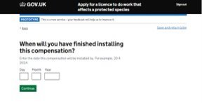
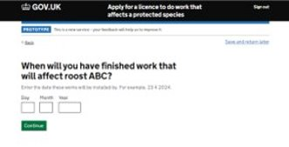
As construction work is dynamic, dates are often unknown or likely to change
M
A start date is expected - crucial for aligning work with maternity and hibernation periods.
End date varies due to:
License grant date
Planned start date
Contractor adherence
Project complexity
Hence, an exact end date is often unknown.
Similarly phrased questions on dates led to some confusion.

Slide 39
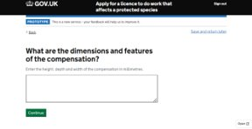
Rather than enter dimensions of the compensation, users are likely to enter a model.
L
"Can be found on the suppliers website" P6 AL3
"As they're low conservation that level of detail isn't needed by Nat Eng" P3 AL2

Slide 40
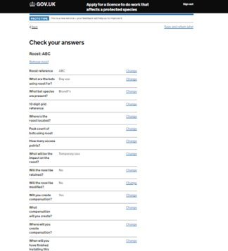
Ecologists highlight the benefits of seeing their information clearly laid out
Allows a higher level of flexibility (making quick changes as opposed to navigating their way back through the steps)
Capturing information of all roosts in one place as opposed to navigating through multiple pages.

Slide 41
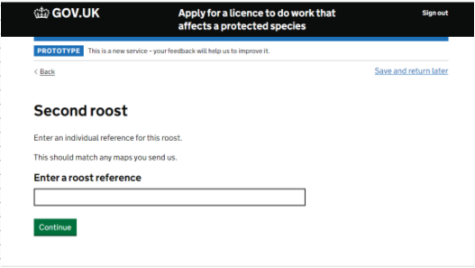
Adding another roost: Ok on simple schemes, time consuming and repetitive on others.
H
Adding roosts can be repetitive on schemes with 30+ roosts. Information within each roost might be the same with minor changes (such as a change in grid reference)
As the number of roosts increases it becomes difficult to navigate the information with separate roosts per page)
Roost details (species, access, peak count etc) are usually documented in table format and viewed collectively rather than individually.
"This is a ridiculously complicated site" P4 AL3
"Maybe just upload a spreadsheet, and it auto populated the document?" P2 AL2

Slide 42
Summary: No one size fits all approach to submitting a site registration.
The form gathers the information users anticipate, and those with AL1-AL2 accreditation find it easy to navigate on straightforward projects. Feedback is fairly positive, with users noting the similarity in the existing Qualtrics form.
However, as projects grow in complexity, featuring more roosts with various species (some AL2, all AL3,) the flow becomes less user-friendly. Completing and navigating these more intricate forms takes longer and becomes challenging. While complex projects are not the norm, the new designs do not adequately cater to the needs of highly experienced bat ecologists.

Slide 43
Suggestions / What next
Define an MVP (simple vs more complex submissions?)
Research with assessors to understand impact of findings
Unmoderated card sort to define roost impact types
Roost flow design iterations as mapped in next slide
Test remaining flows with ecologists of mixed level
Validate discovery / alpha user needs
+ Exploratory research to create a richer picture of user needs / journeys:
Dedicated research on planning a site reg / extraction of information
Dedicated research with more experienced ecologists to understand nuances.

Slide 44
Low Impact
*impact measured on quantity / severity. Difficult to measure without understanding the full picture and impact on other user groups (assessors.)
Insight | Who does it impact | Page | HMW | Suggestion
Users amend the format of the 10-digit grid ref code | All levels | 31 | How might we help users communicate information about the location of their roosts in a way that is quick and intuitive? | Design Iterations
Access unclear when points are clustered, like tiles on a roof or spots on a tree. | All levels | 33 | How might we increase user confidence that they are entering measurements in accordance with assessor expectations? | Design iterations : Guidance on common scenarios?

Slide 45
Low Impact
Insight | Who does it impact | Page | HMW | Suggestion
Users select Yes, despite not requiring compensation. 'Not required' makes users over think their answer. | All levels | 36 | How might we help users communicate information about compensation in a way that is quick and intuitive? | Design iterations: look into need of 'not required'
'other' used when describing where they will create the compensation. (Trees as opposed to buildings) | All levels | 37 | How might we help users communicate information about compensation in a way that is quick and intuitive? | Quant analysis on Qualtrics form to understand relevant options
Rather than enter dimensions of the compensation, users enter a model. | All levels Unknown impact on assessors | 39 | How might we increase user confidence they are entering measurements in accordance with assessor expectations? | Research with assessors to understand impact.

Slide 46
Medium Impact
*impact measured on quantity / severity. Difficult to measure without understanding the full picture and impact on other user groups (assessors.)
Insight | Who does it impact | Page | HMW | Suggestion
Deliberation and inconsistencies in assignment of roost locations. 'Other' used rather than forcing a match | All Unknown impact on assessors | 32 | How might we help users communicate information about the location of their roosts in a way that is quick and intuitive? How might we give users confidence in their choices? | Quant analysis of Qualtrics responses: How is the list currently used? Research with assessors to understand impacts. Design iterations
Unclear roost impact meanings | All | 34 | How might we increase user confidence that they are effectively communicating the impact of the mitigation work | Unmoderated card sorting activity to define impacts / language Design iterations

Slide 47
Medium Impact
Insight | Who does it impact | Page | HMW | Suggestion
Ecologists don’t collect roost measurements Complexities around measurement of tiles or roof cavities. | All | 35 | How might we increase user confidence they are entering measurements in accordance with assessor expectations? | Research with assessors to understand whether / why this is required.
A cm/m first mindset means users spend time converting their measurements. | All | 35 | How might we help users communicate information about their roosts in a way that is quick and intuitive? | Design iterations (mm no impact on assessors- checked)
Dates are often unknown or likely to change Expectation to enter a start date | All | 38 | How might we help users communicate important information about their mitigation plans in a way that is quick and intuitive? | Research with assessors to understand user need Design iteration (less specificity)

Slide 48
High Impact
Insight | Who does it impact | Page | HMW | Suggestion
Adding multiple roosts roost: Ok on simple schemes, time consuming and repetitive on others. | AL3 only | 41 | (As below) | (As below)
Tables are frequently used to record survey data, especially large sets of roosts and where they are located. | All / Biggest impact on AL3 | 24-25 | How might we help users working on complex sites communicate large sets of information in a way that is simple and easy to digest | Dedicated research into complex sites. Exploration into surveys / planning and data entry

Slide 49
Unknown Impact: Research required
Insight | Who does it impact | Page | HMW | Suggestion
Matching a roost reference to a map is not always feasible | Complex projects Unknown impact on assessors |  | How might we support ecologists working on complex projects to clearly communicate information about their roosts? | Low evidence Dedicated research with AL3 ecologists to understand nuances
Locating finer details amongst long survey reports is time consuming | Mid-Complex projects |  | HMW help ecologists quickly gather the information they need to submit a successful site registration | Research exploring planning / extracting of info before submitting a site reg
It is difficult to assign one impact type when there are multiple roosts with multiple species present | Complex projects |  | How might we support ecologists working on complex projects to clearly communicate information about their roosts? | Dedicated research with AL3 ecologists to understand nuances

