Slide 1
Identity Management user research report
Published: Oct 2023
Classification: OFFICIAL
Version: 0.1

Slide 2
Background
The wildlife licence application service is being redesigned with an online channel being developed.
Users will be able to log in and submit their applications online.
To ensure secure and compliant data management, an identity verification and validation service, known as the Defra Identity Management Solution, will be integrated.
This service relies on the Government Gateway.
This integration will impact the user experience of the wildlife service.

Slide 3
What we wanted to learn
What?
Who is involved in producing a licence application and what access do they have to the form?
How usable is the contact details and integrated identity management solution?
How?
Mini (30 minute) contextual interview
Usability test (30 minute) using a prototype

Slide 4
We assumed
Only the 'named ecologist' completes an A24 badger licence application form.
Users will be able to:
Sign up for a Defra ID account and
Add applicant details
Add their own details
Add alternate applicant details
Add alternate ecologist details
Add who to send an invoice to

Slide 5
Method
30 minutes semi structured interview with ecologists exploring:
How is a badger mitigation application is currently produced?
Who is involved - in particular, what is the role of Applicants?
Followed by a 30-minute usability test of a mocked-up, condensed version of Defra ID and the contact details section of the badger mitigation wildlife service.

Slide 6
Who we spoke to
6 ecologists
All from larger (30 + ecologist, multi-disciplinary organisations)
1 x Director
1 x sub-contractor
4 x Principal Ecologists

Slide 7
Limitations
Only ecologists from larger organisations participated
No geographical spread represented – small pool of participants during a busy time of year
Only established ecologists participated (no junior ecologists)

Slide 8
How we've categorised the findings
We've categorized usability issues into three levels of impact on users:
High impact
Medium impact
Low impact
Although we initially used this research to evaluate design usability, our limited prior knowledge of user behaviours and expectations led us to use the research as an opportunity to gain insights about our users. Instead of a traditional usability test with multiple tasks and associated metrics, we conducted a cognitive walkthrough session focused on a single task (completing a report of action). While this resulted in more subjective measures of impact, the approach allowed us to better understand our users while evaluating usability.

Slide 9
What we learned from usability testing Defra ID and the contact details

Slide 10
Key themes
The context of Ecologists' work
Collaboration to produce a badger licence application
Terminology that ecologists use
2. Ecologists' unmet needs, the application sign in process and usability gap in between
Keeping records for auditing purposes
Provide transparency to license holders
Individual vs organisation is unclear
Other roles not included
3. What we got right
4. Standalone usability issues

Slide 11
The context of ecologists' work

Slide 12
Collaboration to produce a badger licence application
A great deal of the collaboration between those involved in making decisions to produce the wildlife application happens outside as well as using the current PDF as a conduit.
Ecologists spoke of collaborating with other stakeholders using document sharing in SharePoint.
Who completes an A24 application?
The named ecologist fills out and submits the form, but not always
Clients (applicants) see and agree to and sometimes sign the A24 form
Ecologists may not speak to the licence holder at all
Sometimes Junior ecologists draft applications before a Senior approves
All applications are quality assured by the same-level or higher Senior colleagues
Sometimes sub-contractors complete and sign an A24 form
It's unlikely a client would submit an A24 form (dependent on client type?)

Slide 13
Collaboration to produce a badger licence application
Collaboration may take place using the A24 form itself.
One ecologist is part of the private beta told us that they had had submitted an application through the trial but, because their stakeholders did not have access to the form on the trial, they used the current A24 PDF form to collaborate and copied the content of that into the online application for the trial, essentially creating more workload.

Slide 14
Collaboration to produce a badger licence application
Ecologists working with larger clients may not work directly with the licence holder
With larger developers, ecologists may never see or speak to the licence holder. Instead, they may be working with a project management team. The PM on the applicant's side will QA the application submission by the ecologist and run it up to the licence holder (who may be a director who doesn't get involved in the day-to-day). The director will then give the 'ok.'

Slide 15
Collaboration to produce a badger licence application
Other ecologists, beside the named ecologist, access the form and some contribute to it
Ecologists at larger organisations involve other ecologists in the application process
Junior ecologists as 'apprentices'
Quality assurance by others
Class licences are different
Larger ecologist consultancies run an 'apprenticeship' style system where junior ecologists gain familiarity with the licencing process by filling out application forms
Junior ecologists will learn about the licencing application process by filling out the bulk of the form
All applications at larger organisations undergo a quality assurance process whereby other ecologists of the same level or more senior will check the form before it is submitted.
Sometimes a sub-contractor may specifically be used because they hold a class licence and no one else in the organisation does. In this case, the sub-contractor would be named on the form and would complete it themselves.

Slide 16
b. Terminology that ecologists use
How ecologists refer to others, themselves and to licences
Ecologists use terms interchangeably depending on context:
Client / licence holder / applicant / person who will hold the licence
Ecologist / named ecologist / person who will hold the licence
If they happen to hold a class licence, they may refer to themselves as 'licence holder'
We have a tentative indication that ecologists do not use the alphanumeric code for a licence (such as A24) but instead refer to it by the licence type (such as badger mitigation licence or badger licence for development purposes).

Slide 17
2. Ecologists' unmet needs, the Returns process and usability gap in between

Slide 18
Keeping records for auditing purposes
Keeping records for audit purposes is essential for ecologists
In a recurring theme we’ve heard in previous Returns research, we heard ecologists need to keep records to be able to refer to what has been said, sent and agreed. This is for the sake of accuracy (both with NE and their clients) but also for insurance indemnity purposes.

Slide 19
b. Providing transparency to licence holders
In another recurring theme we heard in previous Returns research, we found that ecologists need to provide access to a wildlife application to licence holders for sign off.
We've heard again that ecologists will provide their clients with the licence application and all materials prior to submitting it to NE. This is because the ecologist wants their client to understand what ecology work will happen and what they will be held legally responsible for.
We believe clients do not complete or submit an application but some ecologists may ask them to sign it prior to sending it to NE.

Slide 20
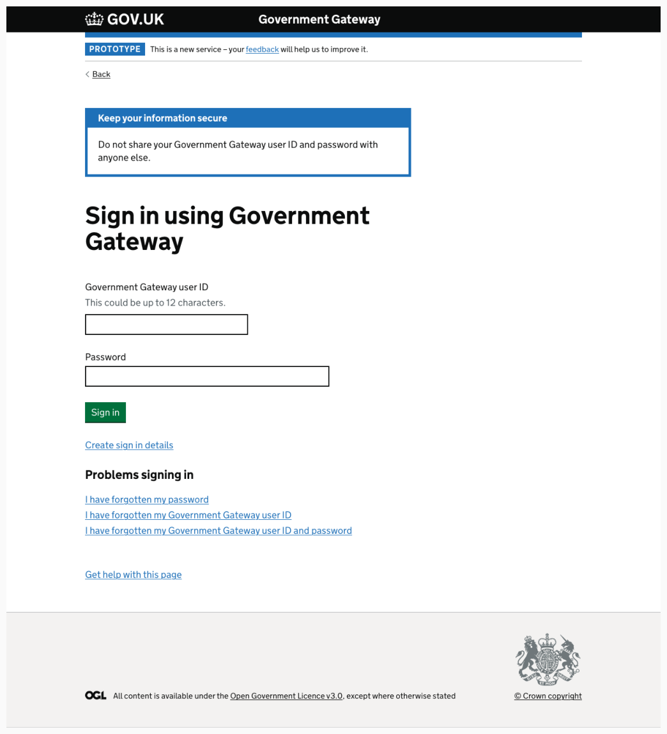
c. Individual vs organisation is unclear
A recurring theme throughout the journey was that participants weren't always clear whether or not personal information was required or details of their organisation.
This stemmed from the lack of clarity for them at the point of signing up for a Defra account and using Government Gateway, since all participants have a Government Gateway account for personal reasons and assumed it would require those details.

Slide 21
c. Individual vs organisation is unclear
However, one participant - a director or his organisation - was concerned that having users in his consultancy use their personal government gateway accounts would be problematic from a security perspective. He believed this would mean they would likely fail future tendering processes that would require them to have organisational, rather than personal logins..

Slide 22
c. Individual vs organisation is unclear
We also heard that like we did in Returns research) that participants felt they wanted to keep their 'work' and 'home / personal' lives separate.
It was felt that using a personal government gateway login would be to breach the work / private lives with participants worried about bleeding information from one into the other.

Slide 23
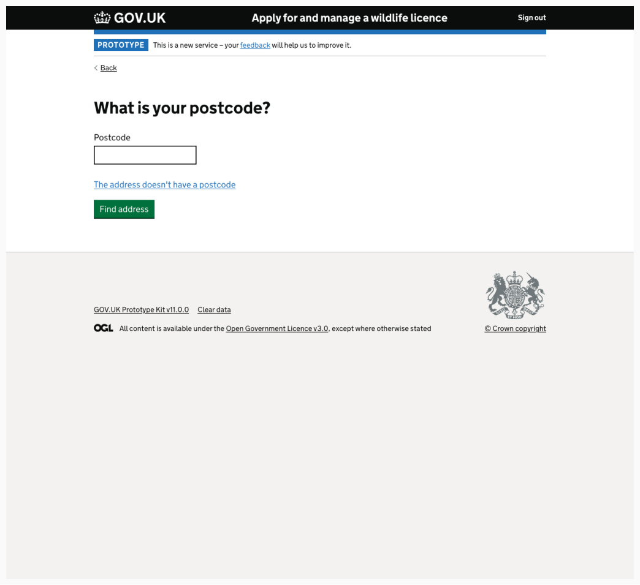
c. Individual vs organisation is unclear
When signing up for a Defra ID account, participants were then unclear if they should be including address details for themselves or for their organisation.
And preferences differed, particularly given people are working remote.
Additionally, some participants felt they would not want their clients to see their where they live.

Slide 24
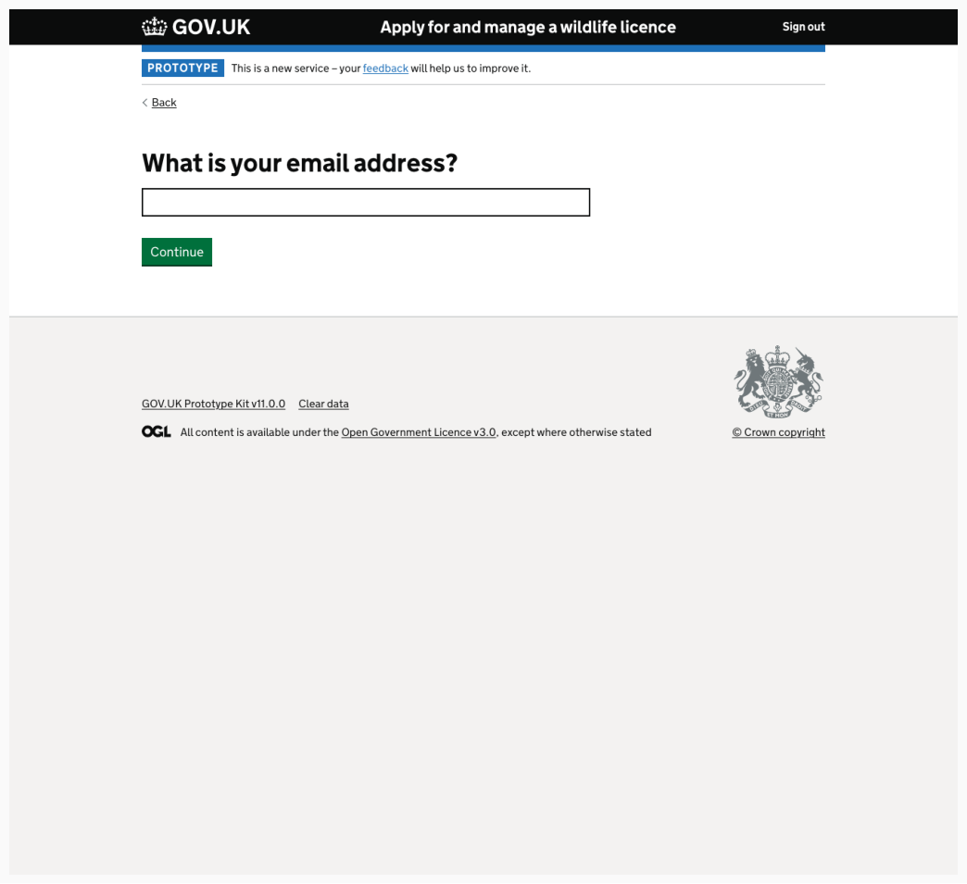
c. Individual vs organisation is unclear
The same issue recurred for the email address where users were unsure to include their personal email or work email address.

Slide 25
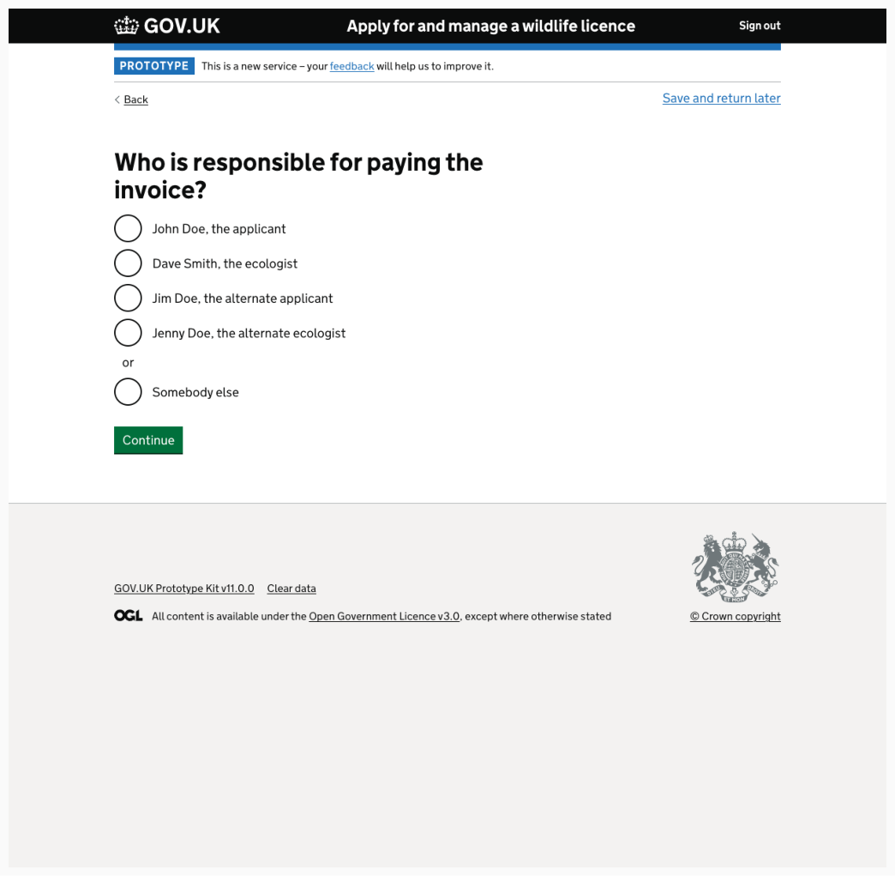
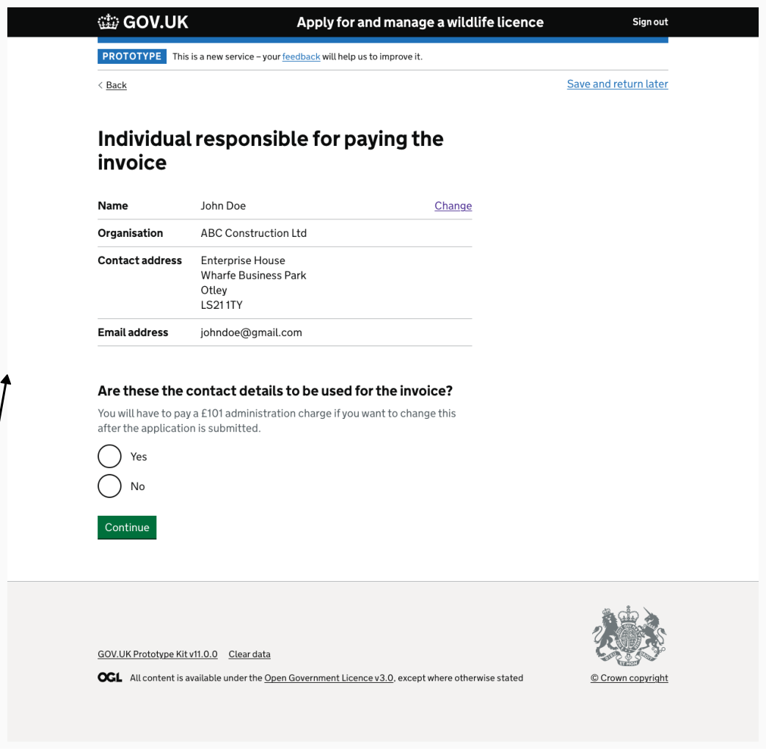
c. Individual vs organisation is unclear
The issue of whether an individual or organisation's details are required arose once more at the stage of discussing payment and entering invoice recipient details.
Ecologists felt that it would be unlikely that an individual would be responsible for paying a licence fee and receiving an invoice. Instead, it would be an individual, causing confusion about why the pre-populated categories showed the name of the individual licence holder instead of the organisation they work for.
However, ecologists presumed they'd click 'something else' which would allow them to input the name of an accounts department with an accounts@ email for their client, or an individual working in that department.

Slide 26
c. Individual vs organisation is unclear
The issue of whether an individual or organisation's details are required arose once more at the stage of discussing payment and entering invoice recipient details.
Ecologists felt that it would be unlikely that an individual would be responsible for paying a licence fee and receiving an invoice. Instead, it would be an individual, causing confusion about why the pre-populated categories showed the name of the individual licence holder instead of the organisation they work for.
However, ecologists presumed they'd click 'something else' which would allow them to input the name of an accounts department with an accounts@ email for their client, or an individual working in that department.

Slide 27
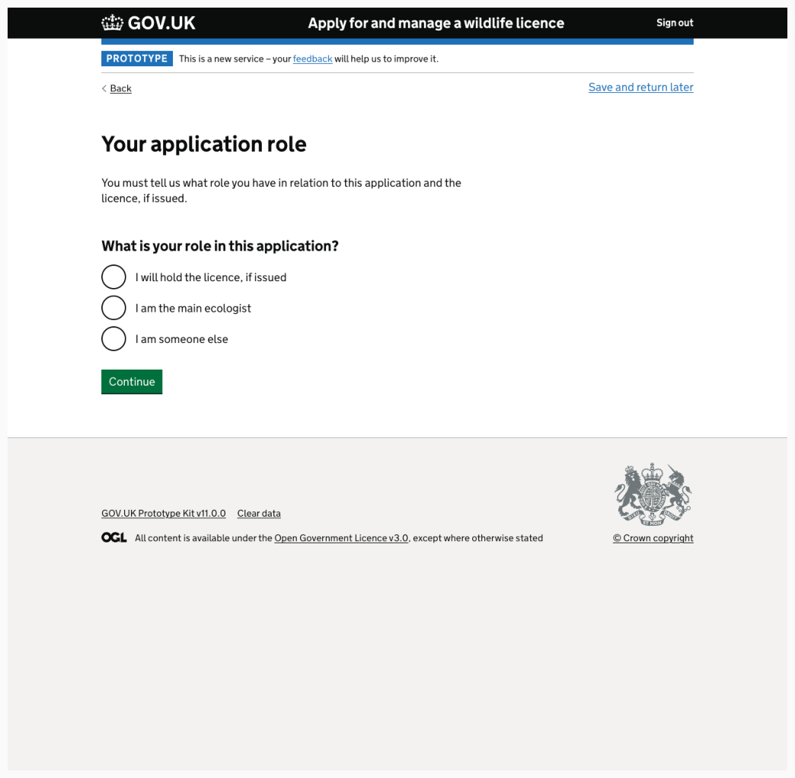
d. Other roles not included
Junior ecologists
Participants were unsure where Junior ecologists would fit here, assuming they might fit into 'I am someone else.'
Class licence holders
Class licence holders were unclear about whether they would be considered the 'licence holder' or 'the main ecologist.'
Applicants
We had an indication that applicants likely do not apply for A24 badger licences, making the applicant option superfluous, but we can't be entirely confident about this without further research.

Slide 28
3. What we got right

Slide 29
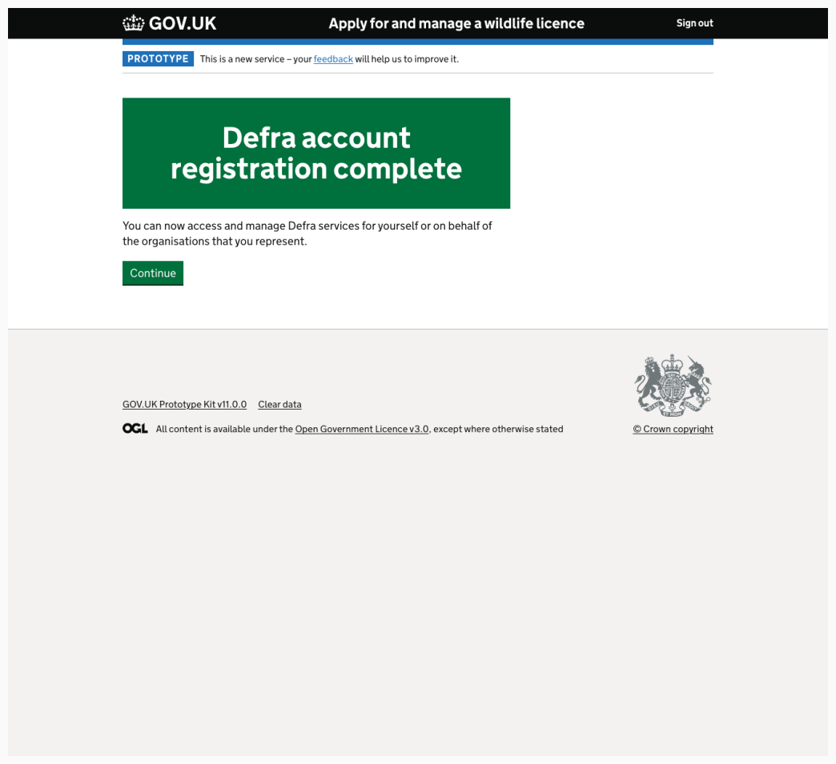
Registering for an account
Participants understood they were signing up for a Defra account, and were able to articulate their expectations for what an account would and allow them to do, which was accurate.

Slide 30
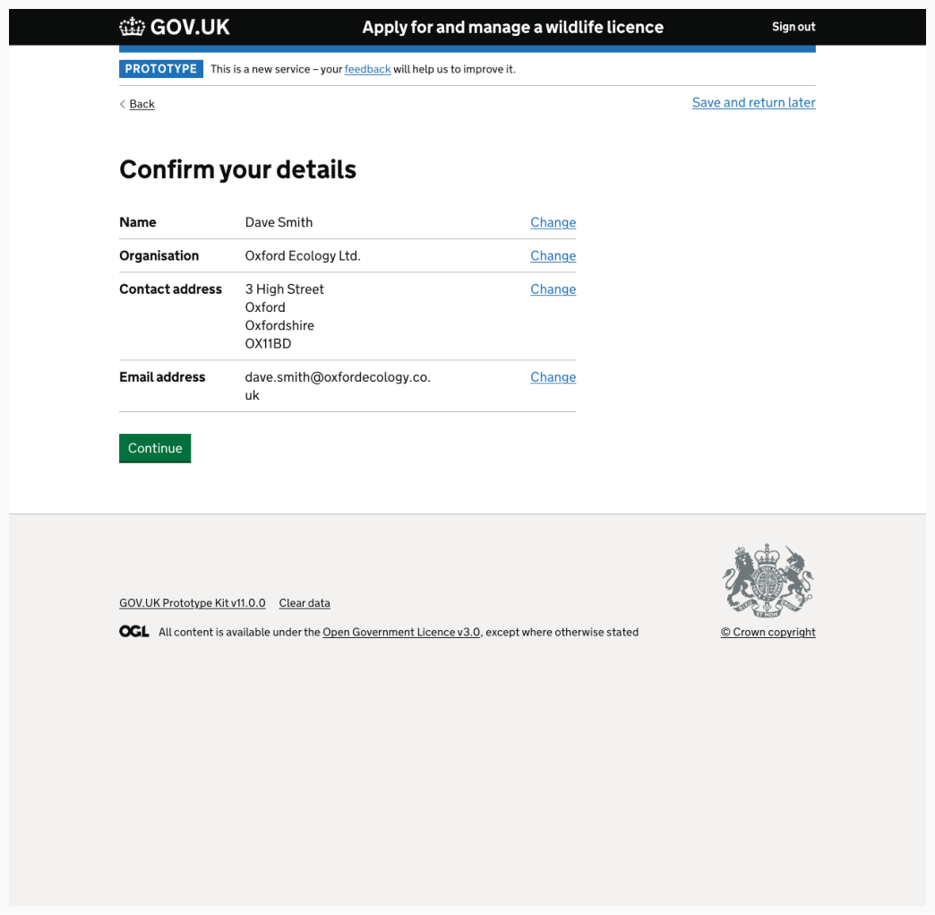
Ecologists recognised that the IDM solution pulled through their details from registration.
Ecologist details pre-populated and participants all understood this was due to the information they had previously filled out at registration being automatically pulled through for them.

Slide 31
4. Standalone usability issues

Slide 32
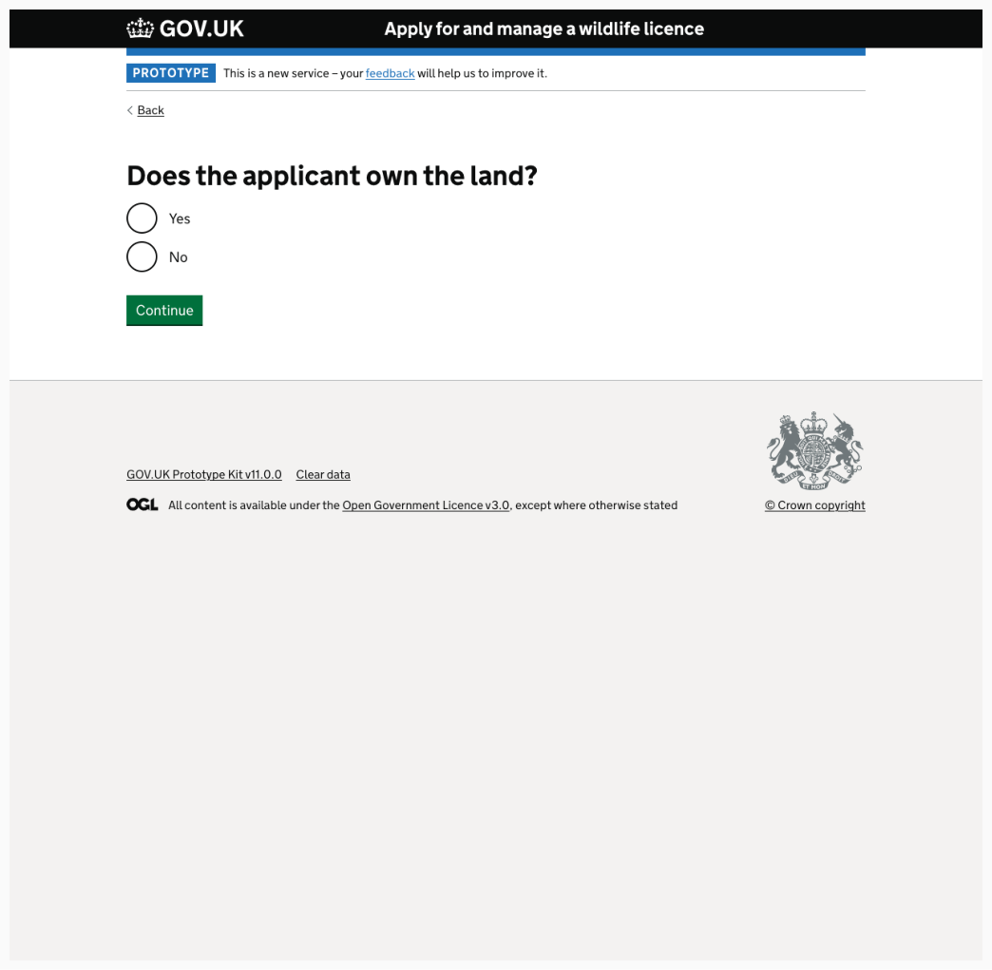
Land ownership can be complex
While participants understood this page, situations could be complex, for example with more than one landowner developing a site and both owning the land but not all of it individually.
It was therefore not clear where this would fit in the options and one participant felt unsure about what would happen if they selected 'no.'

Slide 33
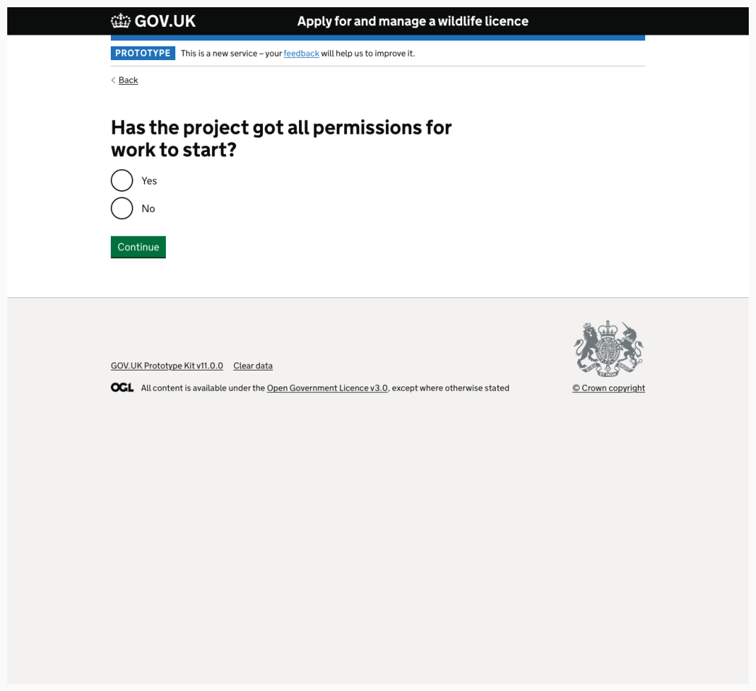
The "project" and "permissions" being asked about weren't necessarily clear
The "project" and "permissions" being asked about weren't necessarily clear, although, all participants either understood immediately, or deduced it was regarding the construction / development work
However, this can still be a difficult question to answer. This is because the ecologist may not know the answers to these questions or because consent may be granted but suspended or inactive.

Slide 34
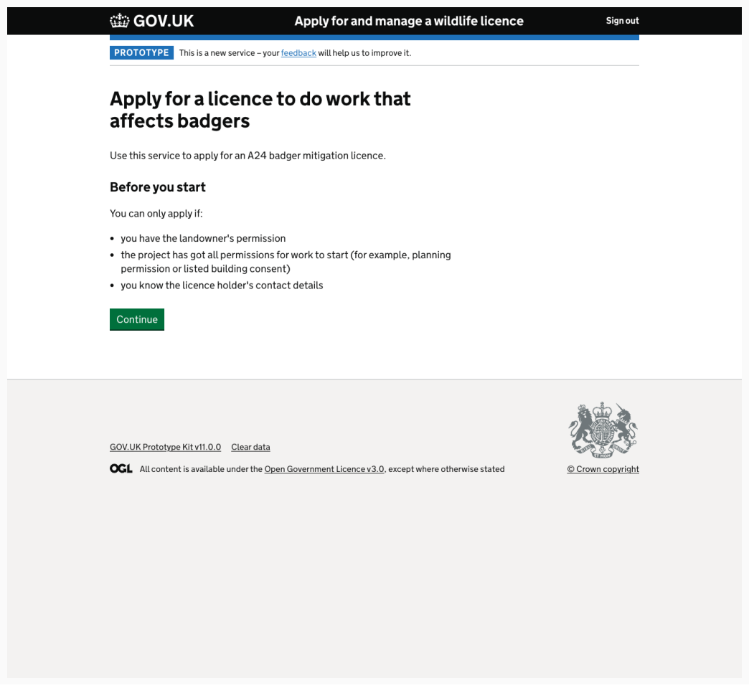
Repetition of start page and licence type
While the repetition of a start page here was surprising, participants understood this was a return to applying for a licence after a brief digression.
However, the lack of description of the licence type being applied for became starker at this period.
One participant felt it is the most important piece of information and should be higher up in the hierarchy, rather than buried as a subheading.

Slide 35
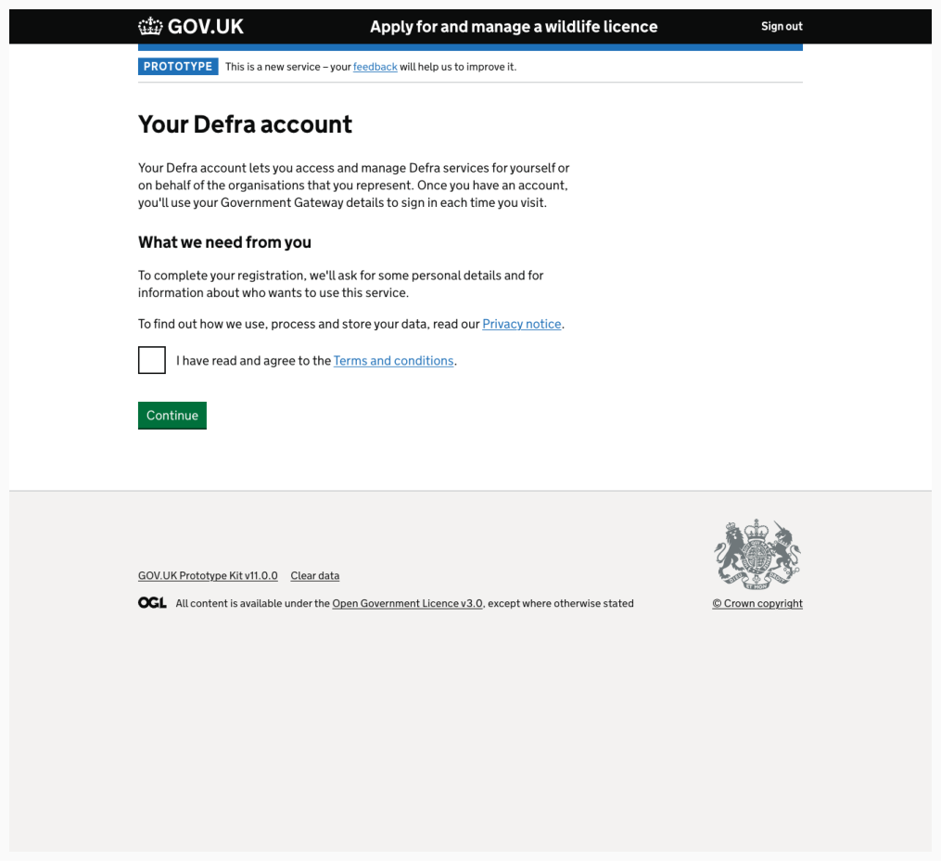
All participants clicked on, or wanted to click on the T&Cs
For one ecologist, this was because they needed to check that the terms and conditions, they were signing up to would mean they are still able to remain compliant within their organisation when it comes to GDPR.
For others, this was because they assumed they were signing up using their personal government gateway account, and they wanted to ensure they would understand what it would mean in terms of linking their personal and professional accounts.
For all participants, they wanted to check there was nothing 'untoward' they would be signing up to.

Slide 36
All participants clicked on, or wanted to click on, the T&Cs
For one ecologist, this was because they needed to check that the terms and conditions, they were signing up to would mean they are still able to remain compliant within their organisation when it comes to GDPR.
For others, this was because they assumed they were signing up using their personal government gateway account, and they wanted to ensure they would understand what it would mean in terms of linking their personal and professional accounts.
For all participants, they wanted to check there was nothing problematic they would be signing up to.

Slide 37
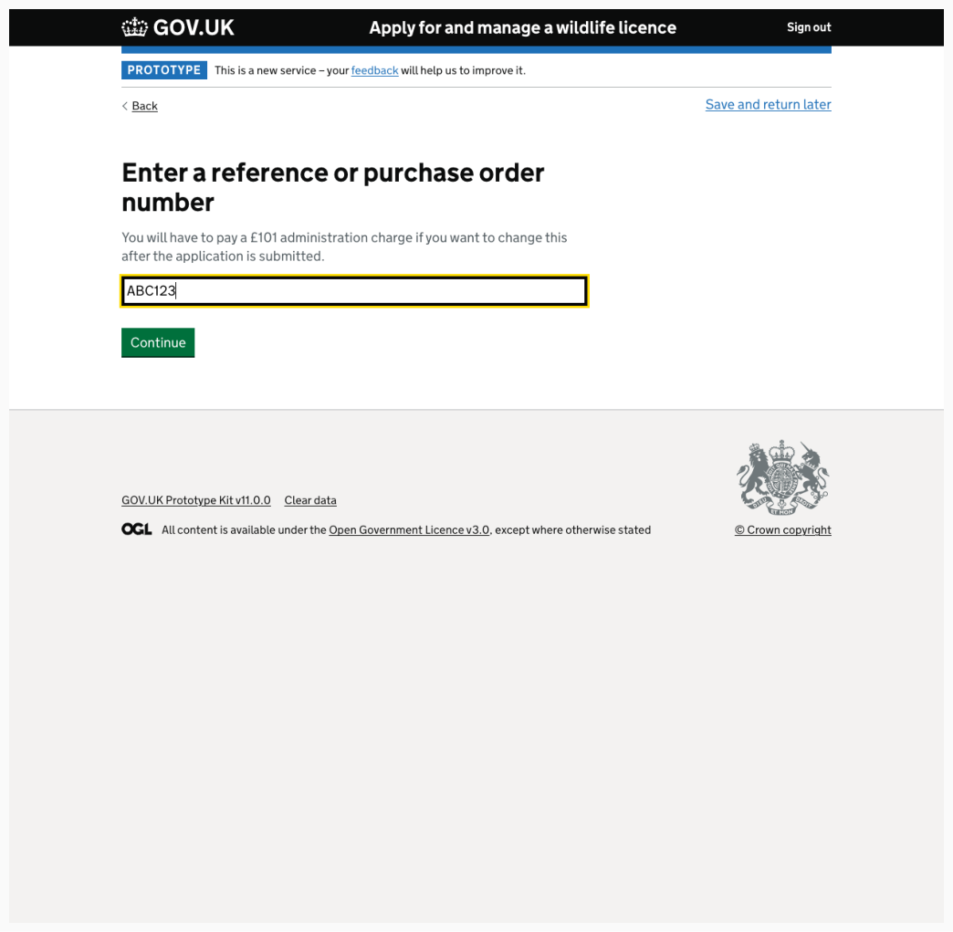
What if there's no PO number?
Participants were unclear they should proceed if their client does not have a PO system or if they do not have a PO number.
While most assumed they could enter a reference number, it wasn't clear what reference number would be useful or appropriate.
In the current PDF form, there isn't a place to put a reference number, so some participants said they put nothing if there is no PO number.
Some simply assumed they would enter the name of the project in the hope that it could be linked by Natural England back to the specific project, but they were not confident about this.

Slide 38
Who pays for the licence?
Ecologists implement different ways of paying for the licence application depending on the situation they face with their client.
Some pay it themselves (their organisation) and have the client reimburse them, whereas some always insist their client pay.

Slide 39
Summary
There are other user groups, besides ecologists who view and fill out the form
User do not want to mix their personal and work government details when completing the application
Users aren’t sure whether home or work details should be entered into the form
Whose details should be entered as the point of contact for invoicing was not clear
Pre-populated role titles were confusing

Slide 40
Suggestions / What next
Further conversations with users (especially applicants) to understand more about 'Applying for a license' journey currently happens looks and works
Further testing necessary to:
Establish the Government Gateway sign in options as well as clearly guiding the process
Clarify and understand the roles of the participants within the application
Clarify whether home or work details should be entered
Simplify 'paying the invoice' language

