Slide 1
Wildlife licensing: Badger ‘returns’ usability testing 2.0 playback
Senior user researcher: Sian Dunn
Reference: LIT 17662
Version: 2.0
Published: June 2022
Classification: OFFICIAL

Slide 2
Content
Background: what exists and how will we improve it?
Returns 2.0 objectives: what did we want to learn and why.
Participants: who was involved?
Assessment recommendations: are we close to achieving them?.
High level insights: what did we learn?
Stand alone insights: What did we learn?
Internal users: what came out of that research?
What next: ‘How might we’ and how you can be involved.

Slide 3

Background

Slide 4
Background
In the UK, or development work near badger setts (burrows), requires a licence. The licence mandates an ecologist to undertake work to mitigate the impact on badgers. The ecologist is hired by the person or entity undertaking the development.
To obtain a licence, the ecologist must apply to Natural England, who review the ecologist's application and decide whether to grant the licence.
Once they complete mitigation work, ecologists submit a Report of Action (RoA), form L24, otherwise known as the Returns process.
This report presents usability test findings for an online Returns process prototype.
Notes:
In the UK, construction near badger setts requires a license.
The license mandates ecologists to minimize badger impact and is obtained by applying to Natural England.
Ecologists submit a Report of Action to ensure work compliance.
This report is known as the Returns process (form L24).
This report presents usability test findings for an online Returns process prototype.

Slide 5
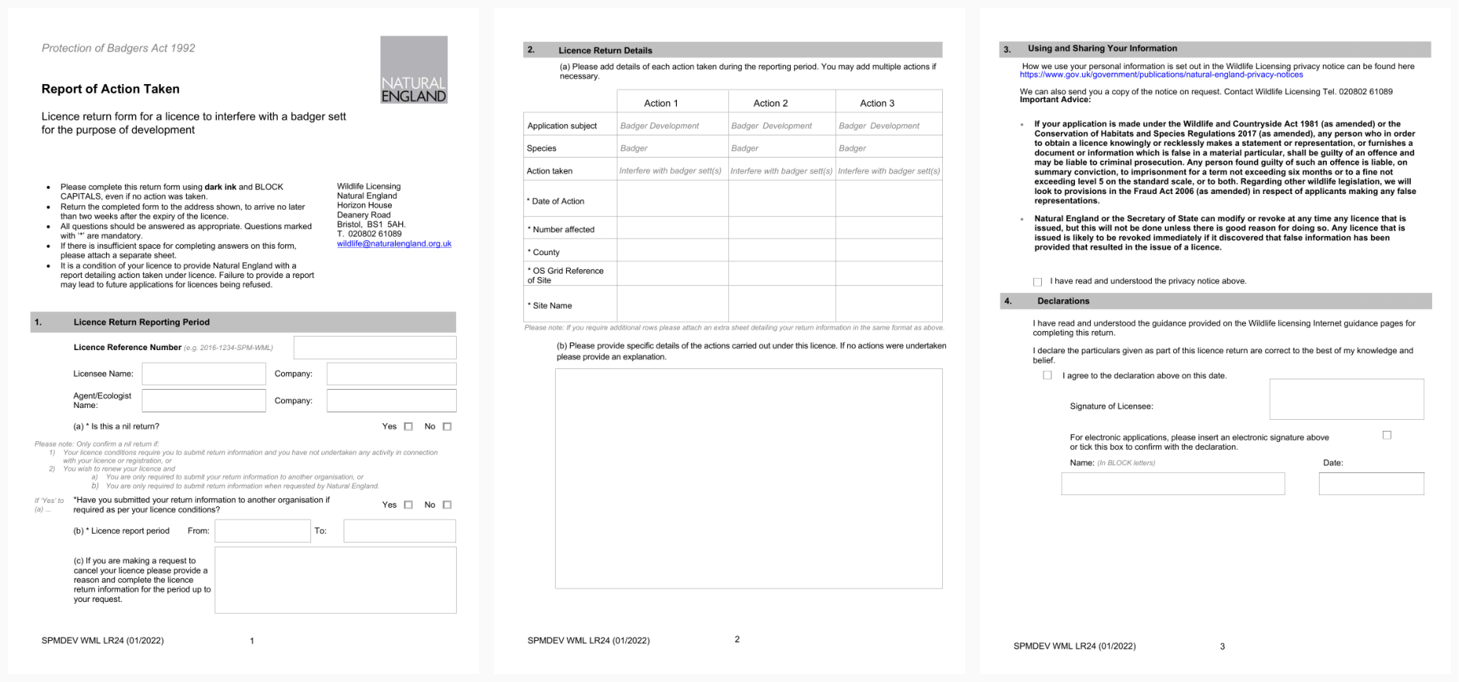
Existing L24 Report of Action taken form

Slide 6
Returns journey 1 – Findings summary
There are significant usability and user experience problems with the current Returns journey
Some are high impact to the user and, if not fixed, would create extreme difficultly for users' current way of working:
Ecologists are unsure what information Natural England need to assess a submission as efficiently as possible.
It's not clear which sett is being referred to at any one time.
Ecologists currently employ workarounds to ensure transparency for licence holders, allowing licence holders to observe completed forms and understand their legal obligations.
Ecologists keep records of forms sent to NE for audit purposes: so it is easily available within their own records, and to send to others for evidence.

Slide 7
Returns journey 1 – Findings summary
Ecologists need more understanding of how ROAs are assessed so that they can collect the right data in the first place and ensure quality submissions
The journey needs to be redesigned to include multiple setts
Some quick fixes can be made, although these are in the medium to low impact to the user categories

Slide 8

Returns 2.0 objectives

Slide 9
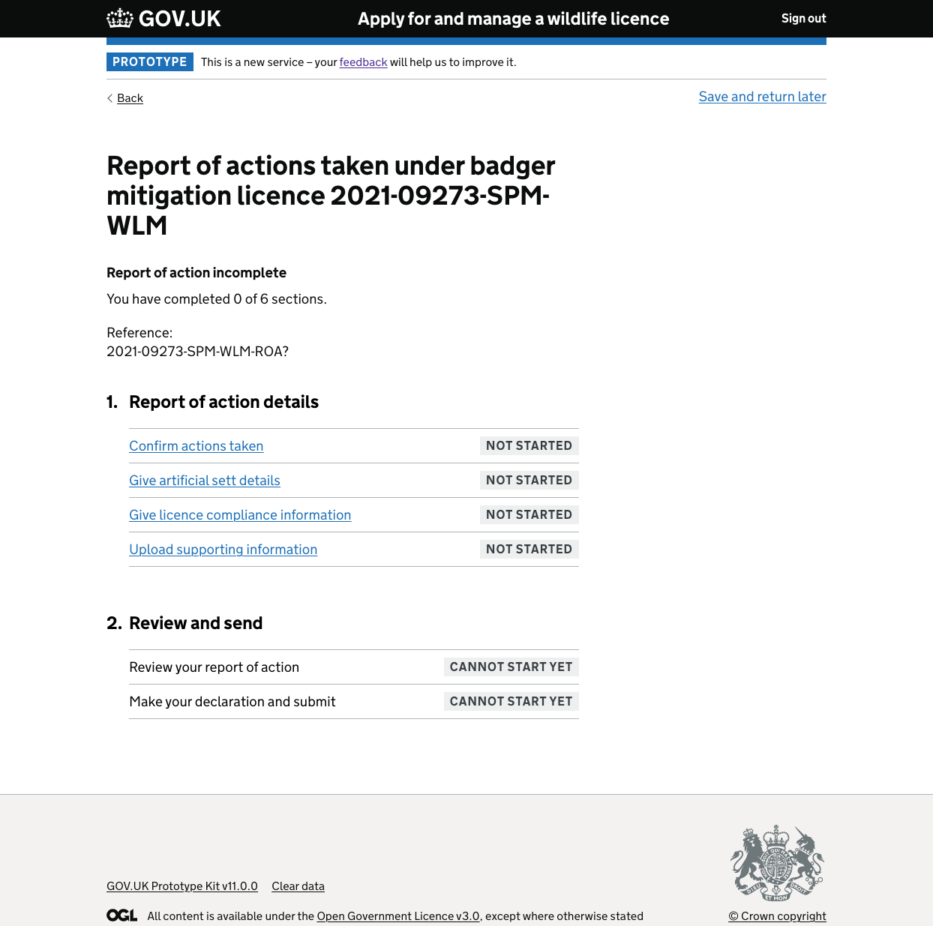
The new prototype journey
The new journey we tested with users, consists of 6 sections and a total of 41 pages.
Prior to the page shown on the right, users would have gone through 6/41 pages including a Government Gateway page.
Scenario: You are asked to submit a Report of Action concerning multiple badger setts, for one of them you did not complete one of your licensed activities

Slide 10
Assumptions and hypotheses
Incorporating multiple setts in the Report of Action flow will improve how ecologists complete the Report of Action.
Without guidance from NE & assessors, ecologist won’t know how much information to provide as answer.
The Report of Action prototype will be a faster, more accessible alternative to the current L24 Report of Action form.
The improved Report of Action prototype will be more usable for users.

Slide 11
Research aims
Test the usability of the Returns flow round 2 (version 5)
Additionally, to probe to answer the following questions:
Are there any problems with navigating through the flows?
Do any of the questions/steps in the user flows confuse people?
How easy is it to fill out the form and provide the information requested?
Are there any options or information missing?
Does the positioning and content for IDM & GG make sense for users?
Are there any risks or implications we haven’t considered that naturally arise during research?
Does the terminology & content make sense?
What are the areas of opportunities and improvements?
How can we improve discussing multiple setts?

Slide 12

Participants & method

Slide 13
Participants
Usability test X5 ecologists
All were senior or above in terms of their job role/title
1/5 users declared on the inclusion form that they had an access need which was cognitive
A consistent limitation is that we haven’t been able to speak with junior ecologists

Slide 14

Assessment recommendations & the bigger picture

Slide 15

Alpha assessment recommendations
Be aware of any biases that might creep into their design based on the legacy pdf service they are converting into digital
Establish exactly what personal data is needed for the service to function and remove any superfluous data currently being gathered.
The form demonstrated looked long but not cumbersome. The panel did reflect whether all data was required for relevant processing. The team need to ensure that all the data that is collected is used and is required for processing.

Slide 16
Beta workshop recommendations
Document uploads: the intention is that the service reduces the burden on NE staff to process paper submissions and answer queries around maps but if the document upload functionality isn’t simple and proven to meet user needs this may not be achieved.
Design of the internal service is shaping design of the external user journey – this approach should be reversed so that Defra are not putting the burden on users.

Slide 17

High level insights

Slide 18





High level insights
Method statement
Relevance
Lost the badger in the flow
Jargon barrier
Multiple setts
Users indicate that they would expect to methods statement to act as a foundation for the Report of Action (Returns)
Based on this assumption, users felt like a lot of the journey was irrelevant, a data collection exercise & it was unclear what assessors want to gain.
It felt like a data collection exercise to users as the flow and questions did not match their ways of working, therefore, the relevancy was lost. As their ways of working wasn’t matched, we lost the badger in the journey and the opportunity to mirror the correct procedure – we unintentionally might cause breach of licence.
Jargon manifested in many forms and stumped our users, at times it was legal jargon, jargon that challenged any users with access need & terminology that didn’t reflect their own.
If multiple setts questions were to remain in this digital journey then questions need to be grouped according to sett context to avoid cognitive overload or loss of information

Slide 19
High level insights
Methods statement: ecologists would expect to outline their plan for the A24 licence in a methods statement, and wouldn’t typically deviate away from that for returns (if they did, they would modify the licence) - so why do we ask for that same information again?
Relevance: ecologists noted that even if they did deviate away from methods statement, they would report a change to their licence, it seems as though their correspondence journey isn’t linking and therefore some questions seemed irrelevant or a ‘data collection exercise’.
Lost the badger in the flow: while the relevancy of things asked was questioned, questions that did seem relevant didn’t have the correct flow, often not reflecting an ecologist's ways of working
Jargon: questions were difficult for all users with some noting that they seemed like a ‘trick question’ and purposely trying to trip the ecologist up.
Multiple setts: one scenario confused users throughout the journey, they couldn’t understand why setts and questions around them weren’t grouped together for better context keeping.

Slide 20

“Refer to method statement”

Slide 21
Users felt like NE should use the method statement as a foundation for ROA
Method statements are artefacts of information and plans outlining what activities will take place to safely disturb badgers as part of an A24 licence.
Ecologists had an expectation that because NE already have the detailed method statement, this should act as a foundation for their ROA.
Typically, ecologists do not deviate away from the outlined method statement, and if they did, they would call to make a modification to the licence to ensure they haven’t breached it.
Of the 41 pages shown to users, ecologists heavily mentioned that they would rely on their methods statement for 11 of those pages.
Ecologists became exhausted and deflated throughout the research sessions having to repeat information. It added confusion and time to the journey with them asking if some were ‘trick questions’.
Notes:
Risks: incomplete applications, incorrect information, overload of info for assessors with them still being able to spot inconsistencies, could lead to calls and emails around the ROA.

Slide 22
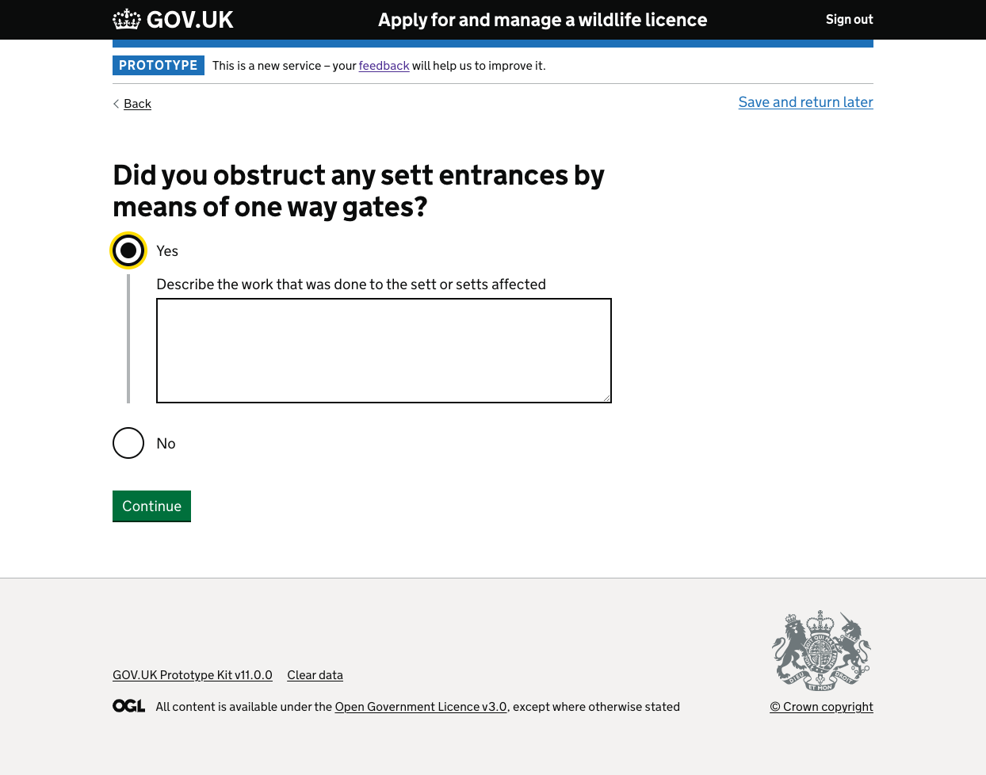
Users felt like NE should refer to the method statement they submitted as a basis for ROA
There was a strong consensus among users that you would rarely have deviated away from the licence conditions, especially by the time they would submit a ROA – so why would that information need to be re-submitted?
“If you've done your job properly you're just going to copy your methods statement” P5

Slide 23
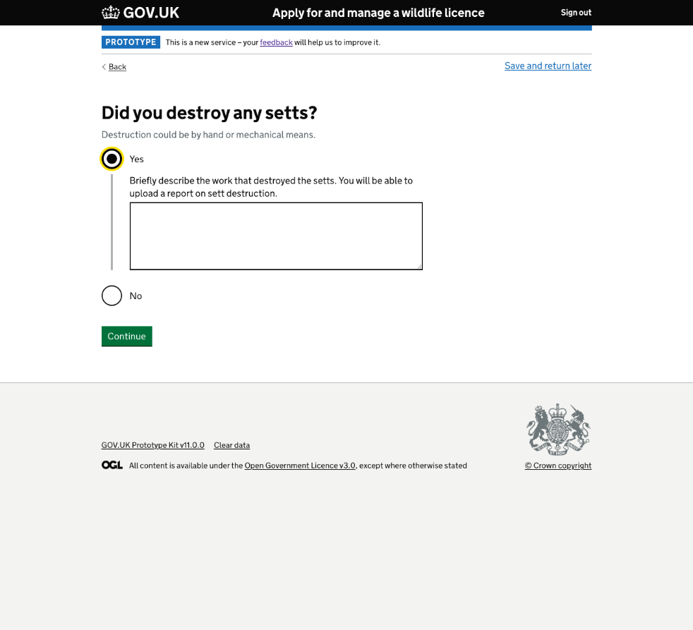
Users felt like NE should refer to the method statement they submitted as a basis for ROA
Users felt like their effort was being duplicated again.
Even with the help text, users couldn’t understand why the methods statement wasn’t used as a source of truth with a user creating the question below:
“was it done in line with the methods statement, if there was any deviation, describe why” P5
This was page 12/41 and already users were exhausted and frustrated at having to repeat information they’ve already provided to NE.
“I don't know what's different about writing and uploading a report. That feels like duplication.” P3

Slide 24
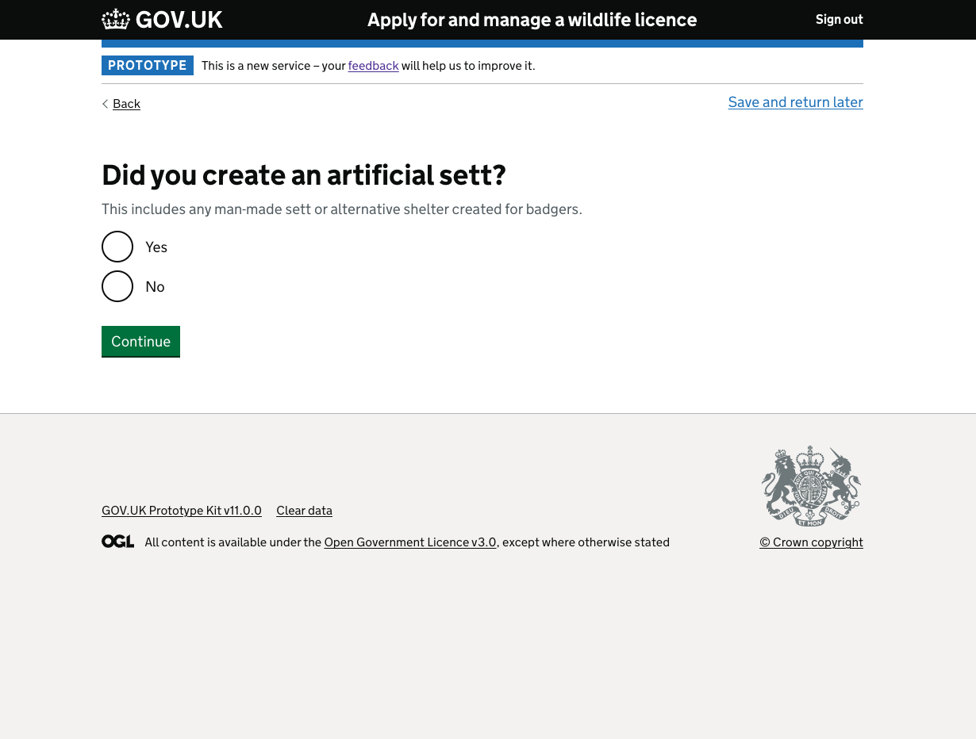
Users felt like NE should refer to the method statement they submitted as a basis for ROA
Question relevancy felt ‘off’ for some users, noting that “you should know this already” P5
Users have an expectation that information they’ve provided previously should be pulled through.
This also includes any modifications they’ve made to the licence.
“You just want was the sett created in line with your methods statement. or explain why not” P5

Slide 25
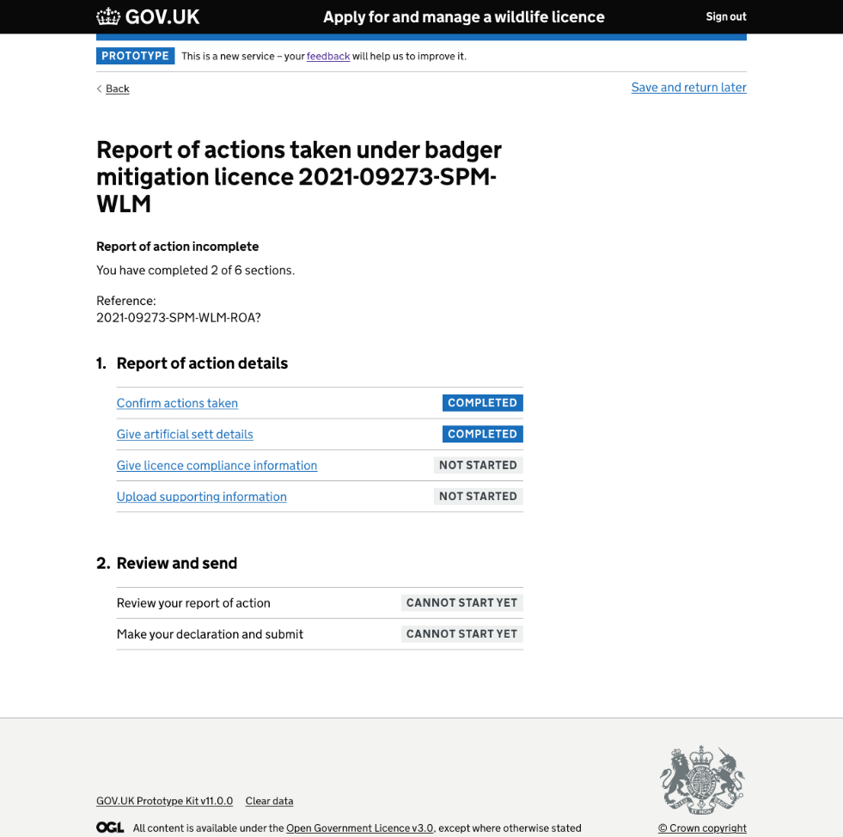
Users felt like NE should refer to the method statement they submitted as a basis for ROA
The page on the right is number 27, 10/27 pages the method statement was heavily referenced, users noted they would have:
Hoped that NE referred to the method statement they submitted
The user would refer back to the method statement and copy across information
The user would type ‘refer to method statement’
“What are you trying to gain from the licence returns?” P3
Notes:
Risk: duplication of data, superfluous data exercise, incomplete ROA & an amass of data for the assessors to pair up.

Slide 26


Relevancy

Slide 27
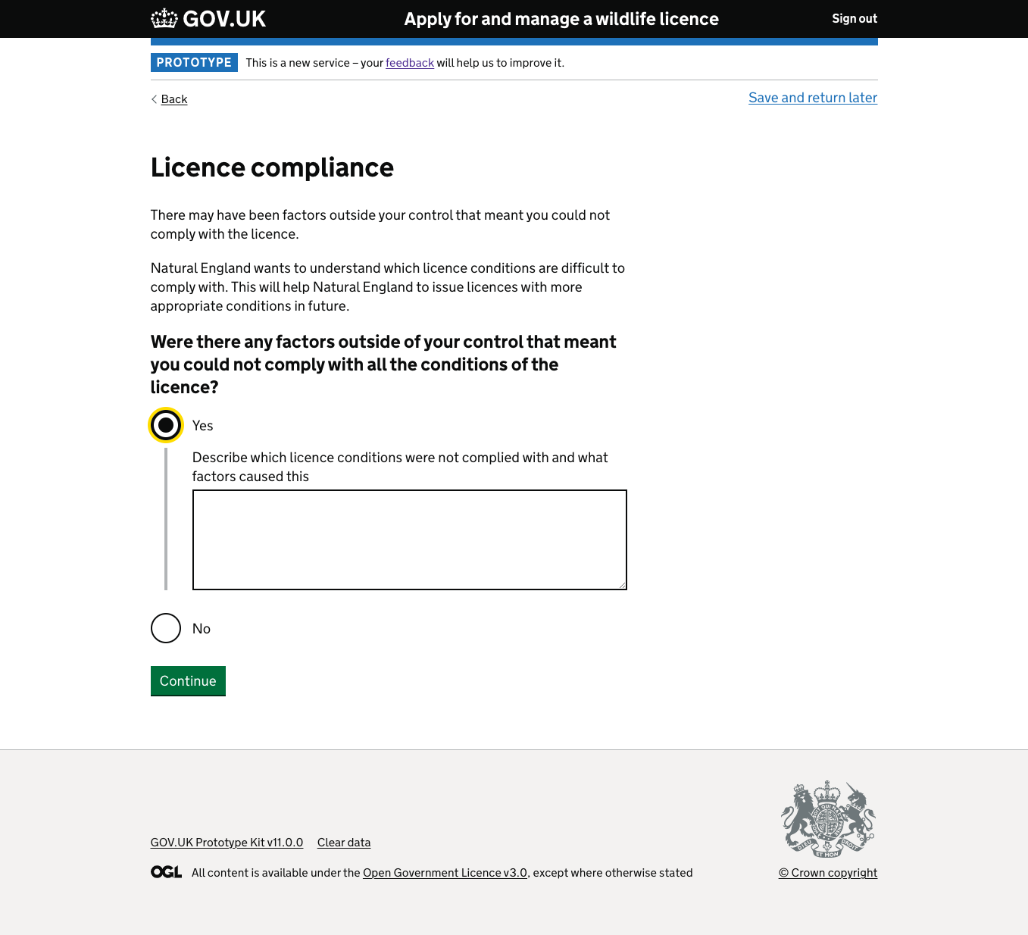
Is the flow relevant?
Aside from users wanting to refer to their methods statement, they were also confused about the relevancy of what was being asked.
Some questions did not mirror the mental model users had and they referred to the ROA as a “data collection exercise”.
Users were confused as to what NE wanted from them and what guidance there was for that.
“What are you trying to gain from the licence returns?
” P3
Notes:
This page was a pivotal moment for users, they felt like this should be frontloaded and the previous pages should be reduced

Slide 28
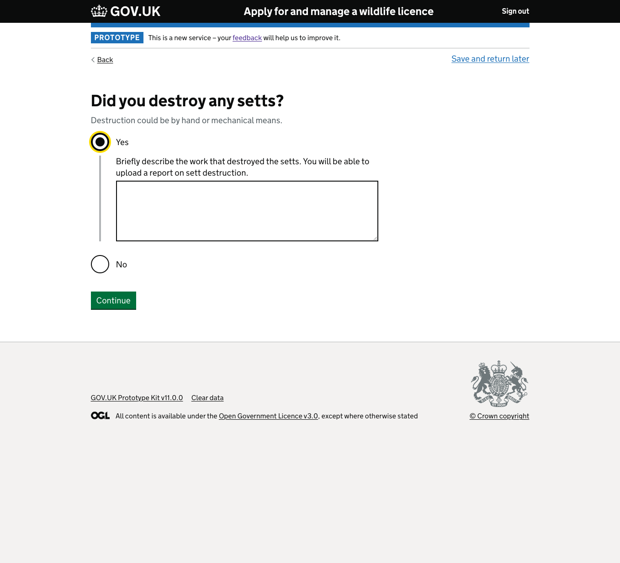
Is the content relevant?
At times, our users felt like they were being asked the same thing e.g. ‘damage vs destroy’ – when users felt like they were asked the same question they would go back and split up the info for the two text boxes which was time consuming.
“*laughs* You've got two words that are quite emotive in meaning. Which are effectively the same.” P1
Notes:
If users are using one batch of info and splitting it across two text box answers – are NE getting anything new, is there value of having two questions?

Slide 29
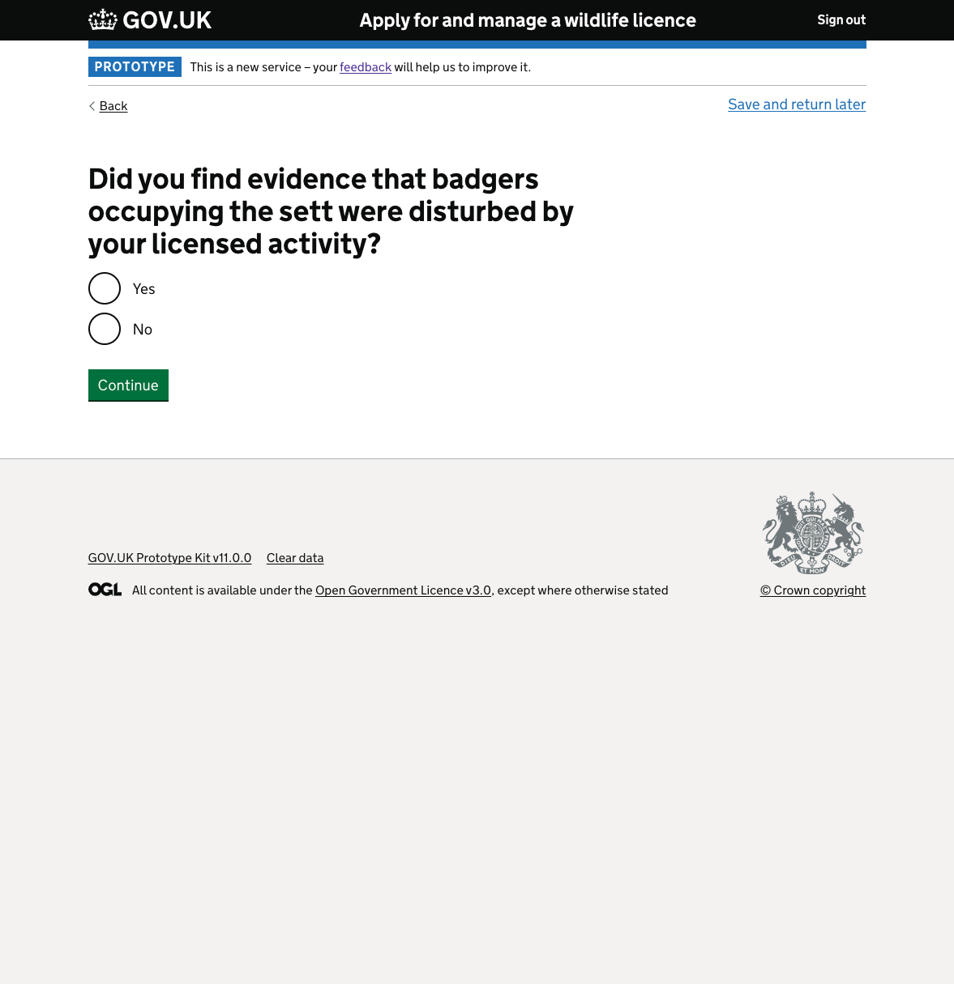
Are the questions relevant?
At times, our users felt like some questions just weren’t relevant. Noting that questions seemed obvious and therefore didn’t need to be asked or answered. This led some users believing we were asking ‘trick questions’ intending to trip them up.
“*laughs* How do you answer that? It’s a pointless question, I don’t even know how to answer that“ P4
Notes:
How might we give users information that enlightens them to what they need to convey to NE?

Slide 30
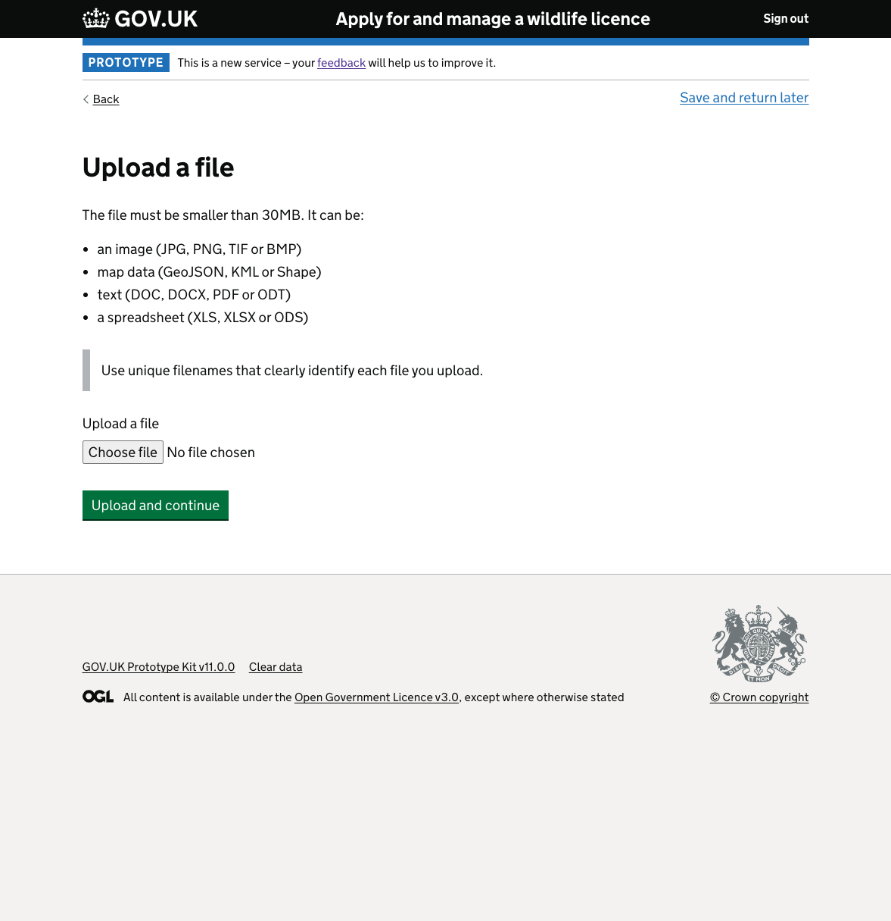

How much is too much? What is relevant for the assessors?
Throughout the journey, users started to worry not just about the amount of information they would need to input, but how the Licence assessors would handle it.
Too much choice was given to users and not enough guidance on what information to provide.
“*laughs* How do you answer that? It’s a pointless question, I don’t even know how to answer that“ P4
Notes:
There’s a real risk and danger that some answers will state ‘refer to methods statement’ when users deem the question irrelevant or they don’t feel informed on how to answer it.

Slide 31
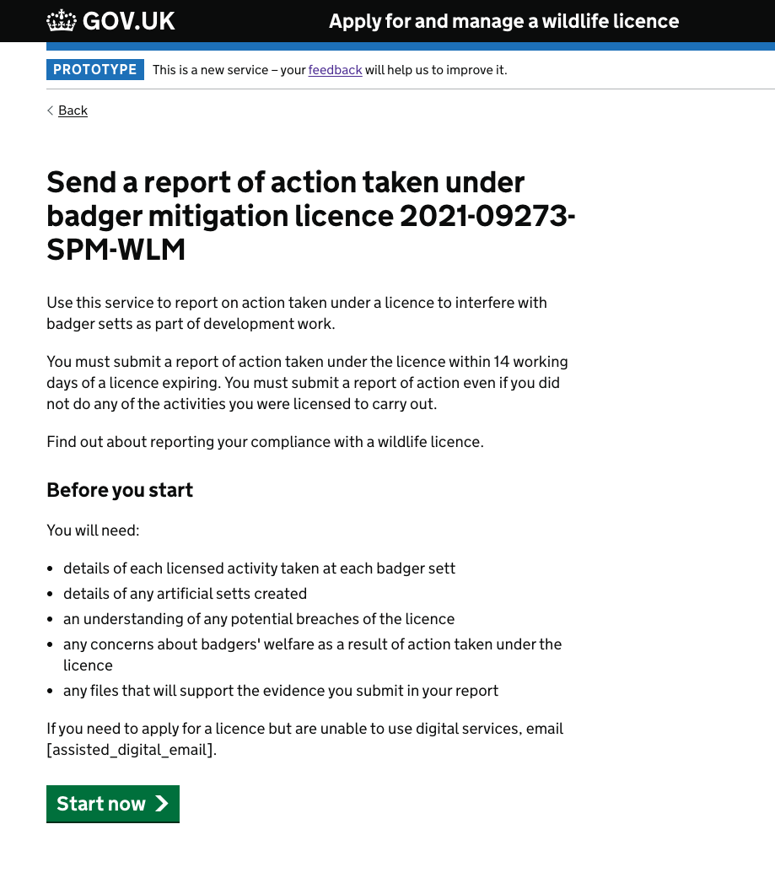

Missing the ‘so what’ which explains the relevance
Throughout the journey we ask a lot from the users and we really lack when it comes to providing clarity and the ‘why’ behind these questions.
For example, P4 mentions it’s not clear what the objectives were, as an analytical scientific user group – ecologists very much value ‘why’ they have to do something and any implications around that.
“Not clear from the outset what the objectives were"
P4
Notes:
There’s a real risk and danger that some answers will state ‘refer to methods statement’ when users deem the question irrelevant or they don’t feel informed on how to answer it.

Slide 32

Lost the badger in the flow

Slide 33
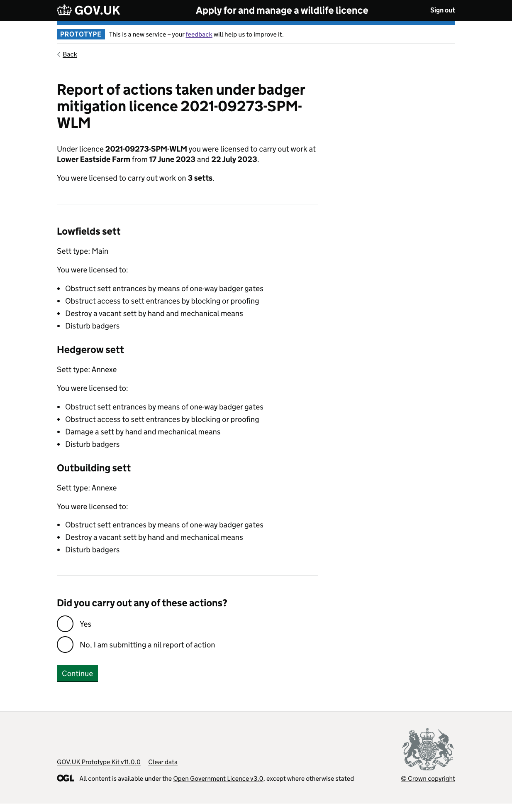
The flow did not match ecologist’s ways of working and puts the badger at risk
The flow did not capture/allow for the monitoring of successful removal of the badger from the sett, the order did not follow the ecologists ways of working.
Limitation: We have not spoken with junior ecologists yet, or any other user group aside from ecologists, if they did not allow the badger to escape the sett before closing it, they could unintentionally cause the badger harm based on following this workflow.
This also runs a reputational risk for NE with Cieem.
“There doesn't seem to be acknowledgement of an artificial sett being created if we're closing a main sett” P1
Notes:
There’s a real risk and danger that some answers will state ‘refer to methods statement’ when users deem the question irrelevant or they don’t feel informed on how to answer it.

Slide 34
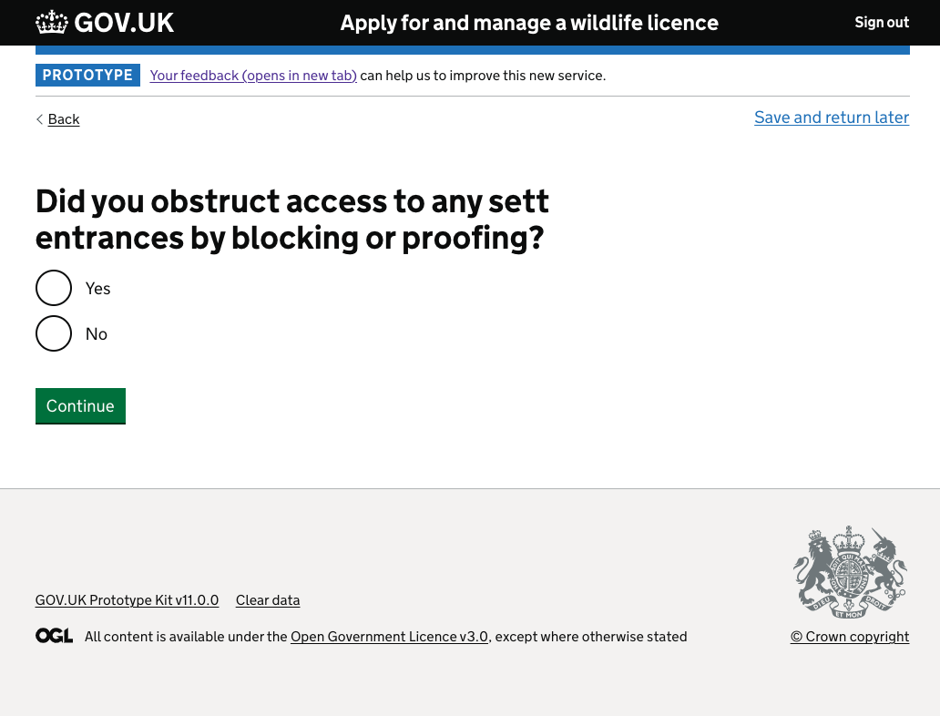
The flow did not match ecologist’s ways of working and puts the badger at risk
For section ‘confirm actions taken’ we had a serious issue with the flow and order of questions – one user even went back and reordered them verbally as to how they should be (almost like a card sort)
3/5 users stated that they were confused by this questions
“I would be a little bit scratching my head trying to work out what you mean by that, considering we've already talked about one-way gates. Which is effectively blocking or proofing.” P1
“Again, at what stage?, at the beginning that would be illegal. I would not be happy filling out this form. You can't shoehorn 6 days of work into a textbox"
P4
Notes:
There’s a real risk and danger that some answers will state ‘refer to methods statement’ when users deem the question irrelevant or they don’t feel informed on how to answer it.

Slide 35
The flow did not match ecologist’s ways of working and puts the badger at risk
Part of section ‘confirm actions taken’ the users are asked:
‘did you obstruct sett entrances by means of one ways gates?’
‘did you obstruct access to any sett entrances by blocking or proofing?’
‘did you damage any setts?’
‘did you destroy any setts?’
If users answer ‘yes’ to the above questions – at what point was the badger safely removed before they destroyed setts? At what point was they given an artificial sett? At what point was they monitored for a successful move?
"The order is wrong, the thing you needed first is did you do the monitoring. There's a bit missing, did you check any badgers were still in the setts?"
P4
Notes:
‘give artificial sett details’ felt strange to be so far down the journey and separate for the users

Slide 36

Jargon was a barrier

Slide 37
Legal jargon acted as a barrier
Users struggled with the legal jargon and the implications around this with some noting “it’s not plain English” P4
Users stated that the legal jargon made them feel like they didn’t do something as part of licence conditions and therefore made them hesitant as to what to put:
“We're playing around with legal jargon now: is that non-compliance or not?” P1
“’potential breaches of licence’ - Explain the consequences of these things, maybe that's on the next page?" P4
Notes:
‘give artificial sett details’ felt strange to be so far down the journey and separate for the users

Slide 38
Jargon was a barrier especially for those with access needs
One of our users had declared an access need on the digital inclusion forms, however, they weren’t the only user to struggle with terminology which caused them to pause or need assistance and help.
Even with the help text, users still struggled to know what was needed from them and how to answer certain questions.
Questions that were “open to wide interpretation” were most problematic.
“There was a few terminology things I didn't know what you mean. And honest truth, I'm dyslexic, so I have to ask other people what do they mean. And I wasn't always sure what you meant. And you have damage and destroy.” P1
Notes:
‘give artificial sett details’ felt strange to be so far down the journey and separate for the users

Slide 39
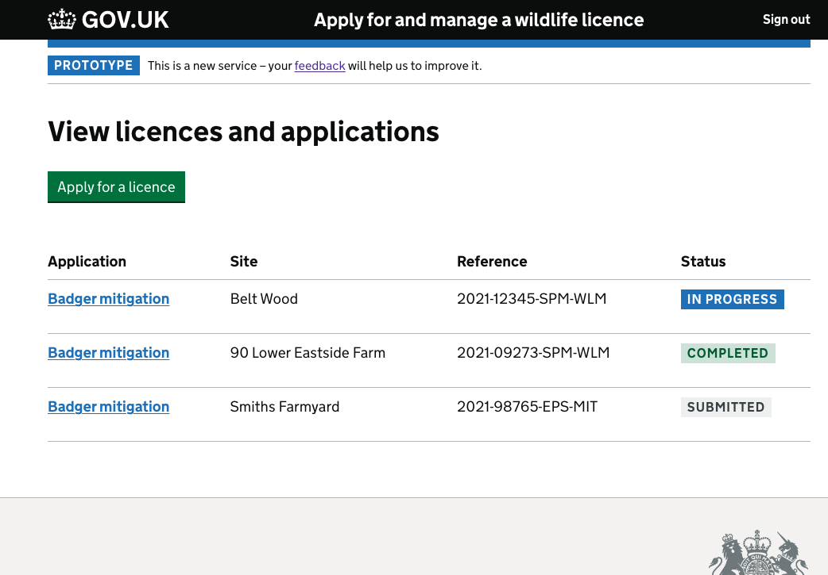
Jargon did not reflect the language of our users
We’ve already mentioned that users struggled with terms such as ‘damage’ and ‘destroy’ but some would mention the term ‘close’.
The same for badger ‘welfare’ with some mentioning ‘concern’ – it’s important that we use language our users recognise to prevent cognitive overload and mistrust in the form.
Even the ‘status’ not matching a user’s expectations could potentially mean they fill in the wrong form.
“I think that should probably say completed pending review, because it could change to completed once someone has looked at it so I know the difference between the two stages.” P3
Notes:
‘give artificial sett details’ felt strange to be so far down the journey and separate for the users

Slide 40

Multiple setts without context was a problem

Slide 41
Users struggled to remember that questions could refer to multiple setts
There was inconsistency across our users and across the journey for where they remembered the questions wanted to capture information around multiple setts.
While ‘any’ and ‘setts’ is doing lots of heavy lifting here, the user is still struggling to remember they should be speaking about every sett relevant for the question.
The users mentioned that it was much easier to remember things per sett, than it was to remember actions and THEN each sett.

Slide 42
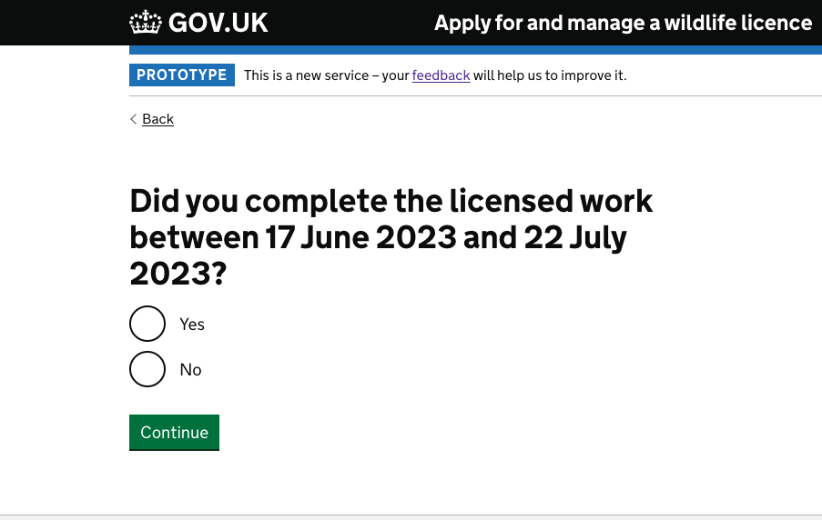
Users wanted multiple setts to remain in context and deal with each sett accordingly
For example, users struggled with this question when they remembered the scenario was around multiple setts asking whether the date was regarding on sett or all of them?
“It would be much easier for me to have the setts with text boxes too... because I can write what happened to one sett without tying it in or making it with another sett.... if you've got 1 sett and you've got to write about 4 setts it becomes easier to forget something but if you've got a text box for each sett it gives more nuanced info.” P3
Notes:
‘give artificial sett details’ felt strange to be so far down the journey and separate for the users

Slide 43
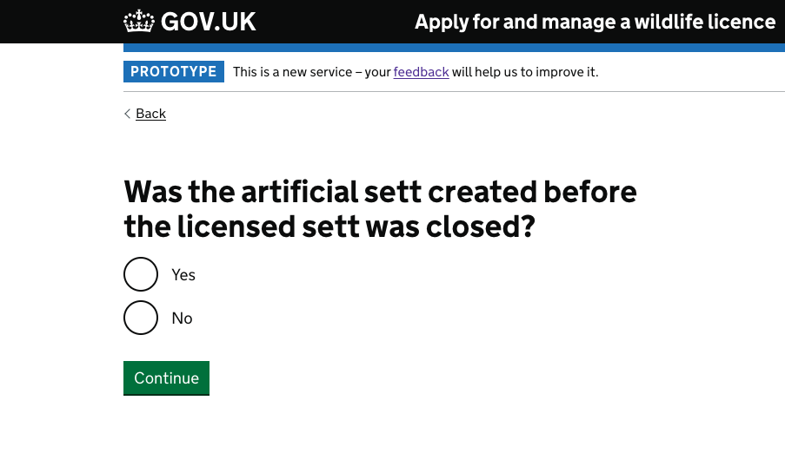
Remembering to answer for multiple setts was cognitive overload for the user
Throughout the journey users would sporadically remember a question might be referring to multiple setts, they especially struggled to answer with this in mind when given a closed question.
The onus was on users to keep remembering this and that was not always consistent.
The questions frequently change from plural to singular in reference to the setts.
“Again, it's not asked me which sett it’s referring to“ P2
“This is another one where you need to split out the setts... because I could have closed the outlier but not the main sett” P3
Notes:
‘give artificial sett details’ felt strange to be so far down the journey and separate for the users

Slide 44

Stand alone insights

Slide 45
Government Gateway
“I don’t know if I have GG ID?” P2
Government Gateway was a surprise for some users, most felt like it was a barrier as they wasn’t prepared and it didn’t match their mental model of seeing this part of wildlife licensing (most mentioned seeing it with HMRC).
A big concern is that this would prevent users from doing their returns as they would either need to stop and go and find that information, create a new one or they simply wouldn’t complete it and we don’t know if they would.
“Is that in a document? Great. But 12 characters - where would I find that. I'm stuck, I haven't submitted my licence return” P5
“It's a bit like a barrier to get stuff done - It's bureaucratic“P4
“The only thing with this is I have multiple GG user IDs which makes it a pain when I have to do it this way because I have one that I use personally (for tax) and one for the business, and I forget which is which.“P4
“So I clicked the link and it says sign in using your GG password, so I wouldn't know what that is or the password” P1
Notes:
‘give artificial sett details’ felt strange to be so far down the journey and separate for the users

Slide 46
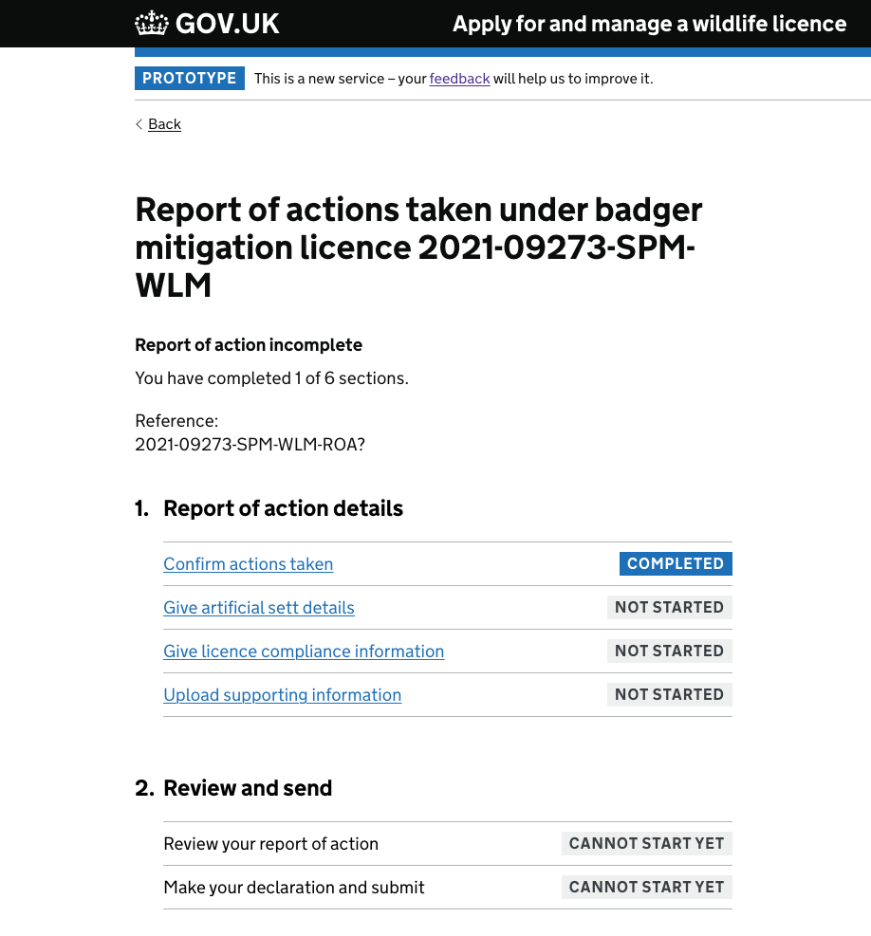
Visibility of the journey – what question is next?
Throughout the journey, the users were back and forth between the pages, some did this because:
They wanted to prepare for the next question
They wanted to see what the next question asked so they didn’t write too much in the question text box they were on (avoid duplication & unnecessary effort)
They wanted to see how much of the journey there was still left to do
Notes:
‘give artificial sett details’ felt strange to be so far down the journey and separate for the users

Slide 47
Document upload – cat pictures?
Again, the lack of context around the files was cognitive overload for users – most users stated that they would prefer to group their files with the setts they were talking about. Users were also concerned about how assessors would handle this data with no context.
Users were surprised at this point seeing ‘Upload file’ and remembered they needed to add files or ‘evidence’ for some prior questions but couldn’t remember the questions and what they wanted.
Users also stated that while it states the file type, it does not mention specifics e.g. ‘map of artificial sett’ – that was left to them to decide.
"Upload file? Well what, a picture of my cat?“ P4
Notes:
‘give artificial sett details’ felt strange to be so far down the journey and separate for the users

Slide 48
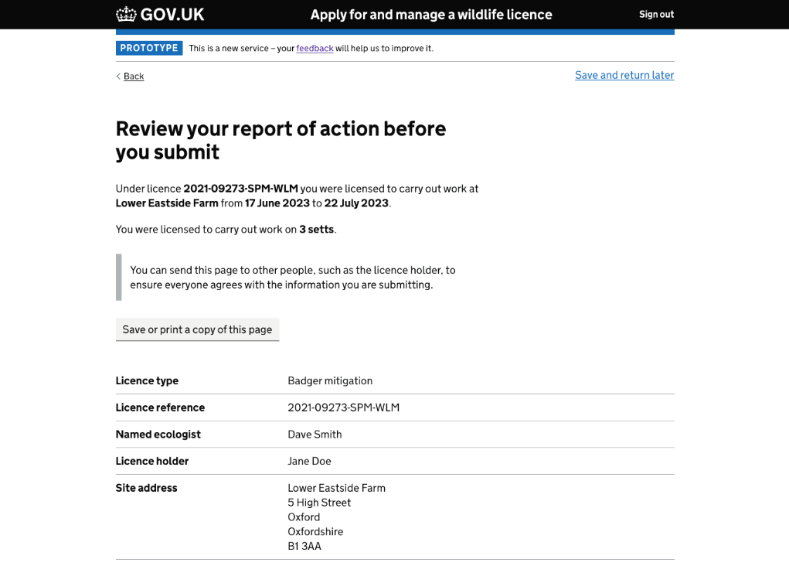
Print & share – ‘why can’t you just email it to me?’
This was a new design based on Returns 1 research which addressed our users need to share steps of this RoA, or all of it, with their client.
As part of the new design, we added in ‘save or print a copy of this page’ but there was inconsistency amongst users regarding whether they identified this and whether it was at the right part of the journey.
Our users took it one step further this time asking ‘why can’t you just email this?’ – a great example of ‘don’t make me think!’

Slide 49

Pairing up the journey

Slide 50
What do our internal users need?
It has to be clear enough in what we want them to provide. If we’re asking them for a site plan, we should tell them what scale and that it shows A, B and C.
So we often get applications that just don't give us the information we need because we haven't actually set out anywhere what it is that we do need
I think the biggest one is like you said, just having the quality of applications coming in, So you don't need to go back to the customer quite as often. I think that would massively save time.”
It all starts from the information that’s been put on the application. You have to ask the right questions in the first place.
Notes:
‘

Slide 51
Assessment recommendations – how did we do for returns?

Slide 52


Alpha assessment recommendations
Be aware of any biases that might creep into their design based on the legacy pdf service they are converting into digital
Establish exactly what personal data is needed for the service to function and remove any superfluous data currently being gathered.
The form demonstrated looked long but not cumbersome. The panel did reflect whether all data was required for relevant processing. The team need to ensure that all the data that is collected is used and is required for processing.

Slide 53
Beta workshop recommendations
Document uploads: the intention is that the service reduces the burden on NE staff to process paper submissions and answer queries around maps but if the document upload functionality isn’t simple and proven to meet user needs this may not be achieved.
Design of the internal service is shaping design of the external user journey – this approach should be reversed so that Defra are not putting the burden on users.

Slide 54

Next steps

Slide 55


What issues were resolved?
Returns journey 1 issues:
Ecologists are unsure what information Natural England need to assess a submission as efficiently as possible.
It's not clear which sett is being referred to at any one time.
Ecologists currently employ workarounds to ensure transparency for licence holders, allowing licence holders to observe completed forms and understand their legal obligations.
Ecologists keep records of forms sent to NE for audit purposes: so it is easily available within their own records, and to send to others for evidence.
Returns journey 2 issues:
We ask the user to duplicate too much, they expected to refer back to the method statement – how might we reduce the user's effort?
Users didn’t quite understand why they were being asked some things, and why it seemed as though they were being asked twice – how might we ensure we capture relevant data?
Users were uncomfortable with the flow and how it looks as though they endanger the badger – how might we mirror an ecologist's ways of working?
Language used was a grey area or unusual – how might we use language that helps users
Multiple setts out of context was a cognitive overload – how might we remove the cognitive overload from users?
Notes:
‘give artificial sett details’ felt strange to be so far down the journey and separate for the users

Slide 56

What’s next?
After discussing the user problems with the UCD team we created some ‘How Might We’ statements which look at framing the design challenge on the right problems.
We now have a lot of ‘How Might We’ broad statements that we’d like to share with the team and do some ideation together.
Hoping we can do this for Tuesday 5th December 2023 at 14:30pm – we’ll pop the time in your diary (or propose a new time)
User need statements

