Slide 1
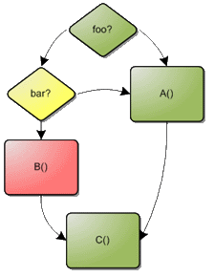
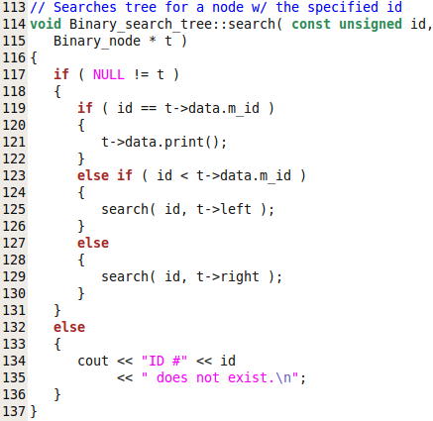
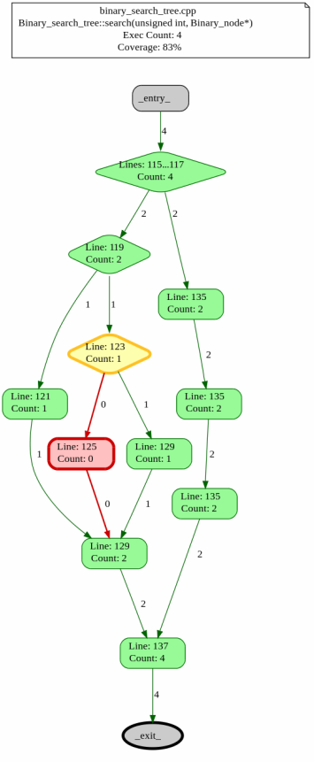
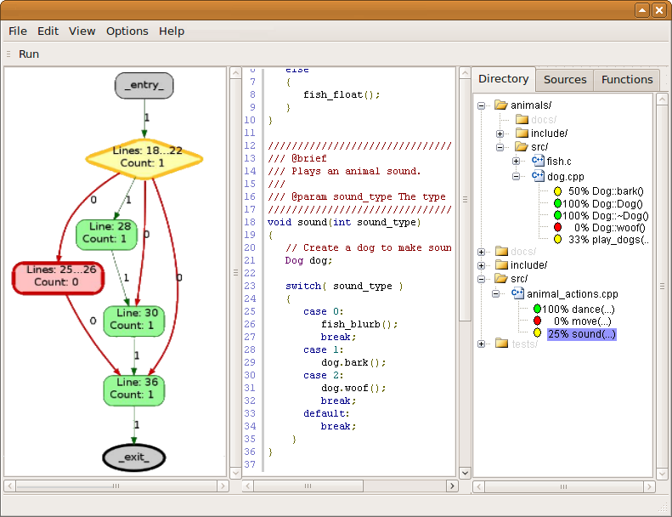

Trucov
The True C and C++ Test Coverage Analysis Tool for Schweitzer Engineering Laboratories
The Problem
If someone were to write a unit test with the goal of 90% coverage over the code, how is this 90% coverage verified? Not reaching test coverage goals can result in occurrences of untested code and may lead to error-prone software. Engineers need a standardized way to check the test coverage of functions, source files, and programs. This standardized process is Trucov.
-----------------------------------------------------------------------------------
What is Trucov?
Trucov is an open source coverage analysis tool that works with the GCC Compiler. Trucov assures quality of test cases by analyzing the branch coverage after the execution of tests.
Trucov indicates the areas of a program not exercised by a set of test cases. Trucov also displays the control flow of a program and its test coverage information.
-----------------------------------------------------------------------------------
Why use Trucov?
Trucov is a free, fast, simple and easy-to-use tool; just compile your code with the “-fprofile-arcs -ftest-coverage” flags, run your tests, and run Trucov. Trucov is available as a command line or graphical interface. Trucov generates control flow graphs of a program which gives visual understanding of test coverage to the user.
-----------------------------------------------------------------------------------
The Trucov Team
Team Members:
Ye Kyaw : Lead Programmer.
Matthew Miller : Team Lead and Architect.
William Reinhardt : Spec Writer and Lead Programmer.
Project Mentors:
Jack Hagemeister : Instructor
Nick Terry : Mentor
Key Features
Trucov is a one command / one click tool, running over a project directory, automatically finding all the source files inside the project, and producing coverage analysis on a per source, per function, and per branch level.
Trcuov detects how many times any particular block, arc, or branch of code has been executed, and converts that data into coverage reports ( text and graphical ) that engineers can easily use.
Trucov hides the coverage information of code from external libraries, unless specified by the user. The graphical reports show test coverage over the control flow graph of a program.
-----------------------------------------------------------------------------------
Command Line
Trucov offers a command line version with over seven different commands for more advanced users.
-----------------------------------------------------------------------------------
Graphical Interface
The Trucov Graphical Interface displays a functions source code and coverage graph side by side. Allowing the user to visual the test coverage over the source code.
Control Flow Graphs
Trucov can create control flow graphs that represent that paths that might be traversed during the execution of the user’s program. This is an excellent way of visualizing both the structure of a source file’s functions and also the thoroughness of a project’s unit tests.
The user can, at a glance, determine which conditions have never been satisfied and which lines of code have never been executed by use of simple color coding.
user:~/project$ trucov status Parsing gcno and gcda files ... 100% Dog::woof() no branches 0% purr (0/2) branches 50% meow (1/2) branches
-----------------------------------------------------------------------------------------------------
Code Coverage Trucov can generate a coverage report with information per source file which offers another way for the user to easily verify the code coverage of the functions contained within. Besides the summary information of each function, Trucov can additionally alert the user of any branches and lines of code that were never executed. Trucov reports the missing branch and destination information while also providing the exact line number and associated content of the source file.
100% Binary_search_tree::make_empty() no branches
83% Binary_search_tree::search(unsignedint, Binary_node*) (5/6) branches
binary_search_tree.cpp:122: 1/2 branches: else if ( id <t->data.m_id )
binary_search_tree.cpp:124: destination: search( id, t->left );
100% Binary_search_tree::is_empty() const no branches
83% Binary_search_tree::insert(Student const&, Binary_node*&) (5/6) branches
binary_search_tree.cpp:38: 1/2 branches: else if ( student.m_id>t->data.m_id )
binary_search_tree.cpp:44: destination: cout<< "Student ID #" <<student.m_id
100% Binary_search_tree::search(unsignedint) no branches
0% Binary_search_tree::maximum() const (0/2) branches
binary_search_tree.cpp:140: 0/2 branches: if ( ! is_empty() )
binary_search_tree.cpp:142: destination: const Binary_node * node = maximum( max
binary_search_tree.cpp:147: destination: cout<< "The tree is empty.\n";
100% Binary_search_tree::print_preorder_traversal(Binary_node*) (2/2) branches
50% Binary_search_tree::print_preorder_traversal() (1/2) branches
binary_search_tree.cpp:198: 1/2 branches: if ( ! is_empty() )
binary_search_tree.cpp:204: destination: cout<< "The tree is empty.\n”;

