Slide 1
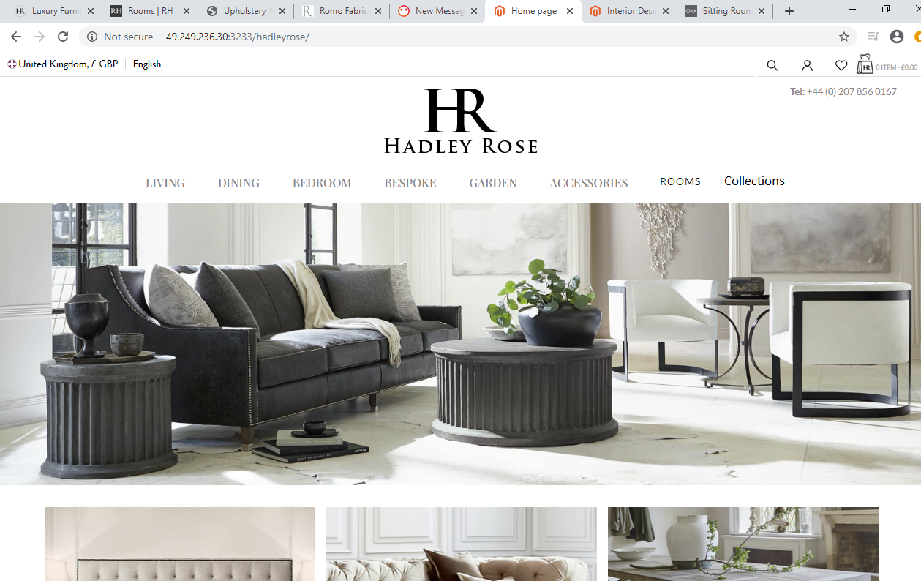

Removed blog and replaced with Collections. See https://www.hadleyrose.co.uk/view-collections/
Removed Range and replaced with Rooms. See below for layout and functionality inspo.. https://www.restorationhardware.com/rooms/?sale=false
Removed Previous Content and replaced with Language select
Removed Previous Content and replaced with currency select. See below functionality link https://www.net-a-porter.com/au/en/

Slide 2
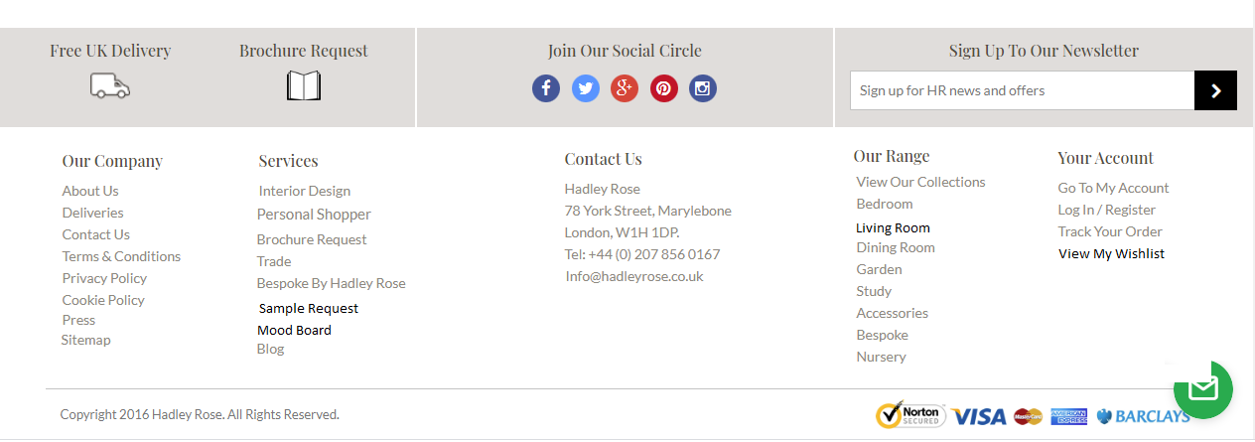
Changed layout here – please keep all columns central
“Personal Shopper” was removed by you, so ive added it again.
Contact Us – Have removed some of the content here and repositioned it. Please make sure this is central to the page
Mood Board Link For new Feature
Changed wording from sitting room to Living Room.
Added “View my Wishlist” this is for the new functionality.
Moved “Press” to this column
Sample Request Link for new functionality. I will provide page design for this

