Slide 1
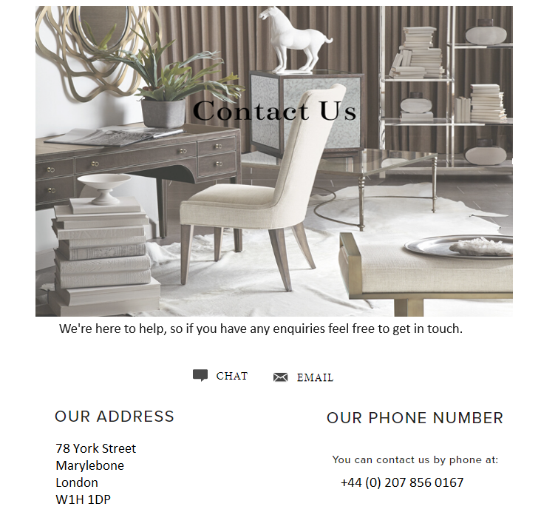
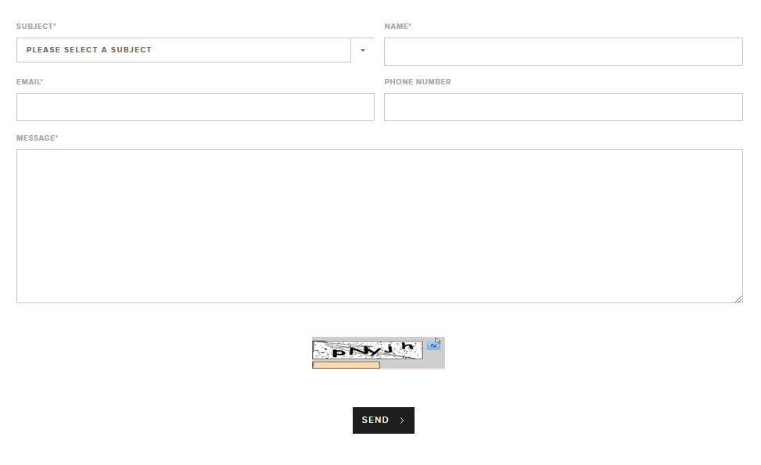
Contact us page design
Sorry for some reason this text was missing in the file we sent through.
Our Customer Service Team are based in London and our
contact hours are 9am–6pm GMT Monday to Sunday.
If you have a query outside of our office hours, please feel free to email us at customerservices@hadleyrose.co.uk or fill in the contact form below.

Slide 2


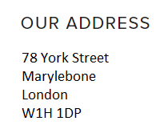
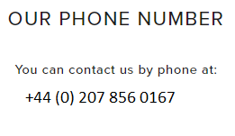
Chat icon when clicks brings up the messenger for live chat
Please smarten all this text up. Please make sure website fonts and colours are used here for all the text on this page. All fonts and colours should be consistent throughout the website
We're here to help, so if you have any enquiries feel free to get in touch.
Email icon when clicked takes the user to his email with customerservices@hadleyrose.co.uk entered automatically
Contact number clickable for mobile users.

Slide 3
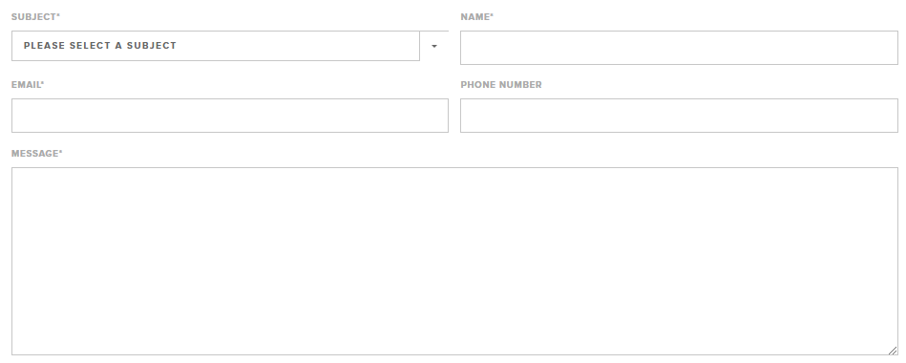
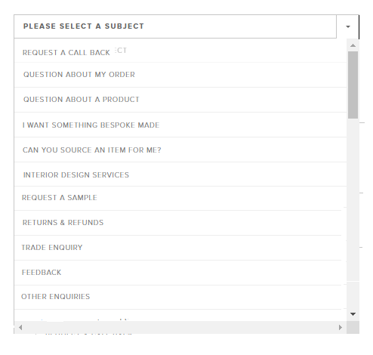
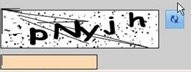

* (this is a required field.
Please copy the drop down options provided for this section

