Slide 1
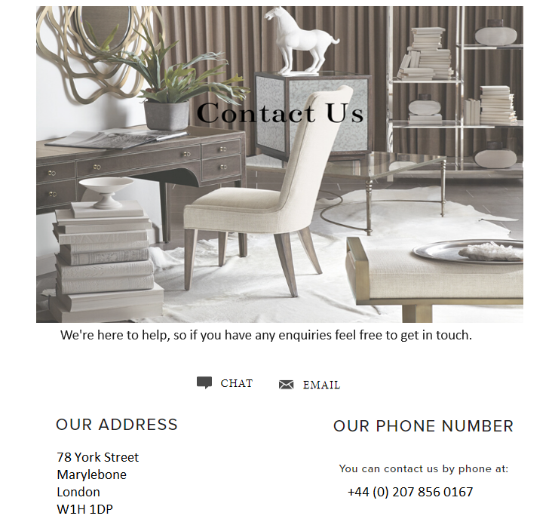
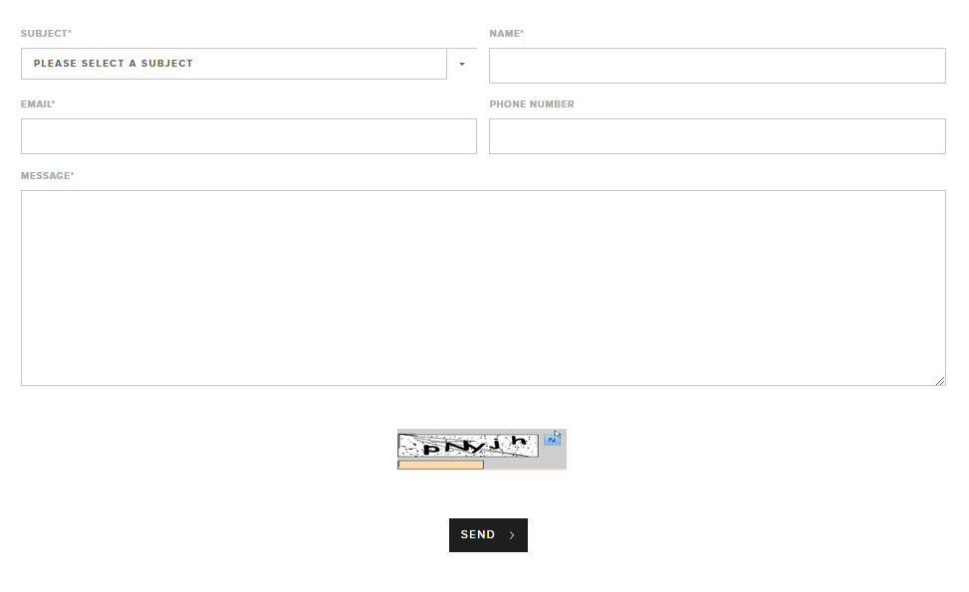
Contact us page design

Slide 2



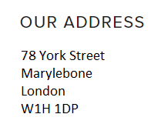
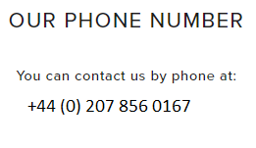
Please centralise this page.
Large image
Chat icon when clicks brings up the messenger for live chat
Please smarten all this text up. Please make sure website fonts are used here for all the text on this page.
We're here to help, so if you have any enquiries feel free to get in touch.
Email icon when clicked takes the user to his email with customerservices@hadleyrose.co.uk entered automatically
Contact number clickable for mobile users.

Slide 3
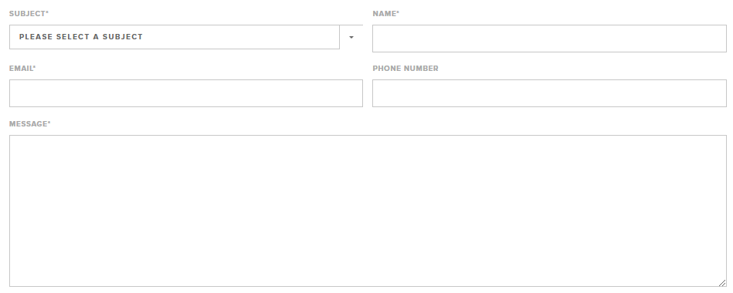
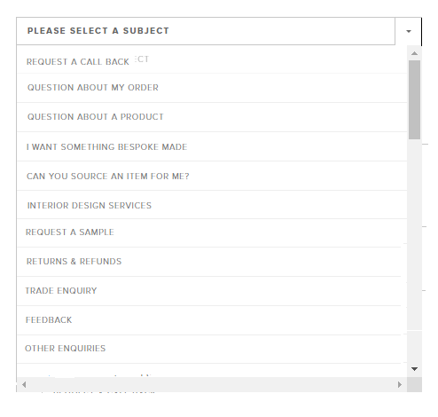
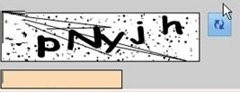

Please copy the drop down options provided for this section

