Slide 1
Indian Traffic Sign Recognition
Arun Nandewal, 2nd Year,
B.Tech (CSE), NIT Surathkal
K Siddharth Kannan, 1st Year,
Dual Degree (Biotechnology), IIT Kharagpur.

Slide 2
Problem Statement
Detect the traffic signs on both sides of the road, recognize and classify them. Then, give useful information to the driver regarding the meaning of the sign and the traffic rules to be followed.

Slide 3
Procedure followed
Image Procurement
Preprocessing (Enhancement, Dilation, Erosion, Thresholding)
Detecting the region of interest (using YCbCr Color Space and Blob Detection)
Submitting these features to a neural network for classification
Extraction of features from this blob

Slide 4
Tools Used
Matlab: As programming Environment
Image Processing Toolbox (Matlab)
Neural Network Toolbox (Matlab)

Slide 5
Step 1: Procurement
Images may be procured from a continuously running camera fixed on the top of the vehicle.
For testing purposes, a database of images was downloaded from the internet.

Slide 6
Step 2: Pre-processing
Dilation: It is the morphological operation which probes the image using a structuring element and expands the shapes that are contained in the image
Erosion: It is the morphological operation which probes the image using a structuring element and reduces the edges of the shapes that are contained in the image.
Enhancement using non-linear Lucy-Richardson Filter.(Not yet implemented)
Notes:
Find out the definitions of dilation and erosion and update here

Slide 7
Step 3: Detecting the region of interest
We convert the image into the YCbCr color space, which we will be using for color segmentation.
Once the image is in the YCbCr color space, the red and the blue components of the image are extracted and stored in two different matrices.

Slide 8
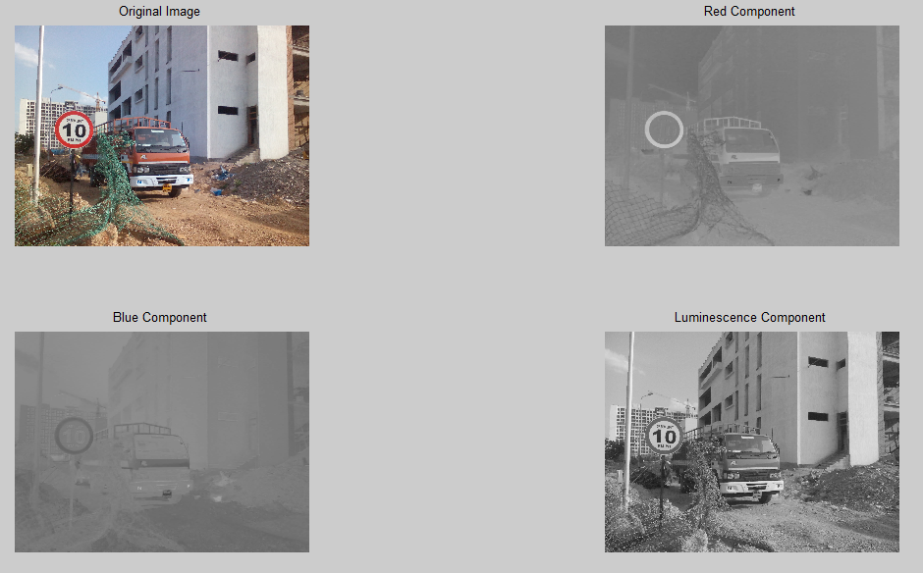

Slide 9
More About Road Signs
There are 4 types of road signs
- Compulsory/Prohibitory
- Warning
- Regulatory
- Informatory (Out of the scope of this project)

Slide 10


Compulsory Signs
Compulsory signs are circles with RED border, WHITE background, and BLACK text/image.
Image Courtesy: Delhi Traffic Police Website

Slide 11


Warning Signs
Warning signs are Triangles with RED border, WHITE background and BLACK text/image.
Image Courtesy: Delhi Traffic Police Website

Slide 12


Regulatory Signs
Regulatory Signs are BLUE circles with a WHITE arrow within.
Image Courtesy: Chandigarh Traffic Police Website

Slide 13
Step 3: Region of Interest
Once the image is in the YCbCr color space, and we have the red and the blue components, we start blob detection.
During the process of blob detection, parts of the image that are connected and satisfy a particular criteria (minimum area, minimum pixel value etc) are extracted.

Slide 14
Step 3: Region of Interest
We find the bounding rectangle of this region and then extract this region from the main image (input from the camera)
We find that this image, has the traffic sign without any of the noise around it. (backgrounds, cars etc).
This part of the original image is the output of step 3.

Slide 15
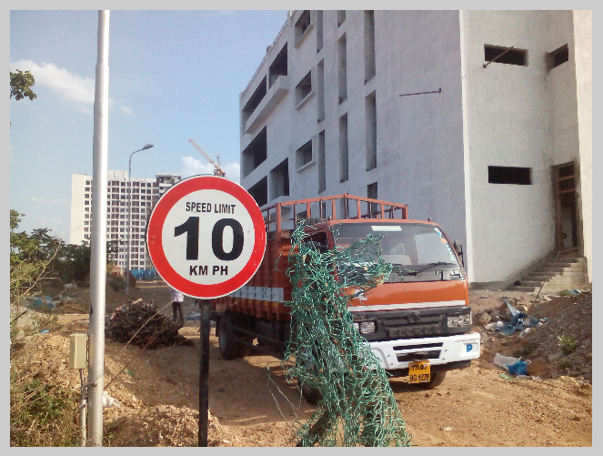
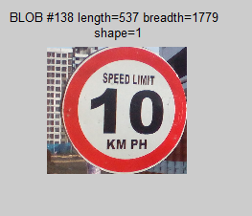
This is the blob that is extracted up to now. As seen below, the truck, building etc, have been removed and we have the image that is ready to be submitted to the neural network

Slide 16
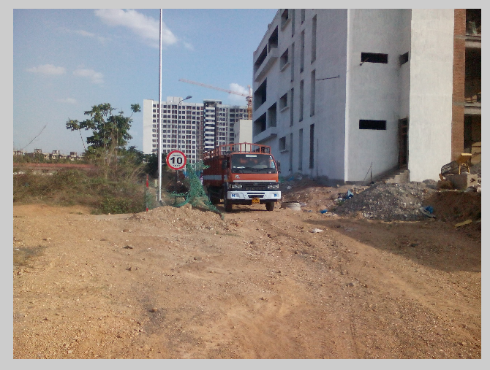
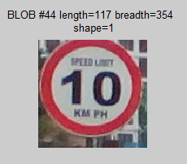
Another example

Slide 17
Until now…
Take the input image
Transfer it to the YCbCr color space
Apply blob detection on the red and blue components
Using this component, we find the “bounding box” of the blob that contains the traffic sign.
Now using this bounding box, find a rectangle from the main image.
We have segmented the traffic sign from an image which had noise (background, cars etc)

Slide 18
Moving on...
Once we have the region of interest, we can proceed in two directions to find the shape.
Use correlation and some stored images of triangles and circles and find the shape, by getting which shape has the maximum correlation coefficient
Train a neural network using images of triangles and circles and all the road signs, and then use this neural network to classify the extracted blob in one of the shapes.

Slide 19
Further classification
Once we have found the region of interest in the input image and found the shape of the image, then we will immediately get the class of the image (compulsory, warning, etc);
Now, in the further steps, we go for further classification into the exact sign that the image represents (“road narrows”, “speed limit”, etc)

Slide 20
Step 4: Feature Extraction
We take the extracted blob as the input image for this step.
Changing the threshold value of the blob and the minimum area of all the blobs that we want to extract, we apply the blob detection operation on the output of the previous step.

Slide 21
Step 4: Feature Extraction
Once we have the blob, we resize it to a 25x25 image using the inbuilt `imresize` function.
After this we take 5x5 submatrices within this 25x25 image and take the mean of all the pixel values in this submatrix. This is one of the features that we will submit to the neural network.
Using this technique we get 25 features, as a column vector, for each image.

Slide 22
Step 5: Neural Network
Now, we have a column vector containing of 25 features of the image that we are considering.
We have already trained the neural network with images that fit our description, by extracting similar features from them and then, using the `nntool` Tool from Matlab (R2009)

Slide 23
More about the Neural Network being used
We are using a feed-forward back propagation neural network with two hidden layers.
Tentatively, we have three classes of input images. This can be easily changed. From here onwards, we will assume that we have three classes of images.
We will be using three matrices throughout: the input matrix, the target matrix and the output matrix

Slide 24
Matrices used in the neural network
input matrix: This is the matrix that has the features of the dataset of images used for training the neural network.
target matrix: This is the matrix that is used for telling the neural network to which class each of the image belongs to.
output matrix: This is a row vector that consists of coefficients ranging from 0 to 1.
Notes:
Find out what the output matrix of the neural network in matlab means. And then update slide 21 and this slide.

Slide 25
1. input matrix
The input matrix for the neural network has the dimensions:
No. of features per image
No. of images used

Slide 26
2. target matrix
The target matrix has the dimensions:
The target matrix is such that, if the value in the ith column is 1 for the jth row, then the ith image in the final dataset belongs to the jth class.
No. of classes of images
No. of images

Slide 27
2. target matrix
Let the target matrix be:
target = 1 1 0 1 0 0
(2x6) 0 0 1 0 1 1
This matrix signifies that the first, second and fourth image belong to the first class. Whereas the third, fifth and sixth images belong to the second class.

Slide 28
3. output matrix
The output matrix has the dimensions:
The output matrix is a row vector that consists of coefficients in the range 0 to 1, such that the closer a coeffecient is to 1, the higher is the probability of the input feature set being a part of that class.
No. of classes of images
1

Slide 29
Step 5: Neural Network
Depending on the output of the neural network, we can classify the image.
We will have the exact meaning of the road sign too (“two way”, “road narrows”, etc)

Slide 30


Limitations
Traffic signs with two independent components
Traffic signs with obstruction
Solved!
Problems faced when dealing with real-world images
Low neural network output coefficients (0.05, 0.12 etc)
Feature Set
Selection of red or blue component as the required component

Slide 31
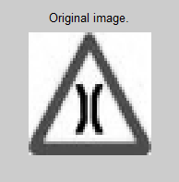
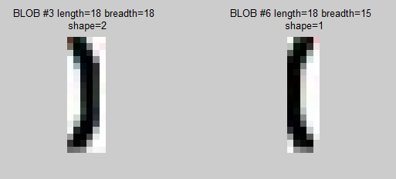
1. Signs with Separate Components
When we do the “blob” detection for such images we get two separate blobs with the two components.
Concatenating these two arrows is not an option as then we would lose the spacing between the arrows. And as the neural network is trained with features from an image where the spacing is different, correct classification is not consistent.

Slide 32
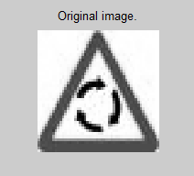
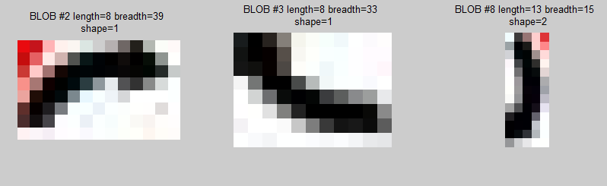
1. Further complications
This problem is even more prominent in the following case.

Slide 33
2. Obstruction
Prohibitory signs always have a red circle with a red line cutting across the circle.
Due to this phenomenon, we get two separate blobs at step 4. And we are unable to find how to fill out the empty space between the two blobs.
Tried: Filling it with a block of black pixels. But this results in us losing the shape of the object behind the obstructing line. Due to this, the neural network does not give desirable results (coefficients as low as 0.04, 0.02 etc)

Slide 34
2. Obstruction: Solution
Instead of trying to find what is there behind the line, we train the neural network to recognize the features on the two sides of the line.
And when we get the input image, we extract the same features from the image and then, give these as input to the neural network.

Slide 35
3. Regarding the component that has the data that we need
Once we extract the blobs from both the red and the blue components, we will notice that one of the two components will give us the blob that we are looking for.
But we are unable to select this component on the basis of the blobs that are detected.

Slide 36
Detected using the blue component of the original image.

Slide 37
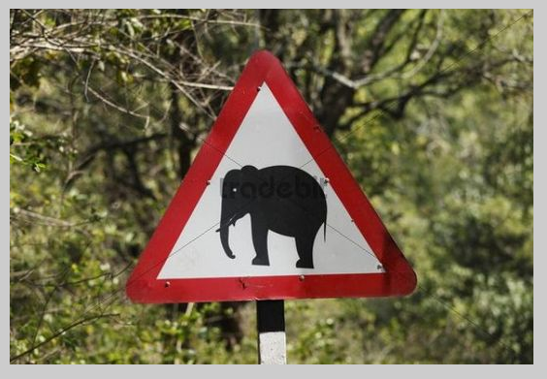
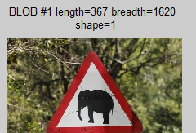
Whereas…
Detected using the red component of the original image.

Slide 38
4. Output Vector of Neural Network
Values in the output vector are doubles from 0 to 1.
The closer the value is to 1, the higher is the match obtained by the neural network.
Sometimes, these values are as low as 0.043 for a correct match.
Due to this, we are unable to give a hard threshold below which we may classify all values as a “wrong” match.

Slide 39
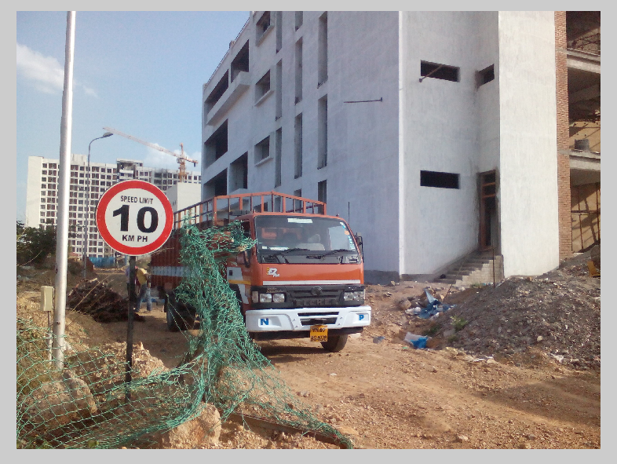
5. Inconsistency with real world images
In this image, as the border of the traffic sign is pretty close to the orange truck, the sign is not detected at all, at the region of interest step.

Slide 40
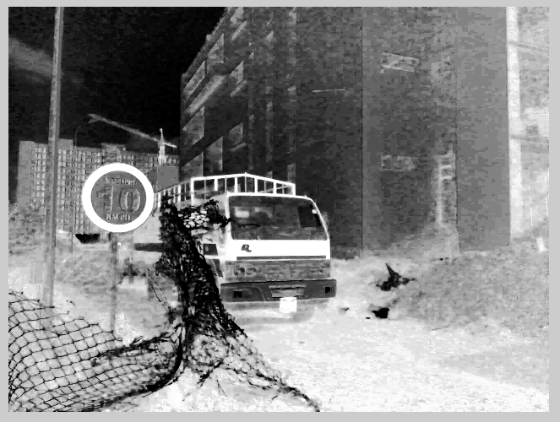
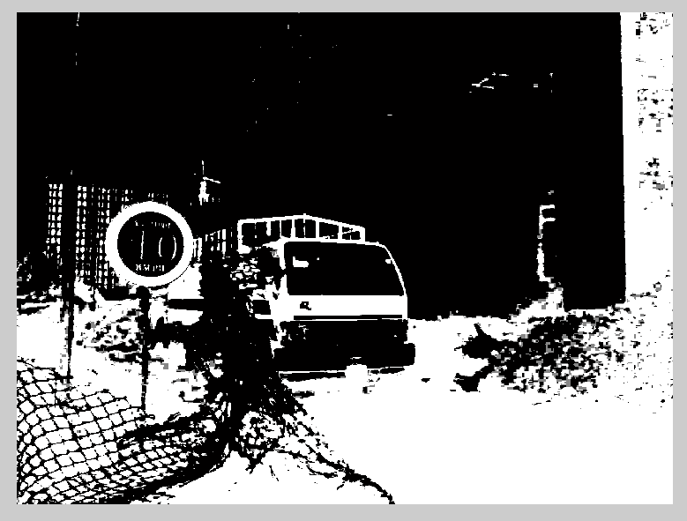
Problems with thresholding
Although the circle is
visible to us,
the threshold is too
low too partition the image properly.
After thresholding and conversion to binary image, using Otsu thresholding, the circle is completely lost, Due to the white part next to it.

Slide 41
Proposed Changes

Slide 42
System of Neural Networks
Instead of one neural network, we propose to use two neural networks.
One neural network for detecting the shape of the traffic sign that has been segmented
Another neural network for detecting the sub-class of the traffic sign that has been segmented

Slide 43
Neural Network 1 (For shape classification)
Using edges instead of the image, for extraction of features

Slide 44
Feature Set
The information about the shape of the traffic sign, that has been segmented, is captured in a more detailed manner in the edge information.
So, we propose to extract the features of the input image for neural network from the edges of the segmented sign, rather than from the sign itself.

Slide 45


Feature Set: Size of Image
We propose to extract features from a 100x100 image, as this shows the edges clearly, as compared to 25x25 as in the paper.
25x25 image
100x100 image

Slide 46
Feature Set: Results
The results are better for this new method.
Although, some images which were working with the earlier method are not working with this new method, the edge data is unique, and this reduces the possibility of mis-classification considerably.

Slide 47
Neural network 2 (for further classification)

Slide 48
Neural Network 2
This will go into the top-level classes of warning, compulsory etc like “vehicles prohibited”, “silence zone”, etc.
Although, exact classification of sign (i.e. The exact meaning of a sign) can’t be extracted without a much more complex approach, we can divide it into sub-classes, with a slightly improved approach.

Slide 49
Classification Chart
Neural Network
Warning
Regulatory
Compulsory
Prohibitory
Non-Prohibitory
Vehicles
Arrows
Human
Others

Slide 50
Limitations with new approach

Slide 51
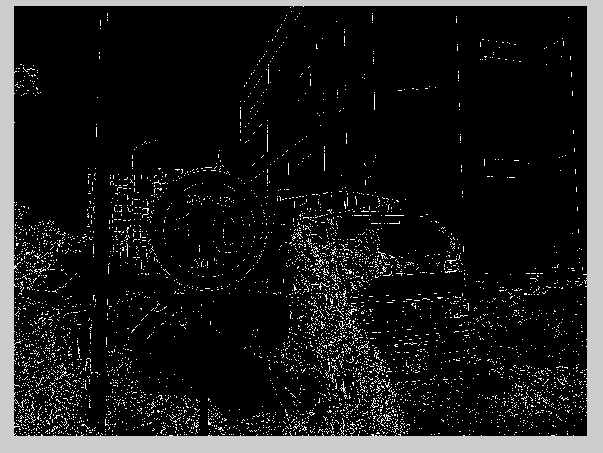
Incomplete edges

Slide 52

After extraction of blob…
This is
mis-classified as a triangle, if directly used.
If the image is sharpened using a high pass filter, then it is mis-classified as a prohibitory sign.

