Slide 1
Proposed Changes

Slide 2
System of Neural Networks
Instead of one neural network, we propose to use two neural networks.
One neural network for detecting the shape of the traffic sign that has been segmented
Another neural network for detecting the sub-class of the traffic sign that has been segmented

Slide 3
Neural Network 1 (For shape classification)
Using edges instead of the image, for extraction of features

Slide 4
Feature Set
The information about the shape of the traffic sign, that has been segmented, is captured in a more detailed manner in the edge information.
So, we propose to extract the features of the input image for neural network from the edges of the segmented sign, rather than from the sign itself.

Slide 5


Feature Set: Size of Image
We propose to extract features from a 100x100 image, as this shows the edges clearly, as compared to 25x25 as in the paper.
25x25 image
100x100 image

Slide 6
Feature Set: Results
The results are better for this new method.
Although, some images which were working with the earlier method are not working with this new method, the edge data is unique, and this reduces the possibility of mis-classification considerably.

Slide 7
Neural network 2 (for further classification)

Slide 8
Neural Network 2
This will go into the top-level classes of warning, compulsory etc like “vehicles prohibited”, “silence zone”, etc.
Although, exact classification of sign (i.e. The exact meaning of a sign) can’t be extracted without a much more complex approach, we can divide it into sub-classes, with a slightly improved approach.

Slide 9
Classification Chart
Neural Network
Warning
Regulatory
Compulsory
Prohibitory
Non-Prohibitory
Vehicles
Arrows
Human
Others

Slide 10
Limitations with new approach

Slide 11
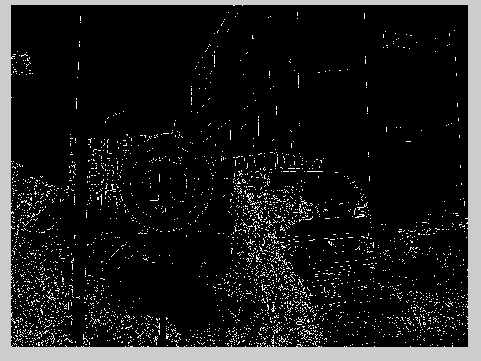
Incomplete edges

Slide 12

After extraction of blob…
This is
mis-classified as a triangle, if directly used.
If the image is sharpened using a high pass filter, then it is mis-classified as a prohibitory sign.

