Slide 1
App UI components
Tabs
Dialogs
Widgets
CBPF:
Contour plane > convert to polar
/tabs
/dialogs
/widgets
Multiple uploads
function()
data
Class/.js
this.$el.querySelector
Adjust parameters
Plot

Slide 2
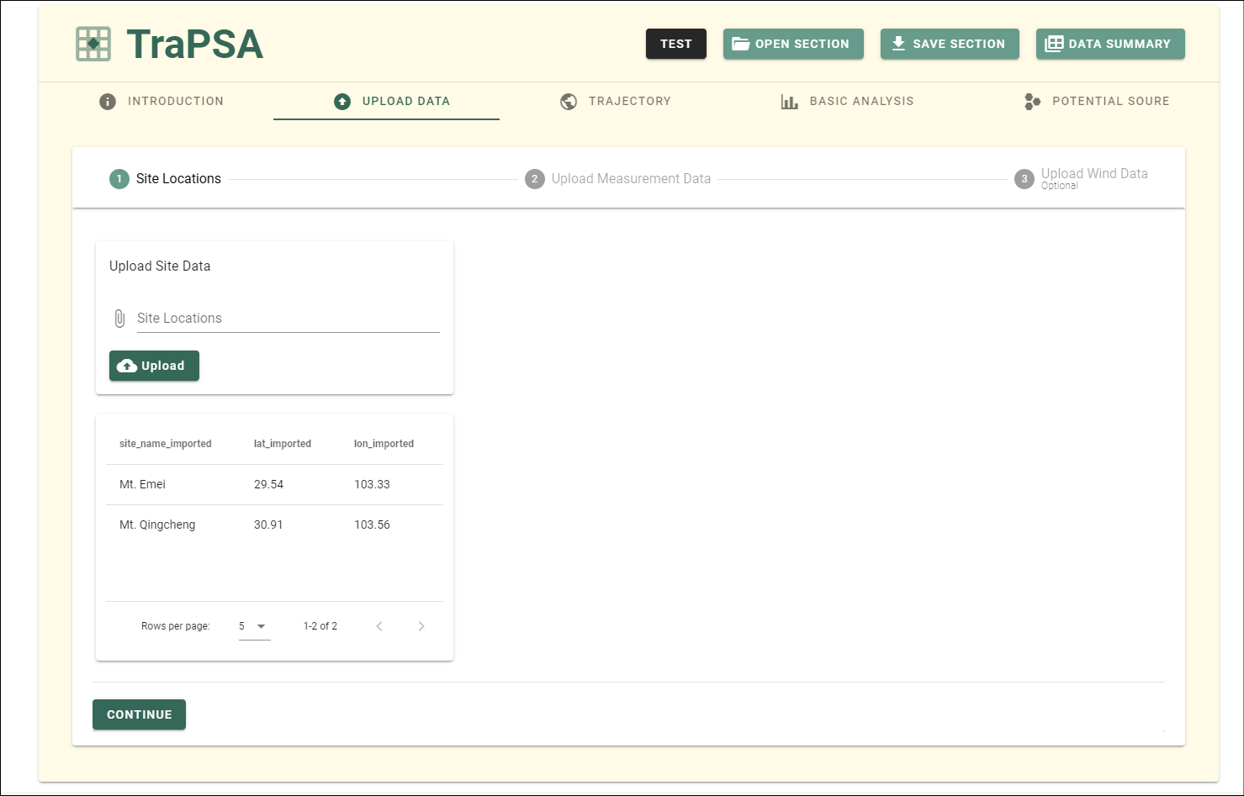
(*) Showing data base
/dialogs /DataView.vue
Show message on top, app_data.ui_control.snackbar
open_section()
save_section()
test()
/dialogs/Message.vue
Show mete data types and download url, app_data.ui_control.mete_dialog
/tabs/About.vue
/tabs/Upload.vue
/tabs/Trajectory.vue
/tabs/Analysis.vue
/tabs/Source.vue
/dialogs /MetedataDialog.vue
Show mete data file required, app_data.ui_control.mete_required
/dialogs /MeteDataRequired.vue
/dialogs /FigureView.vue
(*) Show figure detail
/dialogs /CaseSelect.vue
(*) Selecting new cases

Slide 3
/tabs/About.vue

Slide 4
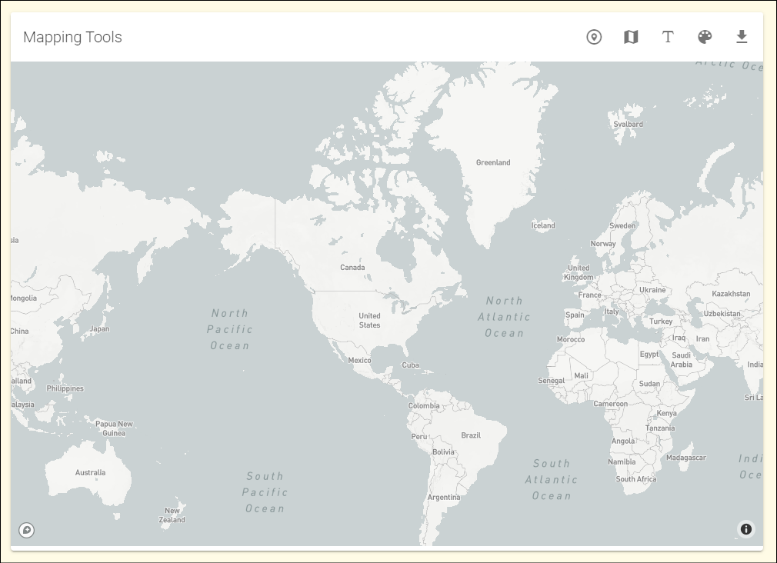
tool_buttons
/widgets /MapCard.vue
button_not_used
card_height"
Class Mapping Mapping.js

