Slide 1

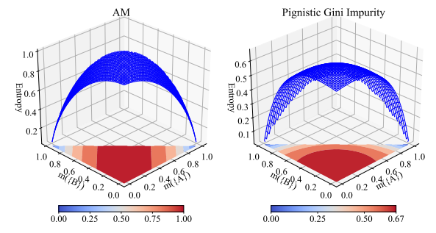
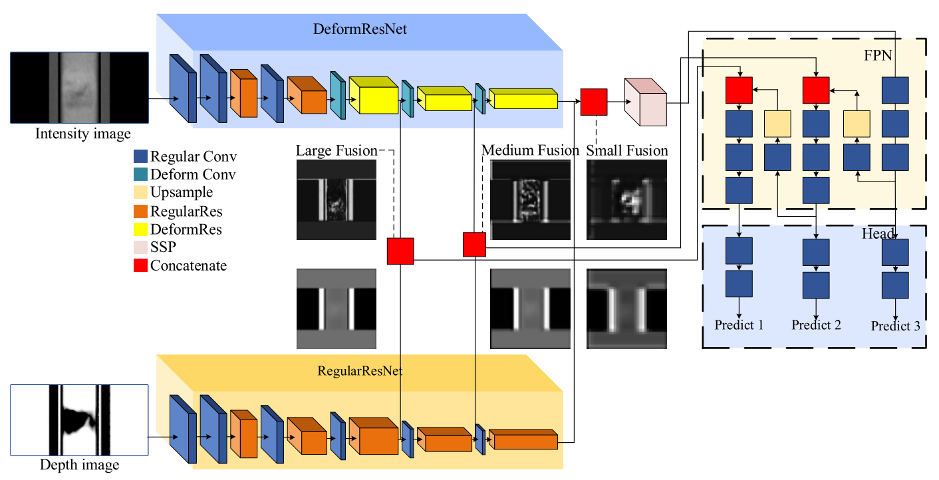
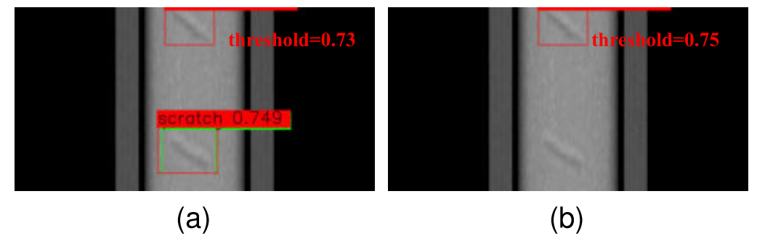
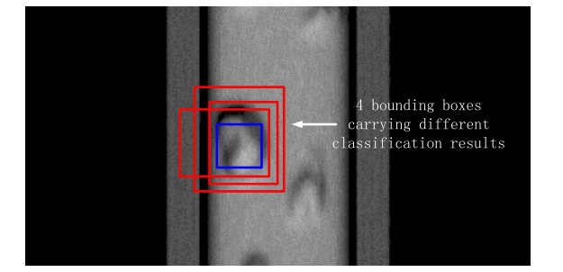
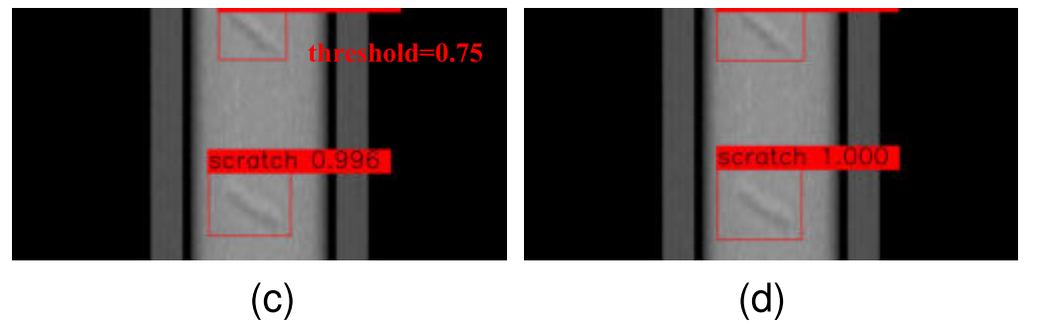
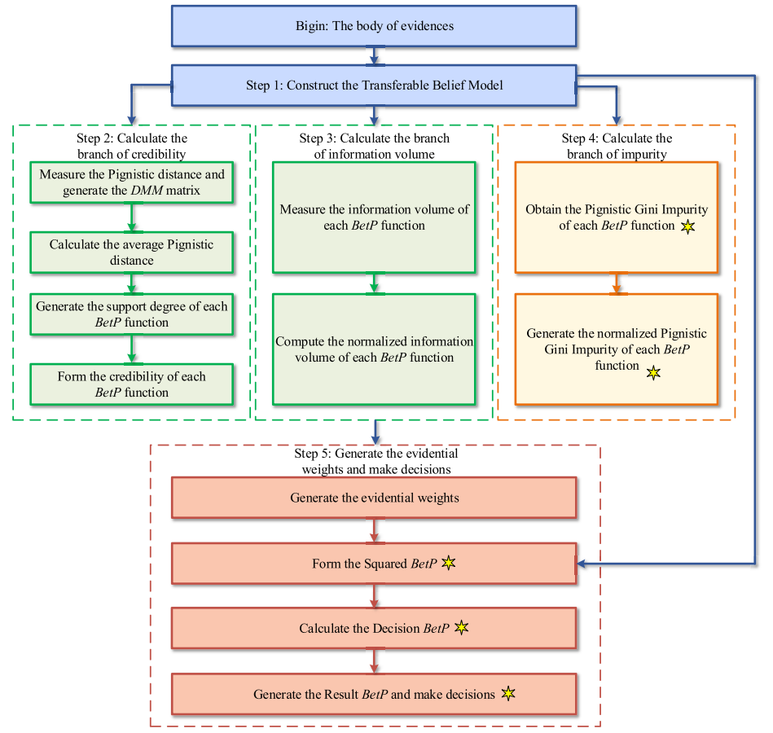
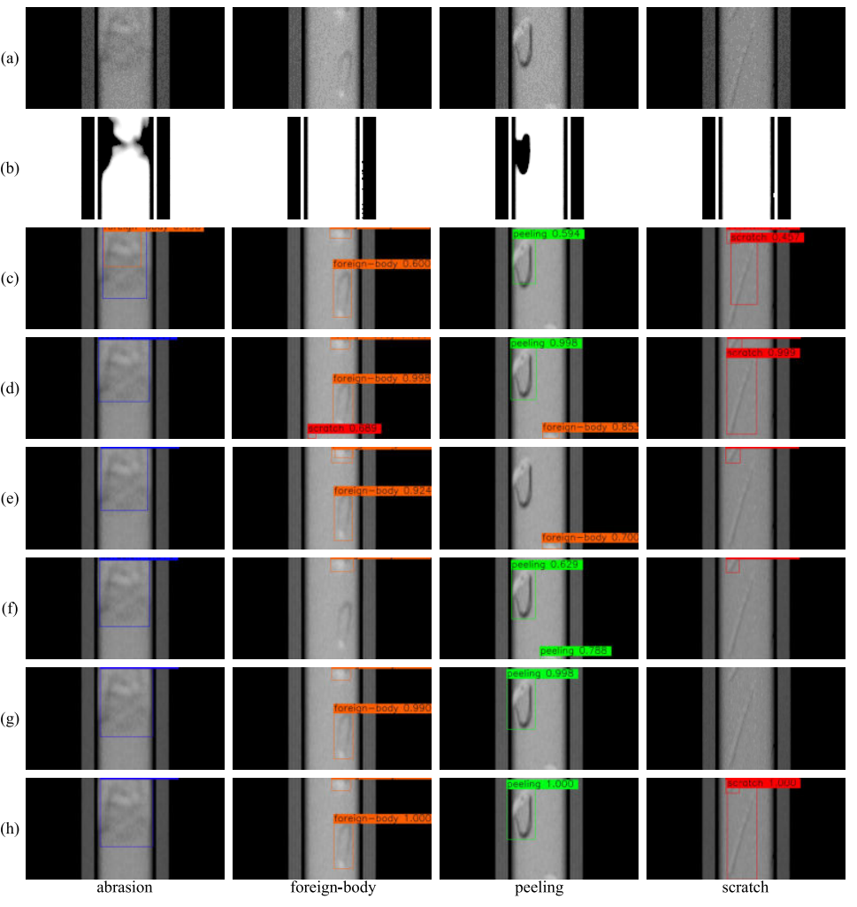
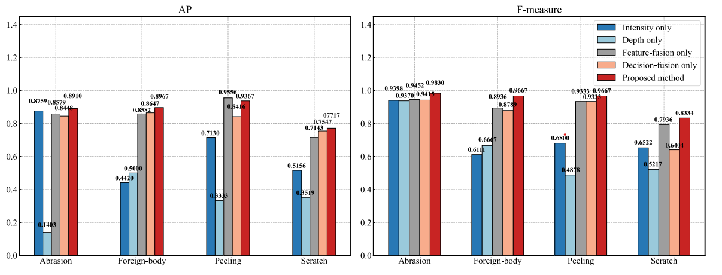
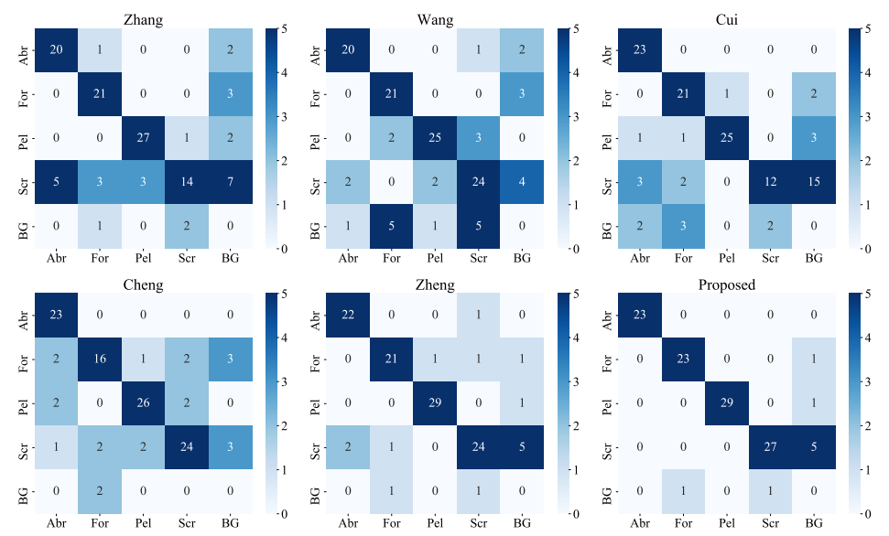
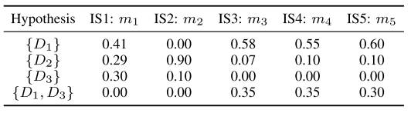
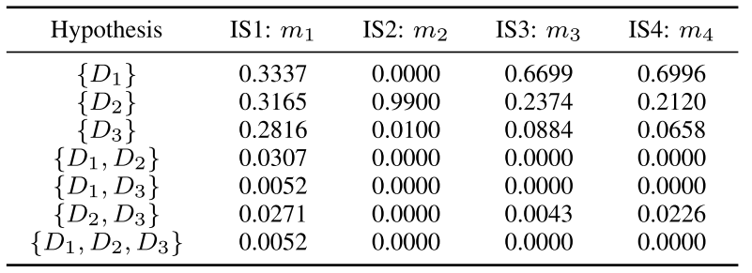
Rail Surface Defect Detection Through Bimodal RSDINet and Three-Branched Evidential Fusion
Jiaxu Zhang*, Jiong Zhang†, Jiejun Chen*, Shengchun Wang #, Liang Wang*
*SECE, Sun Yat-sen University, China †CS, Civil Aviation University of China #IIRI, China Academy of Railway Sciences
Abstract: Current state-of-the-art (SOTA) intensity and depth modal-based railway surface defect inspection systems face the dilemma between a false alarm and miss detection. To overcome this challenge, a bimodal detection scheme using both feature-level fusion and (evidence theory-based) decision-level fusion is designed. Moreover, an improved evidential fusion algorithm is proposed, which adopts a three-branched evidential weight structure and introduces the Transferable Belief Model to the improved decision functions, achieving outstanding performance on effectiveness and robustness analysis. Both theoretical justifications and experimental results validate the efficiency of the hybrid fusion-based detection scheme in solving rail surface defect problems.
DOI: 10.1109/TIM.2023.3253895
1. Introduction
2. The Proposed Model
A new belief impurity measure named Pignistic Gini Impurity is also proposed to overcome the insufficient inspection of evidence conflict. As the third weighting branch, the new measure can be deemed as the supplement of the second branch, the entropy branch.
1.1 The dilemma between “false alarm ” and “miss detection”
In real bimodal rail surface defect detection, it is found that adopting a lower threshold of detection confidence helps detectors avoid miss detection, but a high rate of false alarms emerges. But if a lower false alarming rate is expected, a higher threshold of detection confidence must be chosen, which then runs the risk of miss detection, so this is a dilemma. Fig. 1 illustrates this main obstacle, where (a) and (b) present two detection results with a lower and a higher detection threshold, respectively, both of which are unsatisfying. Especially, when the falsely classified bounding box yells the largest detection confidence, it is difficult to remove it through detection confidence threshold filtering.
2.1 Feature-level fusion
The proposal applies RSDINet to extract the features of intensity and depth modals via three scales of feature-level fusion. The full network structure has been presented in Fig. 2. This network is set to avoid miss detection as much as possible.
Fig. 4. The proposed Pignistic Gini Impurity.
2.3 Postprocessing
As exemplified in Fig. 5, filter the redundant boxes with NMS (the confidence score of boxes has been reassigned) and the leftover will carry the fused decision (i.e. the classification result).
Fig. 2. The network structure of RSDINet.
2.2 Decision-level fusion
Then we choose such a strategy for decision-level fusion: we set a low threshold for NMS, and fuse the decisions of remaining bounding-boxes with an improved three branched fusion. We additionally appended an impurity branch to improve the fusion model’s robustness against evidence conflict. This fusion has been shown in Fig. 3.
Fig. 5. the exemplified postprocessing.
3. Results
Fig. 1. Illustrating instance of (a) false alarming with detection thread being 0.73 and (b) miss detection with detection thread being 0.75. (c) Refined detection via evidential fusion. (d) True bounding box..
1.2 The counter-intuitive results of Dempster’s combination rule
Even though the Dempster’s combination rule is one of the essential components of the evidence theory, when the evidence conflict occurs, a phenomenon named “one-vote veto” may bring about counter-intuitive decision-level fusion results. Table I and II are two examples of evidence conflict.
Table I. The evidence conflict carried by IS2.
Table II. The evidence conflict carried by IS2.
References
J. Zheng et al., An inspection method of rail head surface defect via bimodal structured light sensors, Int. J. Mach. Learn. Cyber., vol. 21, Dec. 2022.
J. Zheng et al., Lightweight bimodal rail surface defect detection method: Parallel-YOLOv4-Tiny, in Proc. 5th Int. Conf. Video Image Process., Dec. 2021, pp. 22-25.
D. Li, Y. Deng, and K. H. Cheong, Multisource basic probability assignment fusion based on information quality, Int. J. Intell. Syst., vol. 36, pp. 851-875, Apr. 2021.
C. Zhu and F. Xiao, A belief Hellinger distance for D-S evidence theory and its application in pattern recognition, Eng. Appl. Artif. Intell., vol. 106, Nov. 2021, Art. no. 104452.
Acknowledgements: Thank China Academy of Railway Sciences for their data and experimental environments.
Fig. 3. The proposed three-branched decision-level fusion.
* Please contact zhangjx283@mail2.sysu.edu.cn for further information.
Published in IEEE Transactions on Instrumentation and Measurement, Vol. 72, 2023

