Slide 1
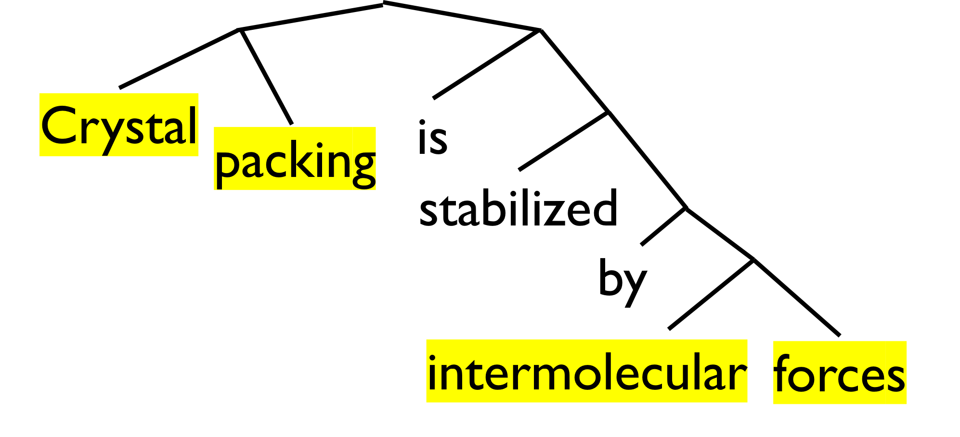
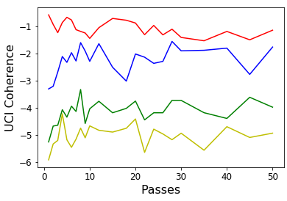
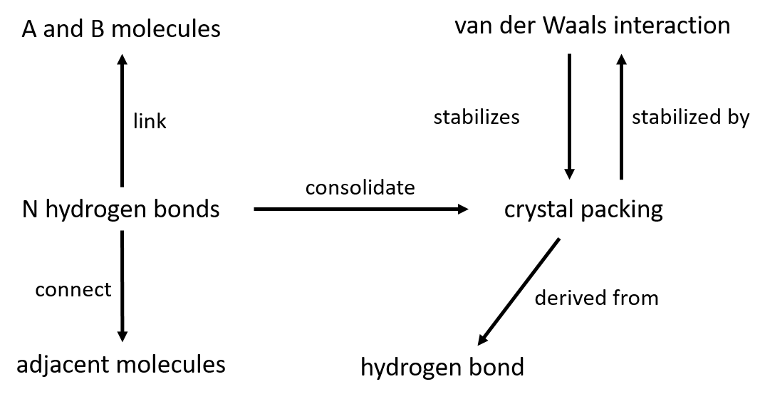
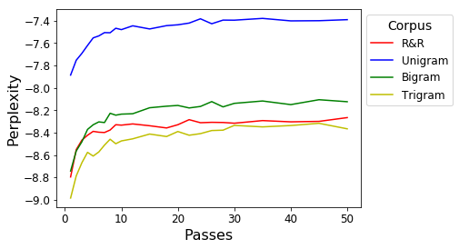
Envisioning Corpora:
Root & Rule Infrastructure for Semantic Web and Topic Modeling
Peter Zhang and Dr. T. N. Bhat
Biosystems and Biomaterials Division, NIST Material Measurement Laboratory
Motivation
Over 2.5 million papers were published in 2018, a rate that is increasing each year
Analyses of groups of documents, or corpora, can reveal trends, relations, and themes
Machine learning approaches struggle to achieve cross-domain efficacy
Background
We deploy a novel natural language processing approach called root-and-rule (R&R)
R&R is inspired by Sanskrit: sentences are built up with rules from a root term
We have designed a framework for extracting R&R terms from sentences of any language
Crystal packing is stabilized by intermolecular forces
R&R Processing
R&R deconstruction of an English sentence
Method
Semantic Web is premised on RDF, a relational data structure on subject-object-predicate triplets
Treating R&R terms as potential subjects and objects, we design a Python script to extract triplets
We compile and clean four corpora (R&R, unigrams, bigrams, and trigrams) and preprocess with TF-IDF
Latent Dirichlet Allocation (LDA) assumes documents are “mixes” of topics and adjust topics to better explain the corpus
First, we measure the UCI coherence score, which denotes how well the terms within a topic cohere with one another
Second, we measure the perplexity, which denotes how well the topics account for the corpus.
Original Sentence
NLTK and WordNet
Linking Verbs
Preposition List and Conjugators
Predicate Phrase
Search Between R&R Terms
RDF Triplet
Automated extraction of triplets
The standard approach to topic modeling is Latent Dirichlet Allocation (LDA), which assumes documents are “mixes” of topics and aims to adjust topics to better account for the corpus
LDA is limited since the user must pre-specify the number of topics; we design an algorithm that infers the number of topics, called Cyclic-LDA
Raw Corpus
Parsing and TF-IDF
LDA
Tentative Topics
Compile
All Topics
Results
In less than a minute, the triplet-building program generated 5585 from a corpus of 1233 crystallography papers
From these triplets, we were able to generate a compact and meaningful Semantic Web
Corpus
Training requires approximately 5 seconds per pass
As the models converge, R&R achieves the best UCI coherence score and competitive perplexity
Keep Non-Converging
Documents
Conclusion
R&R terms are able to achieve

