Slide 1
R&R Topic Modeling
Peter Zhang and Jonah Tash

Slide 2
Motivation
Our motivations are three-fold:
automate the inference of the number of topics
compare the efficacy of R&R terms vs. classical approaches to topic modeling
utilize the results to conduct searches

Slide 3
R&R Terms
Preprocessing
Cyclic-LDA
Visualization
Storage
Process

Slide 4
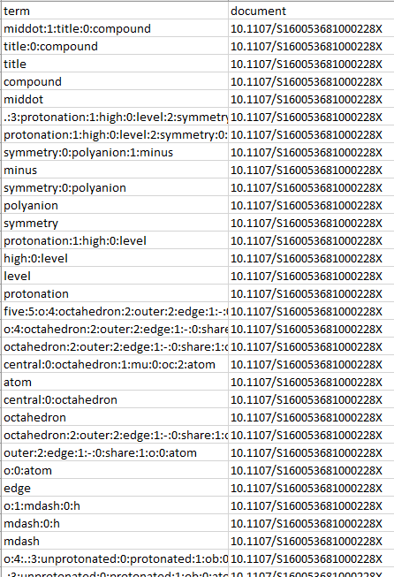
R&R Term
Input database contains terms and document IDs

Slide 5
Remove Too General or Specific Terms
Select R&R terms of level 0, 1, or 2
Ignore terms that are not shared across at least 2 documents or terms that appear in more than 12% of documents
Removes document-specific terms, e.g.
Removes terms that are too general, e.g. “o_h”, “crystal_structure”

Slide 6

Remove Too General or Specific Terms
hot:0:stage:2:solubility:0:microscopy:1:measurement
solubility:0:microscopy:1:measurement
solubility:0:microscopy
microscopy
solubility
measurement
paroxetine:1:chloride:0:hemidrate
chloride:0:hemidrate
case
crystal:0:pack
pack
.:5:br:4:b:0:axis:1:infinite:0:channel:2:form:3:hydrogen:0:bond
br:4:b:0:axis:1:infinite:0:channel:2:form:3:hydrogen:0:bond
b:0:axis:1:infinite:0:channel:2:form:3:hydrogen:0:bond
hydrogen:0:bond
hydrogen
bond
b:0:axis:1:infinite:0:channel
infinite:0:channel
channel
b:0:axis
axis
bromide:0:water:1:anion
bromide:0:water
bromide
anion
Document
S2053273314090007
“solubility_microscopy_measurement”
“solubility_microscopy”
“paroxetine_chloride_hemidrate”
“chloride_hemidrate”
“crystal_pack”
“b_axis_infinite_channel”
“infinite_channel”
“b_axis”
“bromide_water_anion”
“bromide_water”
“solubility_microscopy” “infinite_channel”
“b_axis”
“bromide_water”
Example

Slide 7
Build Corpus
Process the corpus with TF-IDF (term-frequency inverse document-frequency)
Want to give greater weight to uncommon terms
Compile a token-ID dictionary from the corpus

Slide 8
Latent Dirichlet Allocation
Latent Dirichlet Allocation (LDA) is a topic modeling algorithm that links documents to topics and topics to terms
LDA works much like a clustering algorithm
Pre-specify number of topics
Randomly assign terms in corpus to topics
Move terms according to the document composition of the topic (training)

Slide 9
Latent Dirichlet Allocation
We implemented LDA as follows:
Use Gensim’s LDA multi-core model
Train with 100 passes and 500 iterations
Find 6 topics (empirically determined to maximize coherence score)

Slide 10
LDA Example Output
Topic 1: n_hydrogen_bond, pi_interaction, n_hydrogen, intermolecular_c_h, weak_intermolecular_c_h, intermolecular_n_h…
Topic 2: intermolecular_n_h, molecular_structure, complex_cation, asymmetric_unit, o_atom, water_molecule, n_hydrogen_bond, centroid_distance, square_pyramidal, n_atom…
Topic 3: aring_resolution, space_group, pi_interaction, o_atom, n_atom, unit_cell, intermolecular_c_h…
Topic 4: asymmetric_unit, asymmetric_unit_molecule, dimensional_network, intermolecular_c_h, synchrotron_radiation, n_atom, space_group, aring_resolution, single_crystal, o_atom
…

Slide 11
Cyclic-LDA
LDA is not suitable because many documents are left without significant probability of belonging to any topic
We modify the algorithm as follows:
The number of topics for LDA is determined by multiplying the number of documents to model by some specified doc-to-topic ratio R
We call a document “good” if it has a probability greater than some specified probability P of belonging to some topic
We cyclical run LDA on all documents that are not yet “good” until they all converge

Slide 12
Cyclic-LDA Example Output

Slide 13
Comparison
protein, data, using, space, b, xray, p, resolution, beta, scattering
diffraction, data, result, xray, method, protein, using, factor, model, also
diffraction, xray, material, analysis, data, model, sample, using, structural, lattice
xray, data, diffraction, protein, using, domain, time, structural, material, sample
ligand, complex, distorted, prime, water, anion, coordination, cation, coordinated, ion
pi, plane, chno, linked, benzene, the, hn, along, conformation, weak

Slide 14
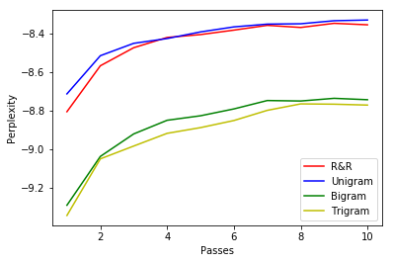
Comparison

Slide 15
van der Waals interaction
A and B molecules
link
stabilizes
stabilized by
consolidate
N hydrogen bonds
crystal packing
connect
adjacent molecules
derived from
hydrogen bond

Slide 16
Next Steps
Normalizing topics (merging synonymous topic areas)

