Slide 1
R&R Topic Modeling
Peter Zhang and Jonah Tash

Slide 2
Motivation
Our motivations are three-fold:
automate the inference of the number of topics
compare the efficacy of R&R terms vs. classical approaches to topic modeling
utilize the results to conduct searches

Slide 3
R&R Terms
Preprocessing
Cyclic-LDA
Visualization
Storage
Process

Slide 4
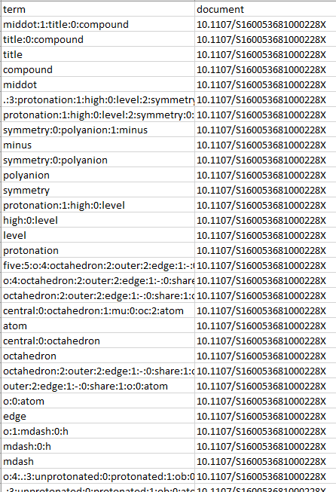
R&R Term
Input database contains terms and document IDs

Slide 5
Preprocessing – Term Selection
Select R&R terms of level 0, 1, 2 or 3
Discard terms that are not shared across at least 2 documents or terms that appear in 15% or more of documents
Removes document-specific terms and general terminology

Slide 6

Preprocessing – Example
hot:0:stage:2:solubility:0:microscopy:1:measurement
solubility:0:microscopy:1:measurement
solubility:0:microscopy
microscopy
solubility
measurement
paroxetine:1:chloride:0:hemidrate
chloride:0:hemidrate
case
crystal:0:pack
pack
.:5:br:4:b:0:axis:1:infinite:0:channel:2:form:3:hydrogen:0:bond
br:4:b:0:axis:1:infinite:0:channel:2:form:3:hydrogen:0:bond
b:0:axis:1:infinite:0:channel:2:form:3:hydrogen:0:bond
hydrogen:0:bond
hydrogen
bond
b:0:axis:1:infinite:0:channel
infinite:0:channel
channel
b:0:axis
axis
bromide:0:water:1:anion
bromide:0:water
bromide
anion
Document
S2053273314090007
“solubility_microscopy_measurement”
“solubility_microscopy”
“paroxetine_chloride_hemidrate”
“chloride_hemidrate”
“crystal_pack”
“b_axis_infinite_channel”
“infinite_channel”
“b_axis”
“bromide_water_anion”
“bromide_water”
“solubility_microscopy” “infinite_channel”
“b_axis”
“bromide_water”

Slide 7
Preprocessing
Process the corpus with TF-IDF (term-frequency inverse document-frequency)
Want to give greater weight to uncommon terms
Compile a token-ID dictionary from the corpus

Slide 8
Cyclic-LDA
Latent Dirichlet Allocation

Slide 9
Next Steps
Normalizing topics (merging synonymous topic areas)

