Slide 1
R&R Topic Modeling
Peter Zhang and Jonah Tash

Slide 2
Motivation
Our motivations are three-fold:
automate the inference of the number of topics
compare the efficacy of R&R terms vs. classical approaches to topic modeling
utilize the results to conduct searches

Slide 3
R&R Terms
Preprocessing
Cyclic-LDA
Visualization
Storage
Process

Slide 4
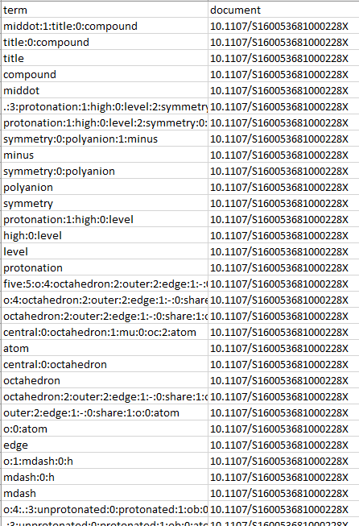
R&R Term
Input database contains terms and document IDs

Slide 5
Remove Too General or Specific Terms
Select R&R terms of level 0, 1, or 2
Ignore terms that are not shared across at least 2 documents or terms that appear in more than 12% of documents
Removes document-specific terms, e.g.
Removes terms that are too general, e.g. “o_h”, “crystal_structure”

Slide 6

Remove Too General or Specific Terms
hot:0:stage:2:solubility:0:microscopy:1:measurement
solubility:0:microscopy:1:measurement
solubility:0:microscopy
microscopy
solubility
measurement
paroxetine:1:chloride:0:hemidrate
chloride:0:hemidrate
case
crystal:0:pack
pack
.:5:br:4:b:0:axis:1:infinite:0:channel:2:form:3:hydrogen:0:bond
br:4:b:0:axis:1:infinite:0:channel:2:form:3:hydrogen:0:bond
b:0:axis:1:infinite:0:channel:2:form:3:hydrogen:0:bond
hydrogen:0:bond
hydrogen
bond
b:0:axis:1:infinite:0:channel
infinite:0:channel
channel
b:0:axis
axis
bromide:0:water:1:anion
bromide:0:water
bromide
anion
Document
S2053273314090007
“solubility_microscopy_measurement”
“solubility_microscopy”
“paroxetine_chloride_hemidrate”
“chloride_hemidrate”
“crystal_pack”
“b_axis_infinite_channel”
“infinite_channel”
“b_axis”
“bromide_water_anion”
“bromide_water”
“solubility_microscopy” “infinite_channel”
“b_axis”
“bromide_water”
Example

Slide 7
Build Corpus
Process the corpus with TF-IDF (term-frequency inverse document-frequency)
Want to give greater weight to uncommon terms
Compile a token-ID dictionary from the corpus

Slide 8
Latent Dirichlet Allocation
Latent Dirichlet Allocation (LDA) is a topic modeling algorithm that links documents to topics and topics to terms
LDA works much like a clustering algorithm
Pre-specify number of topics
Randomly assign terms in corpus to topics
Move terms according to the document composition of the topic (training)

Slide 9
Latent Dirichlet Allocation
We implemented LDA as follows:
Use Gensim’s LDA multi-core model
Train with 100 passes and 500 iterations
Find 6 topics (empirically determined to maximize coherence score)

Slide 10
LDA Example Output
Topic 1: n_hydrogen_bond, pi_interaction, n_hydrogen, intermolecular_c_h, weak_intermolecular_c_h, intermolecular_n_h…
Topic 2: intermolecular_n_h, molecular_structure, complex_cation, asymmetric_unit, o_atom, water_molecule, n_hydrogen_bond, centroid_distance, square_pyramidal, n_atom…
Topic 3: aring_resolution, space_group, pi_interaction, o_atom, n_atom, unit_cell, intermolecular_c_h…
Topic 4: asymmetric_unit, asymmetric_unit_molecule, dimensional_network, intermolecular_c_h, synchrotron_radiation, n_atom, space_group, aring_resolution, single_crystal, o_atom
…

Slide 11
Cyclic-LDA
LDA is not suitable because many documents are left without significant probability of belonging to any topic
We modify the algorithm as follows:
The number of topics for LDA is determined by multiplying the number of documents to model by some specified ratio R
We call a document “good” if it has a probability greater than some specified probability P of belonging to some topic
We cyclical run LDA on all documents that are not yet “good” until they all converge

Slide 12
Cyclic-LDA Example Output

Slide 14
Next Steps
Normalizing topics (merging synonymous topic areas)

