Slide 1

B2TSQL
Projeto de Arquitetura Modular
Modulo 1-) Sistemas Numericos Operações Binárias
Modulo 2-) Algoritmos Boleanos Soluções Avançadas
Modulo 3-) Linguagem T-SQL
Modulo 4-) Banco de Dados SQL SERVER 2014
Modulo 5-) PowerShell Cmdlet
Degmar Gomes Barbosa
Senior Database Administrator
Senior Advanced Programmer

Slide 2



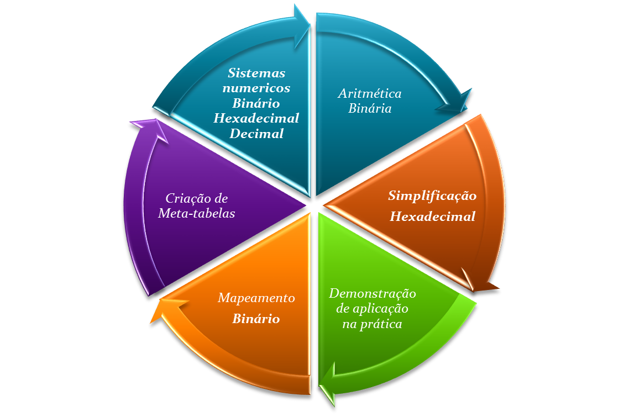




A força do BIT na programação
Notes:
Key Messages:
Now have complete IT lifecycle management – new versions of Configuration Manager, Operations Manager plus addition of Data Protection Manager and Virtual Machine Manager
Integrated solution for both physical and virtual environments – e.g workflow of monitoring application with virtual and physical servers , see issue and fix issue, all within same environment
Complete lifecycle of IT Systems including desktops, servers and devices in any location
All these capabilities in one solution, from Microsoft
Detail:
While System Center products such as Configuration Manager and Operations Manager have been deployed successfully by customers we are now able to offer capabilities to support the complete IT service management lifecycle.
Lets look at how we can now support you through out that lifecycle.
Hardware provisioning: As customers look to roll out new line of business applications or look to update their data center with new versions of Windows Server 2008, SQL Server 2008 or Exchange 2007, able to take advantage of Configuration Managers ability to provision server straight from the bare metal server. Configuration Manager also delivers standardized configurations for servers, similar to the Management Packs available for Operations Manger – making the process much quicker and more reliable
Workload provisioning: Ability to provision goes beyond physical servers. Virtual Machine Manager allows you to do intelligent virtual server and workload provisioning enabling you to make best use of the hardware and network resources in your data center. Also allow you to do conversion of servers to a virtual state. This includes not only physical to virtual conversion but also conversion of virtual to virtual. This in an interface that will be familiar to Operations Manager users, making it easier and quicker to take advantage
Patching and deployment: Lots of manual patching still happens. With Configuration Manager patching a deployment of server is completely automated, even to virtual servers. Includes management of drivers and enforcement of server maintenance windows to support your efforts to meet your datacenter compliance requirements
Monitoring of physical and virtual servers: Once the servers have been deployed the next step is to monitor their performance and health – which of course extends to servers deployed on both physical and virtual environments. Operations Manager delivers that monitoring capability for the data center and can even automate the discovery of the servers once they have been deployed. It is one console to manage both physical and virtual world. Configuration Manager also has a major role to play here in monitoring how servers drift from desired configurations, and flagging that to you – this can help improve compliance, security, performance, all of which can be impacted by server configuration drift.
Disaster Recovery: With Operations Manager monitoring your servers and thus flagging to you where any issues are arising, the next action could well to implement your disaster recovery plan for your key datacenter information - SQL Server database, Exchange messages, or SharePoint information. These are all sources that Data Protection Manager can provide disaster recovery capabilities for (in addition to existing capability for file and print servers)
Backup: Data protection also delivers the backup capabilities that secures your datacenter content, all through one environment. This even includes virtual server based data and the virtual machines themselves.
All of this combines to deliver support for the complete IT lifecycle and its all delivered from one integrated solution. In fact all of these capabilities are available in one package from Microsoft, meaning you can get this complete lifecycle capability from one vendor. Truly integrated server management from Microsoft

Slide 3
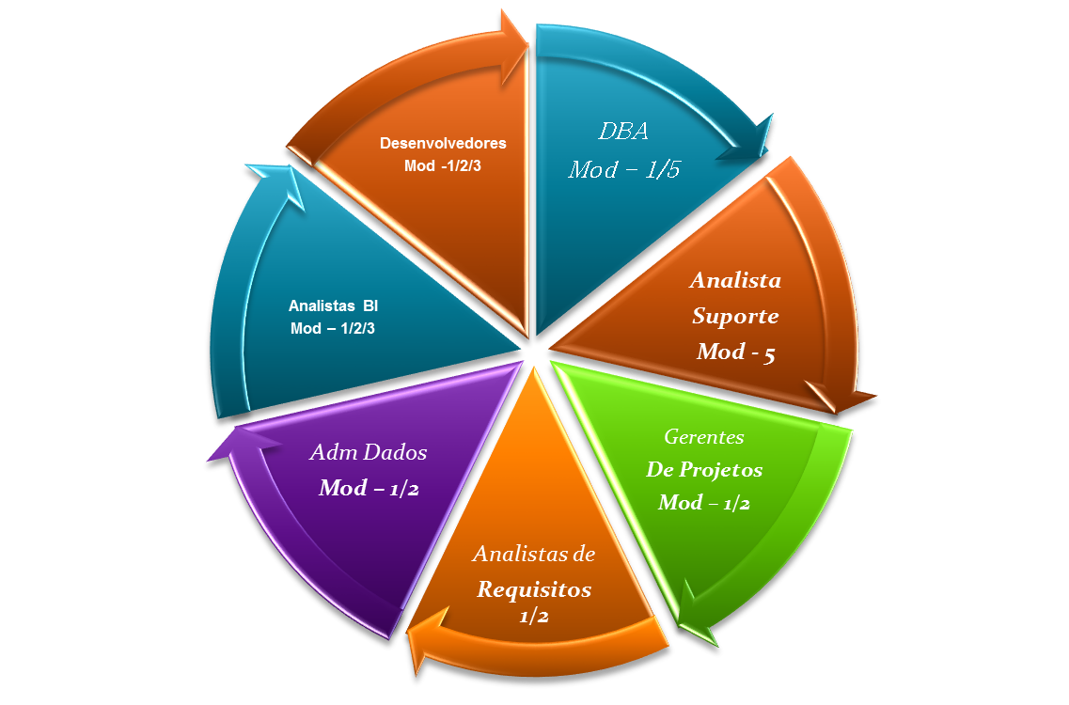
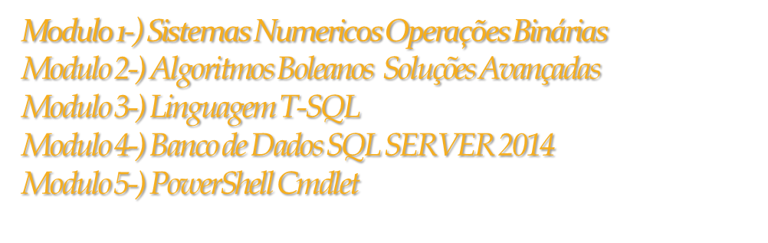
Publico Alvo:
Notes:
Key Messages:
Now have complete IT lifecycle management – new versions of Configuration Manager, Operations Manager plus addition of Data Protection Manager and Virtual Machine Manager
Integrated solution for both physical and virtual environments – e.g workflow of monitoring application with virtual and physical servers , see issue and fix issue, all within same environment
Complete lifecycle of IT Systems including desktops, servers and devices in any location
All these capabilities in one solution, from Microsoft
Detail:
While System Center products such as Configuration Manager and Operations Manager have been deployed successfully by customers we are now able to offer capabilities to support the complete IT service management lifecycle.
Lets look at how we can now support you through out that lifecycle.
Hardware provisioning: As customers look to roll out new line of business applications or look to update their data center with new versions of Windows Server 2008, SQL Server 2008 or Exchange 2007, able to take advantage of Configuration Managers ability to provision server straight from the bare metal server. Configuration Manager also delivers standardized configurations for servers, similar to the Management Packs available for Operations Manger – making the process much quicker and more reliable
Workload provisioning: Ability to provision goes beyond physical servers. Virtual Machine Manager allows you to do intelligent virtual server and workload provisioning enabling you to make best use of the hardware and network resources in your data center. Also allow you to do conversion of servers to a virtual state. This includes not only physical to virtual conversion but also conversion of virtual to virtual. This in an interface that will be familiar to Operations Manager users, making it easier and quicker to take advantage
Patching and deployment: Lots of manual patching still happens. With Configuration Manager patching a deployment of server is completely automated, even to virtual servers. Includes management of drivers and enforcement of server maintenance windows to support your efforts to meet your datacenter compliance requirements
Monitoring of physical and virtual servers: Once the servers have been deployed the next step is to monitor their performance and health – which of course extends to servers deployed on both physical and virtual environments. Operations Manager delivers that monitoring capability for the data center and can even automate the discovery of the servers once they have been deployed. It is one console to manage both physical and virtual world. Configuration Manager also has a major role to play here in monitoring how servers drift from desired configurations, and flagging that to you – this can help improve compliance, security, performance, all of which can be impacted by server configuration drift.
Disaster Recovery: With Operations Manager monitoring your servers and thus flagging to you where any issues are arising, the next action could well to implement your disaster recovery plan for your key datacenter information - SQL Server database, Exchange messages, or SharePoint information. These are all sources that Data Protection Manager can provide disaster recovery capabilities for (in addition to existing capability for file and print servers)
Backup: Data protection also delivers the backup capabilities that secures your datacenter content, all through one environment. This even includes virtual server based data and the virtual machines themselves.
All of this combines to deliver support for the complete IT lifecycle and its all delivered from one integrated solution. In fact all of these capabilities are available in one package from Microsoft, meaning you can get this complete lifecycle capability from one vendor. Truly integrated server management from Microsoft

Slide 4
SISTEMA NUMÉRICO DECIMAL
Porque vamos falar sobre o sistema decimal?
TODAS AS OPERAÇÕES COM OS DEMAIS SISTEMAS REALIZAM O SEU “MODUS OPERANDI” BASEADOS NO SISTEMA DECIMAL
Notes:
© 2007 Microsoft Corporation. All rights reserved. Microsoft, Windows, Windows Vista and other product names are or may be registered trademarks and/or trademarks in the U.S. and/or other countries.
The information herein is for informational purposes only and represents the current view of Microsoft Corporation as of the date of this presentation. Because Microsoft must respond to changing market conditions, it should not be interpreted to be a commitment on the part of Microsoft, and Microsoft cannot guarantee the accuracy of any information provided after the date of this presentation.
MICROSOFT MAKES NO WARRANTIES, EXPRESS, IMPLIED OR STATUTORY, AS TO THE INFORMATION IN THIS PRESENTATION.

Slide 5
A base indica o número de caracteres ou dígitos usados para representar quantidades naquele sistema numérico. Quando um sistema numérico é usado onde à base não é conhecida, um índice é usado para mostrar a base.
Por exemplo: o número 4603₁₀ é proveniente de um sistema numérico com base dez.
Notes:
© 2007 Microsoft Corporation. All rights reserved. Microsoft, Windows, Windows Vista and other product names are or may be registered trademarks and/or trademarks in the U.S. and/or other countries.
The information herein is for informational purposes only and represents the current view of Microsoft Corporation as of the date of this presentation. Because Microsoft must respond to changing market conditions, it should not be interpreted to be a commitment on the part of Microsoft, and Microsoft cannot guarantee the accuracy of any information provided after the date of this presentation.
MICROSOFT MAKES NO WARRANTIES, EXPRESS, IMPLIED OR STATUTORY, AS TO THE INFORMATION IN THIS PRESENTATION.

Slide 6

Notação Posicional
Cada posição tem um peso característico determinado pela potenciação da base do sistema numérico, neste caso o número dez. Os pesos posicionais são 10⁰(unidades), 10¹(dezenas), 10²(centenas); etc.

Slide 7
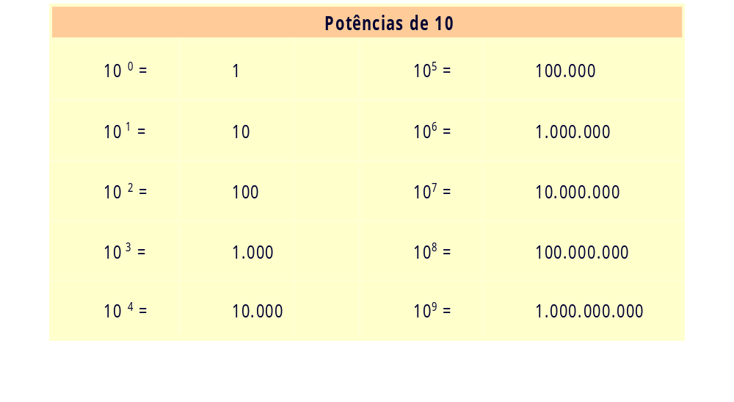
Notação Posicional

Slide 8
Notação Posicional
Nós determinamos o valor total de um número considerando os dígitos específicos e os pesos de suas posições. Por exemplo, o número decimal 4603 está escrito na notação habitual. Este número também pode ser escrito na notação posicional.Para determinar o valor de um número devemos multiplicar cada dígito pelo peso de sua posição e somar os resultados.
Notação Posicional de um Número 4603 na Base 10
( 4 x 10³) + | ( 6 x 10²) + | ( 0 x 10¹) + | ( 3 x 10⁰ )
( 4 x 1000 ) + | ( 6 x 100 ) + | ( 0 x 10 ) + | ( 3 x 1 )
4.000 + | 600 + | 0 + | 3 = | 4.603₁₀
p(x) = a_{o} + a₁x + a₂x² + a₃x³ +...+ a_{n} x^{n}
polinomio genérico : o digito do numero é o coeficiente a_{o ....} an o x é a base do expoente n do polinomio

Slide 9
Números Fracionários
Frações decimais são números cujas posições tem pesos
que são potências negativas de dez tais como:
Potências Negativas de 10
10⁻¹ = | 0,1 |  | 10⁻⁵ = | 0,00001
10⁻² = | 0,01 |  | 10⁻⁶ = | 0,000001
10⁻³ = | 0,001 |  | 10⁻⁸ = | 0,0000001
10⁻⁴ = | 0,0001 |  | 10⁻⁹ = | 0,00000001

Slide 10
Números Fracionários
Um ponto base (ponto decimal para números na base dez) separa a parte inteira da parte fracionária de um número. A parte inteira fica à esquerda do ponto decimal e tem os pesos posicionais de unidades, dezenas, centenas, etc. A parte fracionária do número fica à direita do ponto decimal e tem os pesos posicionais de décimos, centésimos, milésimos, etc. Para exemplificar, o número decimal 278,94 pode ser escrito com notação posicional como mostrado abaixo.
Notação Posicional de um Número 278,94 na Base 10
( 2 x 10²) + | ( 7 x 10¹) + | ( 8 x 10⁰) + | ( 9 x 10⁻¹ ) | ( 4 x 10⁻² )
( 2 x 100 ) + | ( 7 x 10 ) + | ( 8 x 1 ) + | ( 9 x 1/10 ) | ( 4 x 1/100 )
200 + | 70 + | 8 + | 0.9 = | 0.04 = | 278,94₁₀

Slide 11
Números Fracionários (Potências Negativas de 2)
Números binários fracionários são expressos como potências negativas de dois. A tabela abaixo fornece uma lista condensada das potências negativas de dois. Na notação posicional, o número binário 0.1101 pode ser expresso como se segue:(1x2⁻¹) + (1x2⁻²) + (0x2⁻³) + (1x2⁻⁴)
Potências Negativas de 2
2⁻¹ = | 1/2 | 0,5₁₀
2⁻² = | 1/4 | 0,25₁₀
2⁻³ = | 1/8 | 0,125₁₀

Slide 12
O sistema numérico mais simples que usa notação posicional é o sistema numérico binário. Como o próprio nome diz, um sistema binário contém apenas dois elementos ou estados. Num sistema numérico isto é expresso como uma base dois, usando os dígitos 0 e 1. Esses dois dígitos têm o mesmo valor básico de 0 e 1 do sistema numérico decimal.
Devido a sua simplicidade, microprocessadores usam o sistema binário de numeração para manipular dados. Dados binários são representados por dígitos binários chamados "bits". O termo "bit" é derivado da contração de "binary digit". Microprocessadores operam com grupos de "bits" os quais são chamados de palavras.O número binário 1 1 1 0 1 1 0 1 contém oito "bits“ ou 1 byte.

Slide 13
2^x | Integer | Binary Representation of Integer at Left | Binary representation of Integer value at Right | Adding Up
2^0 | 1 | 00000000000000000000000000000001 | 00000000000000000000000000000001 | 1
2^1 | 2 | 00000000000000000000000000000010 | 00000000000000000000000000000011 | 3
2^2 | 4 | 00000000000000000000000000000100 | 00000000000000000000000000000111 | 7
2^3 | 8 | 00000000000000000000000000001000 | 00000000000000000000000000001111 | 15
2^4 | 16 | 00000000000000000000000000010000 | 00000000000000000000000000011111 | 31
2^5 | 32 | 00000000000000000000000000100000 | 00000000000000000000000000111111 | 63
2^6 | 64 | 00000000000000000000000001000000 | 00000000000000000000000001111111 | 127
2^7 | 128 | 00000000000000000000000010000000 | 00000000000000000000000011111111 | 255
2^8 | 256 | 00000000000000000000000100000000 | 00000000000000000000000111111111 | 511
2^9 | 512 | 00000000000000000000001000000000 | 00000000000000000000001111111111 | 1023
2^10 | 1024 | 00000000000000000000010000000000 | 00000000000000000000011111111111 | 2047
2^11 | 2048 | 00000000000000000000100000000000 | 00000000000000000000111111111111 | 4095
2^12 | 4096 | 00000000000000000001000000000000 | 00000000000000000001111111111111 | 8191
2^13 | 8192 | 00000000000000000010000000000000 | 00000000000000000011111111111111 | 16383
2^14 | 16384 | 00000000000000000100000000000000 | 00000000000000000111111111111111 | 32767
2^15 | 32768 | 00000000000000001000000000000000 | 00000000000000001111111111111111 | 65535
2^16 | 65536 | 00000000000000010000000000000000 | 00000000000000011111111111111111 | 131071
2^17 | 131072 | 00000000000000100000000000000000 | 00000000000000111111111111111111 | 262143
2^18 | 262144 | 00000000000001000000000000000000 | 00000000000001111111111111111111 | 524287
2^19 | 524288 | 00000000000010000000000000000000 | 00000000000011111111111111111111 | 1048575
2^20 | 1048576 | 00000000000100000000000000000000 | 00000000000111111111111111111111 | 2097151
2^21 | 2097152 | 00000000001000000000000000000000 | 00000000001111111111111111111111 | 4194303
2^22 | 4194304 | 00000000010000000000000000000000 | 00000000011111111111111111111111 | 8388607
2^23 | 8388608 | 00000000100000000000000000000000 | 00000000111111111111111111111111 | 16777215
2^24 | 16777216 | 00000001000000000000000000000000 | 00000001111111111111111111111111 | 33554431
2^25 | 33554432 | 00000010000000000000000000000000 | 00000011111111111111111111111111 | 67108863
2^26 | 67108864 | 00000100000000000000000000000000 | 00000111111111111111111111111111 | 134217727
2^27 | 134217728 | 00001000000000000000000000000000 | 00001111111111111111111111111111 | 268435455
2^28 | 268435456 | 00010000000000000000000000000000 | 00011111111111111111111111111111 | 536870911
2^29 | 536870912 | 00100000000000000000000000000000 | 00111111111111111111111111111111 | 1073741823
2^30 | 1073741824 | 01000000000000000000000000000000 | 01111111111111111111111111111111 | 2147483647

Slide 14
TABLE 4: Bitwise AND (&) Truth Table
& | 0 | 1
0 | 0 | 0
1 | 0 | 1
TABLE 5: Bitwise OR (|) Truth Table
| | 0 | 1
0 | 0 | 1
1 | 1 | 1
TABLE 1: Bitwise AND (&), OR (|), and XOR (^) Validity
&/|/^ | int* | binary | bit | NULL
int* | valid | valid | valid | NULL
binary | valid | error | valid | error
bit | valid | valid | valid | NULL
NULL | NULL | error | NULL | NULL
* int stands for any of the following integer data types: tinyint, smallint, int, and bigint
TABLE 2: Bitwise NOT (~) Validity
Data Type | ~
int* | valid
binary | error
bit | valid
NULL | NULL

Slide 15
Bitwise exemplos:
  BitAnd(63, 40) = 40
    00000000000000000000000000111111
    00000000000000000000000000101000
    -------------------------------------------------
    00000000000000000000000000101000
  BitOR(40,23) = 63
    00000000000000000000000000101000
    00000000000000000000000000010111
    -------------------------------------------------
    00000000000000000000000000111111
  BitXOR(63,40) = 23
    00000000000000000000000000111111
    00000000000000000000000000101000
    -------------------------------------------------
    00000000000000000000000000010111
  BitNOT(40)
  00000000000000000000000000101000
    -------------------------------------------------
    00000000000000000000000000010111

Slide 16
Notação Posicional
Por exemplo, o número binário 110101 pode ser escrito com notação posicional como segue:
(1x2⁵)+(1x2⁴)+(0x2³)+(1x2²)+(0x2¹)+(1x2⁰)
Para determinar o valor decimal ao número binário 110101₂, multiplique cada "bit" por seu peso posicional e some os resultados.
Potências de 2
2⁰ = | 1₁₀ |  | 2⁵ = | 32₁₀
2¹ = | 2₁₀ |  | 2⁶ = | 64₁₀
2² = | 4₁₀ |  | 2⁷ = | 128₁₀
2³ = | 8₁₀ |  | 2⁸ = | 256₁₀
2⁴ = | 16₁₀ |  | 2⁹ = | 512₁₀
(1x32)+(1x16)+(0x8)+(1x4)+(0x2)+(1x1) =
32 + 16 + 0 + 4 + 0 + 1 = 53₁₀

Slide 17
Números Fracionários (Potências Negativas de 2)
Números binários fracionários são expressos como potências negativas de dois. A tabela abaixo fornece uma lista condensada das potências negativas de dois. Na notação posicional, o número binário 0.1101 pode ser expresso como se segue:(1x2⁻¹) + (1x2⁻²) + (0x2⁻³) + (1x2⁻⁴)
Potências Negativas de 2
2⁻¹ = | 1/2 | 0,5₁₀
2⁻² = | 1/4 | 0,25₁₀
2⁻³ = | 1/8 | 0,125₁₀

Slide 18
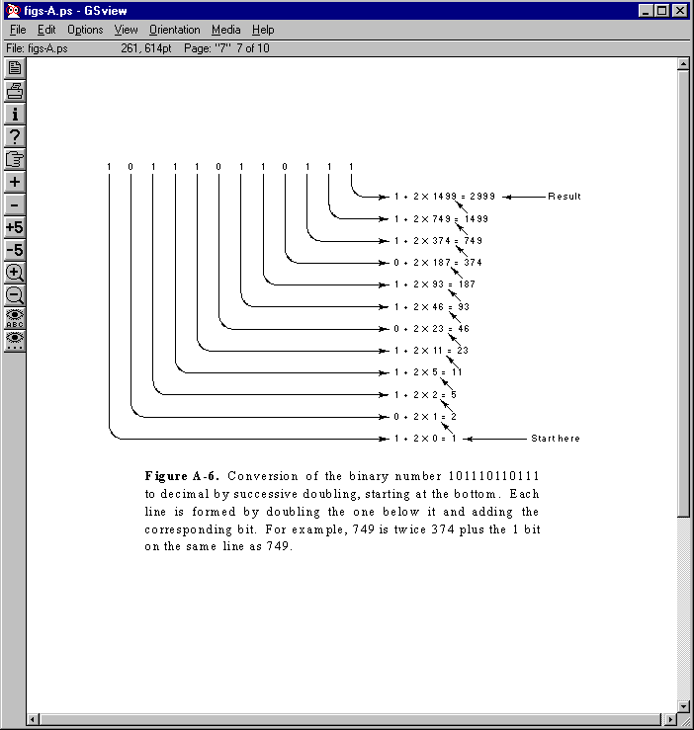
Conversão Binária para Decimal
2**11+2**9+2**8+2**7+2**5+2**4+2**2+2**1+2**0

Slide 19
Conversão Decimal para Binário
Divisões | Resto |  | Divida o número decimal por dois e anote o resto. Então divida o quociente por dois e novamente anote o resto. Continue este processo de divisão até resultar zero. Então pegue os restos começando pelo último ou o "bit" mais significativo (MSB) e continue até o primeiro ou "bit" menos significativo (LSB). O número 11001₂ = 25₁₀.
25/2 = 12 | 1 | LSB
12/2 = 6 | 0
6/2 = 3 | 0
3/2 = 1 | 1
1/2 = 0 | 1 | MSB
128 | 64 | 32 | 16 | 8 | 4 | 2 | 1
 |  |  | 1 | 1 | 0 | 0 | 1

Slide 20
Conversão Decimal para Binário de um número Fracionário
Se o número decimal apresenta uma parte inteira e uma fracionária, deve-se separar as partes inteiras e fracionárias usando o ponto decimal como ponto de separação. Então realiza-se a conversão apropriada em cada parte. Após se converter à parte inteira e a parte fracionária, deve-se juntá-las.
Por exemplo, o número decimal 14,375 é convertido no seu equivalente binário. 14,375 = 1410 + 0,375₁₀ | Operações | resto | resultados parciais
 | 14 ÷ 2 = 7 | 0 LSB
 | 7 ÷ 2 = 3 | 1
 | 3 ÷ 2 = 1 | 1
 | 1 ÷ 2 = 0 | 1 MSB | 14₁₀ = 1110₂
 |  | inteiro
 | 0,375 X 2 = 0,750 | 0 MSB
 | 0,750 X 2 = 1,500 | 1
 | 0,500 X 2 = 1,000 | 1 LSB | 0,375₁₀ = 0,011₂
 | Resultado geral | 14,375₁₀ = 1110.011₂

