Slide 1
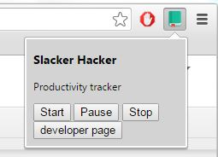

Slack hacker
Vuong Nguyen Luke Dercher
Luke Weber
Dylan Egnoske
Sri Gayatri Sundar

Slide 2
Product vision
Track your productivity and stay on top of your goals.
Constantly reminded to self-care and to avoid Internet distractions.
Those are the vision of the developers of Slacker Hacker. Slacker Hacker is a productivity tracking application for Chrome. When embedded in your web browser as an Chrome extension, it turns the new tab into a web application with various functionalities.
We are inspired by the idea that while working productively, ones should be reminded constantly to self-care. This leads to a healthier and even more effective work routine.

Slide 3
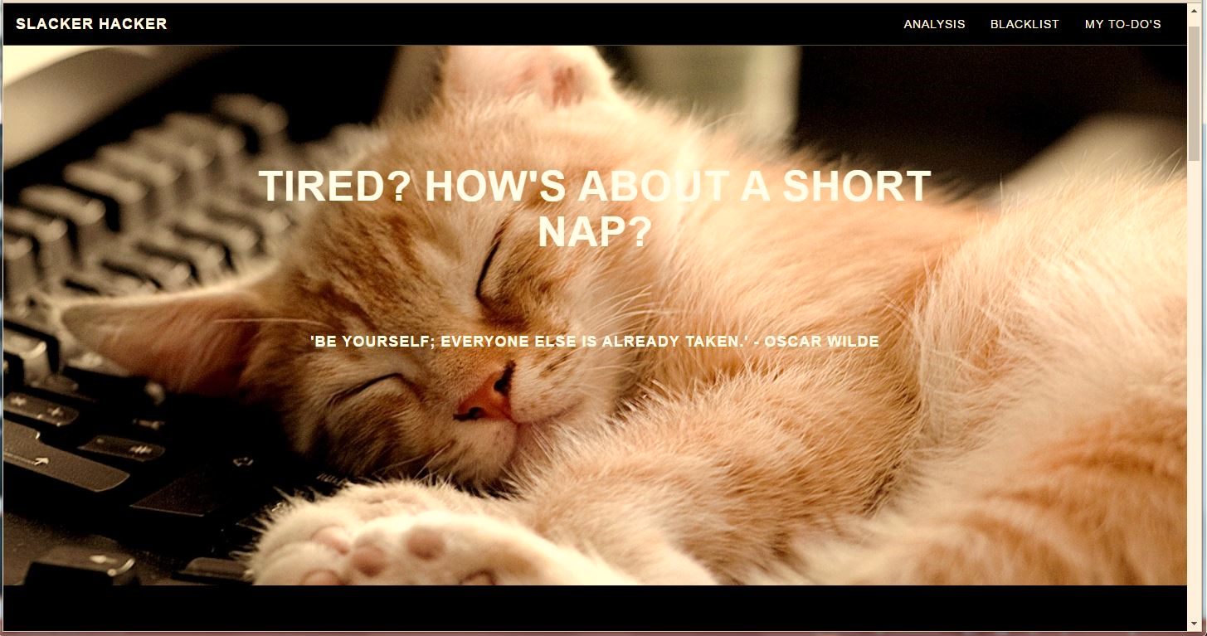
Health reminder
The reminder messages are updated with pictures throughout the day to make sure the users take study breakers, exercise, self-care and eat healthily.
This page is also filled with random inspirational quotes to kick off your productivity. (Screen shots below)

Slide 4
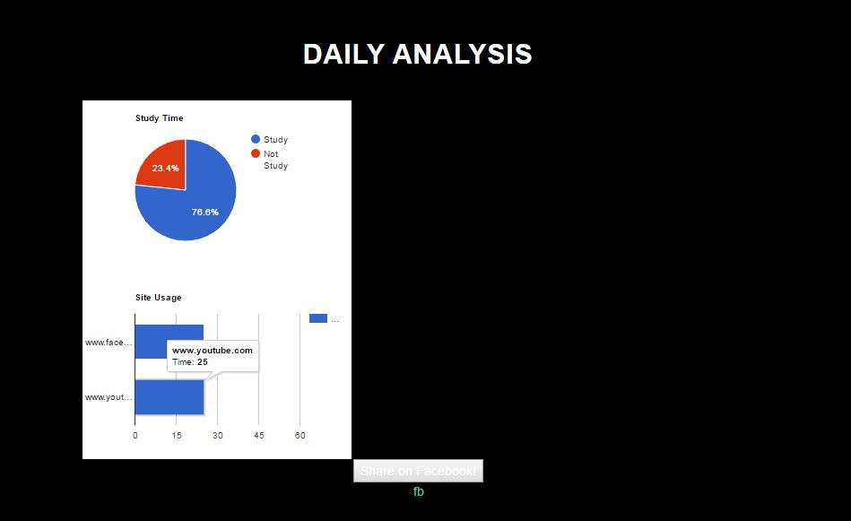

Track your productivity stay on top of your goals.
Slacker Hacker offers productivity charts to with detailed analysis the exact amount of time you have spent on each website.
Slacker Hacker includes web-block feature: It sends friendly reminds when you visit the websites you’ve chosen to be blocked.

Slide 5
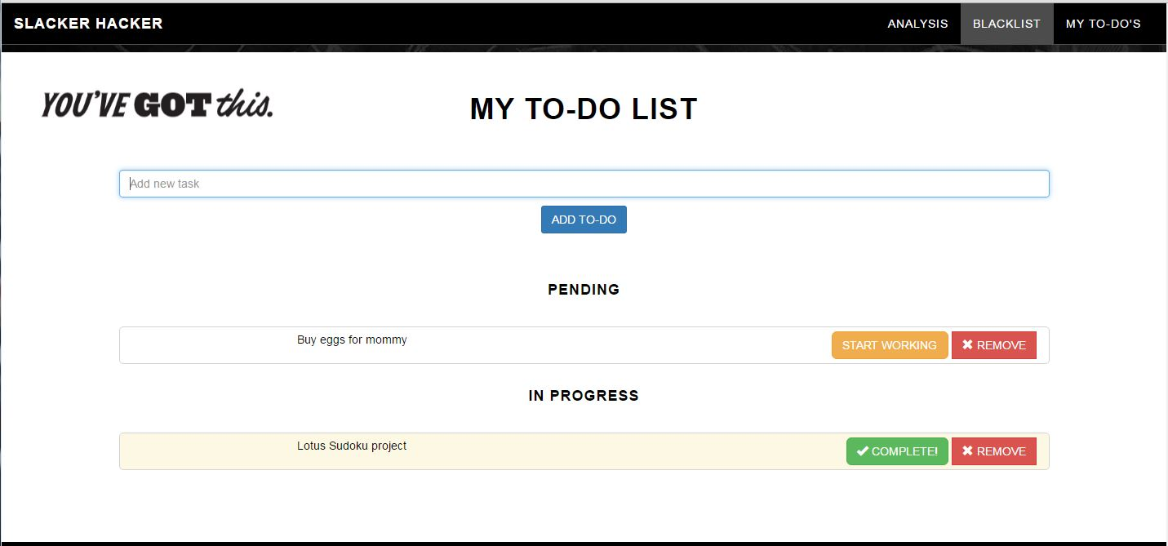
TO-DO List
Users can easily create goals and cross them off the list when done.

Slide 6
Work division
Vuong: Front-end design (new tab), TO-DO list.
Luke Dercher: Blocking Pop-up, Test suite, Timer.
Luke Weber: Data analysis (graphs), Timer.
Dylan Egnoske: Initial Chrome extension setups and front-end design, Bad timer.
Sri Gayatri Sundar: Block websites (database & php work), share on social media.
ALL: User Manual, Documentation, Bug list, Diagrams, Testing.

