Slide 1
Safe harbor sites

Slide 2
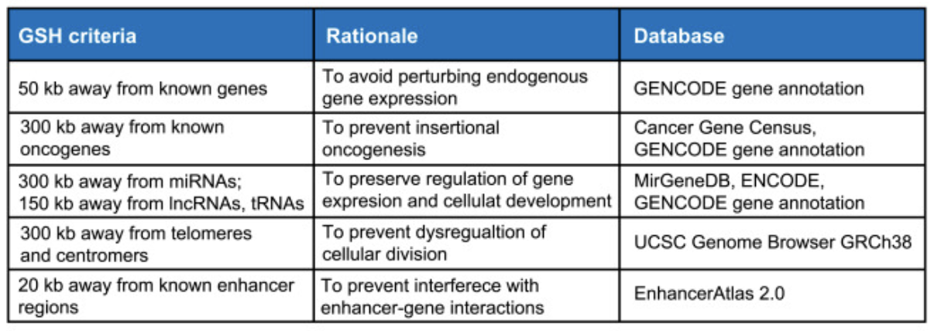
Requirements
Link to paper: https://www.sciencedirect.com/science/article/pii/S2667237521002319

Slide 3
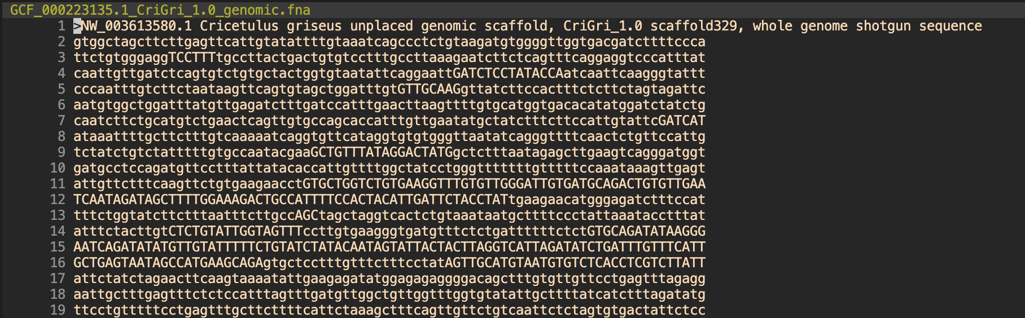
Data
NCBI CHO genome
NCBI CHO annotation file
Notes:
seqname - name of the chromosome or scaffold; chromosome names can be given with or without the 'chr' prefix. Important note: the seqname must be one used within Ensembl, i.e. a standard chromosome name or an Ensembl identifier such as a scaffold ID, without any additional content such as species or assembly. See the example GFF output below.
source - name of the program that generated this feature, or the data source (database or project name)
feature - feature type name, e.g. Gene, Variation, Similarity
start - Start position* of the feature, with sequence numbering starting at 1.
end - End position* of the feature, with sequence numbering starting at 1.
score - A floating point value.
strand - defined as + (forward) or - (reverse).
frame - One of '0', '1' or '2'. '0' indicates that the first base of the feature is the first base of a codon, '1' that the second base is the first base of a codon, and so on..
attribute - A semicolon-separated list of tag-value pairs, providing additional information about each feature.

Slide 4
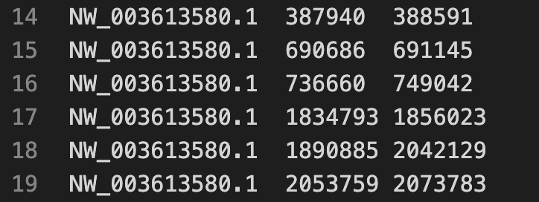
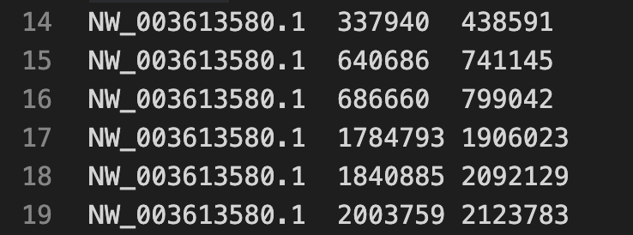
Approach
1. Filter original BED for feature (ex. gene, miR, telomere, etc)
2. Gene BED
3. Gene BED with flanks (50000 bp)

Slide 5
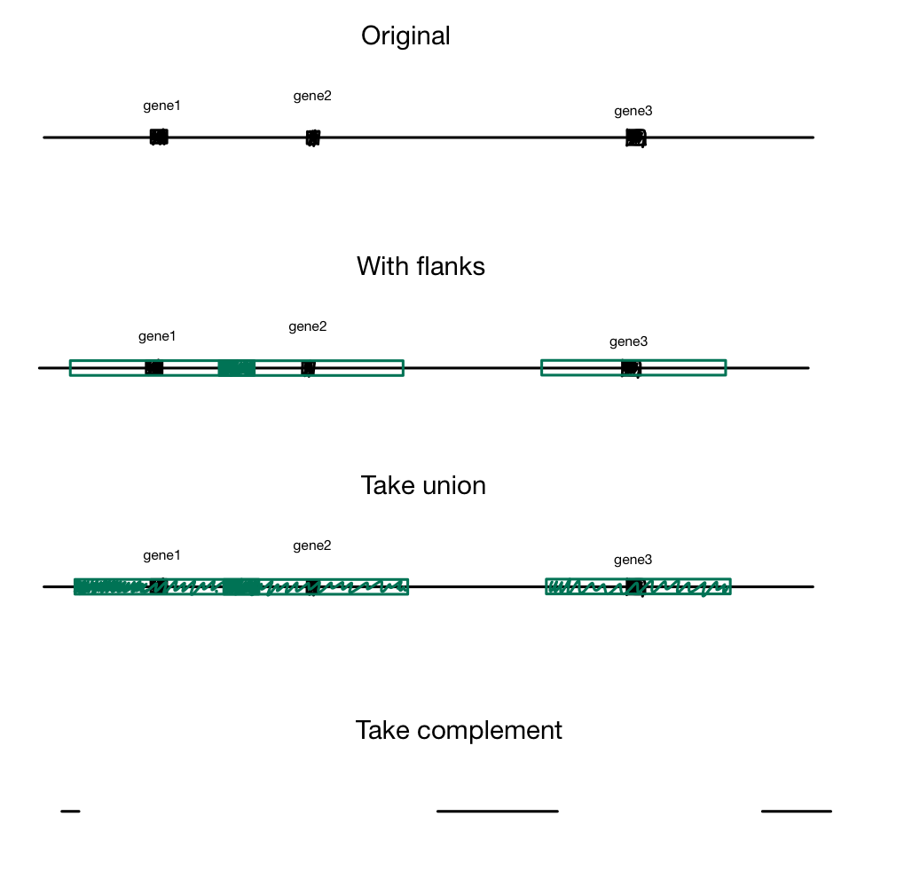
4. Take union of flanks
5. Subtract union from original bed

Slide 6
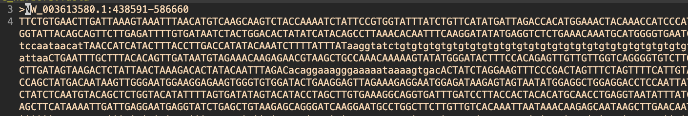
Results
Example region
Size

Slide 7
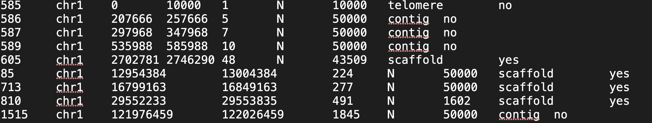
Limitations
Annotations
Only using the information in annotation file
Tried to pinpoint features through description sentence only
Paper uses multiple sources for each feature
Ex. gaps database

