Slide 2
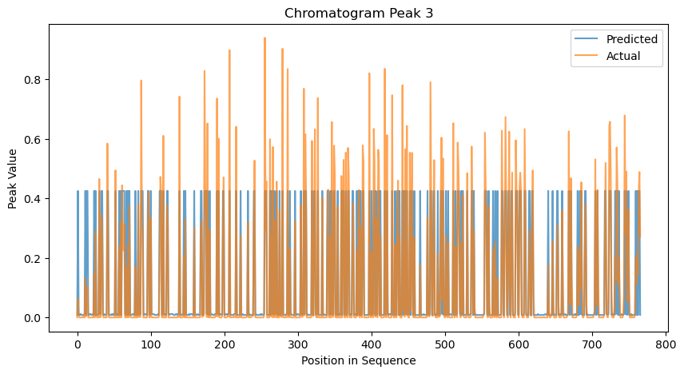
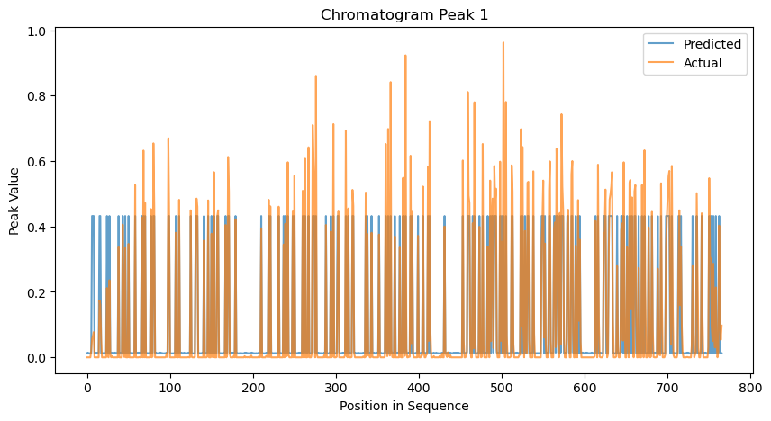
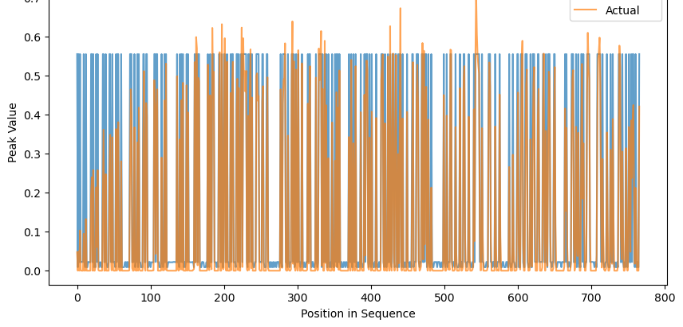
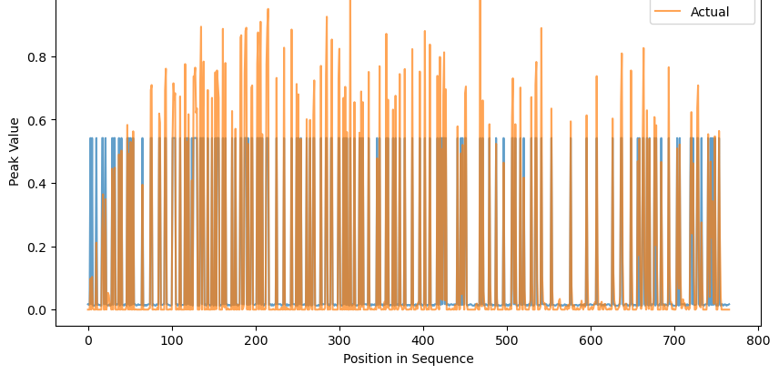
[0.006082335753100384,0.00888088417151475,0.009139759583797471,0.00874669108966390]

Slide 3
[0.006082335753100384,0.00888088417151475,0.009139759583797471,0.00874669108966390]

