Slide 1
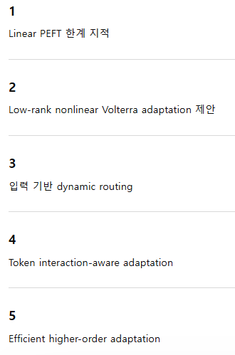
VoRA
입력에 따라 adaptation 자체가 변하는 구조
VoRA: Adaptive Volterra Low-Rank Adaptation for Efficient Vision Fine-Tuning

Slide 2
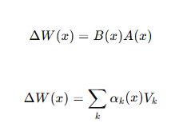
Dynamic Nonlinear PEFT
: 입력에 따라 adaptation 자체가 변하는 구조
입력 별
Degradation 별
Token 별
=> Nonlinear interaction이 달라짐
Conditioned nonlinear adaptation

Slide 3

2. Low-rank Volterra Kernal
: volterra는 원래 계산량이 큼
Efficient higher order adaptation
Seperable
Low-lank
factorized
=> Volterra kernal을 만드는 것
parameter-efficient nonlinear kernel adaptation

Slide 4
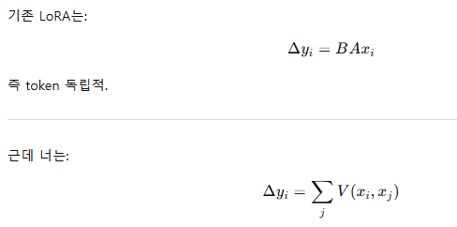
3. Token interaction-aware PEFT
: vision transformer에서 강함
Token-token interaction
Spatial coupling
Neighbor dependency
=> 를 adaptation에 넣을 수 있음
parameter-efficient nonlinear kernel adaptation

Slide 5
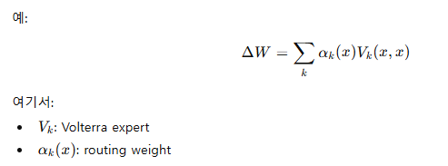
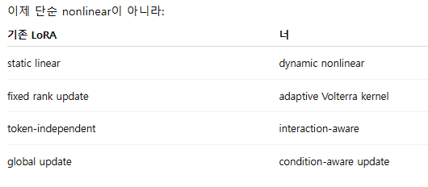
4. Adaptive Volterra routing
: 입력마다 다른 nonlinear PEFT를 사용
LoRA + MoE + Volterra
Dynamic Nonlinear PEFT via Volterra Experts

Slide 6
Linear LoRA를 ➔ nonlinear+dynamic+interaction-aware PEFT
Input Feature x
↓
Feature Analysis / Routing
↓
Dynamic Volterra Expert Selection
↓
Low-rank Nonlinear Adaptation
↓
Interaction-aware Token Update
↓
Efficient Output Projection

Slide 7
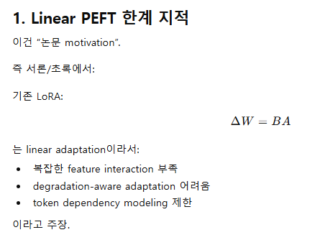
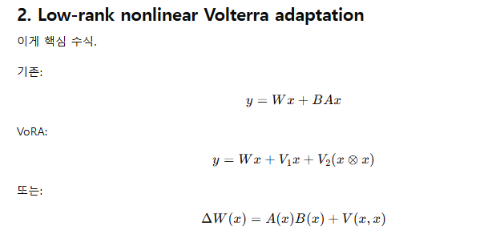
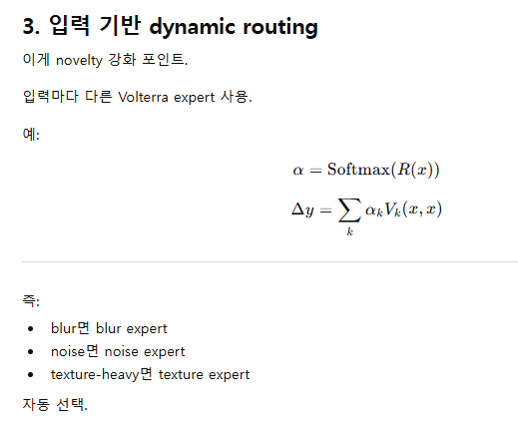
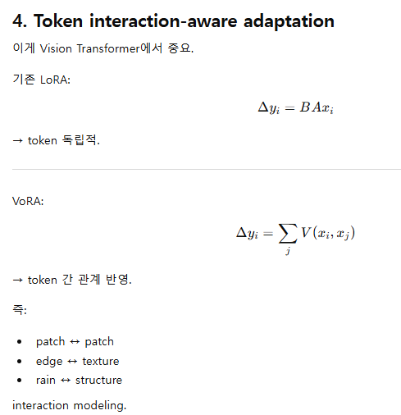

Slide 8
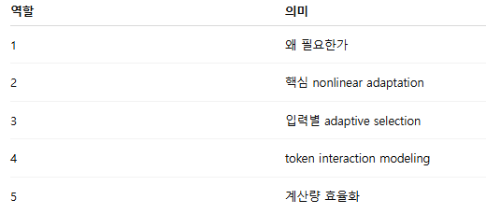
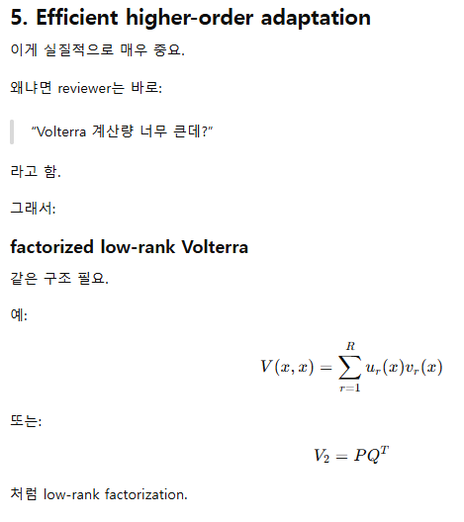
기존 LoRA : Static Linear update
VoRA : Dynamic Nonlinear Interaction-aware Update

Slide 9
실제 구현 과정

Slide 10
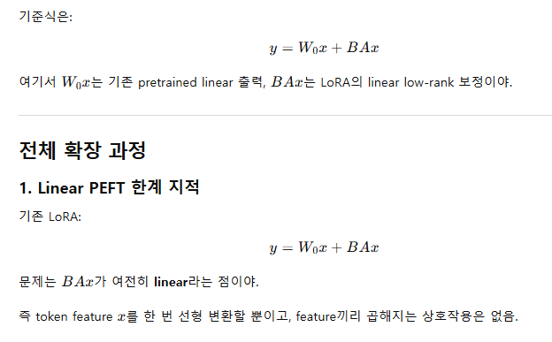
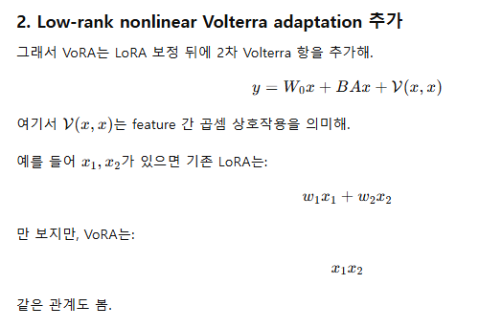

Slide 11
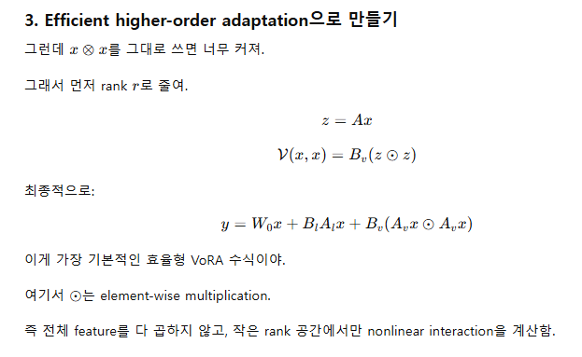
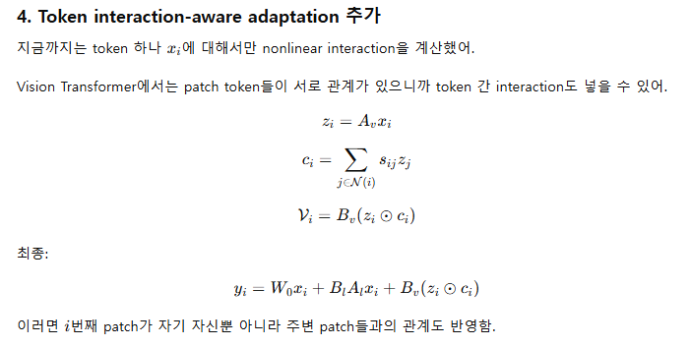
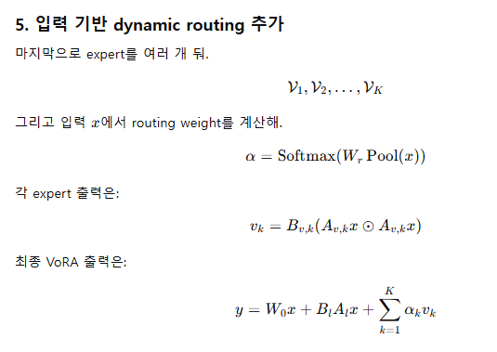

Slide 12
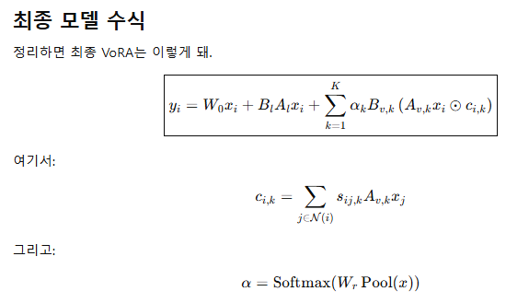
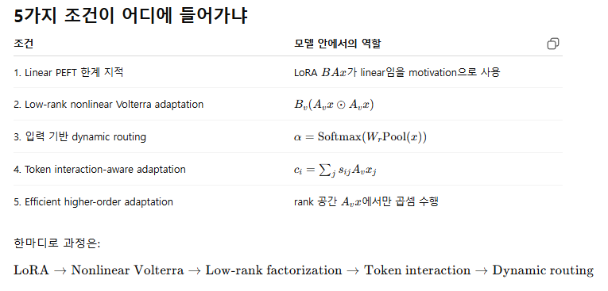

Slide 14
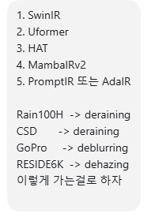
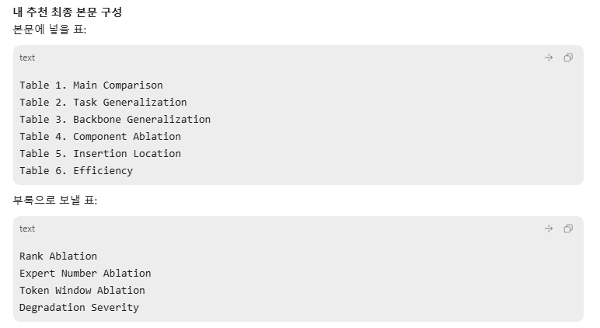
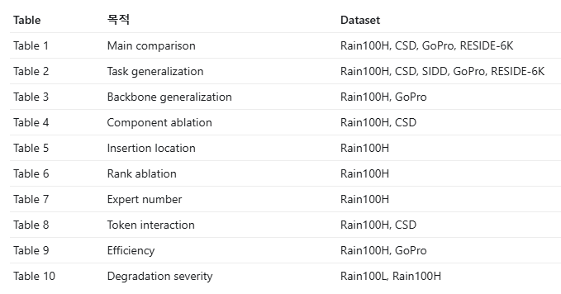

Slide 15
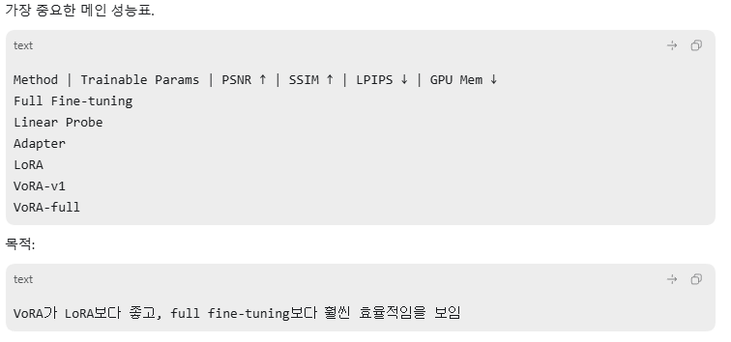
Table 1 Main Comparison
Rain100H, CSD, GoPro, RESIDE-6K

Slide 16
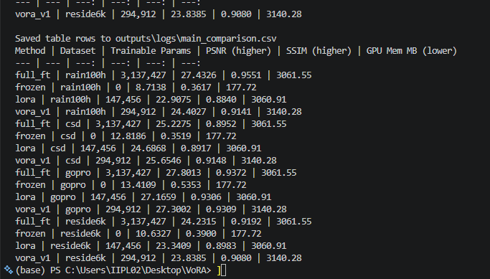
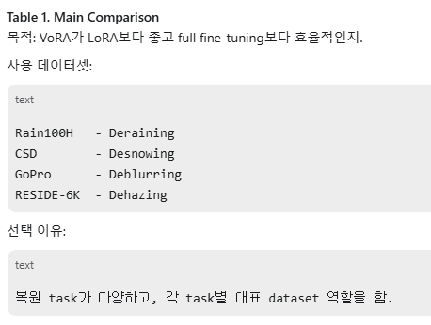
Table 1 Main Comparison
Table 1 확장판은 Adapter / VoRA-full / LPIPS 추가 후 재실험 필요

Slide 17
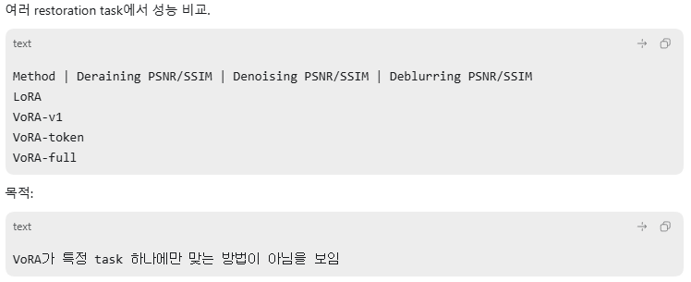
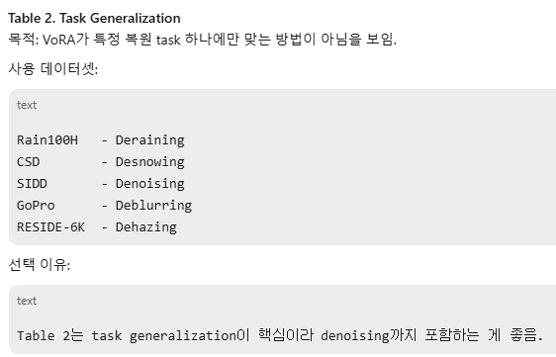
Rain100H, CSD, SIDD, GoPro, RESIDE-6K
Table 2. Task Generalization

Slide 18
Table 2. Task Generalization

Slide 19
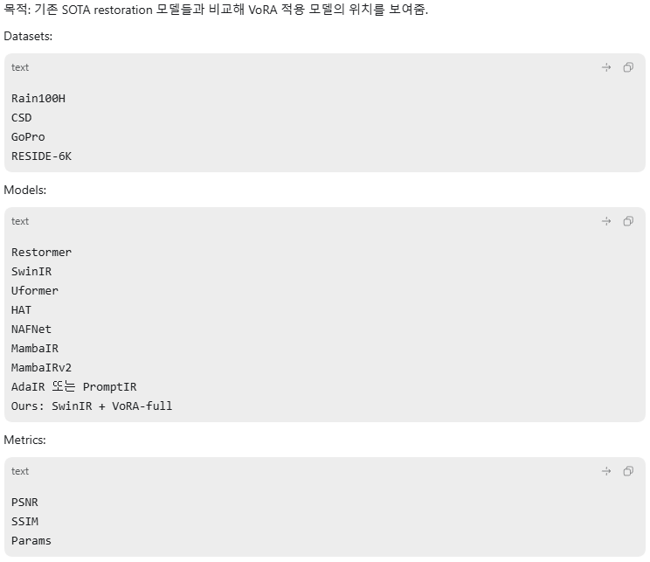
Table 3. Comparison with SOTA Restoration Models

Slide 21
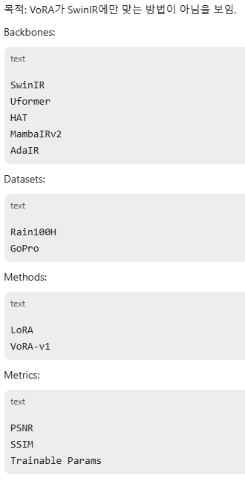
Table 4. Backbone Generalization

Slide 22
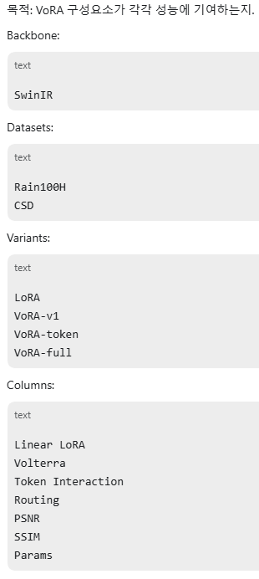
Table 5. Component Ablation

Slide 23
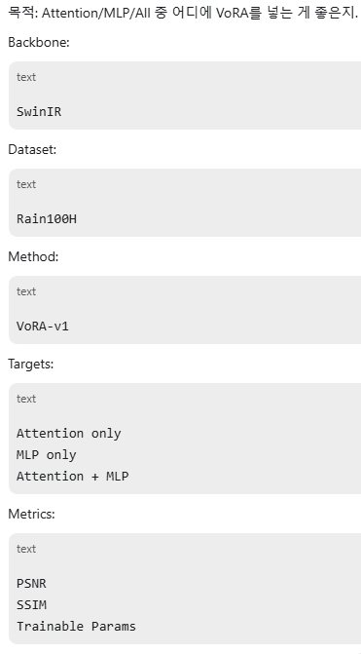
Table 6. Insertion Location Ablation

Slide 24
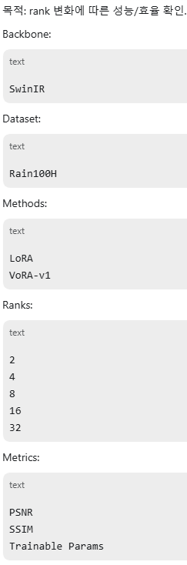
Table 7. Rank Ablation

Slide 25
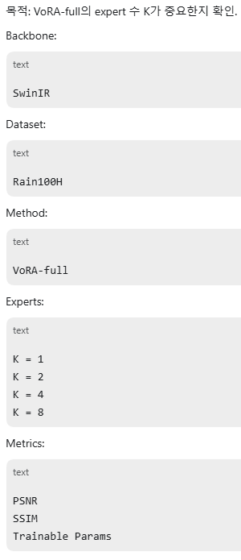
Table 8. Expert Number Ablation

Slide 26
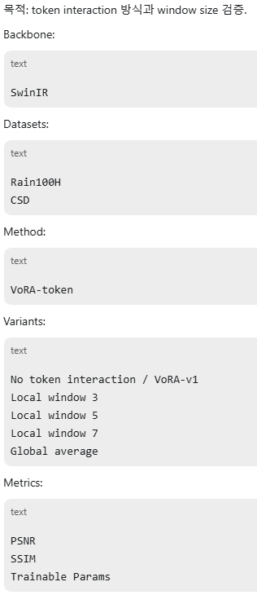
Table 9. Token Interaction Ablation

Slide 27
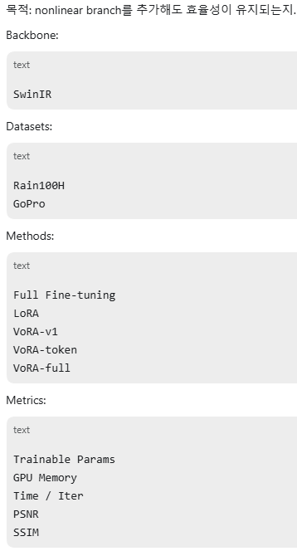
Table 10. Efficiency Comparison

Slide 28
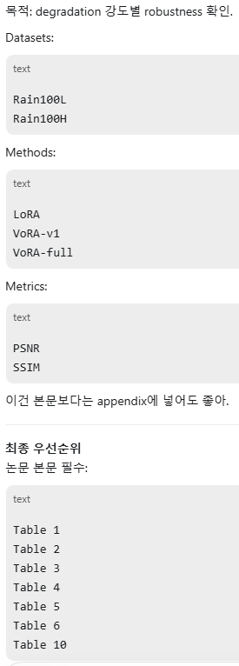
Optional Table 11. Degradation Severity

Slide 29
