Slide 1
DSA302: FINANCIAL
DATA ANALYSIS
Group 4: Austin, Eugene, Dehan, Jeremy, You Joh
Notes:
Good afternoon everyone. My name is Jeremy and this is group 4 and we are here to present to you our group project. In group 4 we have me, Austin, Eugene, De han and You Joh.

Slide 2

TABLE OF CONTENTS
01
02
ESTIMATE YIELD CURVE
FIT YIELD CURVE
Dataset
Forward Rates
Spot Rates
Exploratory Data Analysis
NS and NSS Models
Impact of Parameters
Notes:
Moving on to the agenda, there are 2 parts to this project. The first part is on estimating the yield curve where we will look at the dataset, forward and spot rates. The second part is on fitting the yield curve where we will do some exploratory data analysis, build the NS and NSS models and analyse the impact of the parameters

Slide 3
DATASETS
ZCBP.txt
ZCBYF86.csv
Contains a set of zero-coupon bond prices with their corresponding maturities up to 30 years
Contains spot rate from 1982-02-01 to 2020-08-28 of US Treasury Zero Coupon bonds that have maturities of 1 to 30 years
Notes:
For the datasets, we have 2 dataset. ZCBP.txt contains a set of zero-coupon bond prices with their corresponding maturities up to 30 years. ZCBYF86.csv contains the spot rate of US treasury zero coupon bonds that have maturities of 1 to 30 years from 1982 - 2020

Slide 4

Part
01
Estimate the yield curve
Notes:
Moving on to part 1, where we look at estimating the yield curve

Slide 5

ESTIMATING YIELD CURVE
Zero Coupon Bonds are priced: P(t)=100e^(-r(t)t)
We can’t find the spot rate directly but we know how forward rates are related to price
Spot rate is related to prices through forward rate, f(t)
r(t)=(1/t)∫f(s)ds
Notes:
Ultimately, we want to estimate the empirical spot rate so that we can plot the yield curve. In order to estimate the empirical spot rate, we have to look at Zero Coupon Bonds. They are priced using the bond price formula, which is face value of 100 multiplied by e to the power of negative rt multiplied t, where rt is the spot rate. Since we know how forward rates relate to price and how spot rates relate to forward rate, hence we can estimate spot rate from the forward rate.

Slide 6
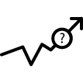
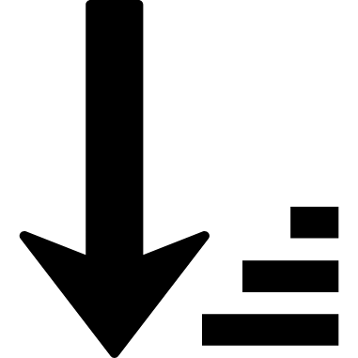

Data
Missing Values
Arrange
Plot bond prices vs Maturities
Check for missing values
The data was not arranged by time
Notes:
In terms of data integrity and data preparation, we checked for missing values. Thereafter, we arranged the data by time. This is to help the later parts of the question.

Slide 7
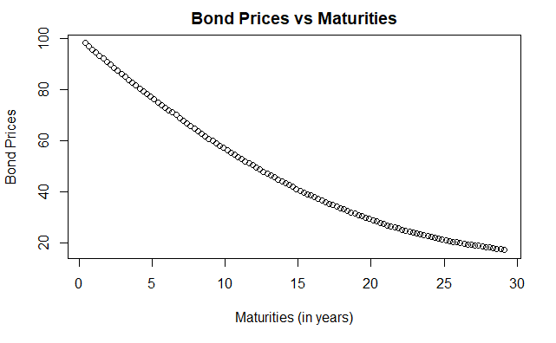
BOND PRICES VS MATURITIES
Zero-coupon bonds of longer maturities are priced lower than those with shorter maturities
Notes:
This plot shows that the zero-coupon bonds of longer maturities are priced lower than those with shorter maturities.

Slide 8

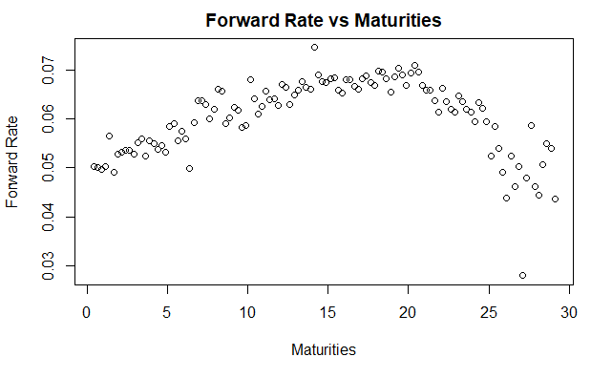
FORWARD RATES
Using the formula given, we calculated the empirical forward rates of the given data
Calculate f0 separately and bind the output together to give us 116 values of forward rates
Notes:
So to plot the forward rate vs maturities, we used the formula given to calculate the empirical forward rates of the given data.
Then, we calculate the f0 separately and binded the output together to give us 116 values of forward rates
I will be handing over my time now to Eugene who will talk about smoothing the forward rates

Slide 9


SMOOTHING FORWARD RATES
STEP 1
STEP 2
STEP 3
STEP 4
Create a function and obtain sum of squared errors (SSE)
Optimise the parameters of the function to obtain the min SSE
Fit the optimised values into the model
Superimpose the smoothing functions onto the same plot

Slide 10
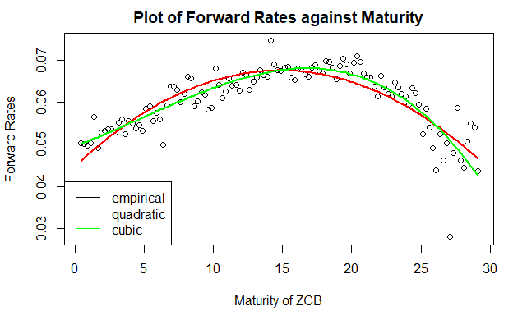
SMOOTHING FORWARD RATES
Graphically, we can observe that the cubic function fits the empirical data better as compared to the quadratic function

Slide 11




SPOT RATES
STEP 1
STEP 2
STEP 3
STEP 4
Create breaks at each points t_{j} in the data. Create a grid that sequences from the minimum to the maximum values of t given
Use findInterval() function to find the interval each value of t is in
Apply to both formulas to find the empirical spot rates
Use cumsum() function to obtain the first part of the formula

Slide 12
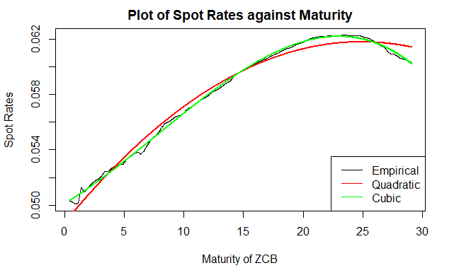
SMOOTHING SPOT RATES
Smoothing of the spot rates is done similarly to smoothing of forward rates
Graphically, we can observe that the cubic function fits the empirical data better as compared to the quadratic function

Slide 13

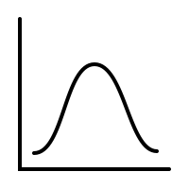
CUBIC CURVE GIVES LOWER SSE
LOWER BIAS
HIGHER VARIANCE
Increasing the number of parameters allows the estimated value to become more precise
Bias-Variance trade-off suggests that having more parameters would create greater variance

Slide 14
Part
02
Fitting the Yield Curve and Presenting the data in a suitable way
Notes:
Now we move on to the 2nd half of the presentation. In this section we aim to model the yield curve data and visualise the data in a suitable way.

Slide 15
Presenting the data in a suitable way
Data Set: “ZCBYF86.csv”
Contains US Treasury Zero Coupon bonds spot rates
Duration: 1986-02-01 to 2020-08-28
Bonds with maturities of 1 to 30 years.
The dataset has 3 dimensions available for plotting:
1. Spot Rates
2. Time
3. Maturity
Notes:
As a quick overview of, the data set used, ZCBYF86.csv contains the spot rate ( in percent per annum) from from 1986-02-01 to 2020-08-28 of US Treasury Zero Coupon bonds that have maturities of 1 to 30 years.
Therefore, the dataset has 3 dimensions available for plotting: spot rates, time, maturity.
This gave alot of options on how to visualise the data. WHile at the same time, poses the problem of potentially not being unable to represent the data well using purely 2-dimensional plots.

Slide 16
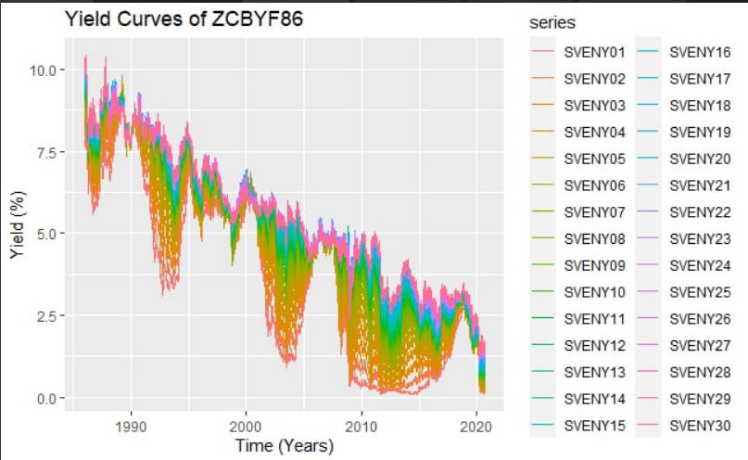
Presenting the data in a suitable way
Trends:
Shorter term bonds generally have lower spot rates
Shorter term bonds display higher volatility
Overall downwards trend of spot rates over time
Notes:
The first method of visualisation we used was plotting yield against time, with each line representing a different time-to-maturity ranging from 1-30. Further we used color that changed gradually across the years, with orange for 1 year bonds morphing into green, blue, and pink for 30-year bonds.
From this plot, we observe the following trends:
1. Shorter term bonds have generally lower spot rates than longer term bonds
2. Shorter term maturity bonds display more volatility in spot rates than longer term bonds
3. We also note an overall downwards trend of spot rates over time, for both short- and long-term bonds.

Slide 17

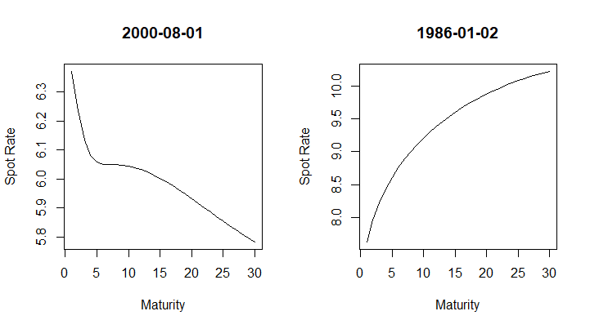
Presenting the data in a suitable way
Changes in annualized yield curve over time (1986 to 2020)
Over the years, we can see that the yield curve takes on many different shapes
Notes:
Next, as the dataset contained data from 1986-2020, we attempted to plot the annualized yield curves for each year, and output it as a gif, as can be seen here.
We observe that the shape of the yield curve varies throughout time. Generally, it stays as a normal yield curve, while only in certain years they are inverted. Examples of inverted yield curve is shown on the left, normal on the right.

Slide 18
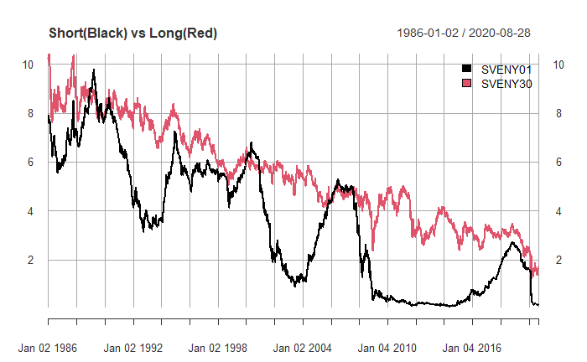
Yield Curves as a predictor for recessions
We observe 3 recession periods:
Savings & Loans crisis (1990-1991)
Dot-Com Bubble (2001)
Sub-prime Housing Bubble (2007-2009)
We can observe:
SVEN01 > SVEN30 spot rates before recessions
Inverted yield curves
Notes:
Next we came across the concept of using yield curves as a predictor for recessions. In the literature, they are well documented as leading indicators, where they tend to invert before a recession occurs.
We observe 3 recession periods, which arose from the Savings & Loans crisis, Dot-com BUbble and the subprime housing bubble.
From examining these periods closely, we noticed that the 1-year bonds had higher spot rates than 30-year bonds during these periods of recession. And this corresponds to inverted yield curves for these periods.
Now You Joh will elaborate more on the NS and NSS models.

Slide 19
Fitting the Yield Curve: Models
Nelson-Siegel (NS) Model (1987)
Equation
Nelson-Siegel-Svensson (NSS) Model (1994)
Equation
From a dataset of 30 different bonds for each day, the spot rates can now be collapsed into an equation predicted by just a few parameters when expressed as a function of maturity
It is the set of 𝚹_{i} that help to describe the shape of the yield curve.
Notes:
Svensson (1994) model and the Nelson & Siegel (1987) model
Rate expressed as time.

Slide 20
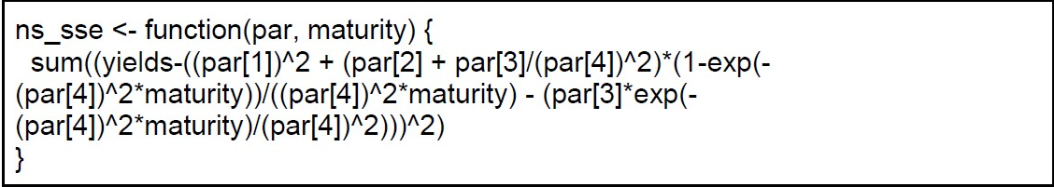
Finding the Parameters: Considerations
1. Since both models require certain parameters to be positive (𝚹₀, 𝚹₃, 𝚹₅ > 0), we will first apply the transformation to the following parameters:
𝚹_{i} = 𝜷_{i}²
2. The parameters of the equation can be obtained by minimizing the sum of non-linear squared errors of a non-linear regression
Hence, we first similarly start by defining a function to return the non-linear sum of squared errors in terms of the spot rates and parameters of the model.
3. After which, optim() function is used to minimize the SSE of the NS and NSS models using this function
In this example, the optimization of this function will return the parameter 𝜷_{i} instead
Notes:
Square transformation.
Last part:
Betai instead of thetai

Slide 21
Comparison between the NS and NSS Models
Sum of Squared Errors (SSE)
Akaike Information Criteria (AIC)
Bayesian Information Criteria (BIC)
Plotting the differences in these criteria over time…
Obtained from the optimization
A smaller SSE denotes a better fit
AIC=log(𝑑𝑒𝑣𝑖𝑎𝑛𝑐𝑒)+2𝐾
A smaller AIC denotes a better fit
BIC=𝑛log(𝑑𝑒𝑣𝑖𝑎𝑛𝑐𝑒)+𝐾log𝑛
A smaller BIC denotes a better fit
Notes:
Since we have 2 models we want to find which is the better one.
K is the no. of parameters.?

Slide 22
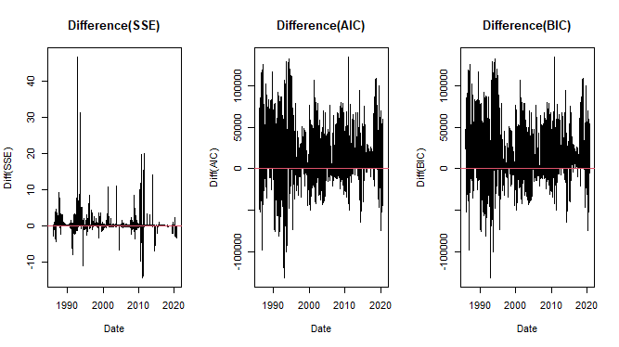
Comparison between the NS and NSS Models
Sum of Squared Errors (SSE)
Akaike Information Criteria (AIC)
Bayesian Information Criteria (BIC)
Conclude: The NSS model fits the data better most of the time
Notes:
We took the difference of the NS-NSS to do the plotting.
Since the difference is positive, NSS is better

Slide 23
Importance of the Parameters
𝚹₀
𝚹₁
𝚹₂/𝚹₃
But why does the yield curve take such a shape?
How can we see the relationship between the shape of the yield curve and the parameters?
Based on literature surrounding the parameters of the NS and NS Models, the 3 parameters that control the shape of the yield curve are:
Since it is independent of time, it is the long term rate
Affects the slope of the yield curve
It is expected that the curve slopes downwards when 𝚹₁ > 0
Affects the “hump” of the yield curve
The additional parameter in the NSS model accounts of the 2nd “hump”
Notes:
Next I will be diving into the importance of the parameters in the NS and NSS models. We wanted to find out how the parameters affected the shape of the yield curve, and based on the literature on the NS and NSS models, the paramters affect the shape in the following ways. Firstly, theta0 is independent of time and thus is asymptotically the longterm rate. Theta1 affects the slope of the curve and it is expected that the yield curve slopes downwards when it is positive. Lastly theta2/theta3 is what affects the “hump” of the curve. We see that the NSS model has additional parameters and those actually account for the second hump in te yield curve to give it a s-shape

Slide 24
Importance of the Parameters
Because of the presence of a second “hump” in the yield curve creating a local minima/maxima that is difficult to locate, we will be focusing our analysis on the NS model where we only expect 1 “hump”
Hence we filter the data for the days in which the NS model would fit better than the NSS model
Research by:
Gilli, et al. (2010, March 30)
Notes:
1 difficulty mentioned by authors is that since the NSS model has a second hump, there are local maxima and minima that are hard to locate and so to simplify things we will be restricting our analysis to just the NS model that has one hump. So we will filter and work on data in which the NS models fitted better so as to expect a simpler model.

Slide 25
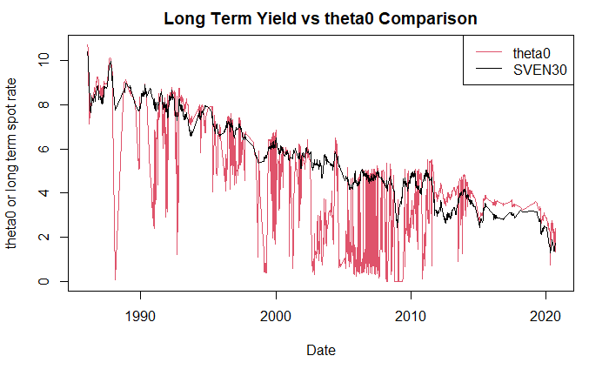
𝚹₀
Since it is independent of time, it is the long term rate.
Hence if we were to superimpose the 𝚹₀ onto the plot of the long term rates over time,
We observed that the value of 𝜃₀ follows a similar downwards trend of the long-term bond spot rates over time.
However, the 𝜃₀ is a lot more volatile than the long-term bond spot rates.
Notes:
First off, the theta0 parameter, as mentioned it is independent of time and so if we superimpose the 2 plots of theta0 and the long term rate, we see that they do generally follwo the same trend over time. However, the theta0 is a lot more volatile than the long term spot rate.

Slide 26
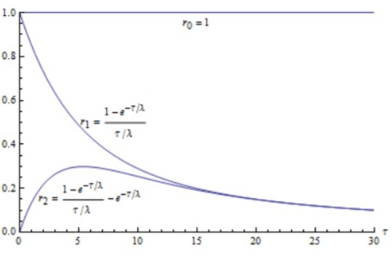
𝚹₁
Affects the slope of the yield curve
It is expected that the curve slopes downwards when 𝚹₁ > 0
Notes:
Next theta1 affects the slope of the yield curve. As for why that is the case, we see that it affects this term in the equation which we see decays over time but contributes alot to the spot rate in the short term. Hence we expect it to curve downwards when it is positive

Slide 27
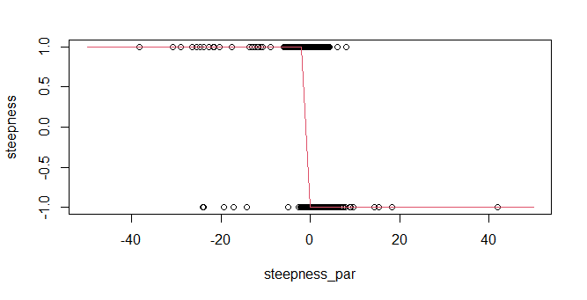
𝚹₁
We take the slope in the short term to be SVEN02-SVEN01
Plotting the sign of the slope against 𝚹₁, we see that the relationship generally holds.

Slide 28
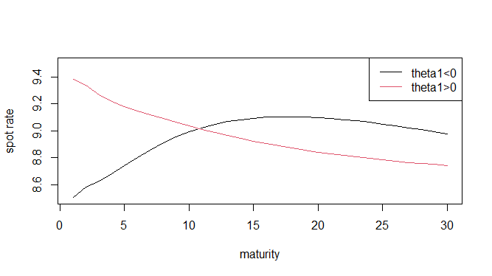
𝚹₁
We take the slope in the short term to be SVEN02-SVEN01
Plotting the sign of the slope against 𝚹₁, we see that the relationship generally holds.
Plotting the yield curve for days when 𝚹₁ was positive and when it was negative, we see that it seems to be the case.

Slide 29
𝚹₂/𝚹₃
Affects the “hump” of the yield curve
The additional parameter in the NSS model accounts of the 2nd “hump”
Notes:
Lastly, the theta2/theta3 paramter adjusts the equation for the hump in the yield curve as we see it to also be the case in its factor loading where it increases then decreases over time. Ive hihglighted the terms that the parameter will affect in red as you can see

Slide 30
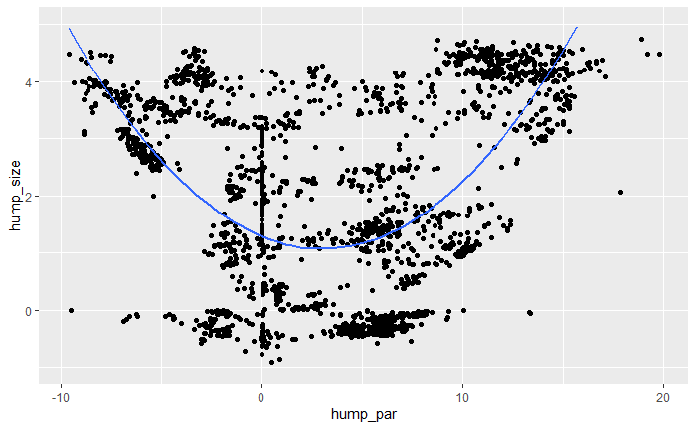
𝚹₂/𝚹₃
To get the size of the hump,
If the yield curve slopes upwards, we take the maximum of the yield curve - SVEN01
If the yield curve slopes downwards, we take the SVEN01 - the minimum of the yield curve
Plotting the size of the hump against 𝚹₂/𝚹₃, we see a weakly quadratic relationship
This suggests that as the value of 𝚹₂/𝚹₃ becomes more extreme, the size of the hump gets bigger.

Slide 31
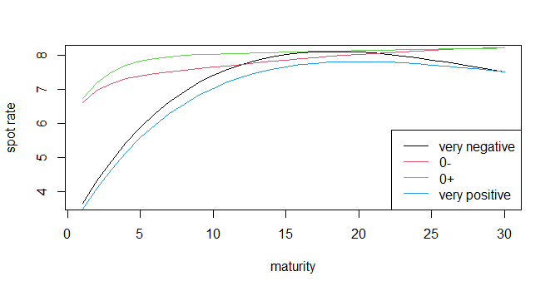
𝚹₂/𝚹₃
To get the size of the hump,
If the yield curve slopes upwards, we take the maximum of the yield curve - SVEN01
If the yield curve slopes downwards, we take the SVEN01 - the minimum of the yield curve
Plotting the size of the hump against 𝚹₂/𝚹₃, we see a weakly quadratic relationship
Plotting the yield curve for days when 𝚹₂/𝚹₃ was extremely positive, extremely negative, and near 0, this relationship seems to hold as well

Slide 32
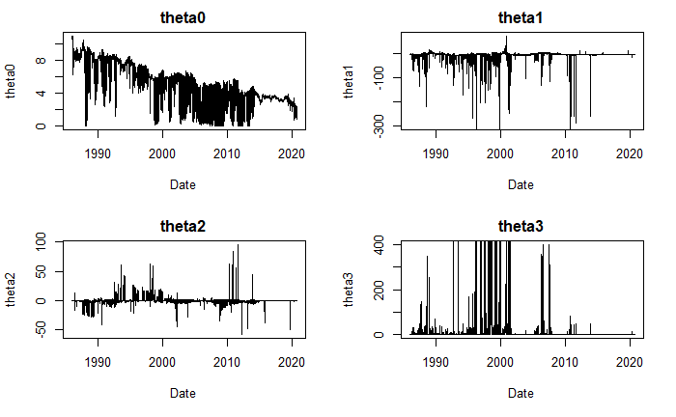
Conclusion
Our analysis may have several limitations as:
It uses only the parameters of the NS model even though we have shown that NSS model parameters are better at fitting the yield curves
Our analysis of 1 parameter may not hold if the other parameters are very volatile
There may be high correlation between parameter values as suggested by some authors
Future Study:
More study could be done on creating a creating a predictive model for a set of 𝚹_{i} to predict in which the 𝚹_{i} parameters are relatively stable.
We could also look into modelling the volatility and correlation of the parameter values.
Research by:
Gilli, et al. (2010, March 30)

Slide 33
Thank You
Notes:
Now we move on to the 2nd half of the presentation. In this section we aim to model thje yield curve data and visualise the data in a suitable way.

Slide 34
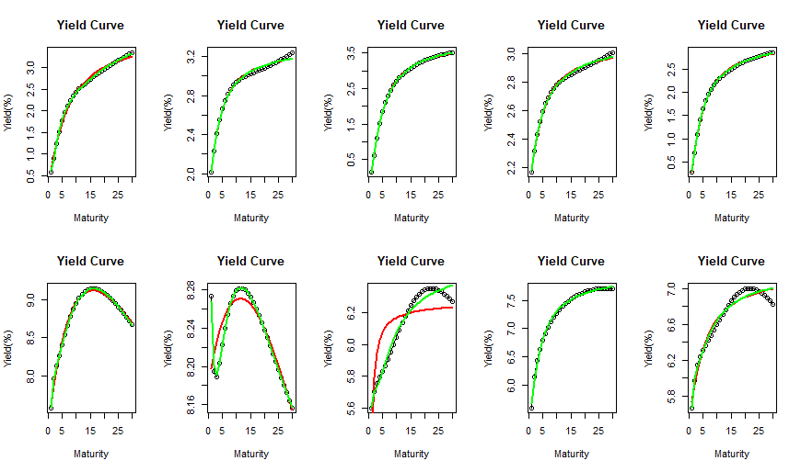
Visual Representation
Using a random sample of 10 days, if we model the yield curves using the NS and NSS model:
(red = NS, green = NSS)

Slide 35
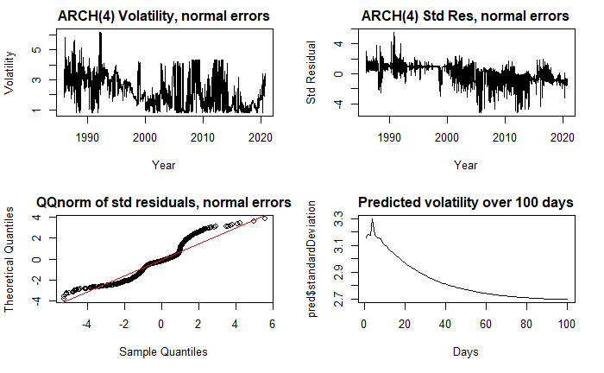
Volatility Modelling of 𝚹

