Slide 1
Wisconsin breast cancer dataset
Prof. sadeghi
By Mohammad Dehghan-Rouzi(810197243)
dehghanr.mohammad@gmail.com
dehghanr.mohammad@ut.ac.ir

Slide 2
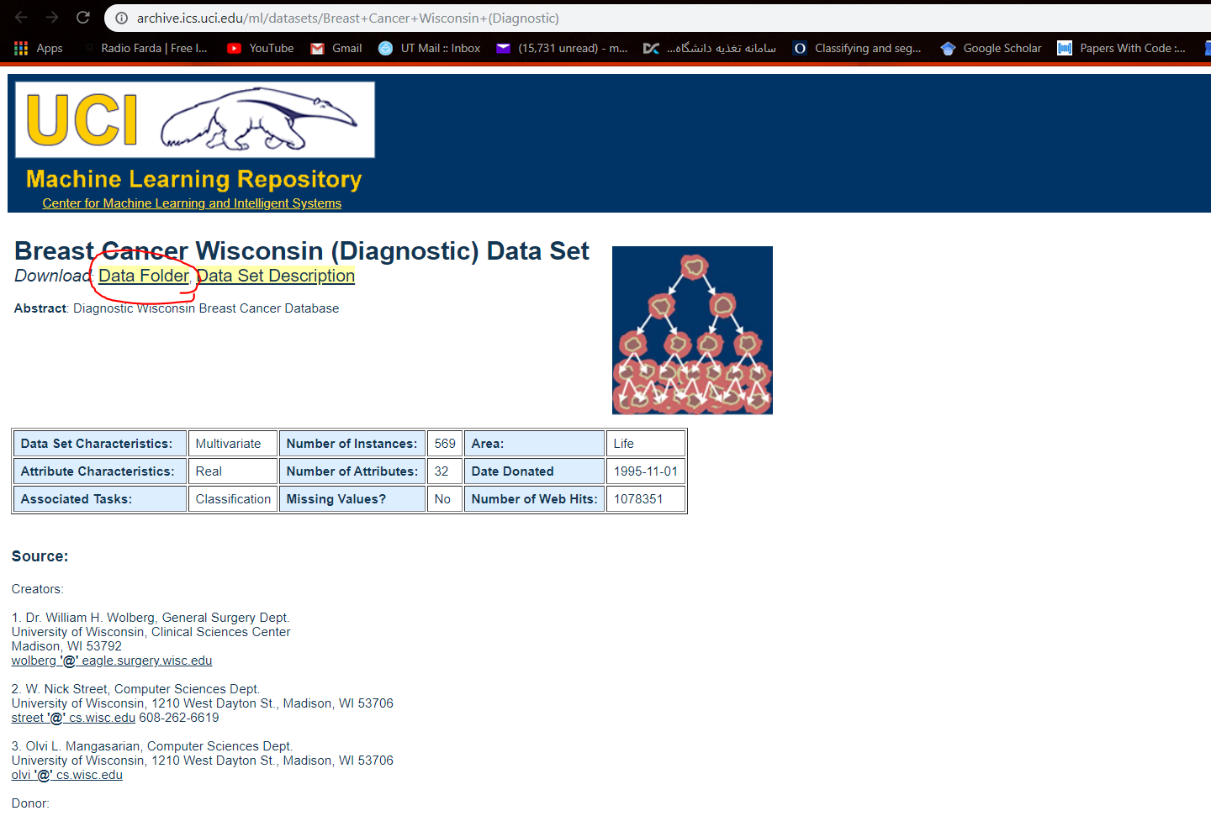
Dataset
https://archive.ics.uci.edu/ml/datasets/Breast+Cancer+Wisconsin+(Diagnostic)

Slide 3
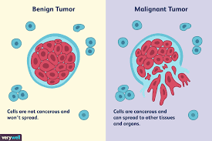
Breast cancer dataset description
How many features? 30
How many examples (rows)? 178
How many classes? 2
class_0 → Benign
class_1 → Malignant

Slide 4
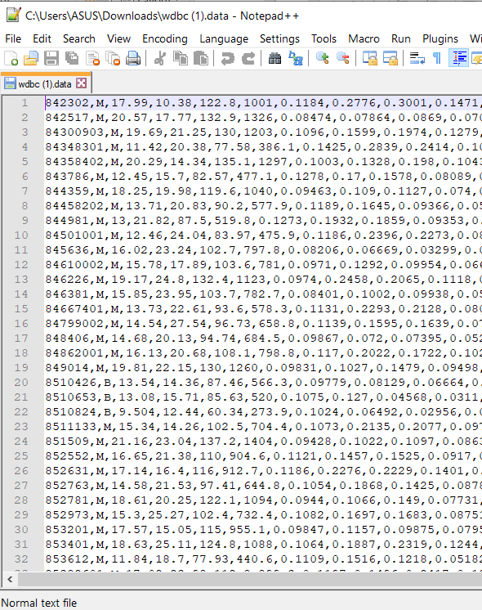
Features od dataset
30 features (3*10)
a) radius (mean of distances from center to points on the perimeter) b) texture (standard deviation of gray-scale values) c) perimeter d) area e) smoothness (local variation in radius lengths) f) compactness (perimeter^2 / area - 1.0) g) concavity (severity of concave portions of the contour) h) concave points (number of concave portions of the contour) i) symmetry j) fractal

Slide 5
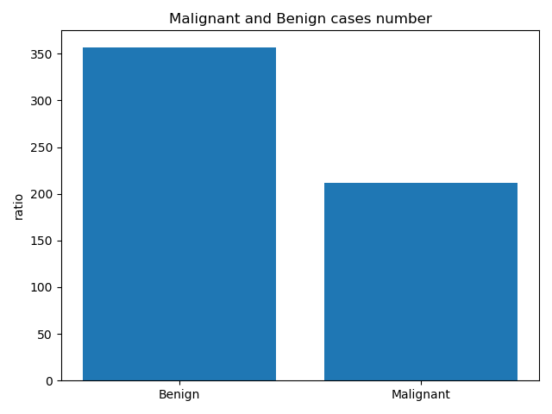

Now lets visualize the data!

Slide 6
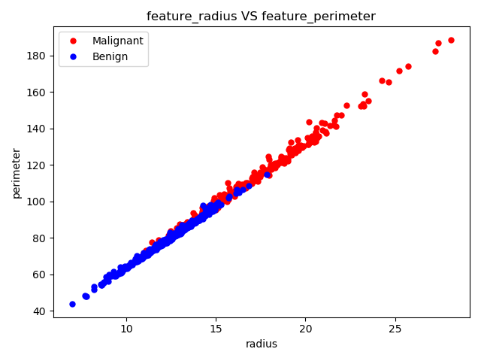
Correlation between features
Radius vs perimeter

Slide 7
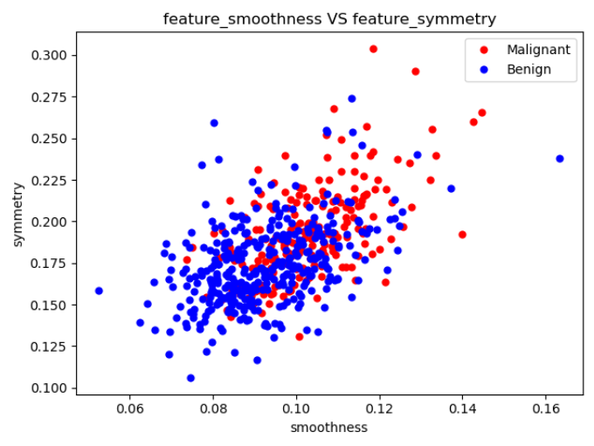
Some bad features
Smoothness vs symmetric

Slide 8
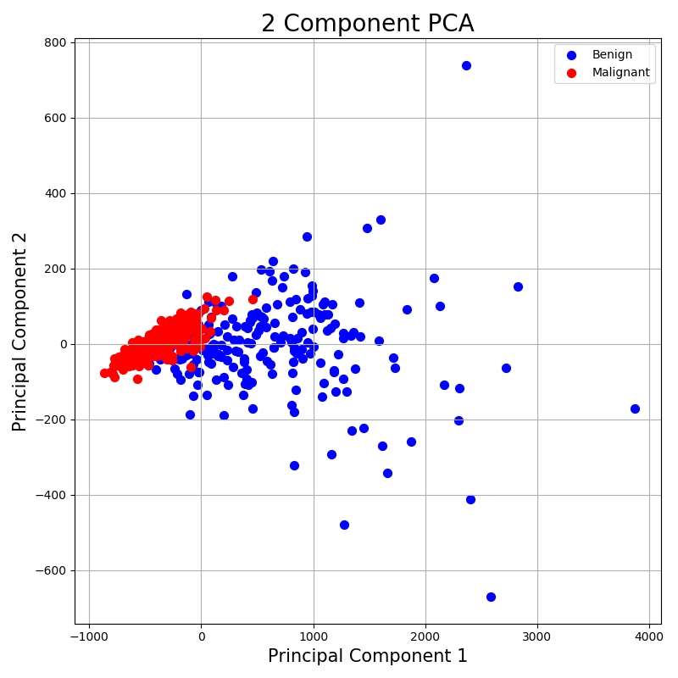
PCA (Principal component analysis)
pca = PCA(0.99)
principal_components = pca.fit_transform(data)
Explained variance ratio:
[0.98204467, 0.01617649]

