Slide 1
Results & Action Areas | Management Summary
KEY FINDINGS
ACTION AREAS — EFFECTIVE IMMEDIATELY
1
OI –29% vs. Plan
①
Reduce costs → Win Rate > 25%
YTD €25.7M vs. €36.2M YTD plan → remaining target €25.3M to full-year €51M Run-rate €3.2M/month — below monthly minimum €4.3M
Design identification · Costing · Subcontractors-Procurement · Hardware (Metasys / EasyIO etc.)
②
Quality Gate + BANT (≥ 150k)
2
Win Rate 15 % (historically > 30 %)
7-question briefing + verify Budget · Authority · Need · Timing before every proposal · Identify potential Change Order / Claims through bidder questions
Cost structure too high: design, costing, subcontractors → proposals not competitive enough
③
Pre-Sales Mandatory (≥ 150k)
Win mix: > 75% Installed Base
Early involvement of Pre-Sales team ·
3
+€13M CO by Execution → real new share even lower Greenfield must grow
④
Project size: avg. 350k → ≥ 750k
Fewer, but larger deals · BANT qualification filters out micro-projects
⑤
Vertical focus per location
Leverage strengths, don't spread thin
⑥
Greenfield & new customer share increase
Currently 75% Installed Base — strategically grow into new customers & Greenfield
BTS EUR SCE PE Controls Germany | Kaizen Event June 2026 | Management Summary

Slide 2
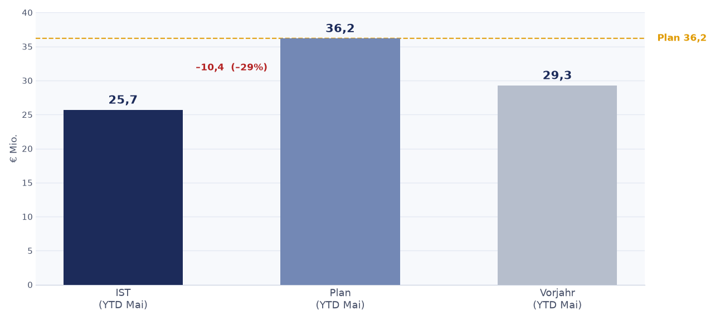
Order Intake YTD | October 2025 – May 2026
Actual YTD (€M)
25,7
Plan YTD (€M)
36,2
Variance
–10,4 (–29%)
Prior Year YTD
29,3
→ Shortfall vs. prior year: –12% | Shortfall vs. plan: –29% | Remaining time: 4 months
* Total Volume Secured YTD M08 (May 2026) | Figures in €M
Avg. actual / month
~€3.2M
YTD €25.7M / 8 months
Source: Controlling KPI report (M08) / Ops Review May 2026 | Figures in €M

Slide 3
EFFECTIVE IMMEDIATELY
Quality Gate
Mandatory process for all opportunities ≥ €150,000
Goal: Deploy resources strategically · Identify high-potential projects early Improve costing and decision quality · Recognize low-win projects early
1. Quality
2. Efficiency
3. Control
Better proposal quality through structured preparation
Resource deployment only where win probability is realistic
Management overview before every proposal submission ≥ 150k

Slide 4
Quality Gate | The Process (≥ €150,000) — simplified to 4 steps
1
2
3
4
Quality Gate
Send THF file
Kick-off Meeting
Go / No-Go Decision
10-min check: answer the mandatory questions via Teams. Pre-Sales involved from €150k.
→
At latest 4 days before submission deadline to costing.
→
10 min. with sales: present project, clarify questions.
→
Final approval for submission or rejection.
≤10 Min.
–4 days before deadline
10 Min.
immediately
* Applies to all proposal submissions ≥ €150,000 | Pre-Sales involvement mandatory | Budget proposals (no win chance): no Pre-Sales, no supplier involvement

Slide 5
Quality Gate | Email Brief Questions (≥ €150,000)
Sales answers these 7 questions via Teams at the start of every opportunity ≥ 150k – max. 10 minutes effort
1
Win Design
2
Subcontractors
What technical and commercial design do we want to win this project with?
Which subcontractors should be deployed on this project?
3
Strategic Importance
4
Data Points
Why is this project important for our company (reference, customer, region, technology)?
How many data points (I/O points) does the project have? (complexity, size estimate)
5
Special Considerations
6
Duration
Are there project-specific special considerations, risks, or special requirements to note? Identify potential Change Order / Claims through bidder questions?
What is the planned project duration? (execution period, milestones)
7
BANT Check
NEW
Budget · Authority · Need · Timing – 4 criteria to be verified before creating a proposal: Is the budget approved? Are we talking to the decision-maker? Is there a clear need? Is there a binding deadline? → Details & practical example: Slide 17

Slide 6
QUALITY GATE — OWNERSHIP & TRANSITION
Gate Owner & Deputy | a temporary bridge until competence is built
GATE OWNER (GATEKEEPER)
DEPUTY (STELLVERTRETER)
Name: ________________
Name: ________________
Mandate owns the Go/No-Go and may say No-Go.
Competence technical + commercial experience — the single quality check for every deal ≥ €150k (closes the fachliche-Eignung gap).
Does quick-check · decide ≤ 24 h · document · trigger Pre-Sales / Costing on a Go.
Covers the Gate Owner in absence — same mandate & competence.
Guarantees the ≤ 24 h decision SLA is always met — no opportunity has to wait.
Second view on borderline or high-risk deals when needed.
A TEMPORARY BRIDGE — NOT FOREVER
The Quality Gate is a transition measure. It is needed as long as the technical competence (fachliche Eignung) is not yet established across the team.
As the team builds competence, the gate is simplified step by step — and can later be reduced or phased out.
Goal: fewer errors now · self-sufficient teams later.
BTS EUR SCE PE Controls Germany | Quality Gate – Ownership & Transition | June 2026

