Slide 1
Avalon VR
Giant Mech Action
Bryce Wilson, Derek Holland, Doug Allen, Jesse Tao

Slide 2




Tools
Github *****
Doxygen *****
Trello **
C# ***
Unity ****
Discord ****

Slide 3
Tools (Unity Frameworks)
Steam VR
VR Toolkit

Slide 4
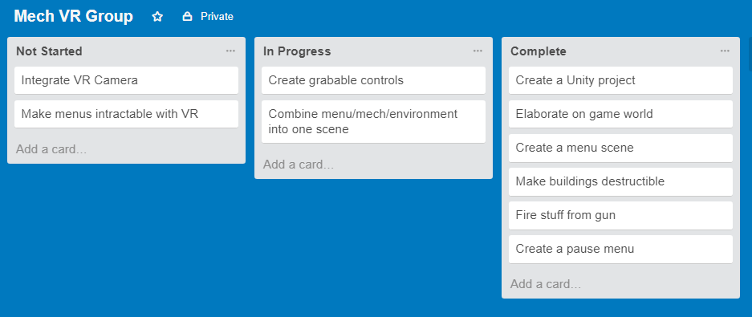
Working with Trello

Slide 5
Methodologies
Agile
Pair Programming

Slide 6
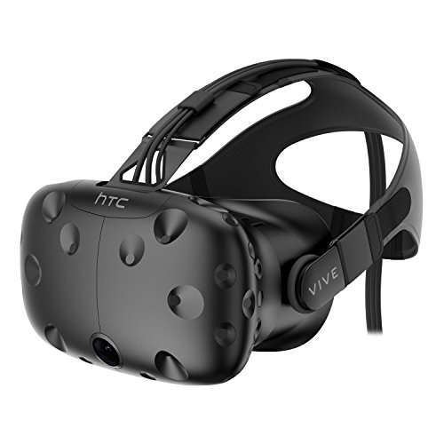
Hardware
HTC Vive

Slide 7
Challenges
C# and Unity scripting (most of us are new to Unity)
VR implementation is complex
Finding assets
Git and Unity don’t mix

