Slide 1
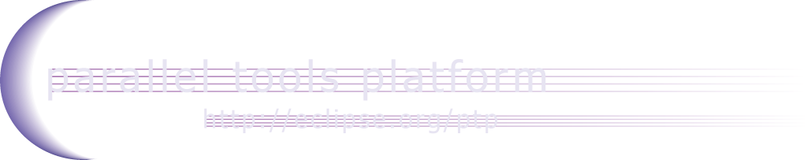
Development Environments for HPC: The View from NCSA
Jay Alameda
National Center for Supercomputing Applications, University of Illinois at Urbana-Champaign
DEHPC ‘15
San Francisco, CA
18 October 2015

Slide 2
Acknowledgements
Portions of this material are supported by or based upon work supported by the Defense Advanced Research Projects Agency (DARPA) under its Agreement No. HR0011-07-9-0002, the United States Department of Energy under Contract No. DE-FG02-06ER25752, the Blue Waters sustained petascale computing project, which is supported by the National Science Foundation under award number OCI 07-25070, and the SI2-SSI Productive and Accessible Development Workbench for HPC Applications, which is supported by the National Science Foundation under award number OCI 1047956
The SI2-SSI team is lead by Jay Alameda (NCSA), Greg Watson (IBM), Steven Brandt (LSU), and Allen Malony (U Oregon). Team members and senior personnel include Beth Tibbitts (IBM), Ralph Johnson (U Illinois), Chris Navarro (NCSA), Sameer Shende (U Oregon), Wyatt Spear (U Oregon), Brian Jewett (U Illinois), Galen Arnold (NCSA), and Rui Liu (NCSA)
Any opinions, findings, and conclusions or recommendations expressed in this material are those of the author(s) and do not necessarily reflect the views of the National Science Foundation

Slide 3
Outline
Overview of Eclipse and the Parallel Tools Platform (PTP)
Motivation for Workbench for High Performance Computing (WHPC)
Advantages of Eclipse for HPC Software Developers
Sustainability, Investment, Collaboration: Building Community
Challenges with DEHPC
Opportunities (for discussion)
Notes:
Updated res mgr info at end, but not Installation info – it’s all still 3.4 stuff here (BRT 8/13/09)

Slide 4
Eclipse
Integrated development environment (IDE)
Edit code, compile, run, debug without leaving Eclipse
Graphical user interface

Slide 5
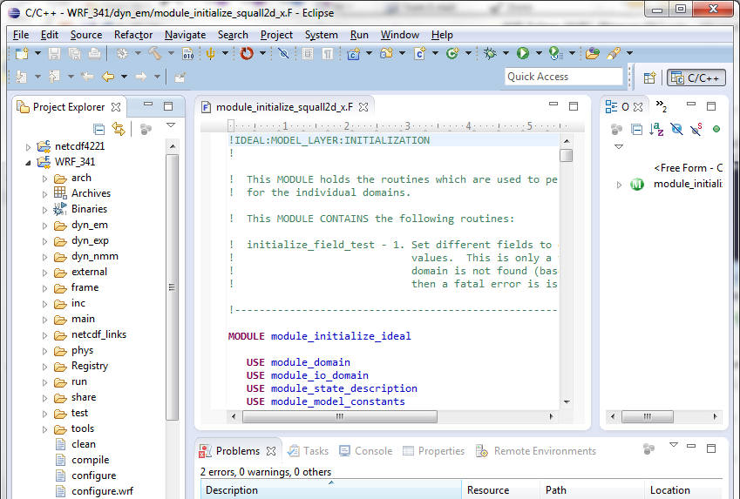
Eclipse

Slide 6
Eclipse
Integrated development environment (IDE)
Edit code, compile, run, debug without leaving Eclipse
Graphical user interface
Plug-ins add new functionality to Eclipse
Support languages: C/C++, Fortran, Python, …
Support version control systems: Git, Subversion, …
Support issue tracking systems: Bugzilla, Jira, …
Support HPC development (?!)

Slide 7
Parallel Tools Platform (PTP)
PTP: a set of plug-ins that extend Eclipse to support HPC development
Write code on your laptop
Build it on a remote HPC system using its compilers
Run it on the remote HPC system (qsub)
Debug it on the remote system (MPI debugger)
Tune it for performance on the remote system
…all inside Eclipse!

Slide 8
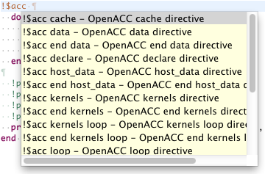
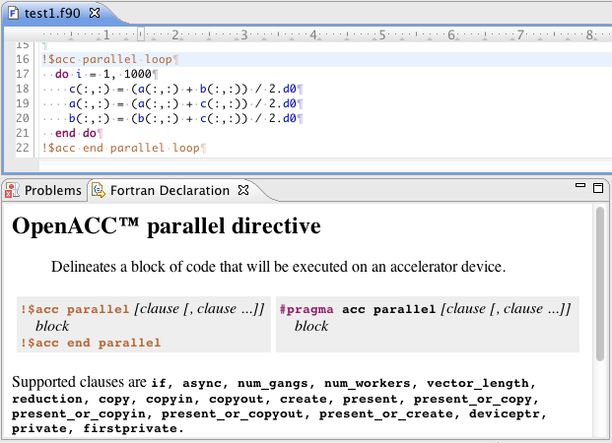
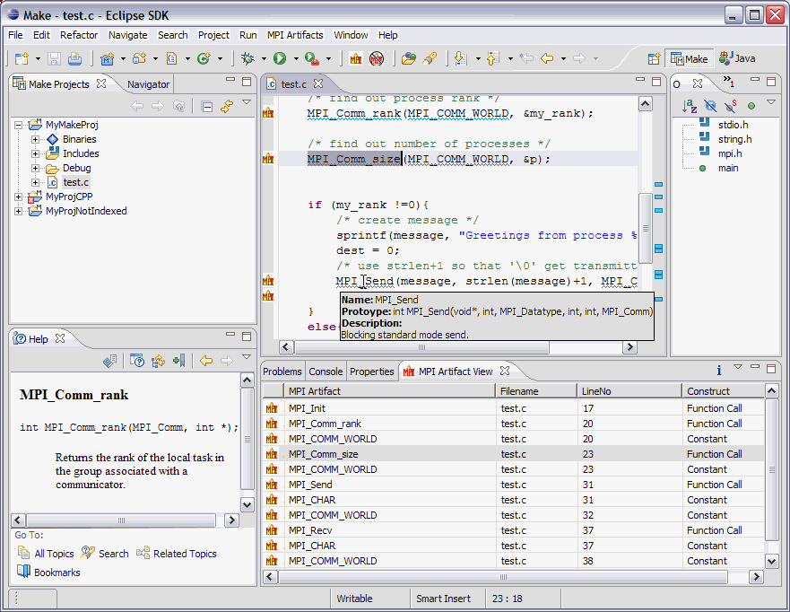
Eclipse Parallel Tools Platform (PTP)
Coding & Analysis
Code completion
Notes:
This slide shows the main parts of the current PTP in a single view; details most of these are on the subsequent slides.
Eclipse is the unifying platform for a variety of tools, which can all be integrated into the same workbench.
The blue oval shows the parts originally contributed by IBM (PLDT, and eventually, Performance Tools)

Slide 9
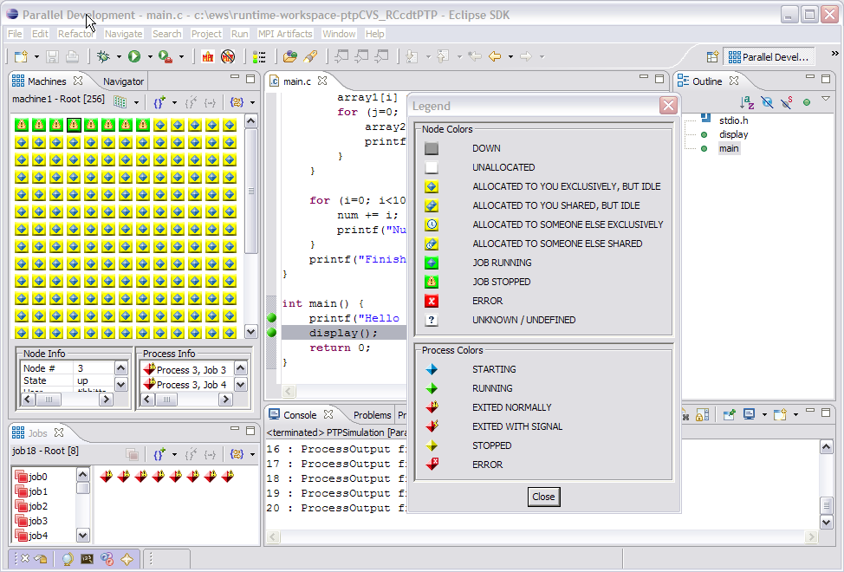
Launching & Monitoring
Eclipse Parallel Tools Platform (PTP)
Coding & Analysis
Notes:
This slide shows the main parts of the current PTP in a single view; details most of these are on the subsequent slides.
Eclipse is the unifying platform for a variety of tools, which can all be integrated into the same workbench.
The blue oval shows the parts originally contributed by IBM (PLDT, and eventually, Performance Tools)

Slide 10
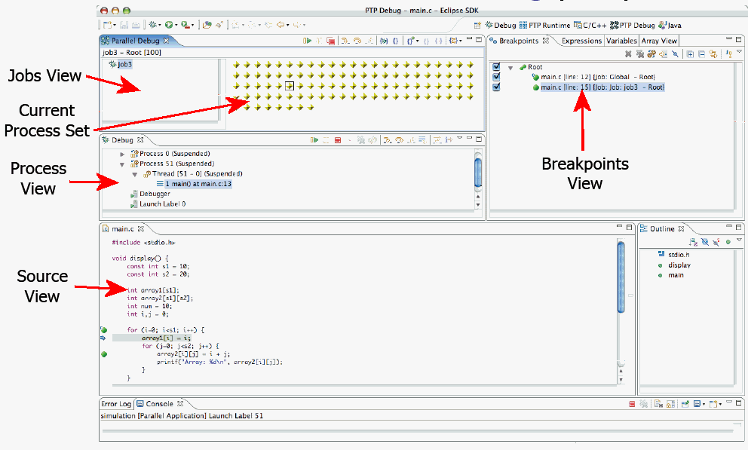
Launching & Monitoring
Eclipse Parallel Tools Platform (PTP)
Coding & Analysis
Debugging
Notes:
This slide shows the main parts of the current PTP in a single view; details most of these are on the subsequent slides.
Eclipse is the unifying platform for a variety of tools, which can all be integrated into the same workbench.
The blue oval shows the parts originally contributed by IBM (PLDT, and eventually, Performance Tools)

Slide 11
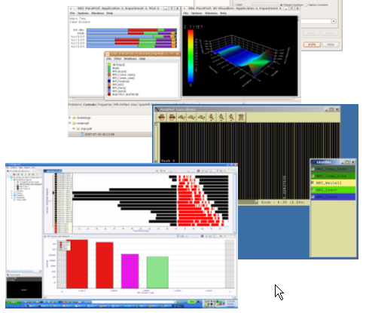
Launching & Monitoring
Eclipse Parallel Tools Platform (PTP)
Coding & Analysis
Debugging
Performance Tuning
Notes:
This slide shows the main parts of the current PTP in a single view; details most of these are on the subsequent slides.
Eclipse is the unifying platform for a variety of tools, which can all be integrated into the same workbench.
The blue oval shows the parts originally contributed by IBM (PLDT, and eventually, Performance Tools)

Slide 12

Launching & Monitoring
Eclipse Parallel Tools Platform (PTP)
Coding & Analysis
Debugging
Performance Tuning
Notes:
This slide shows the main parts of the current PTP in a single view; details most of these are on the subsequent slides.
Eclipse is the unifying platform for a variety of tools, which can all be integrated into the same workbench.
The blue oval shows the parts originally contributed by IBM (PLDT, and eventually, Performance Tools)

Slide 13
Motivation for Workbench for High Performance Computing (WHPC)
Context
NSF 1047956: SI2-SSI: A Productive and Accessible Development Workbench for HPC Applications Using the Eclipse Parallel Tools Platform
Stable, portable platform for tool development
Focus on tool functionality, manage rapid evolution of HPC platforms
Encourage consistent tool look and feel
Support for HPC application development practices
Why Parallel Tools Platform?
High potential to meet needs of a WHPC.
Target next generation of HPC developers growing up with IDEs (Eclipse, Visual Studio, ...)
Need to cultivate community of users!

Slide 14
Improvements
Work within Eclipse release cycle
Major (API-breaking) improvements with coordinated June release
Last major release Eclipse 4.5 “Mars” released June 2015
Minor enhancements and bug-fixes with two coordinated service releases in September and February
Eclipse 4.5 SR1 Released September, 2015.
Foci of improvements
Improve usability
Improve productivity

Slide 15
Consider 2 possible types of users of Eclipse Parallel Tools …
Science code users/modelers
Need to build science code
May need to modify science code (and rebuild)
Software specialists enabling modeling projects
Lots of software engineering concerns
Next set of slides address some of those concerns.

Slide 16
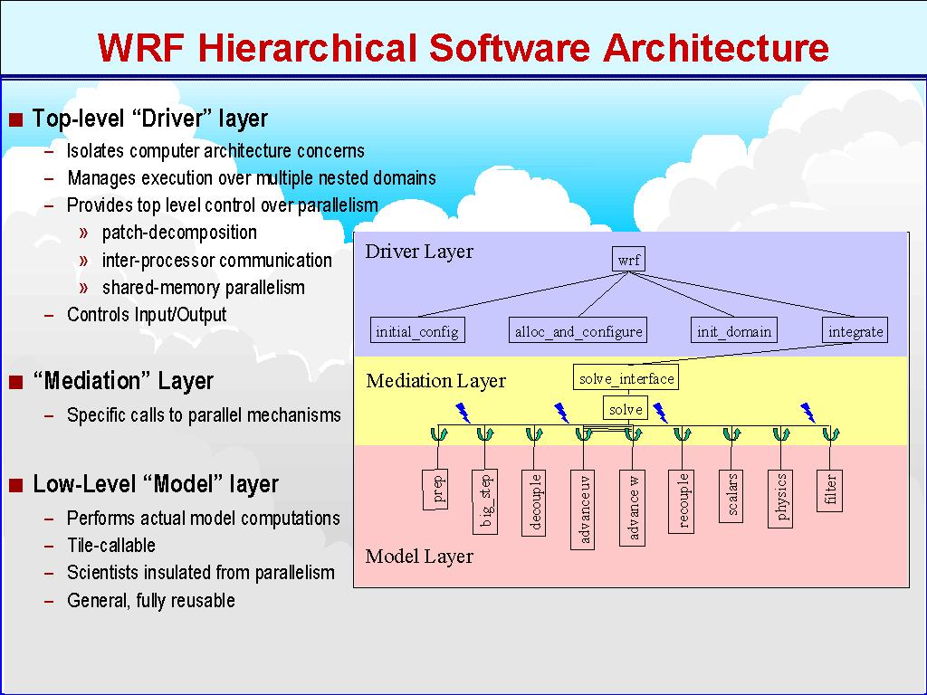
Science code users/modelers
Some of the challenges
Complex codes (eg WRF)
Codes + HPC architectures can be daunting
Adding user code not always easy
WRF: from http://wrf-model.org/PRESENTATIONS/2000_04_18_Klemp/sld007.htm

Slide 17
Navigating Computational Science Codes
Code Outline
Code navigation
Syntax-aware editing
(navigate to program
units and declarations)

Slide 18
Eclipse aiding in a typical code workflow…
May want to add a model output variable
Eclipse PTP makes it easy to navigate source, make changes
Drive remote builds on HPC resources
Make, autotools…
Run – can generate a run configuration for particular system, batch environment

Slide 19
Software Specialists enabling modeling projects
Need a wider array of software engineering tools
Source repository
Issue tracking
Documentation
Performance tuning…
Eclipse Parallel Tools can help with many of these concerns

Slide 20
Source Code Control: “Team” Features
Eclipse supports integration with multiple version control systems (VCS)
CVS, SVN, Git, and others
Collectively known as “Team” services
Many features are common across VCS
Compare/merge
History
Check-in/check-out
Some differences
Version numbers
Branching

Slide 21
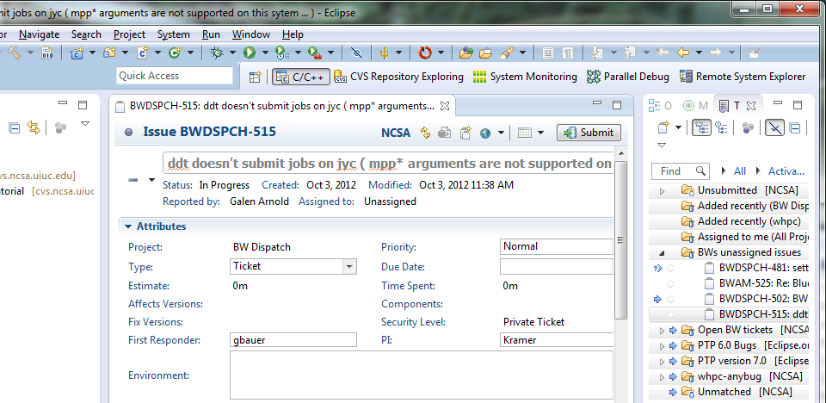
Issue Tracking
Mylyn Bridge
Tracks tasks, links to source and bug repositories
Connections to Jira, bugzilla, …

Slide 22
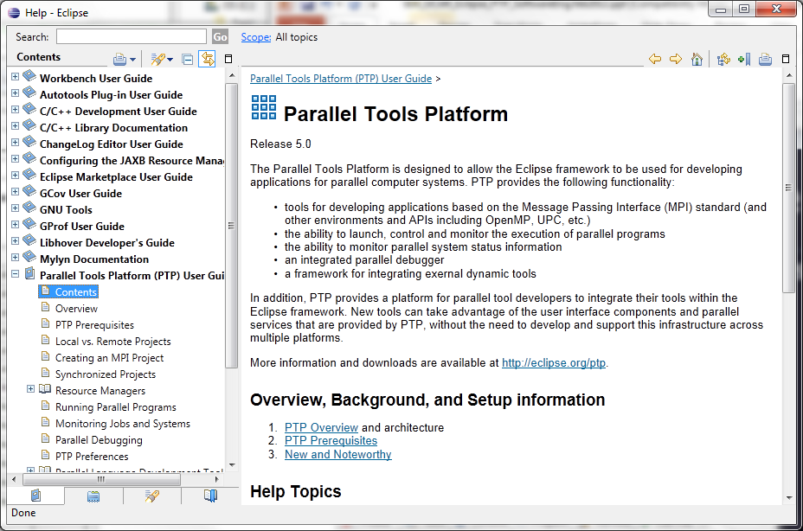
Eclipse Documentation
Eclipse Help System – built in and standalone (http://help.eclipse.org)

Slide 23
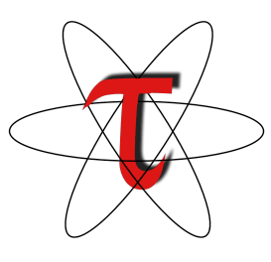
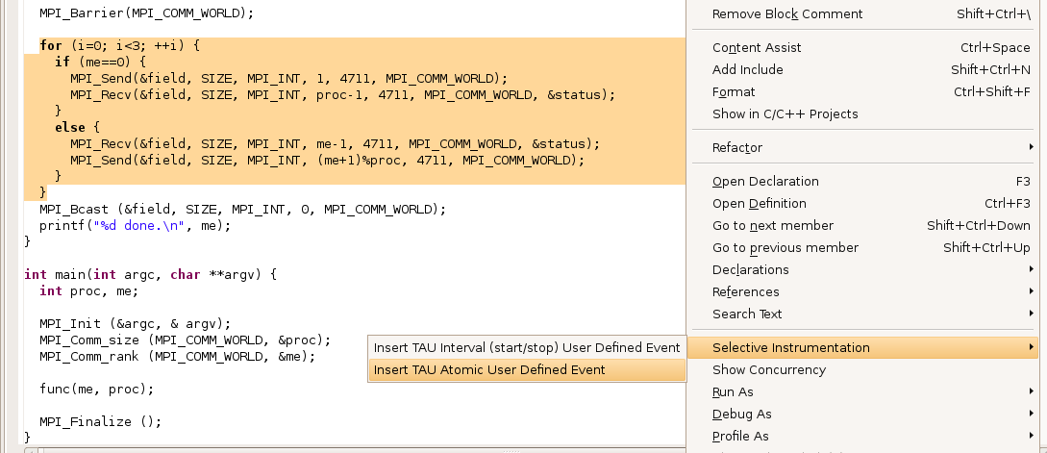
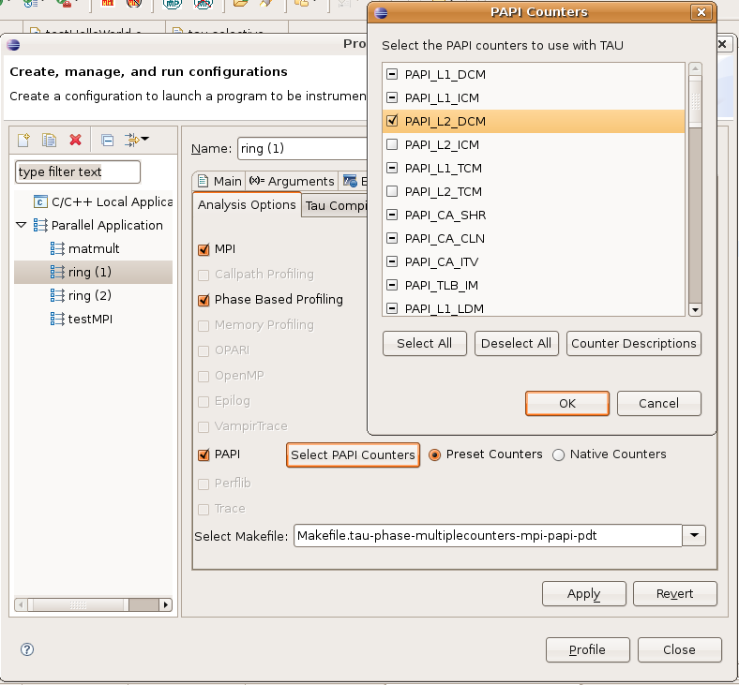
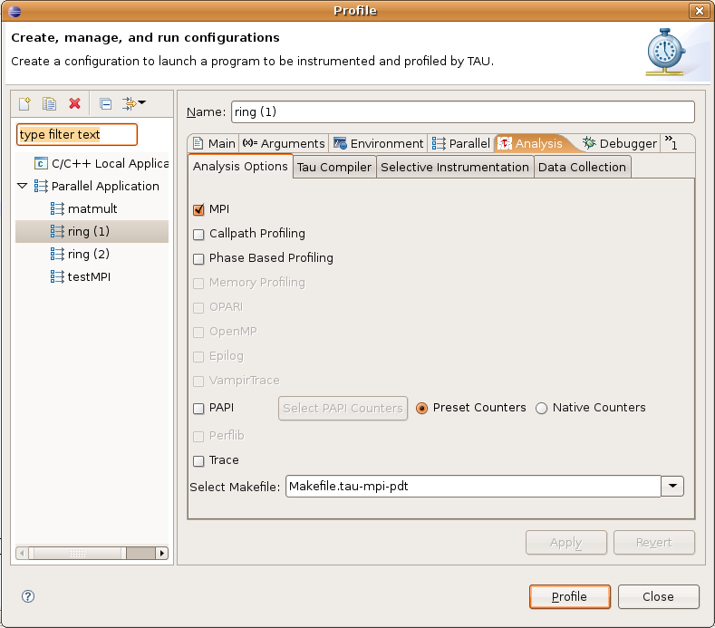
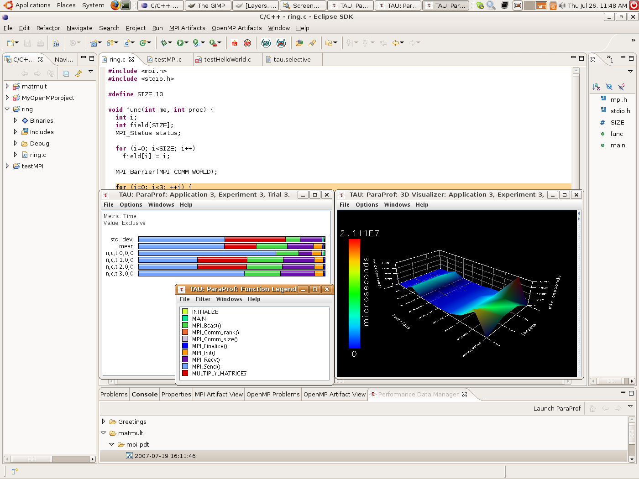
Performance Tuning: PTP TAU plug-ins http://www.cs.uoregon.edu/research/tau
TAU (Tuning and Analysis Utilities)
First implementation of External Tools Framework (ETFw)
Eclipse plug-ins wrap TAU functions, make them available from Eclipse
Full GUI support for the TAU command line interface
Performance analysis integrated with development environment

Slide 24
Sustainability, Investment, Collaboration: Building Community
Stakeholders/investors
Funding agencies → innovative capability
HPC vendors
contribute to open source foundational software
basis for proprietary or open-source add-ons
Supercomputing centers
user support and training
xml documents for batch system and local policy integration

Slide 25
Sustainability, Investment, Collaboration: Building Community II
Stakeholders/investors continued
Supercomputing integrating organizations (eg, XSEDE):
user support
single sign-on support (?)
training
education support
Tool providers
xml documents for integration of command line tools
extra value-add from tool-specific plugins?
Anyone else?

Slide 26
Challenges for DEHPC
Budgetary pressure on supercomputing centers and integrating organizations
Challenges successfully competing proposals in open calls (eg, NSF SI2).
Innovation, impact are paramount here
User community is large, disperse (eg lots of downloads of PTP, hard to connect to user community)

Slide 27
Opportunities (for discussion)
Can we build a community to support a DEHPC?
PIs proposing to funding agencies for innovative additions?
Vendor contributions to DEHPC?
Supercomputing centers and integrating organizations support?
Eg, User support, training, configuration (xml) documents

Slide 28
Eclipse Parallel Tools Platform www.eclipse.org/ptp

