Slide 1

On the Effectiveness of OpenMP teams for Programming Embedded Manycore Accelerators
Work supported by
FP7 – ICT
GRANT N° 611016
Andrea Marongiu
Swiss Federal Institute of
Technology in Zurich (ETHZ)
a.marongiu@iis.ee.ethz.ch
Alessandro Capotondi
University of Bologna

Slide 2
Outline
Motivation
Heterogeneous architectures
Manycore accelerators
NUMA communication and OpenMP
Flat parallelism
Nested parallel regions
OpenMP teams and the distribute directive
Other constructs for non-loop parallelism
Experimental setup and results

Slide 3
Heterogenous Manycores
Ever-increasing demand for computational power has recently led to radical evolution of computer architectures
Two design paradigms have proven effective in increasing performance and energy efficiency of compute systems
>Many-cores
>Architectural Heterogeneity
A common template is one where a powerful general-purpose processor (the host) is coupled to one or more a many-core accelerators
Notes:
Add some pictures such as k1 kalray +add virtualization and embedded hpc

Slide 4


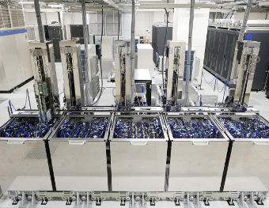

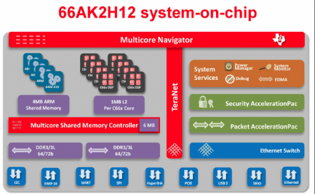

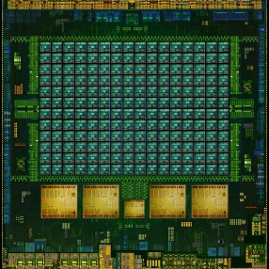
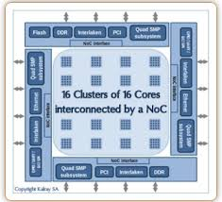
Heterogenous Manycores
Shoubu RIKEN
Titan Cray X47
SERVER / SUPERCOMP
SoC
Opteron 6274
16C 2.2GHz
Cray Gemini
NVIDIA K20x
TI KeystoneII
Xeon E5-2618Lv3
8C 2.3GHz
Infiniband FDR
PEZY-SC
Tianhe-2
NVIDIA Tegra X1
Kalray MPPA256
Xeon E5-2692
12C 2.2GHz
TH Express-2
Intel Xeon Phi
True virtually in every computing domain and at every scale!
Notes:
Add some pictures such as k1 kalray +add virtualization and embedded hpc

Slide 5
HETEROGENEOUS MANYCORES
Manycore accelerators share many commonalities across computing domains..
Cluster-based design → NUMA
Explicitly managed memories

Slide 6
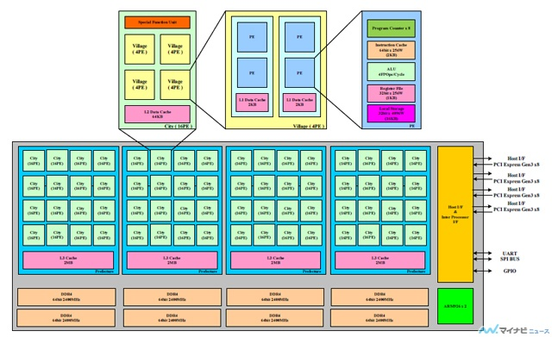
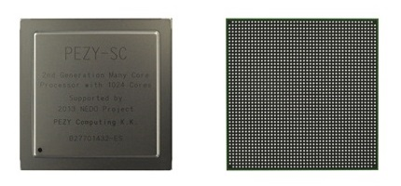
PEZY-SC 1024
Dominates the Green500
Heavily cluster-based
http://www.pezy.co.jp/en/products/pezy-sc.html
http://news.mynavi.jp/articles/2014/09/17/pezy/
Logic Cores(PE) | 1,024
Core Frequency | 733MHz
Peak Performance | Floating Point Single 3.0TFlops / Double 1.5TFlops
Host Interface | PCI Express GEN3.0 x8Lane x 4Port (x16 bifurcation available) JESD204B Protocol support
DRAM Interface | DDR4, DDR3 combo 64bit x 8Port Max B/W 1533.6GB/s +Ultra WIDE IO SDRAM (2,048bit) x 2Port Max B/W 102.4GB/s
Control CPU | ARM926 2core
Process Node | 28nm
Package | FCBGA 47.5mm x 47.5mm, Ball Pitch 1mm, 2,112pin

Slide 7
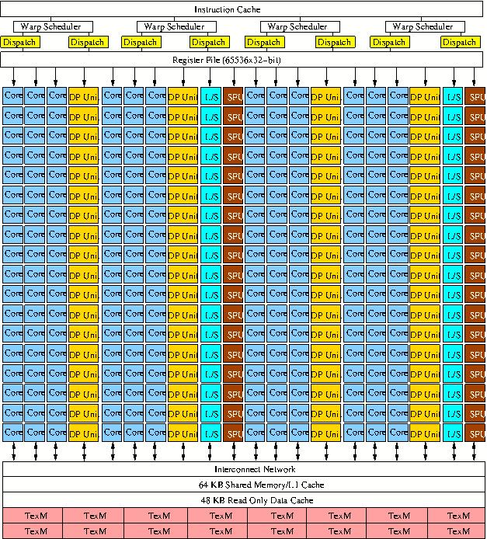
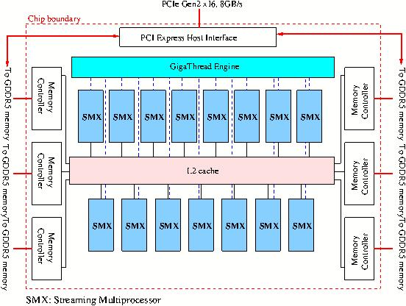
NVIDIA K20
15 clusters (SMX) sharing L2 SPM
192 cores per SME, sharing 64KB L1 SPM
1.17 DP TFLOPS - 3.52 SP TFLOPS
235 W

Slide 8
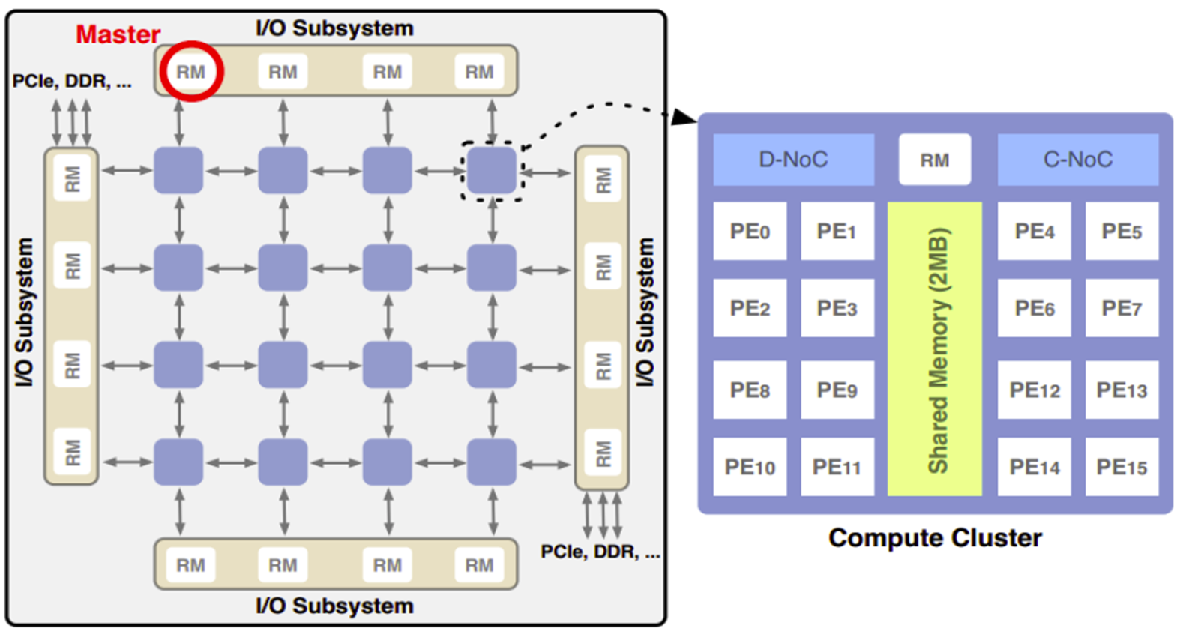
Kalray MPPA 256
16 clusters
16 cores per cluster, sharing 2MB L1 SPM/cache
1.25 TFLOPS
25 GOPS/W – 75 GOPS/W
Image, audio, signal processing
Control commands (aeronautics, industrial automation)

Slide 9

STHORM
4 clusters
16 cores per cluster, sharing 256KB L1 data SPM
80 GOPS @ 2W
NoC
L2 SPM
AXI BRIDGE
Notes:
Questa piattaforma, non nasce con il solo scopo di essere standalone. Perché manca il parallelismo, manca anche la potenza «computazione» nel singolo core.
Il controllo nell’host, acceleratore per le parte computazionali intense

Slide 10
NUMA communication
PE0 on CLUSTER 1 writes on data
Local communication
1 cycle latency
I$
I$
I$
PE
#0
PE
#1
. . .
PE
#15
TCDM
Network Interface
data
CLUSTER 1
PE0 on CLUSTER 0 writes on data2
Remote communication
Increasing latency with distance
I$
I$
I$
CL
CL
PE
#0
PE
#1
. . .
PE
#15
NI
NI
TCDM
R
R
data2
Network Interface
CL
CL
CLUSTER 2
NI
NI
R
R

Slide 11


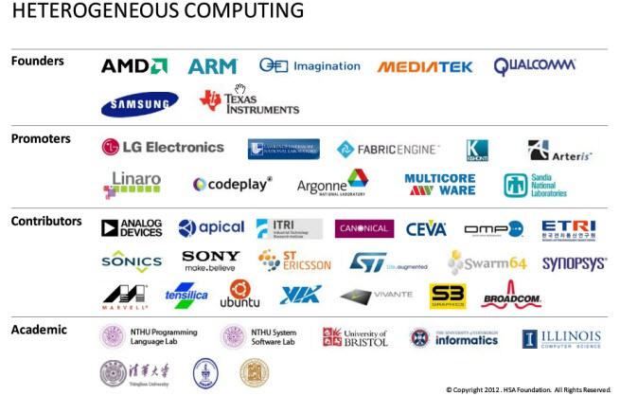





CrowdED constellation of Programming models
Proprietary
Programming models
Khronos Standard for
Heterogeneous Computing
Standard
for shared memory system
Academic
Proposals
OmpSS
OpenHMPP
…

Slide 12
OpenMP
De-facto standard for shared memory programming
Support for nested (multi-level) parallelism → good for clusters
Annotations to incrementally convey parallelism to the compiler → increased ease of use
Based on well-understood programming practices (shared memory, C language) → increases productivity
“OpenCL for programming shared memory multicore CPUs” by Akhtar Ali , Usman Dastgeer , Christoph Kessler

Slide 13
OpenMP
De-facto standard for shared memory programming
Support for nested (multi-level) parallelism → good for clusters
Annotations to incrementally convey parallelism to the compiler → increased ease of use
Based on well-understood programming practices (shared memory, C language) → increases productivity
Designed for uniform SMP with main shared memory
Lacks constructs to control accelerators
And compilation toolchain to deal with multiple ISA..
..and multiple runtime systems too!!
But…
?
Intel’s Parallel Universe magazine – May 2014
Notes:
Virtical starts in 2011 to target this issue

Slide 14
FORK-JOIN PARALLELISM
OpenMP leverages a fork-join execution model
The program starts on a single thread (the master), then new threads are recruited upon entering a parallel region
Parallelism in application is always found at multiple levels, in a hierarchical manner
How to capture this in the program?
How to map the wokload in a NUMA-aware manner?

Slide 15
NESTED PARALLELISM
while(1)
{
#pragma omp parallel num_threads(4)
{
#pragma sections
{
#pragma section
{
#pragma omp parallel num_threads(16)
ColorScaleConv();
}
#pragma section
{
#pragma omp parallel num_threads(16)
cvThreshold();
}
#pragma section
{
#pragma omp parallel num_threads(16)
cvMoments();
}
#pragma section
{
#pragma omp parallel num_threads(16)
cvAdd();
}
}
}
}
A powerful abstraction for specifying structured parallelism
void ColorScaleConv()
{
for(i = 0; i < FRAME_SIZE; i++)
{
[ALGORITH]
}
}
#pragma omp for
A.
And very suitable for NUMA (cluster-based) systems
B.
C.
A
B
C
D
A
B
C
D
E
E
H
E
E
H
E
E
F
G
E
F
G
E
E
E
But what about PHYSICAL thread mapping?
D.

Slide 16
Nested Parallelism CLUSTER-AWARE
void ColorScaleConv()
{
for(i = 0; i < FRAME_SIZE; i++)
{
[ALGORITH]
}
}
while(1)
{
#pragma omp parallel
{
#pragma sections
{
#pragma section
{
#pragma omp parallel
ColorScaleConv();
}
#pragma section
{
#pragma omp parallel
cvThreshold();
}
#pragma section
{
#pragma omp parallel
cvMoments();
}
#pragma section
{
#pragma omp parallel)
cvAdd();
}
}
}
}
#pragma omp for
I$
I$
I$
PE
#0
PE
#1
. . .
PE
#15
A.
TCDM
Network Interface
data[i]
CLUSTER i
B.
E
E
C.
CL
CL
A
B
C
D
A
B
C
D
A
B
C
D
NI
NI
E
E
E
E
H
H
E
E
H
E
E
E
E
G
F
G
E
F
G
E
E
F
E
E
R
R
D.
CL
CL
NI
NI
R
R

Slide 17
NUMA-unaware Thread mapping
T0
Cluster 0
PE0
PE1
Cluster 1
PE2
PE3
PE0
PE1
PE2
PE3
Cluster 2
PE0
PE1
PE2
PE3
Cluster 3
PE0
PE1
PE2
PE3
T0
T1
T0
T0
T1

Slide 18
NUMA-unaware Thread mapping
T0
Cluster 0
PE0
PE1
Cluster 1
PE2
PE3
PE0
PE1
PE2
PE3
Cluster 2
PE0
PE1
PE2
PE3
Cluster 3
PE0
PE1
PE2
PE3
T0
T1
T0
T0
T1
T0
T1
T0
T0
T1
T1
T1

Slide 19
NUMA-unaware Thread mapping
T0
Cluster 0
PE0
PE1
Cluster 1
PE2
PE3
PE0
PE1
PE2
PE3
Cluster 2
PE0
PE1
PE2
PE3
Cluster 3
PE0
PE1
PE2
PE3
T0
T1
T0
T0
T1
T0
T1
T0
T1
T2
T3
T0
T0
T0
T0
T0
T2
T3
T1
T0
T1
T1
T1
T1
T0
T3
T1
T1
T2
T2
T2
T2
T2
T0
T1
T1
T2
T3
T3
T3
T3
T3

Slide 20
LOCALITY-AWARE WORKLOAD DISTRIBUTION
How to best distribute parallel workload within a cluster-based manycore accelerator?
Flat parallelism?
Nested parallel for?
The distribute directive: Teams and leagues
And how about non-loop centric parallelism?

Slide 21
void KER(in1, in2, out) {
#pragma omp parallel for
for(i = 0; i < … ; i++){
[ALGORITHM]
}
}
#pragma omp target map(in, out)
{
for(stripe = 0;
stripe < N_STRIPES;
++stripe)
{
dma_in(in[stripe]);
KER (in[stripe], out[stripe]);
dma_out(out[stripe]);
}
}
flat parallel thread team
PE 0
PE 1
PE 2
PE 3
PE 4
PE 5
PE 6
PE 7
PE 8
PE 9
PE 10
PE 11
PE 12
PE 13
PE 14
PE 15
L1
L1
BUF0
R
R
R
R
PE 16
PE 17
PE 18
PE 19
PE 20
PE 21
PE 22
PE 23
PE 24
PE 25
PE 26
PE 27
PE 28
PE 29
PE 30
PE 31
L1
L1
The role of DMA in explicitly managed memory hierarchies!
master thread
slave thread
outer team
inner team

Slide 22
LOCALITY-AWARE WORKLOAD DISTRIBUTION
How to best distribute parallel workload within a cluster-based manycore accelerator?
Flat parallelism?
Nested parallel for?
The distribute directive: Teams and leagues
And how about non-loop centric parallelism?

Slide 23
void KER(in1, out) {
#pragma omp parallel for \
num_threads(16)
for(i = 0; i < … ; i++)
[ALGORITHM]
}
#pragma omp target map (in, out)
#pragma omp parallel num_threads(4)
for(stripe = 0;
stripe < N_STRIPES;
++stripe)
{
dma_in(in[stripe]);
KER (in[stripe], out[stripe]);
dma_out(out[stripe]);
}
}
nested team
PE 0
PE 1
PE 2
PE 3
PE 4
PE 5
PE 6
PE 7
PE 8
PE 9
PE 10
PE 11
PE 12
PE 13
PE 14
PE 15
L1
L1
B0
B1
B2
B3
R
R
R
R
PE 16
PE 17
PE 18
PE 19
PE 20
PE 21
PE 22
PE 23
PE 24
PE 25
PE 26
PE 27
PE 28
PE 29
PE 30
PE 31
L1
L1
master thread
slave thread
outer team
inner team

Slide 24
LOCALITY-AWARE WORKLOAD DISTRIBUTION
How to best distribute parallel workload within a cluster-based manycore accelerator?
Flat parallelism?
Nested parallel for?
The distribute directive: Teams and leagues
And how about non-loop centric parallelism?

Slide 25
void KER(in1, out) {
#pragma omp parallel for
for(i = 0; i < … ; i++){
[ALGORITHM]
}
}
#pragma omp target teams num_teams(4) map (in, out)
#pragma omp distribute
for(stripe = 0;
stripe < N_STRIPES;
++stripe)
{
dma_in(in[stripe]);
cvADD (in[stripe], out[stripe]);
dma_out(out[stripe]);
}
}
distributed nested team
PE 0
PE 1
PE 2
PE 3
PE 4
PE 5
PE 6
PE 7
PE 8
PE 9
PE 10
PE 11
PE 12
PE 13
PE 14
PE 15
L1
L1
B0
B1
R
R
R
R
PE 16
PE 17
PE 18
PE 19
PE 20
PE 21
PE 22
PE 23
PE 24
PE 25
PE 26
PE 27
PE 28
PE 29
PE 30
PE 31
L1
L1
B2
B3
master thread
slave thread
outer team
inner team

Slide 26
LOCALITY-AWARE WORKLOAD DISTRIBUTION
How to best distribute parallel workload within a cluster-based manycore accelerator?
Flat parallelism?
Nested parallel for?
The distribute directive: Teams and leagues
And how about non-loop centric parallelism?

Slide 27

NON-loop CONSTRUCTS?
For NUMA
NEW! Clause on specification v4.0 coupled to the parallel directive to specify thread mapping:
master: assigns every thread to the same place as the master thread.
close: assigns threads to places close to the place of the parent’s
Thread.
spread: creates a sparse distribution for a team of T threads among the P places of the parent’s place partition.

Slide 28
Nested Parallelism CLUSTER-AWARE
void ColorScaleConv()
{
for(i = 0; i < FRAME_SIZE; i++)
{
[ALGORITH]
}
}
while(1)
{
#pragma omp parallel
{
#pragma sections
{
#pragma section
{
#pragma omp parallel
ColorScaleConv();
}
#pragma section
{
#pragma omp parallel
cvThreshold();
}
#pragma section
{
#pragma omp parallel
cvMoments();
}
#pragma section
{
#pragma omp parallel)
cvAdd();
}
}
}
}
proc_bind (spread)
#pragma omp for
I$
I$
I$
PE
#0
PE
#1
. . .
PE
#15
proc_bind (close)
TCDM
Network Interface
A.
data[i]
CLUSTER i
proc_bind (close)
B.
E
E
C.
proc_bind (close)
CL
CL
A
B
C
D
A
B
C
D
A
B
C
D
NI
NI
E
E
E
E
H
H
E
E
H
E
E
E
E
G
F
G
E
F
G
E
E
F
E
E
R
R
D.
proc_bind (close)
CL
CL
NI
NI
R
R

Slide 29
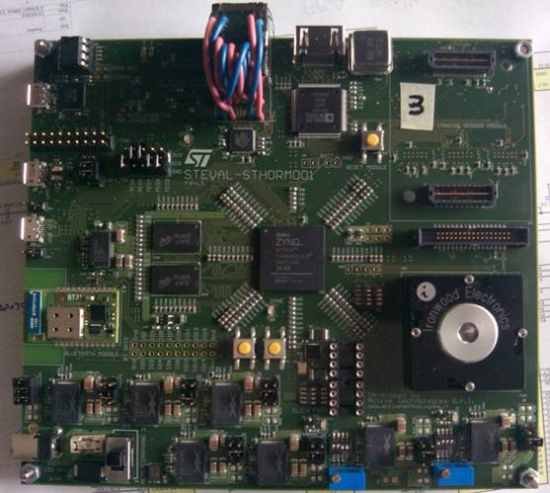
Experimental Setup
STHORM BOARD
ZYNQ
STHORM SoC
FPGA
IO periph
64-bit
2D SNoC
AXI interconnect
2D port2
RAB
SNoC2AXI
IO periph
113
PS1
SM2
S
ARM A9
ARM A9
Ref. clock, Sys. Clock, Reset, JTAG, Trace, interrupts…
L1
L1
snoop
16-bit
2D SNoC
L2
2D port1
RAB
AXI2SNoC
L2 ctrl
PM1
SS1
M
DRAM ctrl
GIC
DRAM
47
2D GPIOs
29
PIO1
SIO0
GPIO
Notes:
Anche il system on board permette lo shared memory attraverso il bridge. Questo sistema permette di accedere attraverso la DRAM.
Bandwith limitato.
RAB (Remap Address Block)

Slide 30
Experimental Setup
We consider 6 benchmarks from the image processing/computer vision domain
Acronym | Brief explanation
STRAS | Matrix multiplication using Strassen decomposition
GSID | Generalized squared interpoint distance
LRFR | Local reference frame radius (surface matching)
HIST | Histogram interpolation
NCC | Normalized cross-correlation algorithm
CT | Object tracking based on a specific color
FAST | Corner detector

Slide 31
Experimental Setup (2)
FAST is highly sensitive to input data
Image size
Image composition (number of corners)
Acronym | Brief explanation
1.5%_S | 1.5% corner density in a small image (QVGA)
6%_S | 6% corner density in a small image
15%_S | 15% corner density in a small image
1.5%_L | 1.5% corner density in a large image (VGA)
6%_L | 6% corner density in a large image
15%_L | 15% corner density in a large image

Slide 32
NUMA-aware Nested Parallelism
5x avg speedup wrt flat parallelism
Notes:
Submitted Elsevier Parallel computing

Slide 33
CT
#pragma omp target teams num_teams(4)
#pragma omp distribute
for(stripe = 0;
stripe < N_STRIPES;
++stripe)
{
dma_in(in[stripe]);
CSC (in[stripe], tmp1[stripe]);
cvTHR (tmp1[stripe], tmp2[stripe]);
cvMOM (tmp2[stripe], xy[stripe]);
}
#pragma omp barrier
#pragma omp distribute
for(stripe = 0;
stripe < N_STRIPES;
++stripe)
{
dma_in(in[stripe]);
dma_in(track[stripe]);
cvADD (in[stripe], track[stripe], out[stripe]);
dma_out(out[stripe]);
}
}
void CSC(in, tmp1) {
#pragma omp for
for(i = 0; i < … ; i++){
[ALGORITHM]
}
}
void cvTHR(tmp1, tmp2) {
#pragma omp for
for(i = 0; i < … ; i++){
[ALGORITHM]
}
}
void cvMOM(tmp2, xy) {
#pragma omp for
for(i = 0; i < … ; i++){
[ALGORITHM]
}
}
void cvADD(in1, in2, out) {
#pragma omp parallel for
for(i = 0; i < … ; i++){
[ALGORITHM]
}
}
distributed nested team

Slide 34
On the Effectiveness of OpenMP teams for Programming Embedded Manycore Accelerators
Work supported by
FP7 – ICT
GRANT N° 611016
Andrea Marongiu
Swiss Federal Institute of
Technology in Zurich (ETHZ)
a.marongiu@iis.ee.ethz.ch
Alessandro Capotondi
University of Bologna

