Slide 1
Chapter 12: Design Principles
Summary slides from M. Camilli, E. Di Nitto, A. Fuggetta, A. Margara, M.G. Rossi, D.A. Tamburri. Software Engineering: a Structured Journey from Inception to Delivery. BUP 2025.

Slide 2

Design Principles
Chapter 12
Focus: Principles to consider during design of
software components
interfaces

Slide 3
Why Design Principles Matter
Architectural decisions should be guided by principles
Influence:
Software structure
Decision-making processes
Organization of development teams
Principles apply across:
Design
Implementation
Maintenance

Slide 4
Some important principles
Divide and conquer
Abstraction
High cohesion
Encapsulation
Low coupling
Reuse
Reusability
Flexibility
Obsolescence planning
Portability
Testability
Defensive design

Slide 5
Divide and conquer
Break a complex problem into smaller subproblems
Solve each subproblem independently
Combine partial solutions
Applicable both at the programming and design level

Slide 6
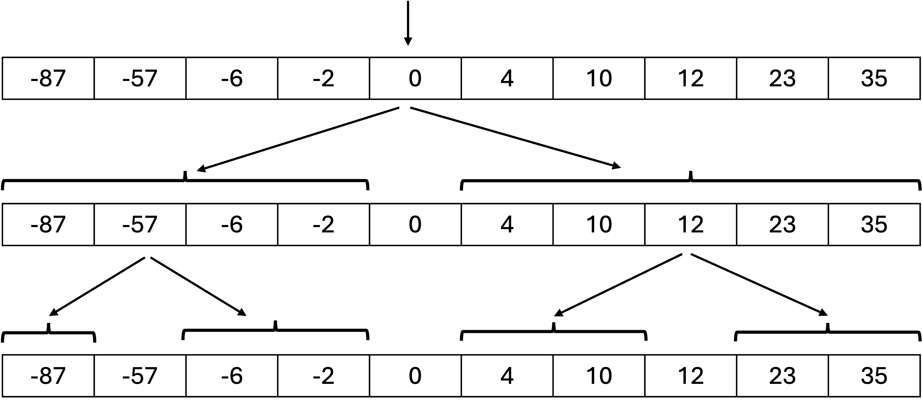
Programming-level example
Binary search:
Works on sorted data
Reduces search space by half each step
Time complexity: O(log n)

Slide 7
Design-level example
Develop an e-commerce system to support: UC1: search for product, UC2: check product availability in the warehouse, UC3: purchase and pay, and UC4: package and deliver
Can lead to the identification of the components:
ProductCatalogService
WarehouseService
PurchaseManager
DeliveryManager
… each focusing on a specific concern

Slide 8
Benefits of divide and conquer
Simplifies analysis
Improves maintainability
Supports modularity
Enables parallel development

Slide 9
Design principle 1
Divide a problem in smaller subproblems both during design and implementation

Slide 10
Abstraction
Definition: view of an object that focuses on the information relevant to a particular purpose and ignores the remainder of the information (ISO/IEC/IEEE (2017)).
Software can be described at different levels to:
Highlight specific concerns
Hide low-level complexity
ISO/IEC/IEEE (2017). ISO/IEC/IEEE International Standard - Systems and software engineering–Vocabulary. ISO/IEC/IEEE 24765:2017(E), pp. 1–541 (cit. on pp. 202, 204, 207).

Slide 11
Surveillance system example
Description suitable for analyzing high-level concerns:
The need to interface cameras and sensors with the software components
The need to define proper communication mechanisms
Not suitable for lower-level tasks, e.g.
The algorithm that detects unauthorized entry into the building

Slide 12
Why abstraction matters
Manages complexity
Allows focus on the task at hand
Prevents premature concern with details

Slide 13
Design principle 2
Maintain the highest possible level of abstraction for a given task

Slide 14
Three related concepts
Cohesion → inside a module
Encapsulation → module boundaries
Coupling → interactions between modules

Slide 15
Cohesion - definition
A module is cohesive if its parts are logically related
Each module should represent a single, clear responsibility

Slide 16
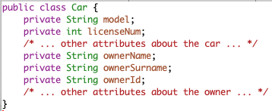
Example of poor cohesion
Leads to:
Duplication
Maintenance problems

Slide 17
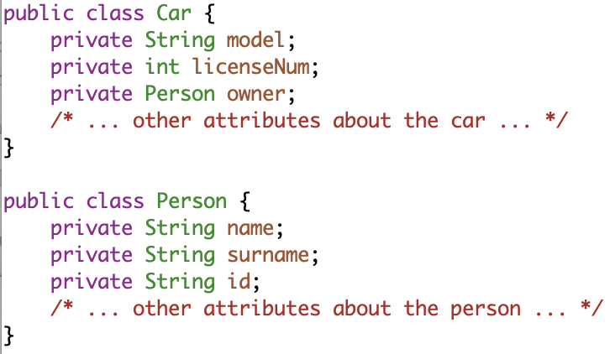
Example of good cohesion
Clear responsibility boundaries

Slide 18
Design principle 3
Keep all modules as cohesive as possible

Slide 19
Encapsulation - definition
The idea that a module [...] has an external interface and an internal implementation (ISO/IEC/IEEE 2017)
Also known as information hiding
ISO/IEC/IEEE (2017). ISO/IEC/IEEE International Standard - Systems and software engineering–Vocabulary. ISO/IEC/IEEE 24765:2017(E), pp. 1–541 (cit. on pp. 202, 204, 207).

Slide 20
Why encapsulation is important
Protects internal state
Reduces interdependencies between modules (coupling)
Enables implementation changes without breaking users

Slide 21
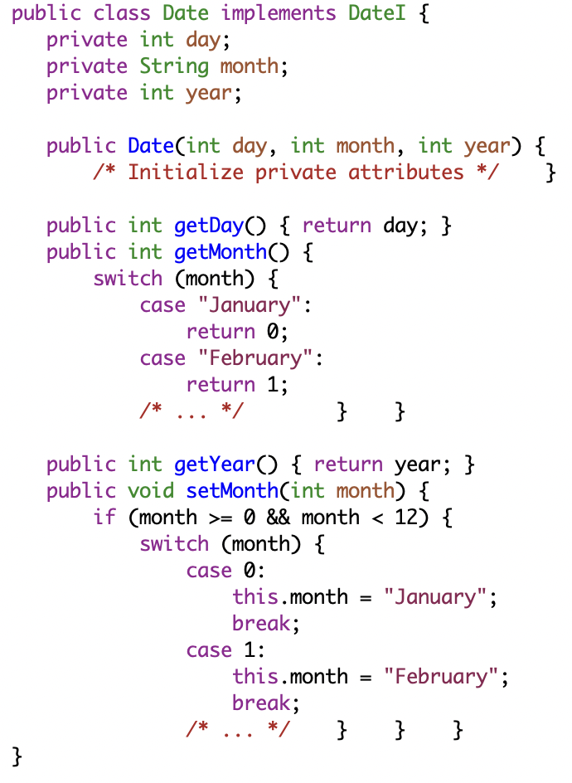
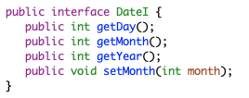
Encapsulation example…
Interface
Public interface defines allowed operations
Internal state is private
Input validation ensures consistency
Implementation

Slide 22
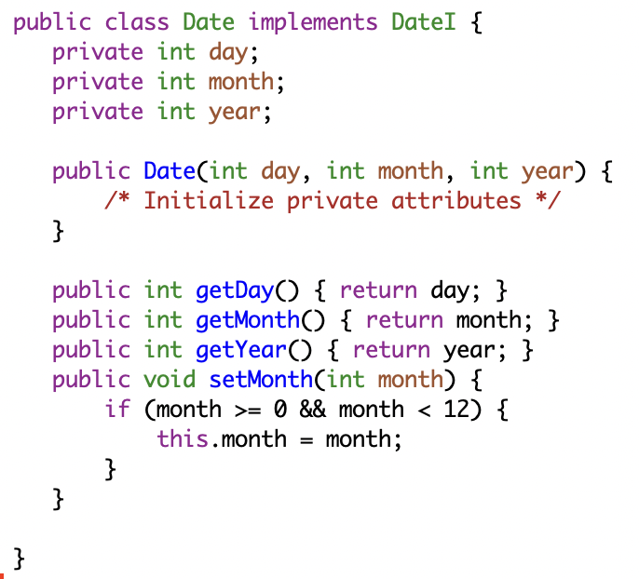
… Encapsulation example
Alternative implementation
Internal representation can change
Interface remains stable
Users unaffected

Slide 23
Design principle 4
Expose the minimum amount of resources

Slide 24
A note on encapsulation and visibility
Not all operations need to be public
Example:
Observer pattern
Internal notification methods should remain private

Slide 25
Coupling - definition
The manner and degree of interdependence between software mod- ules (ISO/IEC/IEEE 2017)
Some coupling is necessary
Excessive coupling is harmful
ISO/IEC/IEEE (2017). ISO/IEC/IEEE International Standard - Systems and software engineering–Vocabulary. ISO/IEC/IEEE 24765:2017(E), pp. 1–541 (cit. on pp. 202, 204, 207).

Slide 26
Types of coupling
Communication coupling
Content coupling
Control coupling

Slide 27
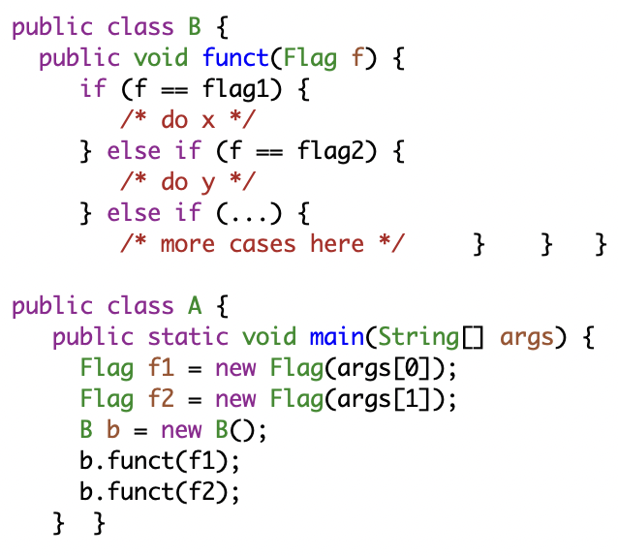
Control Coupling Example
Behavior of one module depends on control flags
Requires knowledge of internal logic

Slide 28
Problems with high coupling
Harder to maintain
Changes propagate
Breaks encapsulation

Slide 29
Design principle 5
Reduce coupling where possible

Slide 30
Reuse vs reusability
Reuse: using existing components
Reusability: designing components to be reused

Slide 31
Benefits of reuse
Saves development time
Often improves quality
Leverages proven solutions

Slide 32
Challenges of reuse
Component selection
Documentation quality
Compatibility
Independent evolution

Slide 33
Design principle 6
Apply reuse whenever possible.
Take advantage of investments in reusable components, but …
always account for the need to align your system with changes in the reused components.

Slide 34
Design principle 7
Design for reusability, both at the system level and for individual components.

Slide 35
Designing for Change
Software must evolve
Anticipate future requirements and design shifts
Avoid rigid assumptions and hard-coded values
Apply the other principles

Slide 36
Design principle 8
Design for future changes in mind.

Slide 37
Obsolescence Risks
Technologies evolve
APIs, platforms, regulations change
Example: impact of European GDPR regulations on software systems

Slide 38
Design principle 9
Anticipate obsolescence.
Avoid immature or vendor-specific technologies.
Prefer stable standards.

Slide 39
Portability
Run software across platforms
Avoid platform-specific features
Test on multiple environments

Slide 40
Design principle 10
Design software to be portable from the start.

Slide 41
Design for Testability
Objective: maintain confidence in software correctness and stability
Approach: design software to facilitate efficient and comprehensive testing
Key practices
Structure code in a modular and reliable way to facilitate unit testing
Support automated verification by adopting testing frameworks
Decouple business logic for UI to enable automated testing of business logic in isolation

Slide 42
Design principle 11
Design for testability – make software easier to test.

Slide 43
Defensive design
Objective: build components that behave predictably and fail gracefully under adverse conditions.
Approach: assume that other components, or external users, may misuse the module
Validate inputs
Handle errors gracefully
Anticipate edge cases

Slide 44
Balance in defensive design
Avoid excessive checks
Apply defensive measures at module boundaries and public interfaces
Take into account the criticality of your software

Slide 45
Design principle 12
Design defensively, but strike the right balance with clar- ity and efficiency.

Slide 46
Interface design and design principles
Role of interfaces
Define component boundaries
Establish long-term contracts
Affect maintainability and evolution
Important general principles
Encapsulation
Low coupling
Specific principles
Contract principle
Least surprise
Small interfaces

Slide 47
Interface development: key technical elements
Interaction style (e.g., RPC, REST, sockets)
Data representation (e.g., XML, JSON, Protocol Buffers)
Error handling mechanism

Slide 48
Data representation
 | XML | JSON | Protocol Buffers | Java serialization
Expressiveness | Good | Good | Good | Excellent
Implementation independence | Good | Good | Good | Low
Performance | Verbose, requires multiple parsing passes | More compact that XML, single pass parsing | The most compact one | Between JSON and Protocol Buffer
Transparency | Good, data passed as text | Good, data passed as text | Binary format | Bytecode

Slide 49
Multiple interfaces and separation of concerns
A server can offer multiple interfaces at the same time
This enables
Separation of concerns
Different levels of access rights
Support to interface evolution (see next)

Slide 50
Interface evolution
Interfaces constitute the contract between servers and clients
Sometimes interfaces need to evolve (e.g., to support new requirements)
Strategies to support continuity
Deprecation: declare well in advance that an interface version will be eliminated by a certain date
Versioning: maintain multiple active versions of the interface
Extension: a new version extends the previous one

Slide 51
Interface documentation
Focuses on usage, not internals
Audience of an interface documentation
Developers and maintainers of the component offering the interface
Developers and maintainers of the component using the interface
QA teams for system integration and testing
Software architects (including those looking for reusable components)

Slide 52
Final Takeaways
Design principles are not rules, but guidance
Trade-offs are unavoidable
Good design enables:
Maintainability
Evolution
Long-term value

