Slide 1
Chapter 1:
The Software Product
Summary slides from
M. Camilli, E. Di Nitto, A. Fuggetta,
A. Margara, M.G. Rossi, D.A. Tamburri. Software Engineering: a Structured Journey from Inception to Delivery. BUP 2025.

Slide 2

The Software Product
Chapter 1
Focus:
  Definition of software engineering
  Importance and characteristics of software

Slide 3
Introduction to Software Engineering
Software Engineering: the discipline that studies the nature and characteristics of software development and operation (Ghezzi et al. 2002).
It focuses on the principles, methods, techniques, and tools required to effectively manage, support, and, where possible, partially automate this intricate and critically important process.
Key Questions:
  What is software?
  How does it differ from physical products?
  What qualities define good software?

Slide 4
What is software?
It includes the source code and all artifacts resulting from its development
  Requirement analysis and design documentation, quality plan and quality report, installation and use manuals, change requests, deployable components, configuration files …

Slide 5
How does it differ from physical products?
Characteristics of software | Characteristics of physical products
Intangibility: No physical form | Tangible with precise forms
Human intensity: Development driven by skilled individuals | Often, specific machinery needed to create one product
Malleability: Easily modifiable even on-the-fly | A change requires significant investments on the production process

Slide 6
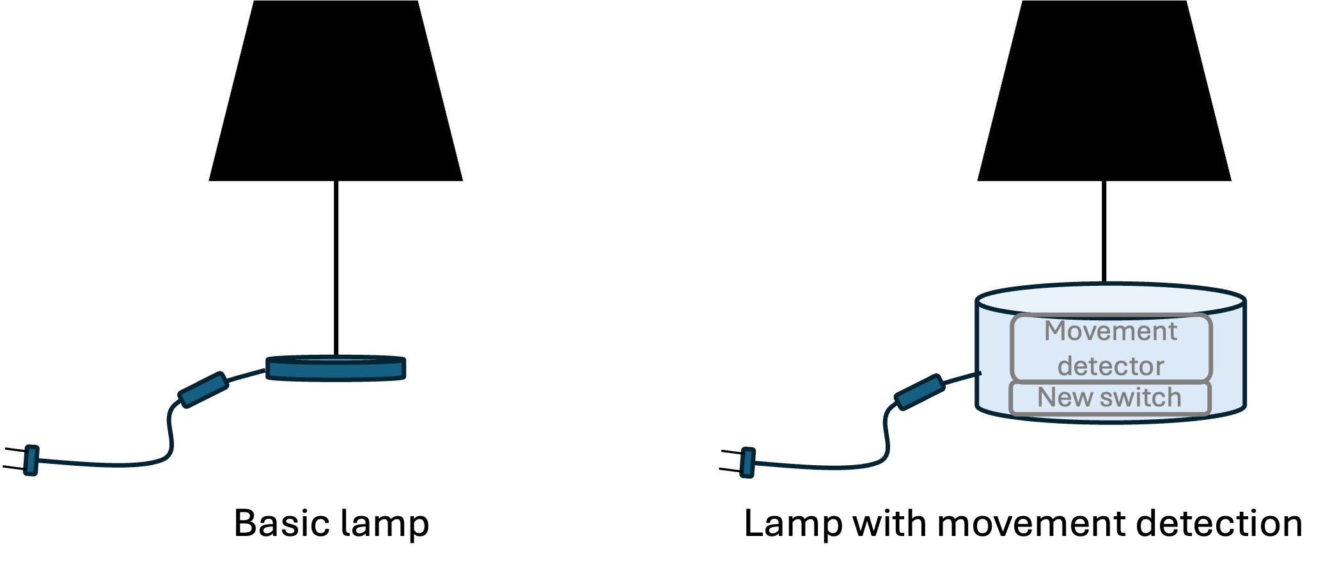
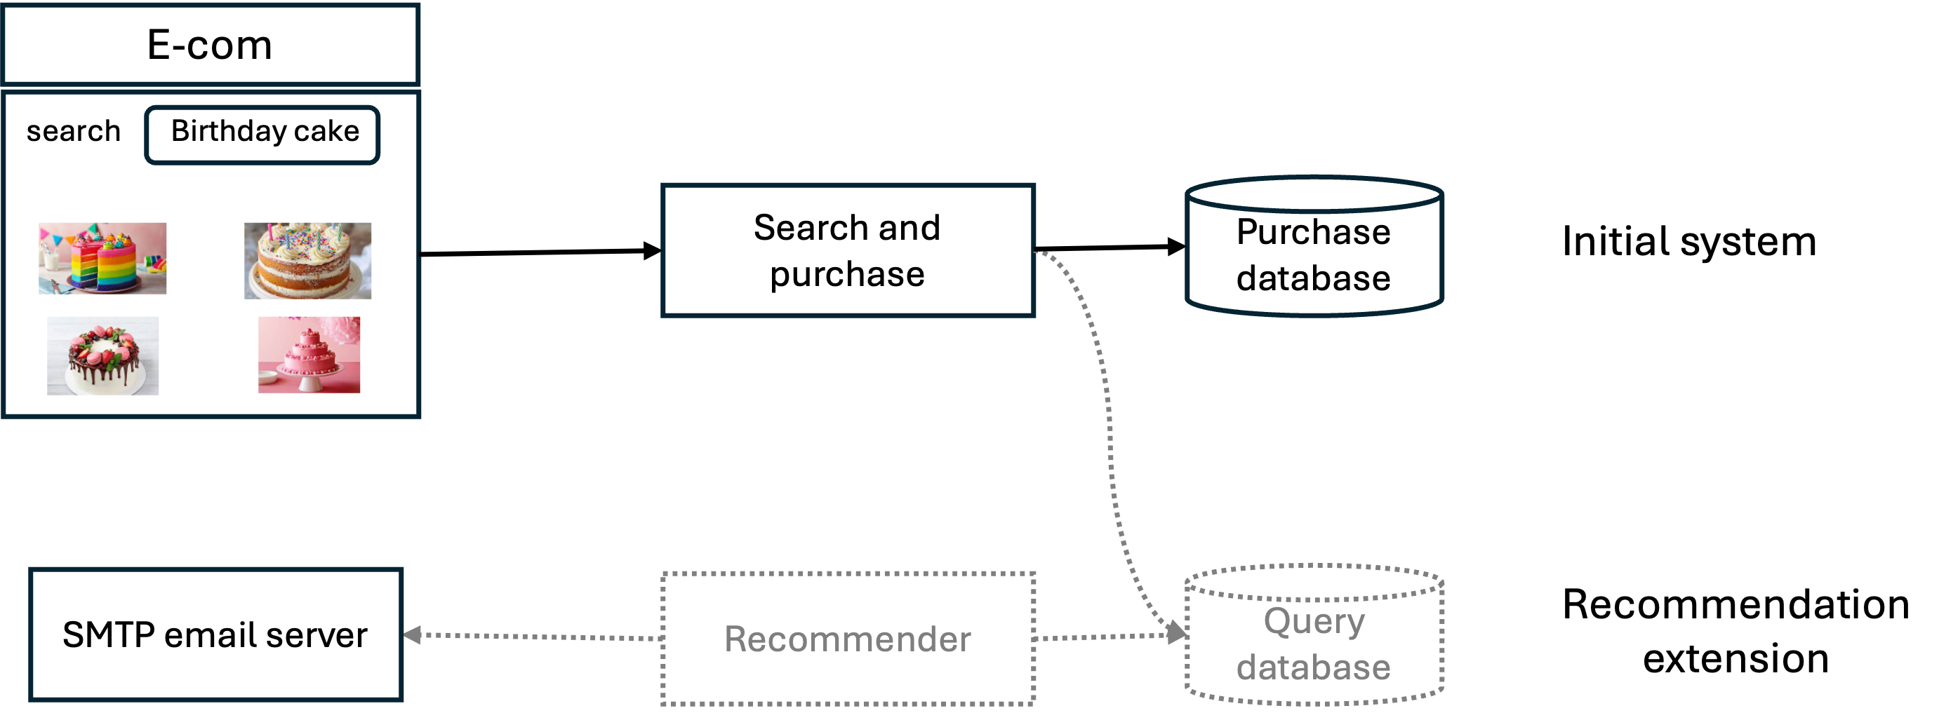
Malleability: a physical object vs software
Table lamp: adding a movement detection component
E-commerce software: adding a recommendation feature

Slide 7
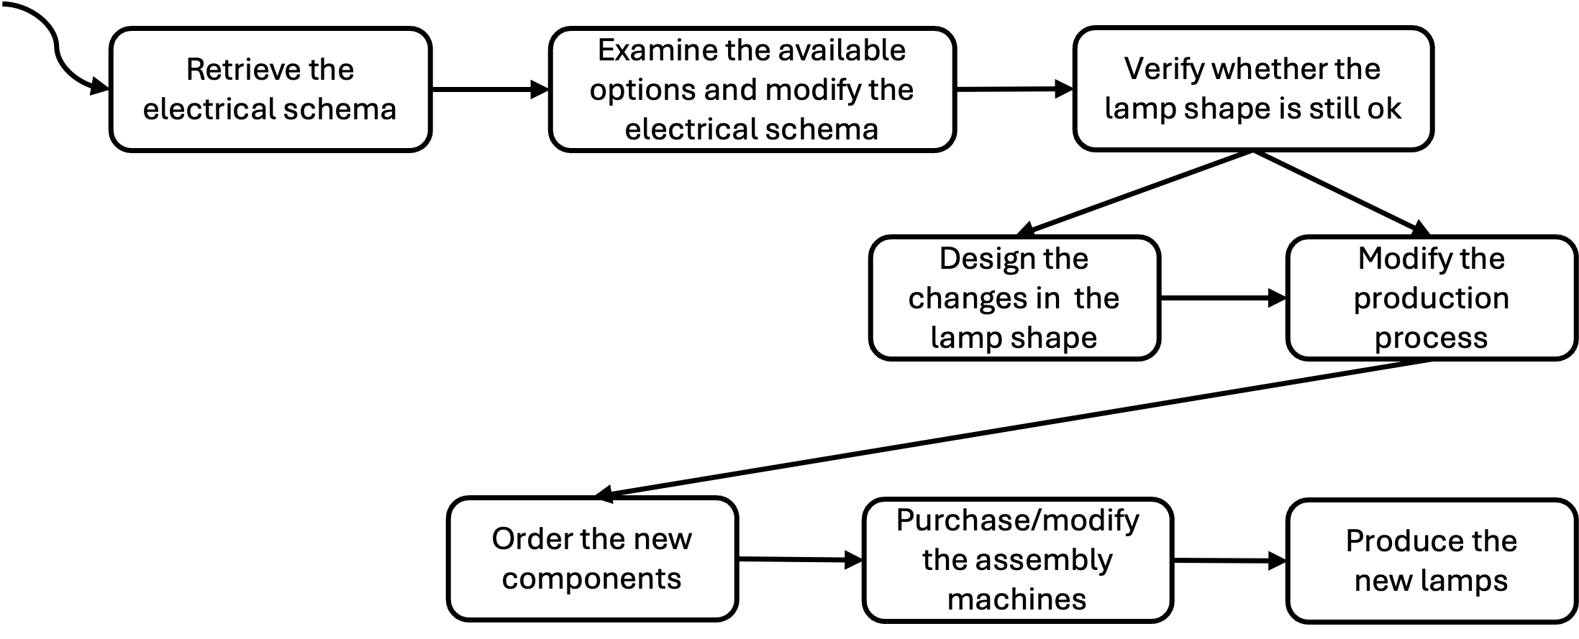
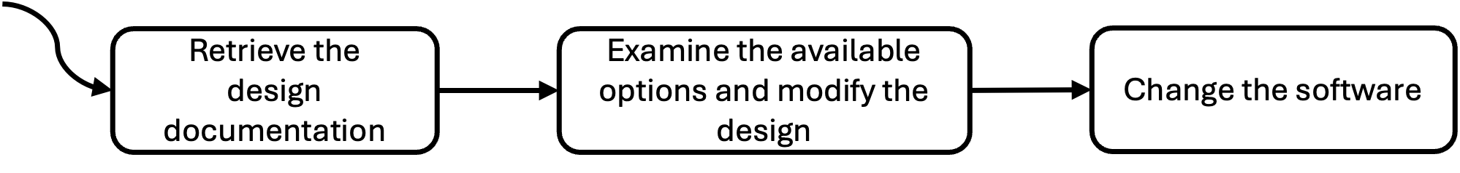
Malleability: comparing the two change processes
Table lamp
E-commerce software

Slide 8
Software as a Solution to a Problem
Problem space: encompasses the application domain, the set of challenges we aim to address through a software product, and the relevant phenomena within the target application domain.
Solution space: the set of elements that characterize the software that must be developed to address the problem: source code, executables, documentation, and tests.

Slide 9
Key Software Qualities (ISO/IEC 25010)
Functional
Functional Suitability
Performance Efficiency
Reliability
Security
Safety
Maintainability
Compatibility
Flexibility
Interaction Capability
Non-functional

Slide 10
Functional suitability
Sub-quality | Definition
Functional completeness | Degree to which the set of functions covers all the specified tasks and intended users’ objectives
Functional correctness | Degree to which a product or system provides accurate results when used by intended users
Functional appropriateness | Degree to which the functions facilitate the accomplishment of specified tasks and objectives

Slide 11
Other important qualities
Performance Efficiency: Time behavior, resource utilization, capacity.
Reliability: Faultlessness, availability, fault tolerance, recoverability.
Security: Confidentiality, integrity, non-repudiation, accountability, authenticity, resistance.
Safety: ability to set operational constraints, identify risks, fail safe, warn about hazards, safe integration

Slide 12
Other important qualities (cont)
Maintainability: modularity, reusability, analyzability, modifiability, testability
Compatibility: co-existence, interoperability
Flexibility: adaptability, scalability, installability, replaceability
Interaction capability: appropriateness recognizability, learnability, operability, user error protection, user engagement, inclusivity, user assistance, self-descriptiveness

Slide 13
Final thoughts
Software production = Creative + Rigorous
Balancing functional and non-functional qualities is essential
Quality acceptance criteria guide software readiness for release
Human expertise remains crucial despite AI advances

