Slide 1
Chapter 10:
Architectural Styles
Summary slides from
M. Camilli, E. Di Nitto, A. Fuggetta,
A. Margara, M.G. Rossi, D.A. Tamburri. Software Engineering: a Structured Journey from Inception to Delivery. BUP 2025.

Slide 2
Introduction to Architectural Style
Architectural decisions strongly influence system qualities
They affect development, evolution, and operation
Architectural styles provide reusable design solutions
Key questions:
How should components be organized?
How should they interact?
What trade-offs do different styles imply?

Slide 3
Architectural Styles and Tactics
An architectural style defines:
  component types
  connector types
  structural constraints
Styles embody proven design principles
Architectural tactics address specific quality attributes
  performance, reliability, scalability, security

Slide 4
Why Architectural Styles Matter
Reduce design complexity
Provide a shared vocabulary
Support reasoning about trade-offs
Facilitate documentation and communication

Slide 5
Client-Server Style
Two main roles:
  Clients request services
  Servers provide services
Clear separation of responsibilities
Widely used in distributed systems
Typical examples:
Web applications
Email systems
Database-backed services

Slide 6
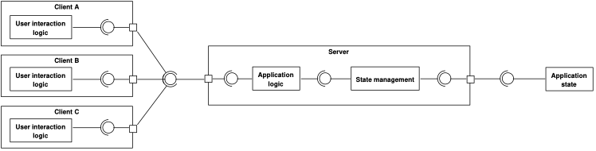
Client-Server Style

Slide 7
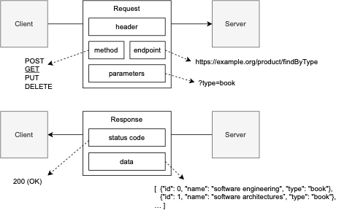
Client-Server Communication
Interaction typically follows request–response
Often stateless (e.g., REST-based systems)
Statelessness enables:
  scalability
  replication
  caching
Trade-off:
Increased responsibility on clients

Slide 8
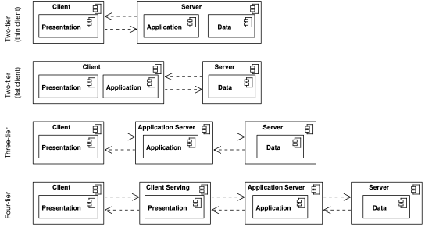
Client-Server Variants
Two-tier architectures
  direct client–server interaction
Three-tier architectures
  presentation, application, data
Four-tier and beyond
  additional mediation layers

Slide 9
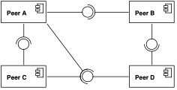
Peer-to-Peer Style
No fixed client or server roles
All nodes can act as both providers and consumers
Common in distributed and collaborative systems
Advantages:
No single point of failure
High scalability
Limitations:
Complex coordination
Partial reliability of nodes

Slide 10
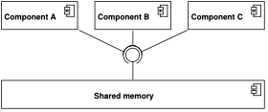
Shared Memory Style
Components communicate through shared data
Typically managed by a central repository
Common in databases and concurrent systems
Advantages:
Simple communication model
Strong consistency guarantees
Limitations:
Scalability limits
Centralized bottleneck

Slide 11
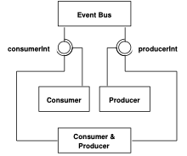
Event-Driven Style
Components interact by producing and consuming events
Producers do not know consumers (and vice versa)
Communication mediated by an event bus or broker
Key properties:
Loose coupling
Asynchronous interaction

Slide 12
Event-Driven Style: Advantages
Strong decoupling between components
High scalability
Good support for system evolution
Natural fit for reactive and distributed systems

Slide 13
Event-Driven Style: Limitations
Harder to reason about global system behavior
Debugging and testing are more complex
Weaker consistency guarantees
Event ordering and duplication must be handled explicitly

Slide 14
Event-Driven Variants: Publish-Subscribe
Events broadcast to multiple subscribers
Subscribers express interest in event types
Typical use cases:
Notifications
Monitoring
Real-time updates

Slide 15
Event-Driven Variants: Message Queues
Events placed in queues and consumed by workers
Each message processed by (typically) one consumer
Typical use cases:
Task distribution
Load balancing

Slide 16
Microservices Style
Application decomposed into small, autonomous services
Each service implements a single business capability
Services communicate via lightweight protocols
Key characteristics:
Independent deployment
Decentralized data management
Explicit APIs

Slide 17
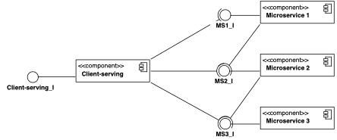
Microservices Style

Slide 18
Microservices: Advantages
Independent development and deployment
Fine-grained scalability
Fault isolation
Technology heterogeneity

Slide 19
Microservices: Limitations
Increased operational complexity
Distributed data consistency issues
Harder testing and debugging
Requires mature tooling and practices

Slide 20
Dataflow Style
Computation organized as a sequence of processing steps
Components transform data streams
Connectors represent data flows
Typical application domains:
Sata analytics
Scientific computing
Stream processing

Slide 21
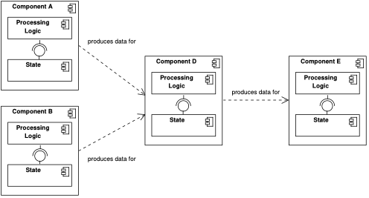
Dataflow Style

Slide 22
Dataflow Style: Advantages
Natural fit for data-intensive applications
High parallelism
Clear separation of processing stages

Slide 23
Dataflow Style: Limitations
Limited flexibility for control-intensive logic
State management can be complex
Debugging distributed pipelines is challenging

Slide 24
Dataflow Variants: Batch Processing
Finite data sets
High throughput
High latency
Typical use:
Offline analytics
Reporting

Slide 25
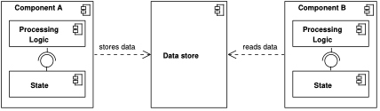
Dataflow Variants: Batch Processing

Slide 26
Dataflow Variants: Stream Processing
Unbounded data streams
Continuous computation
Low latency
Typical use:
Monitoring
Real-time analytics

Slide 27
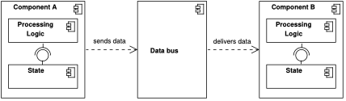
Dataflow Variants: Stream Processing

Slide 28
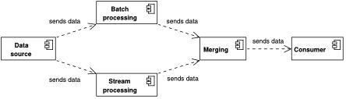
Dataflow Variants: Hybrid Approaches
Combine batch and stream processing
Example: Lambda architecture

Slide 29
Combining Architectural Styles
Real systems rarely adopt a single pure style
Styles are often combined to address different concerns
Examples:
Client–server with microservices
Event-driven dataflow pipelines

Slide 30
Wrap-up
Architectural styles guide high-level design decisions
Each style implies specific trade-offs
No universally best architecture
Choice depends on:
Requirements
Quality attributes
Organizational constraints

