Slide 1
Chapter 11:
Design Patterns
Summary slides from
M. Camilli, E. Di Nitto, A. Fuggetta,
A. Margara, M.G. Rossi, D.A. Tamburri. Software Engineering: a Structured Journey from Inception to Delivery. BUP 2025.

Slide 2
Introduction to Design Patterns
Architectural styles guide high-level system structure
Design patterns address the internal structure of components
They provide reusable solutions to recurring design problems
Focus of this chapter:
What design patterns are
How they are classified
Representative examples

Slide 3
What is a Design Pattern?
A design pattern is a template for solving a recurring design problem
It is:
  Abstract enough to be reusable
  Concrete enough to be recognizable
Helps express design intent clearly

Slide 4
Origins of Design Patterns
Popularized by Design Patterns: Elements of Reusable Object-Oriented Software [Gamma et al., 1995]
Introduced a shared vocabulary for object-oriented design
This chapter adopts their classification

Slide 5
Elements of a Design Pattern
A design pattern consists of:
Name: shared vocabulary
Problem: recurring design issue
Solution: structure of components and interactions
Consequences: benefits and trade-offs
Patterns support informed design decisions

Slide 6
Classification of Design Patterns
Patterns are classified by the problem they address:
Creational: object creation
Structural: object composition
Behavioral: interaction and control flow
Concurrency: safe and efficient parallel execution

Slide 7
Creational Patterns
Focus on how objects are created
Decouple object creation from usage
Hide concrete classes from client code
Examples in this chapter:
Factory Method
Abstract Factory

Slide 8
Factory Method
Solves the problem of creating objects without knowing their exact class
Defines a factory method in a base class
Subclasses decide which concrete object to instantiate
Key benefit:
Extensibility without modifying client code

Slide 9
Factory Method: Example
Context: mobile applications generating notifications
Different apps require different notification types
Client code should not depend on concrete notification classes
Example structure:
App defines a factory method createNotification()
Subclasses (e.g., Game) override it
Concrete products (e.g., GameNotification) are instantiated transparently

Slide 10
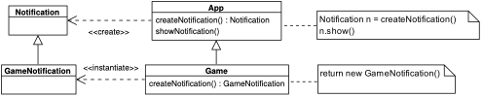
Factory Method

Slide 11
Factory Method: Consequences
Promotes loose coupling
Supports open–closed principle
May increase the number of classes
Used when:
Object type depends on subclass

Slide 12
Abstract Factory
Creates families of related objects
Ensures consistency among created objects
Client code depends only on abstract interfaces
Typical use case:
Interchangeable product families (e.g., UI themes)

Slide 13
Abstract Factory: Example
Context: graphical user interface with multiple themes
Each theme requires a consistent set of components
Example structure:
Abstract factory defines creation methods (e.g., buttons, frames)
Concrete factories implement a specific theme (light, dark)
Client code depends only on abstract interfaces

Slide 14
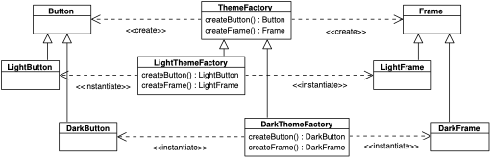
Abstract Factory

Slide 15
Abstract Factory: Consequences
Enforces consistency among related objects
Makes switching product families easy
Harder to extend with new product types

Slide 16
Structural Patterns
Focus on how classes and objects are composed
Build larger structures from simpler ones
Promote flexibility and reuse
Examples in this chapter:
Adapter
Decorator

Slide 17
Adapter
Integrates components with incompatible interfaces
Wraps an existing class with a new interface
Avoids modifying existing or external code
Typical scenario:
Integrating third-party components

Slide 18
Adapter: Example
Context: rendering documents with incompatible interfaces
System expects objects implementing Drawable
External PDF component exposes a different interface
Example structure:
PDFDocumentAdapter wraps PDFDocument
Translates draw() calls into getContent() calls
Allows uniform treatment of PNG and PDF documents

Slide 19

Adapter

Slide 20
Adapter: Consequences
Improves reuse of existing components
Increases flexibility
Adds an extra level of indirection

Slide 21
Decorator
Adds responsibilities to objects dynamically
Avoids explosion of subclasses
Uses object composition instead of inheritance
Typical use case:
Optional or combinable features

Slide 22
Decorator: Example
Context: printing text with optional formatting styles
Styles can be combined dynamically (bold, italics, underline)
Example structure:
Printer defines basic printing behavior
Decorators wrap a Printer instance
Each decorator adds a formatting responsibility

Slide 23
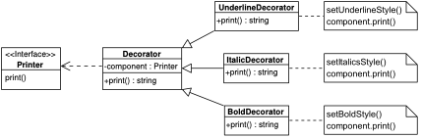
Decorator

Slide 24
Decorator: Consequences
Highly flexible and extensible
Supports runtime composition of behavior
Can make object structure harder to understand

Slide 25
Behavioral Patterns
Focus on communication and interaction between objects
Encapsulate control flow
Improve maintainability of complex behavior
Examples in this chapter:
State
Observer

Slide 26
State
Behavior depends on an object’s internal state
Encapsulates state-specific behavior in separate classes
Eliminates complex conditional logic
Typical use case:
Objects with clearly defined states

Slide 27
State: Example
Context: mobile device notification handling
Device behavior depends on its current mode
Example states:
Normal, Work, Sleep
Example structure:
MobileDevice delegates behavior to a MobileState
State objects encapsulate mode-specific behavior

Slide 28
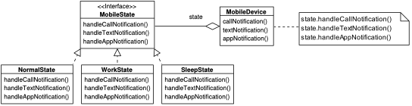
State

Slide 29
State: Consequences
Simplifies context logic
Makes adding new states easy
Behavior scattered across multiple classes

Slide 30
Observer
Defines a one-to-many dependency
Observers automatically notified of changes
Subject unaware of concrete observers
Typical use case:
Event notification and UI updates

Slide 31
Observer: Example
Context: chat application receiving messages
Multiple UI components must react to updates
Example structure:
ChatApp acts as subject
Widgets implement ChatObserver
Observers are notified when a new message arrives

Slide 32
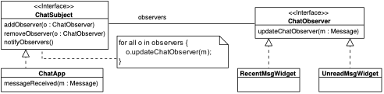
Observer

Slide 33
Observer: Consequences
Promotes loose coupling
Supports dynamic subscription
Notification order and performance may be issues

Slide 34
Concurrency Patterns
Address challenges of concurrent execution
Abstract low-level threading mechanisms
Improve safety and performance
Example in this chapter:
Thread Pool

Slide 35
Thread Pool
Reuses a fixed set of worker threads
Tasks submitted to a shared queue
Controls resource usage
Typical use case:
Systems with many short-lived tasks

Slide 36
Thread Pool: Example
Context: system executing many computational tasks
Creating a thread per task is inefficient
Example structure:
Tasks implement ComputeTask
Tasks submitted to a shared queue
Worker threads reuse resources to execute tasks

Slide 37
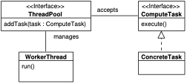
Thread Pool

Slide 38
Thread Pool: Consequences
Efficient resource utilization
Improved responsiveness under load
Requires careful sizing and management

Slide 39
Wrap-up
Design patterns capture proven design knowledge
They complement architectural styles
Provide a shared vocabulary for designers
Operate at different levels of abstraction
Patterns support clarity, reuse, and evolution

