Slide 1
Chapter 15:
Verification and Validation Process
Summary slides from
M. Camilli, E. Di Nitto, A. Fuggetta,
A. Margara, M.G. Rossi, D.A. Tamburri. Software Engineering: a Structured Journey from Inception to Delivery. BUP 2025.

Slide 2

Verification and Validation Process
Chapter 15
Focus: Quality Assurance foundations,
challenges, V-Model

Slide 3
Learning objectives
Distinguish verification from validation
Understand software Quality Assurance (QA) as a process
Explain key challenges of QA
Describe and reason about the V-Model
Classify types of verification activities

Slide 4
Why Verification & Validation
Software failures have high economic and societal impact
Defects propagate and become more expensive over time
V&V provides:
  Risk reduction
  Confidence in correctness
  Evidence-based quality assessment

Slide 5
Foundations of Software Quality Assurance
Software Quality Assurance (QA):
  A systematic, planned set of activities
  Goal: ensure software processes and products meet defined quality standards
Key characteristics:
  Process-oriented (not just product-oriented)
  Continuous throughout the lifecycle
  Includes both preventive and detective actions

Slide 6
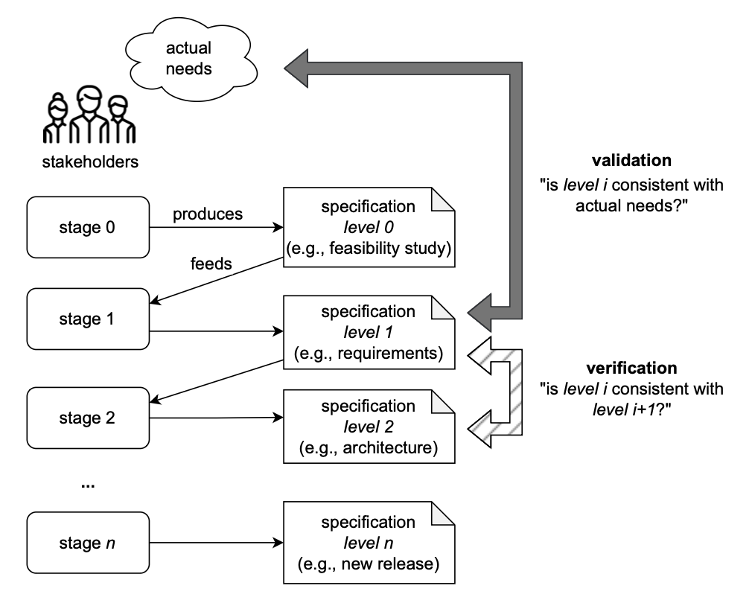
V&V: Core Definitions
Verification
  “Are we building the product right?”
  Conformance to specifications and models
Validation
  “Are we building the right product?”
  Fitness for intended use and stakeholder needs

Slide 7
V&V: Complementary Activities
Verification ≠ Validation
A system can be:
  Verified but not validated
  Validated but poorly verified (rare, but possible)
High-quality software requires both

Slide 8
Challenges in Quality Assurance
Quality assurance is non-trivial due to:
  Human judgment
  System complexity
  Incomplete specifications
  Emergent behavior
We analyze four major challenges

Slide 9
Challenge 1: Objective vs Subjective QA
Objective QA
  Formal properties
  Automated checks
  Repeatable results
Subjective QA
  Usability
  User satisfaction
  Perceived quality
⚠️ Many quality attributes lie on a spectrum, not a binary scale.

Slide 10
Challenge 2: Non-binary QA Outcomes
QA results are rarely “pass/fail”
Common examples:
  Performance: acceptable, good, excellent
  Reliability: probability-based
Leads to trade-offs and thresholds, not absolutes

Slide 11
Challenge 3: Non-continuous Behavioral Patterns
Small input changes → large behavioral changes
Examples:
  Race conditions
  Boundary errors
  Mode-switching systems
Implication:
  Exhaustive testing is impossible
  Strategic selection of V&V techniques is required

Slide 12
Challenge 4: Verification shall be verified
Verification activities can be:
  Incomplete
  Incorrect
  Misapplied
Therefore:
  Verification processes themselves must be reviewed and validated
  Meta-quality assurance is required
  At some point we should stop. When?

Slide 13
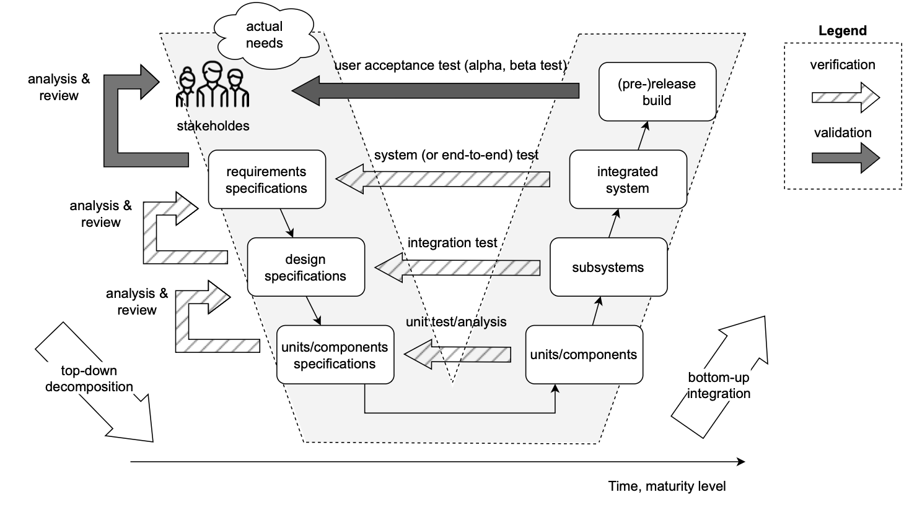
The V-Model Overview
The V-Model links:
  Development phases (left branch)
  V&V activities (right branch)
Key idea:
  Each development artifact has a corresponding verification activity.

Slide 14
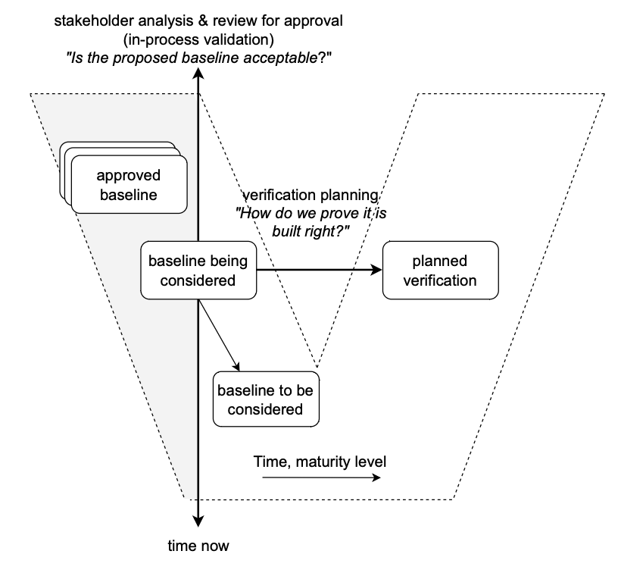
V-Model: Left Side
Descending phase:
  Requirements analysis
  System design
  Detailed design
Artifacts become more:
  Detailed
  Concrete
  Implementation-oriented

Slide 15
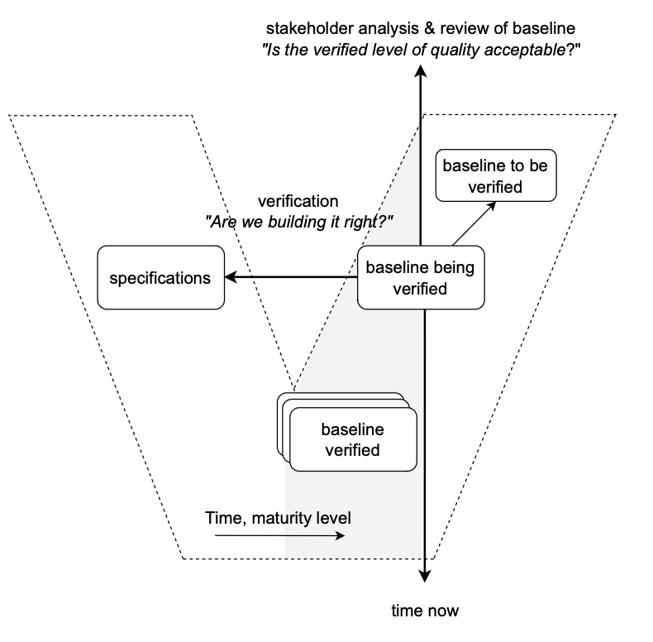
V-Model: Right Side
Ascending phase:
  Unit testing
  Integration testing
  System testing
  Acceptance testing
Each test level:
  Targets a specific artifact
  Validates assumptions made earlier

Slide 16
V-Model: Key Strength
Explicit traceability
  Early planning of test activities
Encourages:
  Early defect detection
  Alignment between specs and tests
Limitations:
  Assumes relatively stable requirements
  Less flexible than iterative/agile models

Slide 17
Types of Verification Activities
Verification can be classified by:
  Technique
  Automation level
  Artifact under analysis
Examples:
  Reviews and inspections
  Static analysis
  Dynamic testing
  Formal verification

Slide 18
Static vs Dynamic Verification
Static Verification
  No execution
  Models, code, documents
  Examples: inspections, static analysis
Dynamic Verification
  Requires execution
  Observes runtime behavior
  Examples: testing, simulation

Slide 19
Manual vs Automated Verification
Manual
  Code reviews
  Walkthroughs
  Expert judgment
Automated
  Static analyzers
  Model checkers
  Test execution frameworks
Trade-off:
  Automation → scalability
  Manual → human judgment

Slide 20
Verification Across the Lifecycle
Verification is not a single phase:
  Requirements → reviews, acceptance criteria
  Design → model consistency checks
  Code → static analysis, unit tests
  System → integration & system tests
QA is continuous and incremental

Slide 21
Wrap-up
Key takeaways:
  Verification and validation are distinct but complementary
QA is inherently challenging
The V-Model provides a structured QA perspective
Effective V&V requires:
  Multiple techniques
  Early planning
  Continuous feedback

