Slide 1
Chapter 16:
Software Analysis
Summary slides from
M. Camilli, E. Di Nitto, A. Fuggetta,
A. Margara, M.G. Rossi, D.A. Tamburri. Software Engineering: a Structured Journey from Inception to Delivery. BUP 2025.

Slide 2

Software Analysis
Chapter 16
Focus: static analysis, data-flow analysis, symbolic execution

Slide 3
Learning objectives
Explain the goals and limits of software analysis
Distinguish manual vs automated analysis
Understand static analysis principles
Construct and reason about control-flow graphs (CFGs)
Explain data-flow analysis (live variables, reaching definitions)
Understand the intuition behind symbolic execution

Slide 4
What is Software Analysis?
The activity of examining software artifacts to infer properties
Main targets:
  Code
  Models
Key purpose:
  Support verification and validation

Slide 5
Why Software Analysis Matters
Testing alone is insufficient
Analysis enables:
  Early defect detection
  Detection of potential errors
  Reasoning about all executions, not just sampled ones
Essential for:
  (Safety-) critical systems
  Security
  Performance reasoning

Slide 6
Principles of Software Analysis
Fundamental constraints:
  Programs have infinite or extremely large behaviors
  Exact analysis is often undecidable
Therefore:
  Analysis relies on abstractions
  Results are approximations
Key trade-off:
  Precision vs Scalability

Slide 7
Manual Software Analysis
Human-driven examination of artifacts:
  Requires expertise
  Scales poorly
  High semantic understanding
Used for:
  Design validation
  Critical code sections
  Process compliance
Examples: code walkthroughs, code inspections, asynchronous code reviews

Slide 8
Automated Software Analysis
Analyzes programs without executing them
Operates on:
  Source code
  Intermediate representations

Slide 9
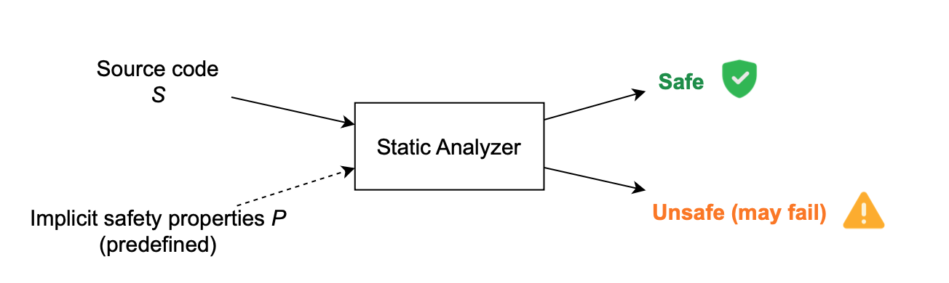
Automated Software Analysis
Analyzes programs without executing them
Operates on:
  Source code
  Approximated representations

Slide 10
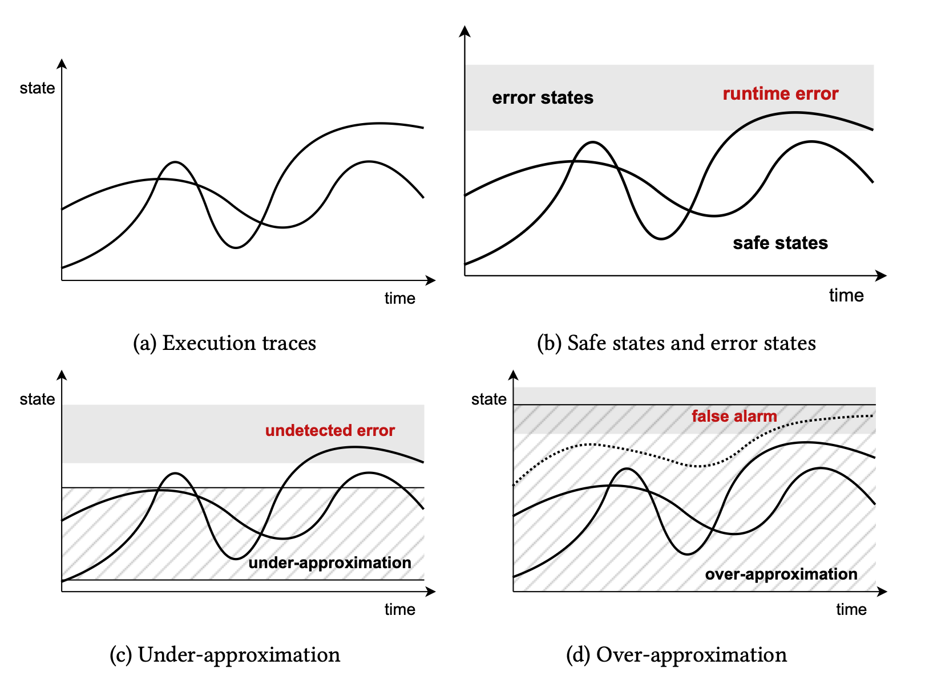
Over- vs Under-Approximation
Over-approximation
  Includes all real behaviors + some spurious ones
  Sound, but imprecise
Under-approximation
  Misses some behaviors
  Precise, but unsound

Slide 11
Over-Approximation: Control-Flow Graphs
Control-Flow Graph (CFG):
  Nodes → basic blocks
  Edges → possible control transfers
Purpose:
  Foundation for most static analyses
  Captures possible execution paths
  Over-approximation used in Data-flow Analysis

Slide 12
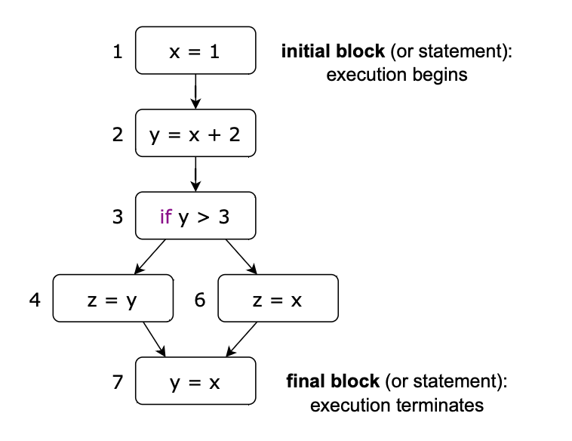
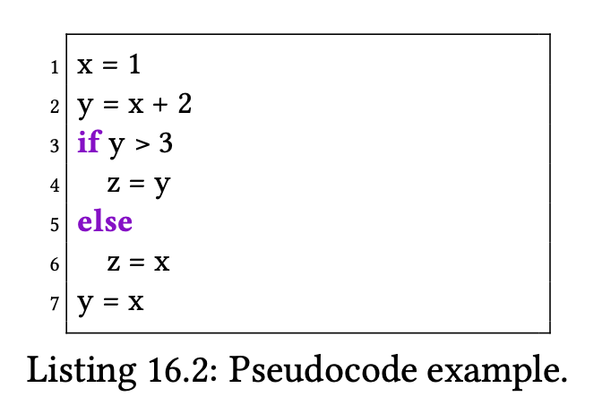
Over-Approximation: Control-Flow Graphs

Slide 13
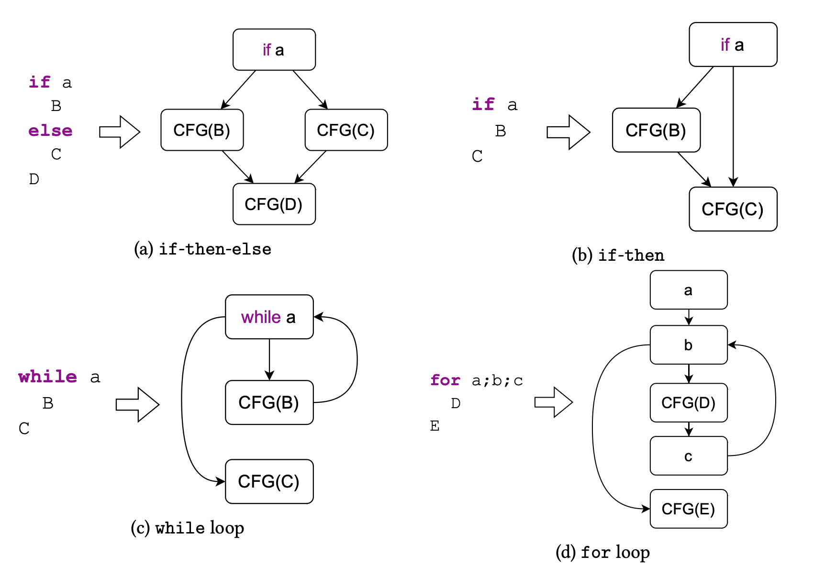
Over-Approximation: Control-Flow Graphs

Slide 14
Data-Flow Analysis
Goal:
  Compute specific properties of programs (depends on type of analysis)
Based on:
  CFG
  Fixed-point computation

Slide 15
Live Variables Analysis
A variable is live at a program point if:
  Its value may be used in the future
Used for:
  Register allocation
  Dead code elimination
  Program slicing
Key sets:
  LV_in
  LV_out

Slide 16
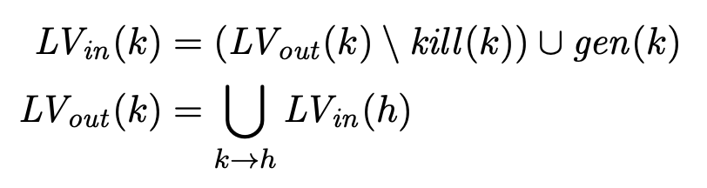
Live Variables Analysis: Equations
Data-flow equations:
  Recursive
  Solved via iterative approximation until fixed point is reached
LV_{in} (k): set of variables live at the entry of block k
LV_{out} (k): set of variables live at the exit of block k
gen(k): set of variables assigned (overwritten) in block k
Kill(k): set of variables used (read) in block k

Slide 17
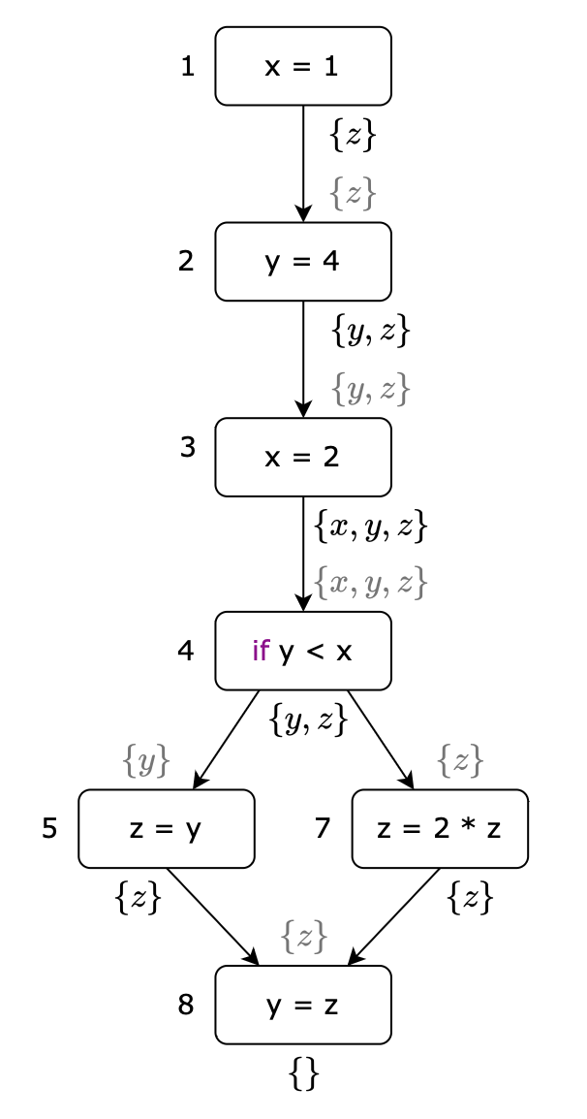
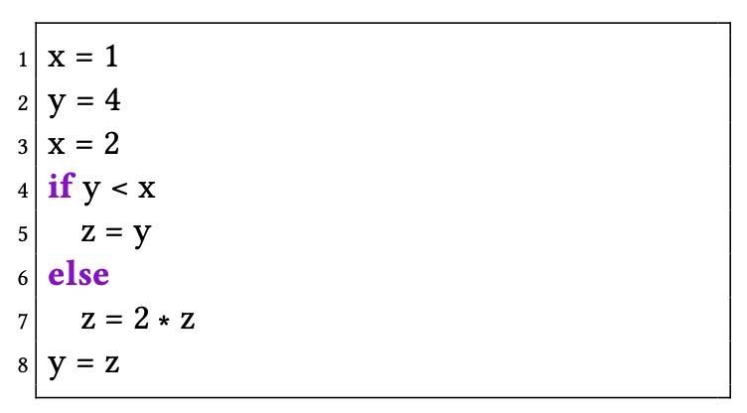
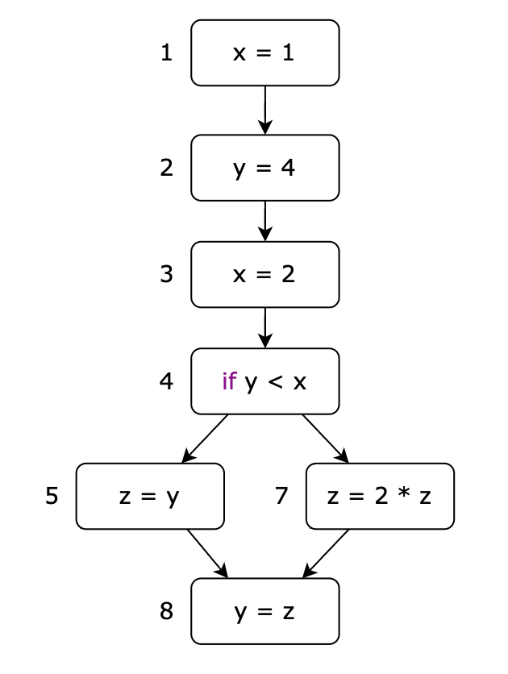
Live Variables Analysis
Pseudocode
CFG
LV_{out} / LV_{in}
x not live at the
exit of block 1 →
Dead code

Slide 18
Reaching Definitions: Preliminaries
A definition reaches a program point if:
  There exists a path with no redefinition
Used for:
  Detecting uninitialized variables
  Optimization
  Program understanding
Produces:
  Definition-use (DU) chains

Slide 19
Reaching Definitions: Preliminaries
Variable Definition: A definition (v,k) is an assignment to variable v occurring at block k.
Reaching Definition (RD): a definition (v,k) reaches block r if there is a path in the CFG from k to r that does not redefine v. In this case, we say that (v,k) is a RD for block r

Slide 20
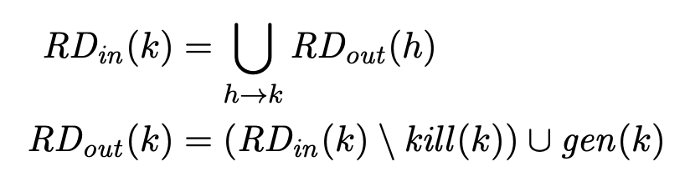
Reaching Definitions: Equations
Data-flow equations:
RD_{in} (k): definitions that may reach the entry of block k
RD_{out} (k): definitions that may reach the exit of block k

Slide 21
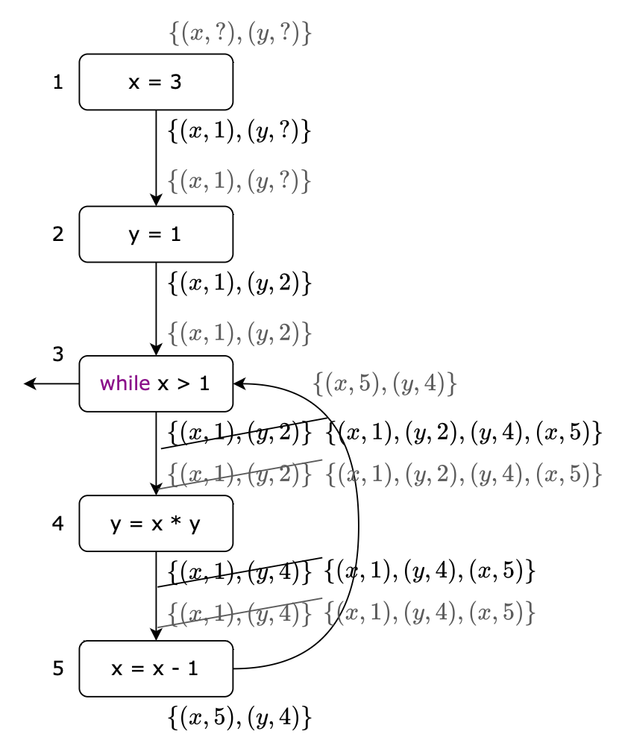
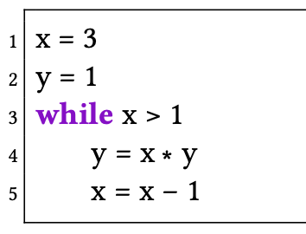
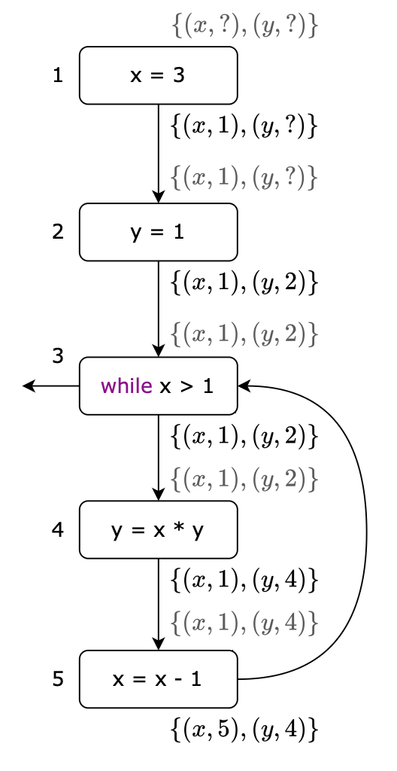
Reaching Definitions
Pseudocode
1st iteration
2nd iteration
“?” implicit
definition

Slide 22
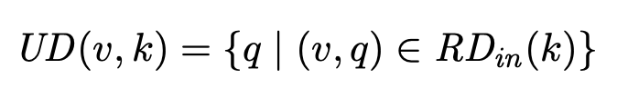
Reaching Definitions: Use-Def Chains
Use-Def (UD) Chains: Given a variable v and a program location k, the corresponding UD chain is defined as
q program location or the implicit definition “?”
if (v,?) belongs to UD(v,k), the implicit definition may reach block k which uses v → v may be used before any explicit assignment

Slide 23
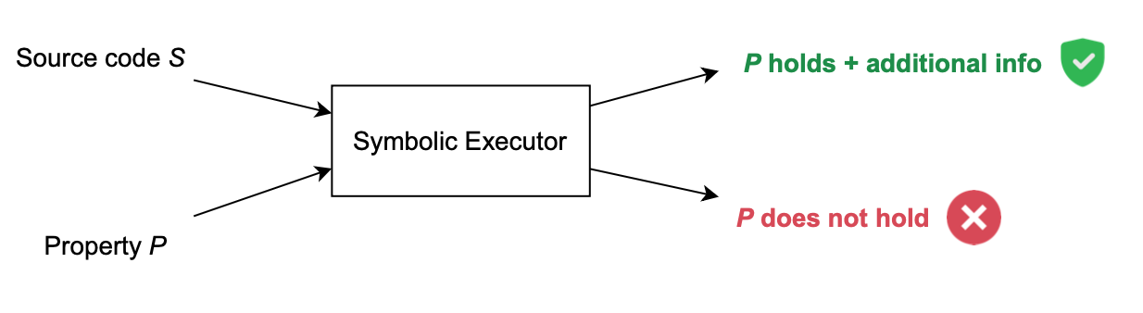
Symbolic Execution
Executes programs with symbolic inputs
Explore multiple execution paths simultaneously to check given properties
  Reachability: can a program location be reached during execution?
  Path feasibility: is a specific execution path actually executable?

Slide 24
Symbolic Execution
Note: symbolic execution is not “purely static”
It blends characteristics of both paradigms: static and dynamic analysis

Slide 25
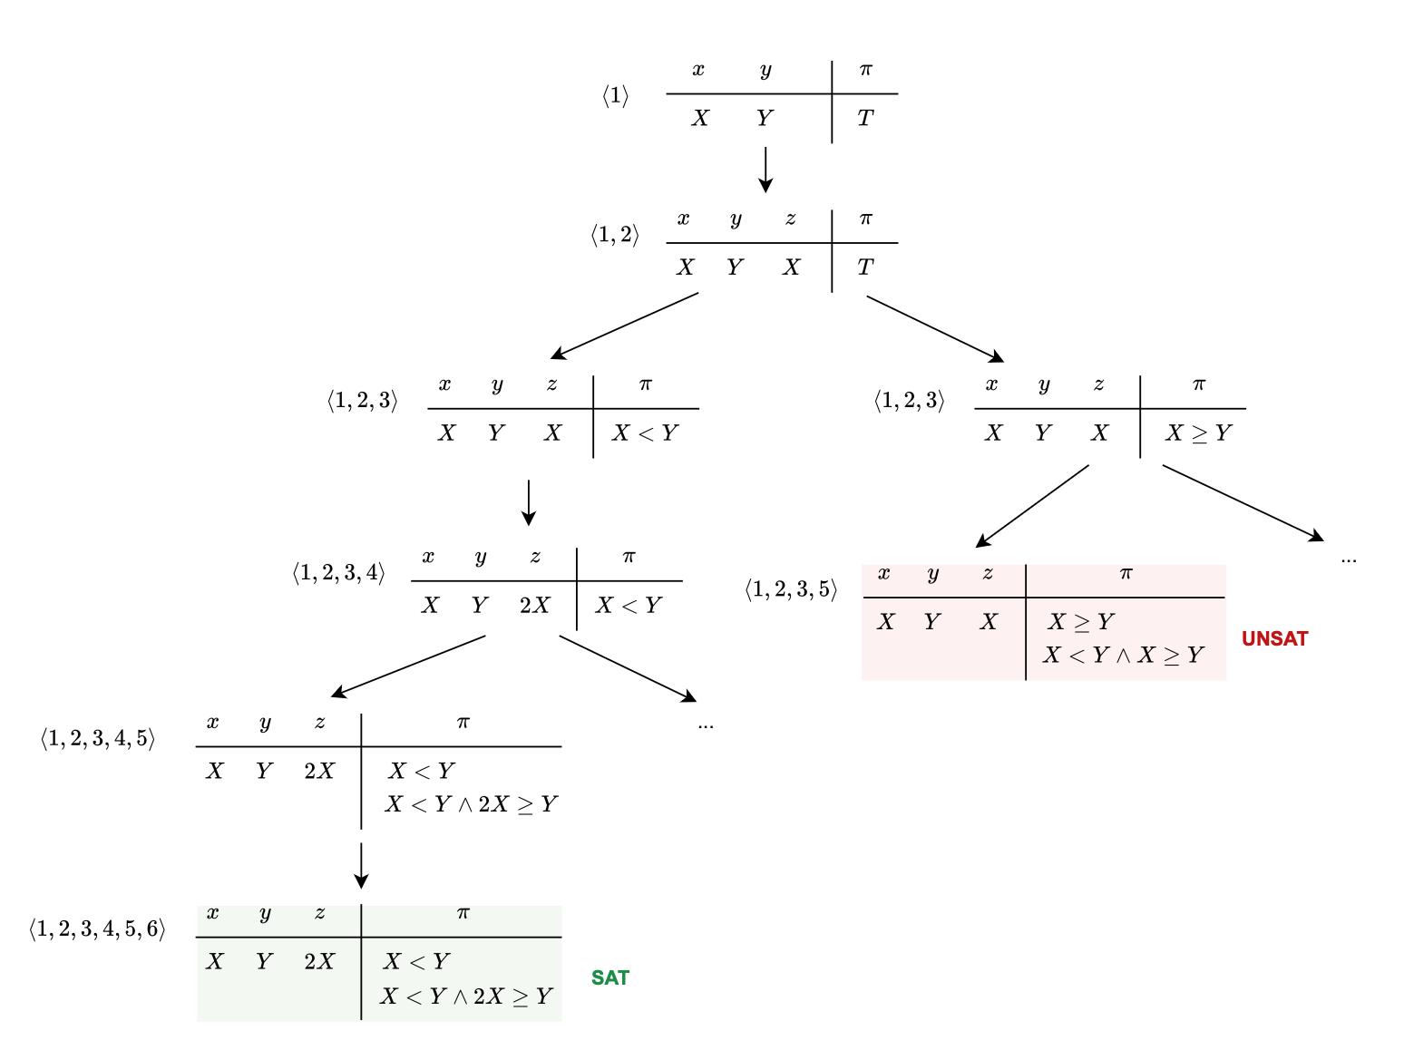
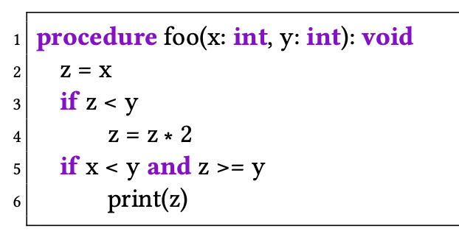
Symbolic Execution
Symbolic execution tree
Pseudocode
variables
Path
condition
Symbolic
expressions
Path condition cannot
be satisfied → <1,2,3,5> is not feasible
Path condition can be satisfied → <1,2,3,4,5,6> is feasible

Slide 26
Symbolic Execution: Strengths and Limits
Strengths:
  High precision
  Systematic path exploration
Limitations:
  Path explosion
  Constraint solver complexity
  Scalability challenges

Slide 27
Wrap-up
Software analysis complements testing
Over-approximation enables sound analysis
Data-flow analysis makes use of CFGs
Symbolic execution bridges analysis and testing

