Slide 1
Chapter 17:
Software Testing
Summary slides from
M. Camilli, E. Di Nitto, A. Fuggetta,
A. Margara, M.G. Rossi, D.A. Tamburri. Software Engineering: a Structured Journey from Inception to Delivery. BUP 2025.

Slide 2

Software Testing
Chapter 17
Focus: theory of testing, testing workflow, test design, testing levels

Slide 3
Learning objectives
Explain the goals and role of software testing
Understand basic testing terminology
Reason about the theoretical limits of testing
Describe the testing workflow
Distinguish black-box vs white-box testing
Explain levels of testing and their purposes

Slide 4
What is Software Testing?
Dynamic verification technique
Executes software to observe behavior
Goal: reveal failures, not prove correctness
“Program testing can be used to show the presence of bugs, but never to show their absence!” (Dahl et al. 1972)

Slide 5
Why Testing Matters
Software is complex and error-prone
Testing provides:
  Empirical evidence of correctness
  Confidence for deployment
  Risk reduction
Testing complements:
  Static analysis (e.g., reviews, inspections, data-flow analysis, …)
  Other forms of verification

Slide 6
Goals of Testing
Primary goals:
  Detect faults
  Reveal failures
  Assess quality attributes
Secondary goals:
  Build confidence
  Support decision-making
  Provide feedback to developers

Slide 7
Faults, Errors, Failures (IEEE standard)
Error: (human) action that introduces a flaw into a program. Example: a mistake made while writing or modifying code.
Defect (bug): flaw in a program, typically introduced by an error. Example: procedure that is expected to return only positive values but occasionally returns a negative value due to a logic flaw.
Fault: manifestation of an error, encountered during software execution. It can lead to incorrect behavior (failure).
Failure: observable deviation of the program from its intended behavior—that is, the software does not perform a required procedure or fails to meet specified requirements.

Slide 8
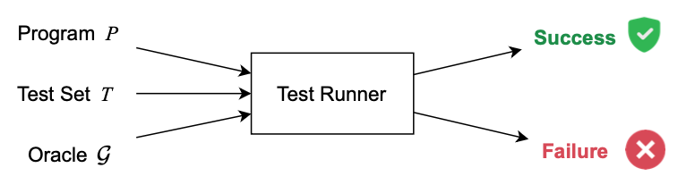
Conceptual View of Testing
Input selection, Execution, Observation, Verdict —based on a given Oracle

Slide 9
Limitations of Testing
Why exhaustive testing is impossible:
  Infinite input domains
  Path explosion
  Undecidability
Implication:
  Testing is selective and heuristic
  Test adequacy ≠ correctness proof

Slide 10
Testing as Sampling
Testing samples from:
  Input space
  Execution paths
  Environmental conditions
Key challenge:
  How do we choose representative and effective tests?

Slide 11
White-Box Testing
Also called structural testing:
  Uses knowledge of internal structure
  Based on: control-flow, data-flow
Selection criteria based on:
  Statement coverage
  Branch coverage
  Path coverage

Slide 12
White-Box Testing: statement coverage
C code example
Test Case
  Input: x = 5
Coverage Achieved
  Executes:
    if (x >= 0)
    return x;
Statement coverage achieved
The else branch is never executed
int abs(int x) {
if (x >= 0)
return x;
else
return -x;
}

Slide 13
White-Box Testing: branch coverage
C code example
Test Cases
  Input 1: x = 5 → if condition is true
  Input 2: x = -3 → if condition is false
Coverage achieved
  Executes:
    Both outcomes of x >= 0
    Both return statements
Branch coverage achieved
Statement coverage implicitly achieved
int abs(int x) {
if (x >= 0)
return x;
else
return -x;
}

Slide 14
White-Box Testing: path coverage
C code example
Possible Execution Paths
  x > 0 ∧ y > 0
  x > 0 ∧ y ≤ 0
  x ≤ 0
Required test cases
  (x=1, y=1)
  (x=1, y=-1)
  (x=-1, y=any)
Usually not feasible in practice: loops (infinite paths), path explosion
if (x > 0)
if (y > 0)
z = 1;
else
z = 2;
else
z = 3;

Slide 15
White-Box Testing: summary
Criterion | Guarantees | Limitations
Statement Coverage | All statements executed | Misses decision outcomes
Branch Coverage | All decision outcomes tested | Misses path combinations
Path Coverage | All execution paths tested | Often infeasible

Slide 16
Black-Box Testing
Based on specifications
Ignores internal structure
Common techniques:
  Equivalence partitioning
  Boundary value analysis
  Decision tables

Slide 17
Black-Box Testing: Equivalence
Example: a procedure check_temperature accepts an integer temperature reading temp with the following specification:
  It returns “Cold” if temp < 0.
  It returns “Normal” if 0 ≤ temp ≤ 20.
  It returns “Warm” if temp > 20.
  Readings outside the valid input range [-20, 50] should result in an “Invalid Input” error message.

Slide 18
Black-Box Testing: Equivalence Classes
Based on this specification, the following equivalence classes are identified:
  Valid input ranges
    Class 1: Temperatures less than 0. Expected output: “Cold.”
    Class 2: Temperatures from 0 to 20 (inclusive). Expected output: “Normal.”
    Class 3: Temperatures greater than 20 up to 50. Expected output: “Warm.”
  Invalid input ranges
    Class 4: Temperatures below -20. Expected output: “Invalid Input.”
    Class 5: Temperatures above 50. Expected output: “Invalid Input.”

Slide 19
Black-Box Testing: Equivalence Classes
Test set: representative value is selected from each class
  Class 1: −10 → Expected: “Cold.”
  Class 2: 10 → Expected: “Normal.”
  Class 3: 30 → Expected: “Warm.”
  Class 4: −25 → Expected: “Invalid Input.”
  Class 5: 55 → Expected: “Invalid Input.”

Slide 20
Black-Box Testing: Boundary Value Analysis
Input validity boundaries: −20 and 50
Output class boundaries (values where the output changes, based on the specification): 0 and 20
Test set augmented with values around boundaries:
  Around input minimum −20: −21 (invalid, outside), −20 (valid, on boundary), −19 (valid, inside). Expected outcomes: “Invalid Input,” “Cold,” “Cold”
  Around output boundary 0: −1 (valid, below), 0 (valid, on boundary), 1 (valid, above). Expected outcomes: “Cold,” “Normal,” “Normal”
  Around output boundary 20: 19 (valid, below), 20 (valid, on boundary), 21 (valid, above). Expected outcomes: “Normal,” “Normal,” “Warm”
  Around input maximum 50: 49 (valid, inside), 50 (valid, on boundary), 51 (invalid, outside). Expected outcomes: “Warm,” “Warm,” “Invalid Input”

Slide 21
Levels of Testing
Testing is organized into levels:
  Unit testing
  Integration testing
  System testing
Each level:
  Targets different faults
  Uses different artifacts

Slide 22
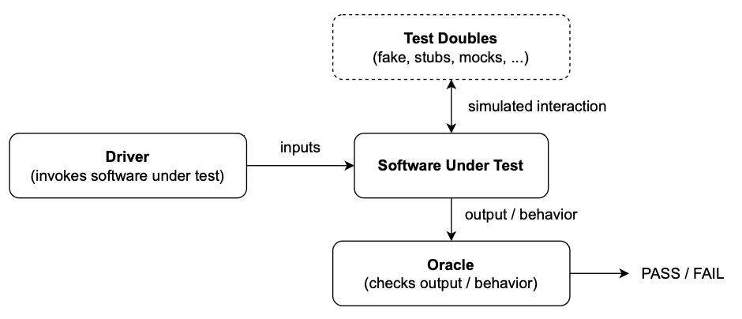
Levels of Testing: Unit
Focus:
  Individual units (functions, classes)
  Defined considering detailed design
Goal:
  Detect local faults early
To isolate units:
  Stubs (simulate callees)
  Mocks (simulate + verify interactions)
  Drivers (simulate callers)

Slide 23
Levels of Testing: Integration
Focus:
  Interactions between components
  Defined considering the architecture
Goal:
  Detect interface and interaction fault
Main strategies:
  Top-down
  Bottom-up
  Thread

Slide 24
Levels of Testing: System
Focus:
  Entire system behavior
  End-to-end scenarios
  Defined considering system-level requirements
Includes:
  Functional testing
  Non-functional testing (e.g., performance, reliability)
Often basis for validation:
  Acceptance testing

Slide 25
Wrap-up
Testing is a core dynamic QA activity
Exhaustive testing is often impossible
Test selection requires effective strategies
Multiple testing levels are essential
Testing complements analysis and reviews

