Slide 1
Chapter 2:
The Software
Development Process
Summary slides from
M. Camilli, E. Di Nitto, A. Fuggetta,
A. Margara, M.G. Rossi, D.A. Tamburri. Software Engineering: a Structured Journey from Inception to Delivery. BUP 2025.

Slide 2
Introduction to the Software Development Process
Software development involves multiple coordinated activities
Activities span the entire life of a software product
Their organization defines the software life cycle
Key Questions:
  What is a software life cycle?
  Which activities does it include?
  How do we choose the right one?

Slide 3
The Notion of Software Life Cycle
A software life cycle defines:
  the activities to be performed
  their order and interactions
It represents both:
  a technical organization of work
  a development philosophy

Slide 4
Foundational Life Cycle Models
Two foundational models:
  Waterfall
  Spiral
They shaped most modern software processes

Slide 5
The Waterfall Model
Introduced around 1970 (Royce)
Development as a linear sequence of activities
Each phase produces input for the next one
Key contribution:
Explicit identification of core development activities

Slide 6
Limits of a Purely Linear Process
Requirements cannot be fully known upfront
Late user involvement is ineffective
Change is unavoidable in real projects
Strict linearity is unrealistic for software

Slide 7
Iterative Life Cycles
Activities are revisited multiple times
Continuous feedback and refinement
Users are involved throughout development
Iteration improves alignment with expectations

Slide 8
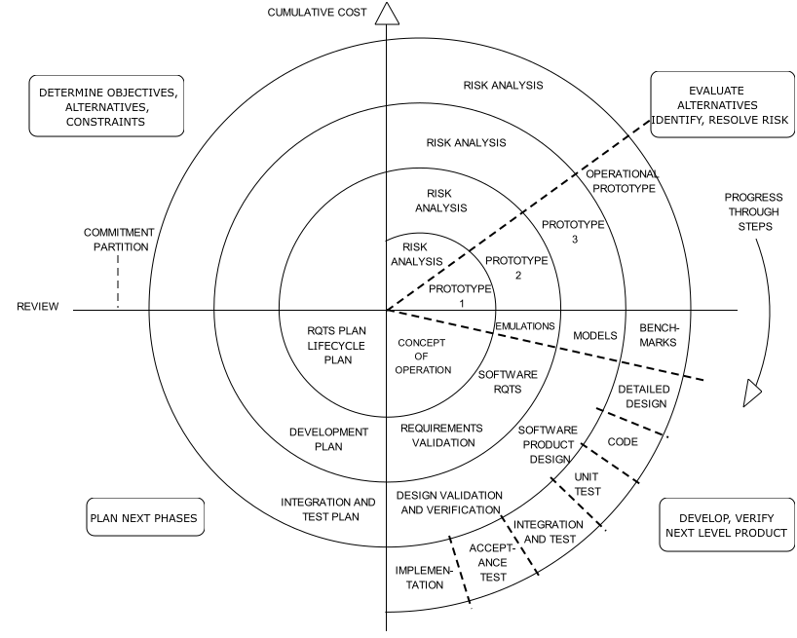
The Spiral Model
Introduced by Barry Boehm (1986)
Development as repeated cycles of activities
Each iteration:
  delivers usable results
  assesses risks
  expands system scope

Slide 9
From Spiral to Modern Processes
Waterfall = spiral with a single iteration
Spiral model inspired:
  iterative
  incremental
  agile approaches

Slide 10
Software Life Cycle Activities
Feasibility Study
Requirements Analysis and Specification
Design
Coding and Unit-Level Quality Assurance
Integration and System Testing
Deployment
Maintenance

Slide 11
Feasibility Study
Assesses whether the project should proceed
Evaluates:
  technical feasibility
  organizational and economic aspects
Includes make-or-buy decisions
Outcome:
  Feasibility Study Document
  Go / No-go decision

Slide 12
Requirements Analysis and Specification
Focus on the problem space
Defines what the software must do
Intensive interaction with:
  customers
  end users
  domain sources
Outcome:
  Requirements Analysis and Specification Document (RASD)

Slide 13
Design
Focus on the solution space
Defines the software architecture
Maps requirements to architectural components
Guides development and integration
Outcome:
  Design Document (DD)

Slide 14
Coding and Unit-Level Quality Assurance
Implementation of individual modules
Developers ensure:
  architectural compliance
  requirement fulfillment
Quality gates at unit level are mandatory

Slide 15
Integration and System Testing
Incremental integration of modules
Verification of component interactions
System-level validation:
  functional requirements
  non-functional qualities

Slide 16
Deployment
Installation of software artifacts on target environments
Increasing complexity due to:
  external services
  multiple dependencies
Automation is crucial
  Infrastructure as Code

Slide 17
Maintenance
Activities after software release
Includes software evolution over time
Two main categories:
  corrective
  evolutionary

Slide 18
Types of Maintenance
Corrective: fixing defects
Evolutionary:
  Adaptive (environment changes)
  Perfective (new requirements)
  Preventive (improving maintainability)

Slide 19
No One-Size-Fits-All Life Cycle
The right life cycle depends on:
  product type
  domain constraints
  team organization
  tools

Slide 20
Highly Critical Systems
Examples:
  aerospace
  medical devices
  industrial control
Characteristics:
  stable requirements
  high reliability needs
Favor:
  structured
  near-linear processes
  rigorous validation

Slide 21
Rapidly Evolving Systems
Examples:
  web-based platforms
Characteristics:
  changing requirements
  fast innovation cycles
Favor:
  iterative life cycles
  frequent releases
  continuous feedback

Slide 22
Life Cycles, Tools, and Teams
Structured life cycles require:
  traceability tools
  formal verification
Iterative life cycles require:
  automation
  CI/CD
  deployment orchestration
Team structure adapts to the chosen process

Slide 23
Final Thoughts
The software life cycle structures development activities
Different products require different processes
No fixed ordering of activities is assumed
Modern approaches emphasize adaptability

