Slide 1
Chapter 20:
The Act of Coding
Summary slides from
M. Camilli, E. Di Nitto, A. Fuggetta,
A. Margara, M.G. Rossi, D.A. Tamburri. Software Engineering: a Structured Journey from Inception to Delivery. BUP 2025.

Slide 2

The Act of Coding
Chapter 20
Focus: Coding and IDEs, Managing the
Technical space, coding conventions, CI/CD

Slide 3
Learning Objectives
Familiarise with the notion of Integrated Development
Understand coding and its standards/conventions
Understanding what happens after coding in CI/CD
Figuring out dependency management

Slide 4
The Act of Coding: Overview
Integrated Development Environments (IDEs) are the host of all activity
Typicals include:
  coding itself (with conventions and their enforcement);
  Debugging;
  dependencies & config management;
  version control and CI/CD;
Emerging paradigms include Low-Code/NoCode & AI Coding;

Slide 5
IDEs Explained: Basics
a code editor provides facilities for guided code development (and eventually, maintenance);
Applying and maintaining code conventions aid in readability, one of the direst problems with coding itself;
Modern IDEs also provide code-completion and intelligent code assistance;

Slide 6
IDEs Explained: Basics (cont’d)
Build automation is often performed at IDE level;
  IDE can manage compilation, and even (continuous) release;
By means of models (e.g., UML) code can be navigated and browsed freely;
  The same approach can be leveraged for automated documentation generation;

Slide 7
IDEs Explained: Coding Conventions
Enhanced readability;
Improved maintainability (e.g., improves diffing capabilities);
Smoother collaboration (better cross-understanding);
Automated enforcement via tooling (e.g., auto-formatters, linters…)

Slide 8
IDEs Explained: Coding Conventions (cont’d)
Enhanced readability;
Improved maintainability (e.g., improves diffing capabilities);
Smoother collaboration (better cross-understanding);
Automated enforcement via tooling (e.g., auto-formatters, linters…)

Slide 9
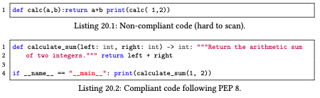
Coding Conventions, an example: Python

Slide 10
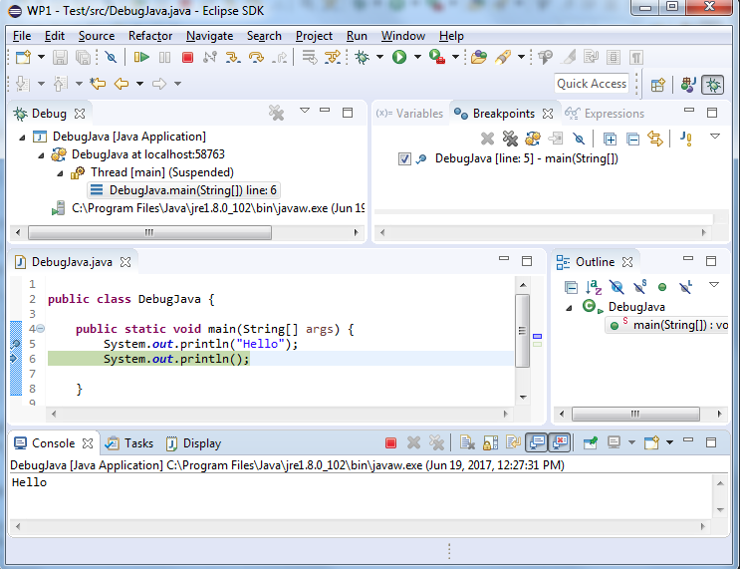
IDEs Explained: Debugging
Steps include:
  Reproduce the bug in a controlled execution mode;
  Isolate the cause(s), e.g., using breakpoints;
  Identify faulty lines, e.g., using step-into, step-out, and variable inspection within the ECLIPSE IDE;
  (Automated) Bug Fixing;

Slide 11
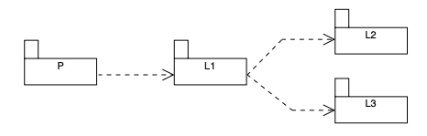
IDEs Explained: Dependency & Version Management
Transitive dependencies tracking is a must for large systems;

Slide 12
Version Conflicts
different parts of the dependency graph require conflicting versions of the same library;
Dependency management tools (in IDEs) must employ strategies to resolve these version conflicts deterministically, e.g.:
  Version select;
  Overrides;
  Reproducibility enforced (e.g., in Python);
  Environment mapping (exact versions enforced);

Slide 13
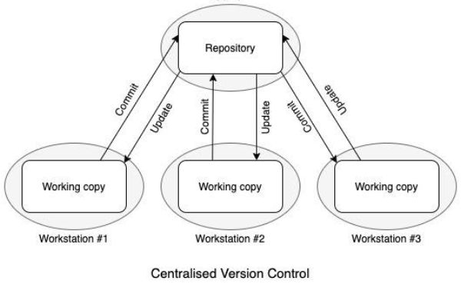
Configuration Management & Vers. Control

Slide 14
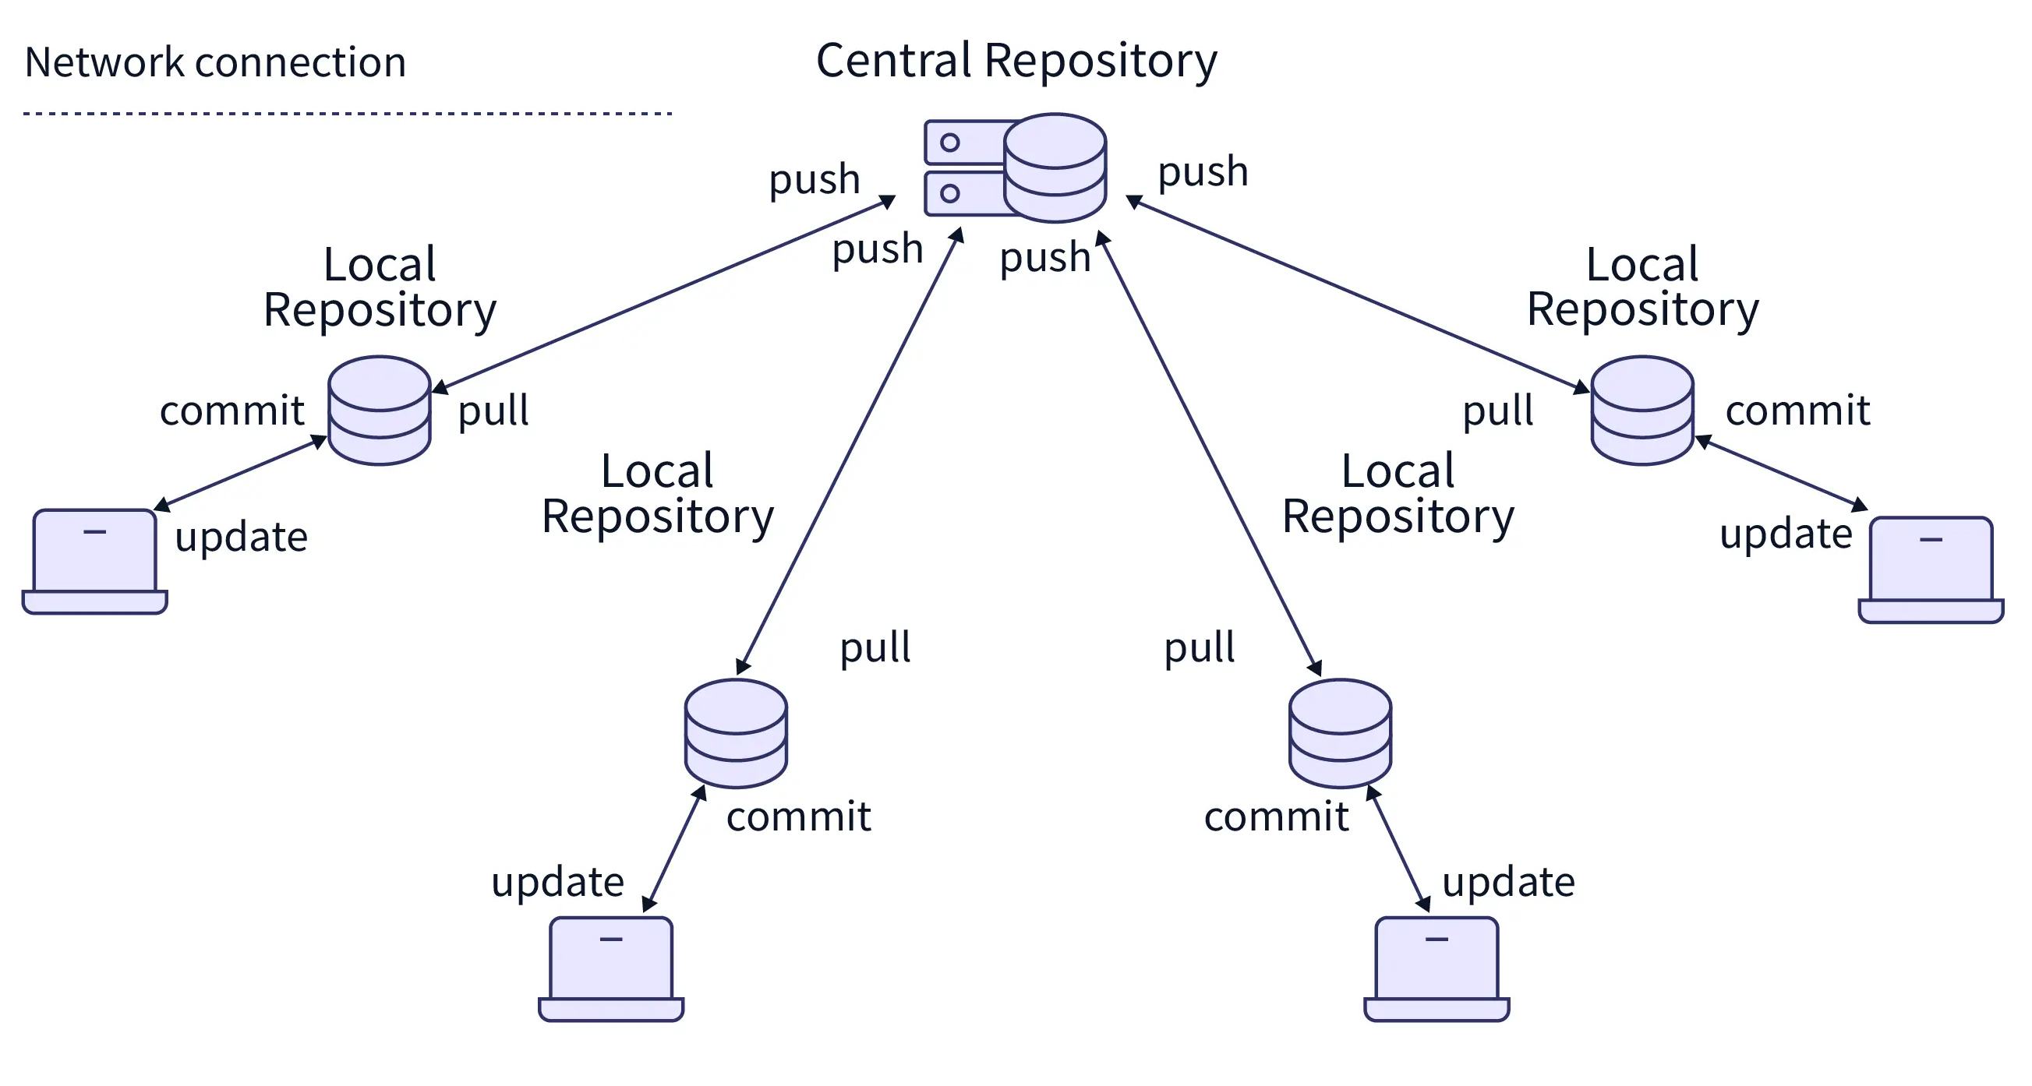
Configuration Management & Vers. Control

Slide 15
CI/CD Explained
Three Pillars:
  Continuous Integration reflects automated pipelines that, at a minimum, executes the source, build, and test stages for every commit;
  Continuous Delivery extends the automation pipeline beyond automated testing to include the preparation of the release itself;
  Continuous Deployment takes Continuous Delivery one step further by automating the final deployment to production;

Slide 16
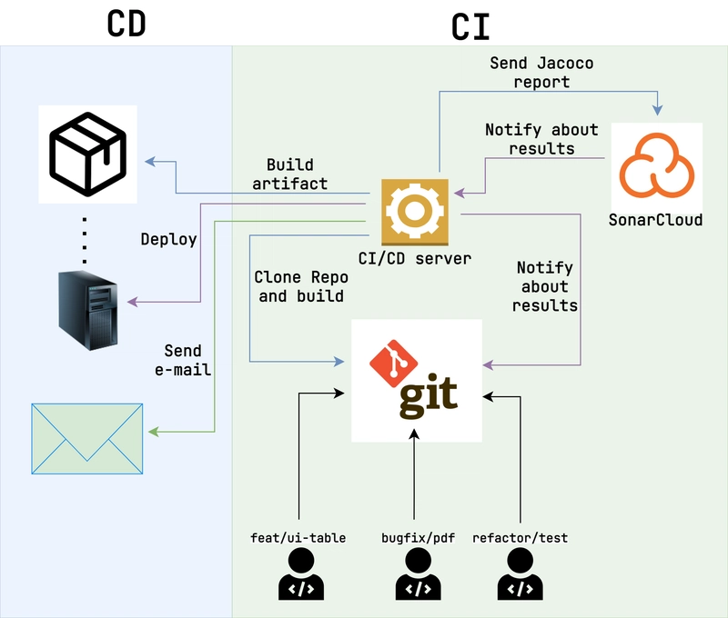
CI/CD Typical Processes

Slide 17
Emerging Paradigms
Low-Code/No-Code:
  Use models to drive creation and evolution of code;
  Model-first development;
  Model-based code verification and validation;
AI Coding:
  Use Language-Models to elaborate portions or totals of code;
  Large models can even revise, improve;

Slide 18
Wrap-up
Coding transforms the abstract products of prior phases into executable forms, IDEs are the means;
The discipline of coding reflects essentials to properly share, maintain, and evolve it (e.g., conventions, dependency mgmgt, etc.);
Novel mechanisms combine human, model, and AI into a coherent approach;

