Slide 1
Chapter 21:
Operations, Maintenance, and Evolution
Summary slides from
M. Camilli, E. Di Nitto, A. Fuggetta,
A. Margara, M.G. Rossi, D.A. Tamburri. Software Engineering: a Structured Journey from Inception to Delivery. BUP 2025.

Slide 2

Operations, Maintenance and Evolution
Chapter 21
Focus: from Dev to Ops, the Maintenance act,
Evolving software systems

Slide 3
Learning Objectives
Understand what operations mean and what activities it comprises
Understanding different types of maintenance as well as how it leads to evolution
Understanding and figuring out how evolution of software systems works and what theories and support exist

Slide 4
Operations
Instrumenting software operations means automating deployment and runtime areas of software in their live environments;
Proper operations reflect:
  Deployment automation and connection to CI/CD;
  Safe deployment strategies for server environments;
  Quality Assurance and Monitoring in Production (e.g., via observability tactics);
  Infrastructure Management;

Slide 5
Maintenance
Different types of activities aimed at improving the software status quo (e.g., increasing understandability, modifyability, etc.);
  Corrective, preventive, adaptive, etc. → all aimed at improving different aspects;
Technical debt is a metaphor to reflect the need for maintenance and the planning of evolution;

Slide 6
Evolution
Follow the spectrum of evolutionary change only for software!
Key Challenges in Software Evolution:
  Understanding the existing system;
  Managing technical debt;
  Change impact analysis;
Tools exist to improve/automate most of the above;

Slide 7
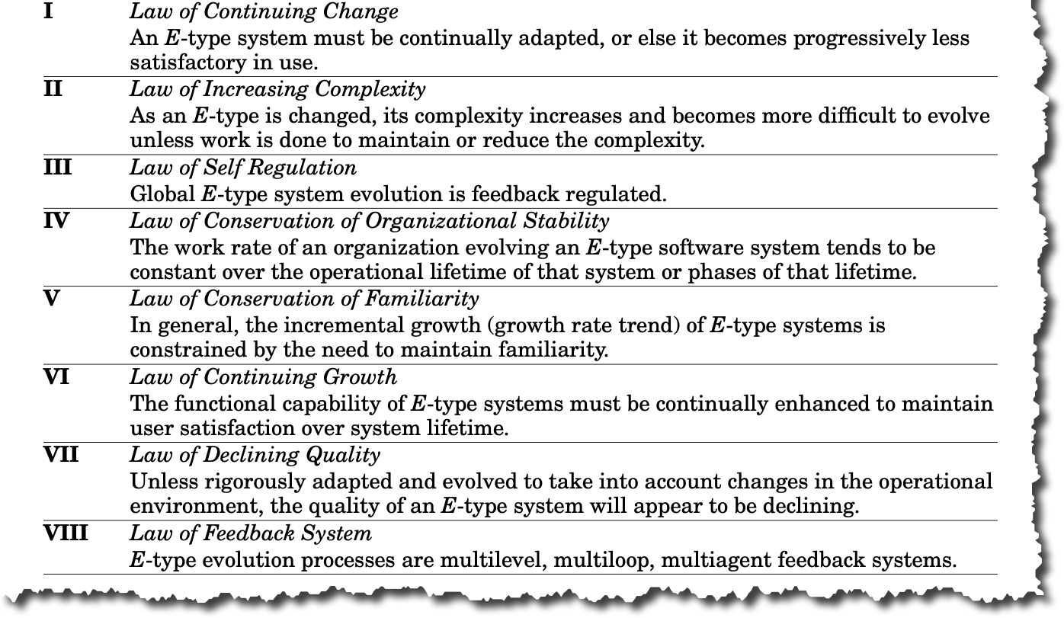
Evolution: Lehman’s laws

Slide 8
Wrap-up
Operations ➔ software operations, the set of practices that put software “in motion”;
Maintenance and evolution reflect technical debt, and its management across all artefacts and phases of software inception and operation;

