Slide 1
Chapter 24:
Open Source
Summary slides from
M. Camilli, E. Di Nitto, A. Fuggetta,
A. Margara, M.G. Rossi, D.A. Tamburri. Software Engineering: a Structured Journey from Inception to Delivery. BUP 2025.

Slide 2

Open Source
Chapter 24
Focus: using open-source components,
Making software as open-source, choosing
Appropriate licensing;

Slide 3
Open Source Explained
software solutions source code must be open to its users and to other developers;
Open Source software is so widespread today that virtually all modern complex systems incorporate at least one such element;
The paradigm shift reflects the licensing of proprietary software: Open Source ➔ non-proprietary;
  A new cultural shift was implied;
  The shift evolves even in present-day open source;

Slide 4
Notable Products
Linux: Widely recognized as one of the most successful Open Source projects, Linux is an operating system that powers many of the world’s servers.
Mozilla Firefox: A prominent example of an Open Source web browser, Mozilla Firefox champions user privacy and choice in a landscape increasingly dominated by a handful of companies.
Python: Python is a popular programming language known for its simplicity and readability.

Slide 5
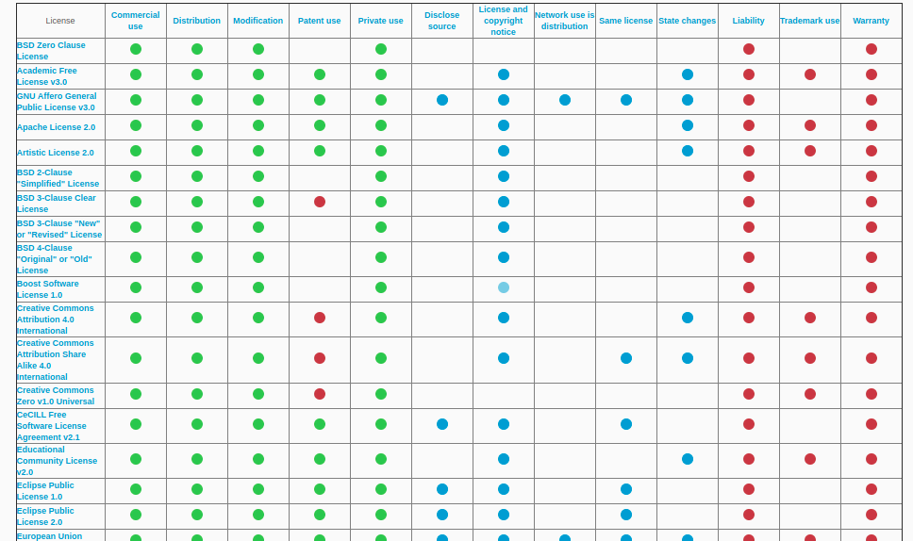
Licensing*
Choosing the appropriate license reflects an explicit cultural and intellectual property choice;
* Licenses overview courtesy of keepgrowing.in/taking-care/how-to-choose-an-open-source-license

Slide 6
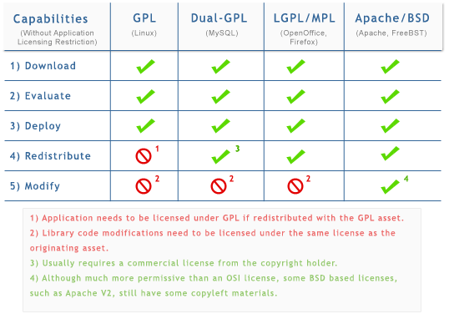
Licensing, some examples

Slide 7
Wrap-up
Open source is a paradigm shift in software development; include open components, contribute to their well-being (for free);
Different licenses reflect different cultural choices;
Licensing is complex and needs to reflect business plans, e.g., dual-licensing options destined to different business segments;

