Slide 1
Chapter 25:
Process Improvement
Summary slides from
M. Camilli, E. Di Nitto, A. Fuggetta,
A. Margara, M.G. Rossi, D.A. Tamburri. Software Engineering: a Structured Journey from Inception to Delivery. BUP 2025.

Slide 2

Process Improvement
Chapter 25
Focus: ways to manifest change
in sw. processes, organizational change mgmt.;

Slide 3
Process Improvement: an Overview
Software processes are artefacts themselves and can therefore be (continuously) improved;
Software metrics are a key asset to instrument and drive the improvement;
Several approaches exist, GenAI is bound to assist in all of them;

Slide 4
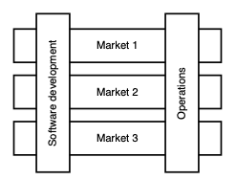
Process Improvement: The Software Organization
Software organizations reflect people and their collaboration over artefacts via specific communication channels
Where one can migrate from Architecture X to Architecture Y, same applies to organizations;

Slide 5
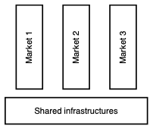
Organizational Improvement
Across markets and new infrastructure options, organizational evolution follows the same software evolution rules laid out for regular software;
Process assessment and improvement are crucial activities that require specific methods and expertise;
Tools and methods are nowadays bridging technology, methodology, and organizational sciences;

Slide 6
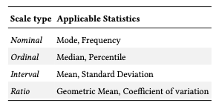
Software Metrics: Key to improvement
Once metrics are established then several approaches exist:
Kaizen – implement small, incremental changes in processes, systems, and workplace practices to enhance quality, efficiency, and overall operational effectiveness.
GQM – stands for Goal/Question/Metrics, offers a way to define KPIs in a way consistent with business targets;
CMMI – framework-driven approach that helps organizations improve their processes and practices;

Slide 7
Wrap-up
organizations must identify a specific responsibility in charge of observing, studying, assessing, and improving a software processes;
Improvement cannot be improvised: it must be a systematic and structured endeavor;
Improvement initiatives must be endorsed by all managerial levels;
Improvement must be based on committed persons who are supported in this journey;

