Slide 1
Chapter 26:
Generative AI and Software Engineering
Summary slides from
M. Camilli, E. Di Nitto, A. Fuggetta,
A. Margara, M.G. Rossi, D.A. Tamburri. Software Engineering: a Structured Journey from Inception to Delivery. BUP 2025.

Slide 2

GenAI and SE
Chapter 26
Focus: how GenAI fits in SE, how SI changes
Benefits and pitfalls;

Slide 3
Generative AI and Software Engineering
GenAI refers to a class of AI models that, unlike traditional models which classify or predict, can generate new, original content based on patterns learned from vast amounts of data;
Different architectures exist (e.g., GANs, VAEs, etc.) with each able to help in different phases and contexts of SE (e.g., code generation vs. maintenance);
SE plays a twin role: (a) SE can be used in AI systems; (b) AI systems can assist SE;

Slide 4
Software Engineering for Generative AI
Data Pipelines and Infrastructure construction and operation reflects SE principles;
Version Control for Everything Data, is required for large-scale ML;
Specialized Testing and QA required for data-driven systems;
CI/CD for Models (MLOps) is considerably different than regular DevOps;

Slide 5
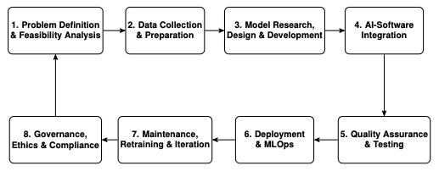
High-level AI-Integrated SE life cycle model

Slide 6

Generative AI for Software Engineering
reduces repetitive manual effort and accelerates prototyping, for example, this prompt: “Write a Python function that computes the factorial of a number recursively.”
Generates this output:

Slide 7
Generative AI for Software Engineering
All artefacts can be covered by GenAI:
  Requirements can be refined with Large-Language Models;
  Software Designs can be revised by GenAI;
  Architecture representations can be synthesized with Transformer models;

Slide 8
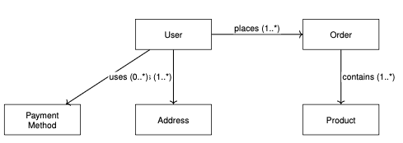
For example…
This representation is elicited automatically by an LLM, starting from a 1-paragraph description of the problem space.

Slide 9
Outstanding Challenges
Excessive use;
Human continuity;
Ethical considerations;
Security and Privacy;
Accuracy and reliability (e.g., Hallucinations);
IPR violations and other data leaks;
…

Slide 10
Wrap-up
The integration of GenAI into software engineering marks a significant evolution in the tools and practices available;
GenAI offers tangible opportunities: clarifying requirements, generating tests, boilerplate coding, legacy migration…;
GenAI constitutes a risk as well as an opportunity which requires further consideration;

