Slide 1
Chapter 4:
Unified Modeling Language
Summary slides from
M. Camilli, E. Di Nitto, A. Fuggetta,
A. Margara, M.G. Rossi, D.A. Tamburri. Software Engineering: a Structured Journey from Inception to Delivery. BUP 2025.

Slide 2
Origin and Nature of UML
UML is a semi-formal notation used to describe both problems and software solutions
It is heavily based on the object-oriented paradigm
Standardization: Maintained by the Object Management Group (OMG)
Flexibility: UML does not impose a strict way to use diagrams
  modelers select combinations that align with their specific objectives

Slide 3
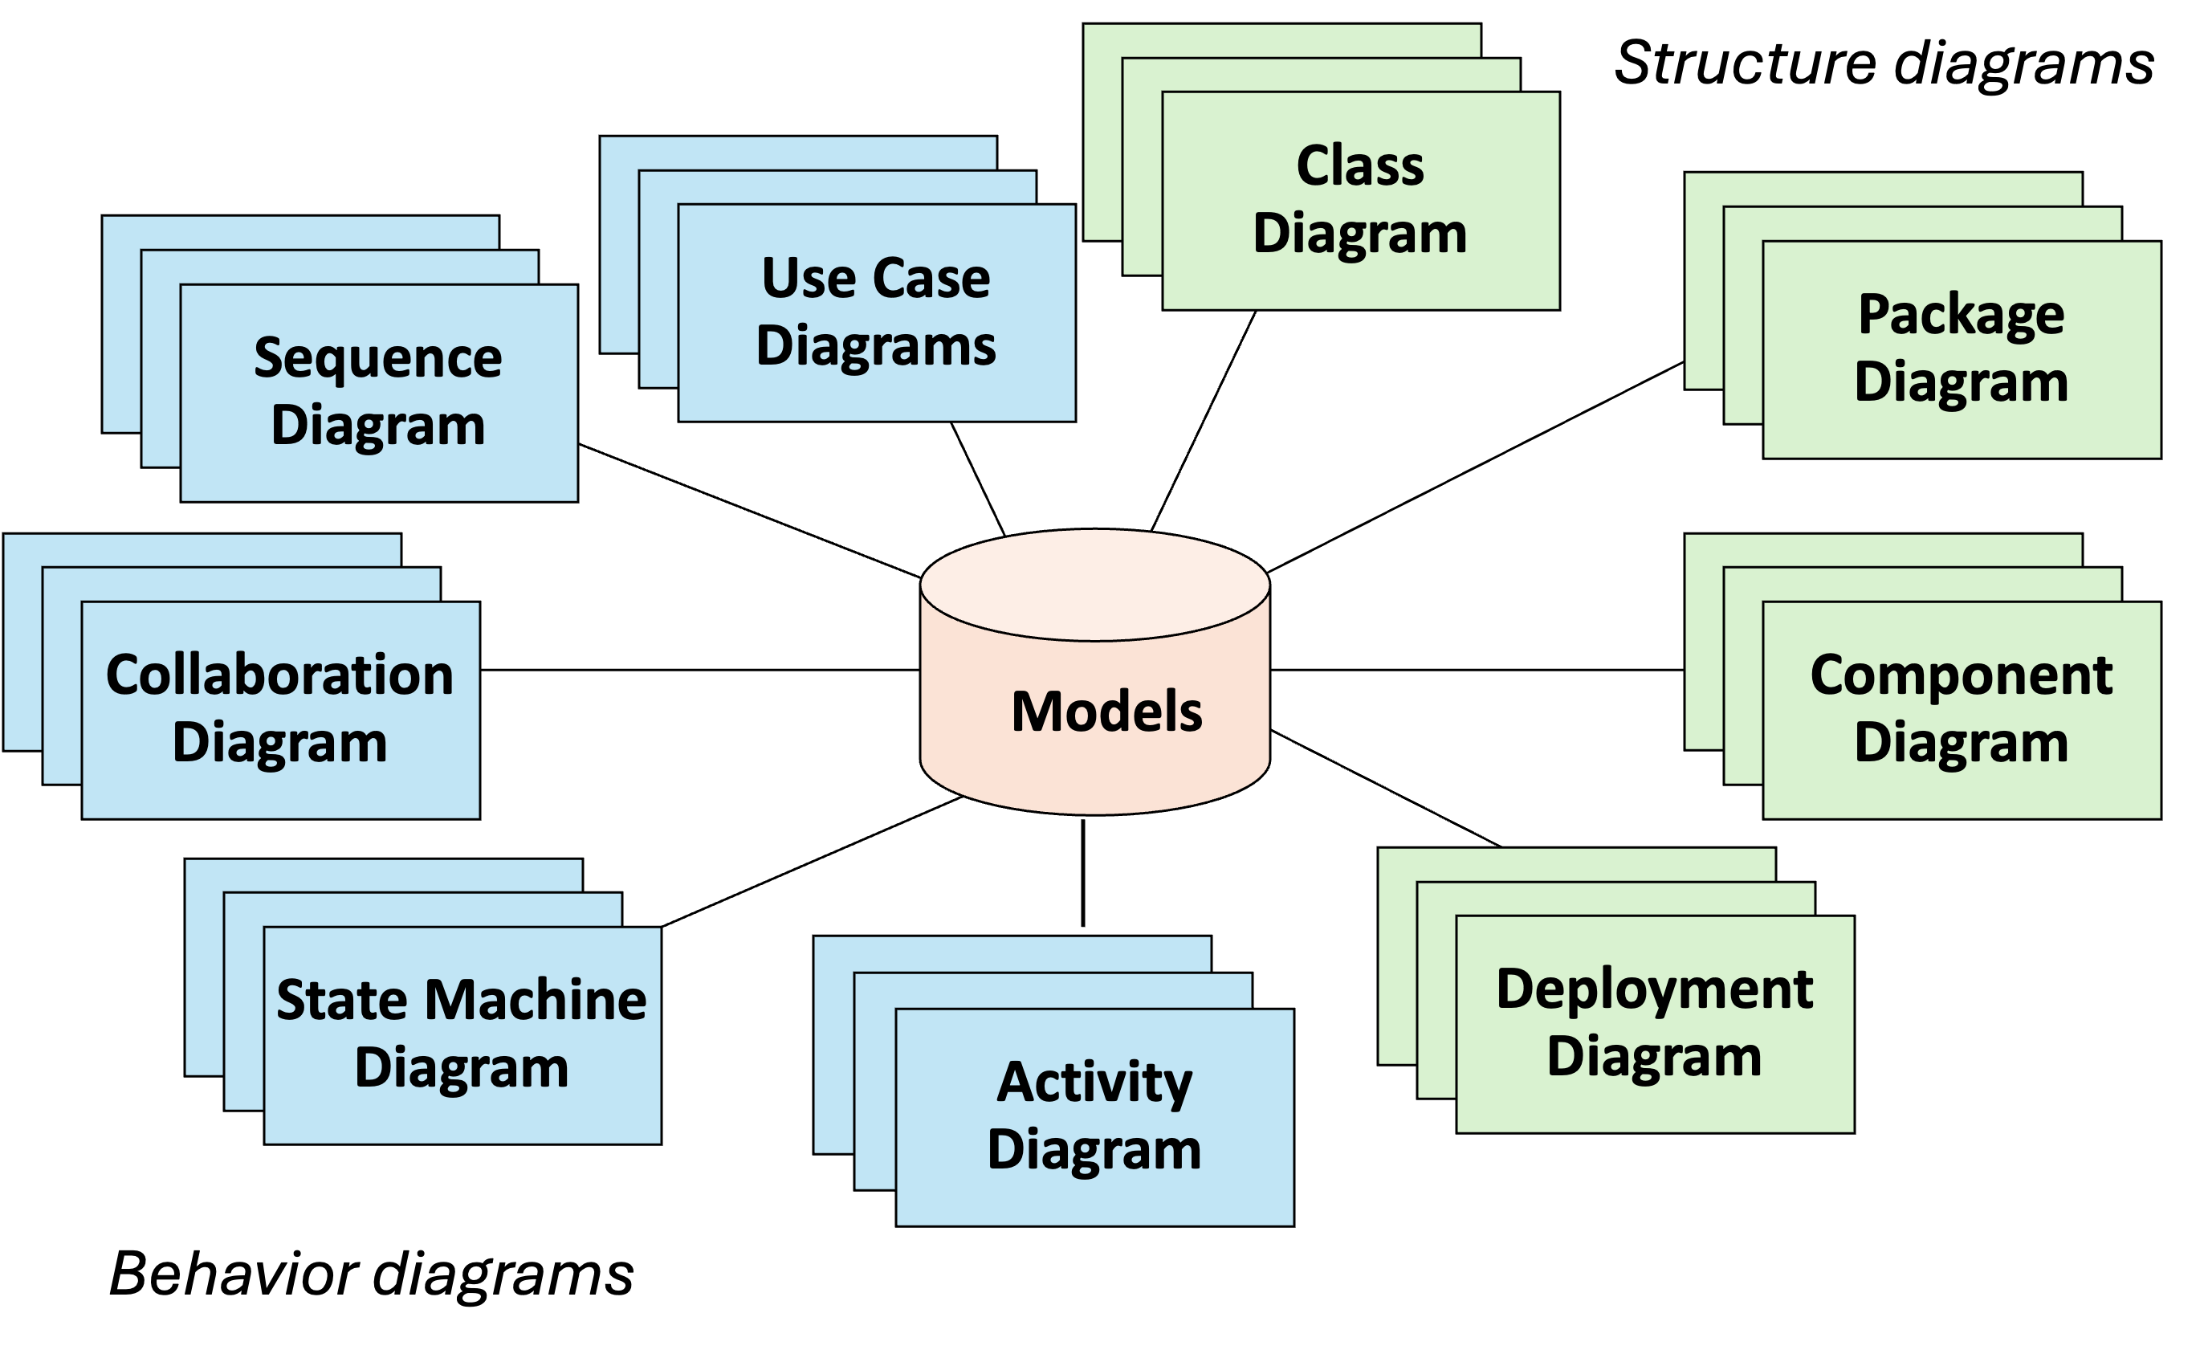
Categories of UML Diagrams

Slide 4
Class Diagrams: Classes and Attributes
Class: Represents a set of entities (objects) with shared characteristics
Attributes are qualified by properties
  Name: Only mandatory property.
  Visibility: Public (+), Protected (#), or Private (-).
  Type (e.g., int, string) and Multiplicity (e.g., [1..3]).
Operations: Actions performed on instances, specifying parameters (in, out, inout) and return types

Slide 5
Example of class

Slide 6
Class Diagrams: Associations
Multiplicity: Indicates the number of instances involved (e.g., 1, 0..*, 1..n)

Slide 7
Class Diagrams: Associations
Navigability: Defines the direction in which access is possible (represented by an arrow)

Slide 8
Class Diagrams: Associations
N-ary Associations: Involve more than two classes to prevent loss of information
Reflexive Associations: Instances involved belong to the same class

Slide 9
Aggregation vs. Composition
Aggregation
Weak form of association
Parts can exist independently of the whole
Composition
Strong relationship
Part is tightly bound; life cycle depends on the whole

Slide 10
Generalization
Generalization: Models is-a relationships (inheritance) where child classes inherit attributes and operations from parents
Abstract Classes: cannot be instantiated directly and serve as blueprints
  Marked in italics

Slide 11
Interfaces
Interfaces: Define a contract of operations using the «interface» stereotype
Interface Realization: A class provides concrete implementations for interface methods

Slide 12
Package Diagrams
Package Diagrams: Organize related elements
Common dependencies include «use», «merge», «import», and «access»

Slide 13
Component Diagrams
Component Diagrams: Represent modular parts of a system
Interaction: Occurs through ports using provided interfaces (lollipop symbol) and required interfaces (socket symbol)
Delegation: Connects external interfaces to internal parts

Slide 14
Deployment Diagrams
Illustrate how software components are deployed on physical processing nodes
Node Types:
  Device: Hardware
    e.g., PC, Server
  Execution Environment: Software infrastructure
    e.g., Docker
Communication Paths: Lines between nodes
  often labeled with protocols like HTTP

Slide 15
Use Case Diagrams
Describe actions (use cases) performed by a system in collaboration with external actors
Actors: Can be people or other systems; they interact with the subject but are usually external to it
Relationships:
  Inclusion («include»): Mandatory for the base use case to function
  Extension («extend»): Optional behavior triggered by specific extension points

Slide 16
Example of Use Case Diagram

Slide 17
Activity Diagrams
Describe workflows and procedures using action nodes and arcs
Control Nodes:
  Fork / Join: Initiate and synchronize parallel flows
  Decision / Merge: Represent conditional branches and convergence
Swimlanes: Identify actors responsible for specific actions

Slide 18
Example of Activity Diagram

Slide 19
State Machine Diagrams
Describe states an entity occupies and the transitions between them
Transitions are annotated as event [condition] / action
Advanced States:
  Superstate: Composite state containing a submachine
  Concurrent State: Superstate where multiple submachines are active simultaneously

Slide 20
Sequence Diagrams
Describe interactions between objects as a sequence over time
Lifeline: Represents the existence of an object.
Messages:
  Synchronous: Caller waits for a response
  Asynchronous: Caller continues without waiting
Frames: Group messages using operators such as loop, alt, and opt

Slide 21
Example of Sequence Diagram

Slide 22
Wrap-up
UML provides multiple perspectives on a system
No single diagram is superior;
  diagrams are used in combination to model application domains, requirements, and software design

