Slide 1
Chapter 5:
Basic Concepts of Requirements Engineering
Summary slides from
M. Camilli, E. Di Nitto, A. Fuggetta,
A. Margara, M.G. Rossi, D.A. Tamburri. Software Engineering: a Structured Journey from Inception to Delivery. BUP 2025.

Slide 2
What is Requirements Engineering (RE)?
Definition (Nuseibeh and Easterbrook 2000):
  The primary measure of software system success is how well it meets its intended purpose
  RE is the process of discovering that purpose by identifying stakeholders, their needs, and documenting these in an analyzable, communicable, and implementable form
Key issues addressed by RE:
  What is the main objective of the system?
  Who will be affected by the system?
  Will the system’s functionality be truly useful and improve users’ lives?
Core idea: Software systems are created to address someone’s needs, and identifying these needs is central to RE

Slide 3
Case Study: Ambulance Dispatching System
Scenario: Developing a system to manage the dispatch of ambulances in response to emergencies within a given region
Target: An ambulance on site no later than 15 minutes after the report is filed
Key questions for Software Engineers:
  What is the main objective (e.g., dispatching vs. guiding)?
  Who is affected and benefits (operators, crew, drivers, citizens)?
  Will the system be useful (e.g., correct, precise instructions)?

Slide 4
Stakeholders in RE
Definition: People (individually or institutionally) who are affected by, or have an interest in, the system
Examples from Case Study: Operators, ambulance crews, ambulance drivers, and indirect beneficiaries like citizens
Beyond human users: Systems can also provide functionality to other software systems (e.g., via API) or interface with legacy systems
Identifying stakeholders: Not always immediate
  The stakeholders of an application for scheduling classes at a university could be transportation authorities

Slide 5
Another view of RE
Definition (Zave and Jackson 1995):
  RE is concerned with real-world goals, functions, and constraints on software systems, and their relationship to precise specifications and evolution over time.

Slide 6
The Evolving Nature of Requirements
Dynamic nature: Goals and requirements are not static; they evolve even during development
Adaptability: Systems need to be adaptable to changing environments (e.g., new transportation requirements due to a pandemic)
Requirements volatility: The tendency of requirements to change over time

Slide 7
Separating the World from the Machine
Core concept: Requirements emerge from the interaction between the software (the machine) and its environment (the world)
Crucial step: Precisely understanding and separating the problem (world) from the solution (machine) and clearly drawing the boundary between them
Impact of boundary: What is considered "machine" versus "world" significantly changes the system’s tasks and functions
  Example: Is guiding the ambulance to the accident's site part of the system’s scope, or is it delegated to the world (e.g., an external map service)?

Slide 8
World and Machine Phenomena
Categories of phenomena:
  World-only phenomena: Occur in the world, machine is unaware
    e.g., occurrence of accidents in the city, citizens calling emergency lines
  Machine-only phenomena: Occur in the machine, world is unaware
    e.g., storing accident info in a database, computing shortest paths
  World-controlled shared phenomena: Originate in the world, experienced by machine
    e.g., emergency report entered into the system by operator, accident detection system informing the dispatching system
  Machine-controlled shared phenomena: Originate in the machine, world is aware
    e.g., system notifying ambulance crew of dispatch

Slide 9
Example of world and machine phenomena

Slide 10
Goals, Domain Assumptions, Requirements
System success requires collaboration between the software (machine) and the environment (world).
Three core categories of properties in RE:
  Goals (G): Prescriptive assertions (desired properties) in terms of world phenomena, from stakeholders’ perspective
    e.g., get ambulance to site within 15 min
  Domain Assumptions (D): Descriptive assertions about the world’s behavior that the system has no control over; taken for granted by developers
    e.g., ambulance driver follows fastest path, location updates are accurate
  Requirements (R): Prescriptive assertions specifying what the system shall do, formulated in terms of shared phenomena
    e.g., system dispatches nearest available ambulance

Slide 11
Goals, Domain Assumptions, Requirements
Requirements act as a "bridge" between the world and the machine, enforced by implementation to meet goals.

Slide 12
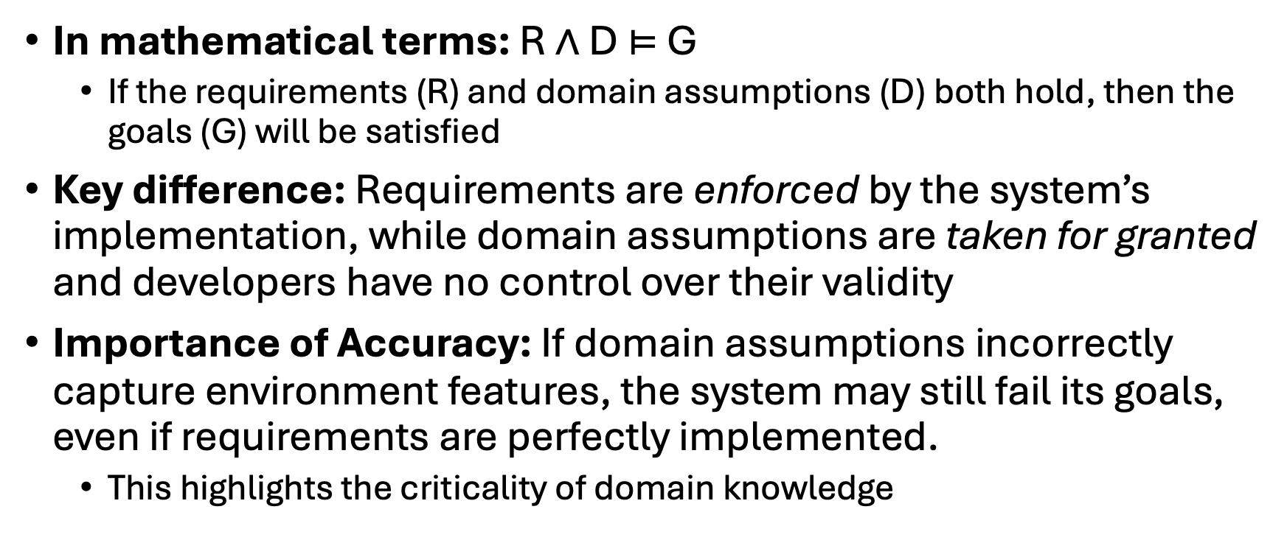
The Goal-Assumption-Requirement Relationship
In mathematical terms: R $∧$ D $⊨$ G
  If the requirements (R) and domain assumptions (D) both hold, then the goals (G) will be satisfied
Key difference: Requirements are enforced by the system’s implementation, while domain assumptions are taken for granted and developers have no control over their validity
Importance of Accuracy: If domain assumptions incorrectly capture environment features, the system may still fail its goals, even if requirements are perfectly implemented.
  This highlights the criticality of domain knowledge

Slide 13
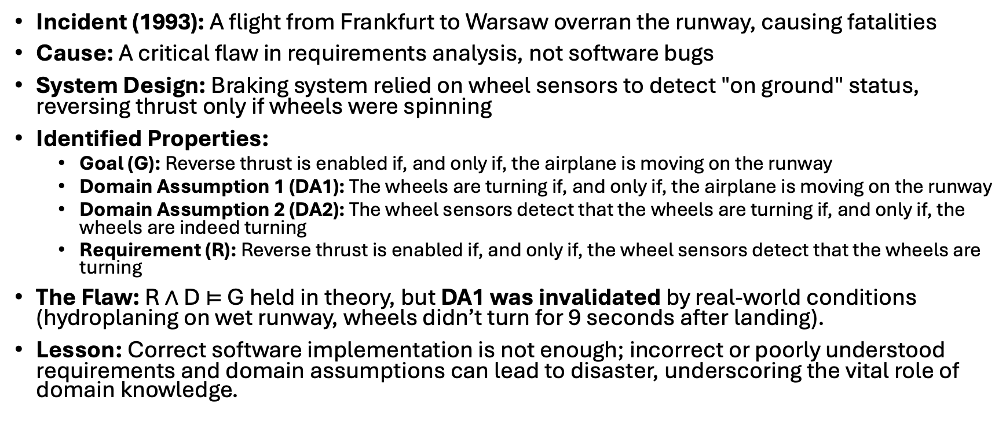
Real-world Case: Airplane Braking System Failure
Incident (1993): A flight from Frankfurt to Warsaw overran the runway, causing fatalities
Cause: A critical flaw in requirements analysis, not software bugs
System Design: Braking system relied on wheel sensors to detect "on ground" status, reversing thrust only if wheels were spinning
Identified Properties:
  Goal (G): Reverse thrust is enabled if, and only if, the airplane is moving on the runway
  Domain Assumption 1 (DA1): The wheels are turning if, and only if, the airplane is moving on the runway
  Domain Assumption 2 (DA2): The wheel sensors detect that the wheels are turning if, and only if, the wheels are indeed turning
  Requirement (R): Reverse thrust is enabled if, and only if, the wheel sensors detect that the wheels are turning
The Flaw: R $∧$ D $⊨$ G held in theory, but DA1 was invalidated by real-world conditions (hydroplaning on wet runway, wheels didn’t turn for 9 seconds after landing).
Lesson: Correct software implementation is not enough; incorrect or poorly understood requirements and domain assumptions can lead to disaster, underscoring the vital role of domain knowledge.

Slide 14
Types of Requirements
Three main categories:
  Functional requirements: What the software should do in its interactions with the environment.
  Non-functional requirements: Characterize aspects of the system perceived by users, not directly related to functionality (i.e., how well it does it).
  Constraints (technical requirements): Internal aspects of the software mandated by customers or the environment.

Slide 15
Functional Requirements
Focus: Describe the functions the system provides to users (the "what").
Nature: They specify what the system performs, not how it performs it
  e.g., they don’t detail algorithms
Examples (Ambulance Dispatching System):
  When a call reporting an accident is received, the system shall determine the nearest available ambulance
  When the system receives a new position from an ambulance, it shall update the recorded ambulance position
  The system shall allow operators to select a specific ambulance to be sent to an accident site
  When an ambulance is assigned, the system shall notify the ambulance crew of the assignment

Slide 16
Non-functional Requirements (NFRs)
Focus: Describe the qualities with which the system delivers its functions (the "how well")
Measurability: Must be expressed in measurable and quantifiable terms for validation and verification
  e.g., "send notifications within 1 second," not "be fast"
Commonly found categories:
  Performance: Efficiency, response times
    e.g., the system shall send notifications of assignments within 1 second
  Reliability: Correct functioning over time, even with faults
  Scalability: Maintain performance under increased load
  Security: Privacy, confidentiality, integrity, authenticity
    e.g., the positions of the ambulances shall be kept confidential and accessible only to
    users with specific access permission
  Interoperability: Collaboration and data exchange with other systems
  User-friendliness: Ease of interaction

Slide 17
Constraints (Technical Requirements)
Focus: Capture technical properties imposed by stakeholders or the environment.
Impact: Can lead to specific technological choices or adoption of certain solutions.
Examples (Ambulance Dispatching System):
  The system shall run on machines equipped with the Linux operating system
  The system shall use the Data Distribution Service (DDS) standard to distribute notifications
Constraints often derive from existing infrastructure, cost considerations, or legal/organizational mandates

Slide 18
The Requirements Engineering Process
Non-trivial Process: Involves several key activities
Typical Workflow:

Slide 19
RE Process: Elicitation & Modeling
Elicitation (Identification):
  Method: Exploring the system’s environment
  Sources: Interviewing stakeholders, existing systems, domain documents (e.g., procedures)
Modeling/Expression:
  Purpose: To communicate requirements to interested parties
  Notations: Can range from natural language to notations with various degrees of formal rigor

Slide 20
RE Process: Analysis and Validation
Crucial: Catch potential errors as early as possible
Impact of Early Detection: The cost of correcting errors in requirements escalates dramatically later in the development process
  e.g., 1x cost in elicitation vs. 200x after deployment
Example: Thorough analysis of the airplane braking system’s domain assumptions could have prevented the accident

Slide 21
RE Process: Documentation
Purpose: To communicate requirements to different groups (customers, programmers, testers)
Deliverable: Requirements Analysis and Specification Document (RASD) presents outcomes clearly and completely

Slide 22
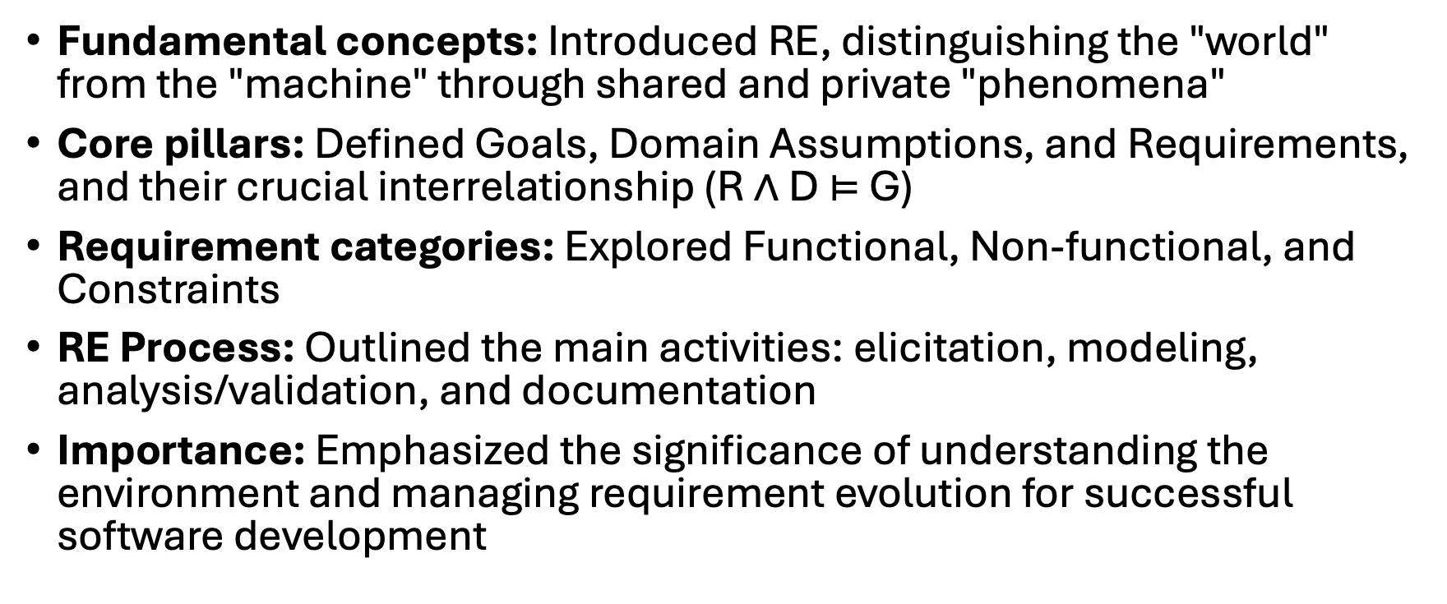
Wrap-up
Fundamental concepts: Introduced RE, distinguishing the "world" from the "machine" through shared and private "phenomena"
Core pillars: Defined Goals, Domain Assumptions, and Requirements, and their crucial interrelationship (R $∧$ D $⊨$ G)
Requirement categories: Explored Functional, Non-functional, and Constraints
RE Process: Outlined the main activities: elicitation, modeling, analysis/validation, and documentation
Importance: Emphasized the significance of understanding the environment and managing requirement evolution for successful software development

