Slide 1
Chapter 6:
Requirements Elicitation
Summary slides from
M. Camilli, E. Di Nitto, A. Fuggetta,
A. Margara, M.G. Rossi, D.A. Tamburri. Software Engineering: a Structured Journey from Inception to Delivery. BUP 2025.

Slide 2
Introduction to Requirements Elicitation
Definition: The process through which engineers identify the features and properties a software system will use to satisfy users’ needs
Core Purpose: To discover and understand the system’s needs and context
Key Principle: Requirements are expressed in terms of shared phenomena and are crucial for achieving system goals
Stakeholder Involvement: The process must involve system stakeholders and consider the operational environment (legacy systems, rules, customs)
Challenges: Gathering good requirements requires a keen understanding of the context and domain, which engineers may not initially possess

Slide 3
Challenges in Requirements Elicitation
Implicit or Incomplete Domain Knowledge: Knowledge is often not codified in documents; it resides with experts or is incomplete
  Example: A manual for train assignment rules might not exist or might omit "soft" constraints like preferring stable assignments
Conflicting Stakeholder Information: Different stakeholders (managers, schedulers, personnel) may provide contradictory priorities or needs
Stakeholder Biases: Conscious or unconscious biases can lead to misrepresentation of information, especially if stakeholders feel threatened
  Example: A scheduler might exaggerate task difficulty if they perceive automation as job replacement
Probe Effect: Observed parties might alter their normal processes when aware of being watched

Slide 4
Challenges in Requirements Elicitation
Heterogeneous Concerns & Conflicts
  Stakeholders have diverse backgrounds and conflicting interests
    e.g., schedulers prefer less variability, personnel want flexibility, developers want fewer constraints
  This leads to conflicts between functional and quality concerns
    e.g., precise assignments vs. speed
  Engineers must distinguish between "hard" (must be met) and "soft" (can be violated) requirements
Complex and Evolving Environment: Systems often interact with humans, physical devices, or legacy systems
  Systems evolve, requiring new functions for new user needs
    e.g., handling last-minute replacements
Requirements elicitation is hard, if not impossible, to automate and needs to be carried out very carefully

Slide 5
Requirements Elicitation Approaches
Two possible approaches
  Scenarios and Use Cases
    Often a bottom-up approach, starting with concrete interactions
  From Goals to Requirements
    A more top-down approach, beginning with system goals
Complementary Nature: These approaches are not mutually exclusive and can both be applied to improve understanding of the system’s behavior and context

Slide 6
Scenarios - Definition and Purpose
Definition:
  "a narrative description of what people do and experience as they try to make use of computer systems and applications." (Carroll 1995)
Characteristics of a scenario:
  Illustrates a specific interaction or sequence of events involving users and the system in a particular context
  A concrete, focused, informal description of a single feature
Benefits for Elicitation
  Helps stakeholders describe and visualize how the system will be used in real-life situations
  Makes it easier to identify, clarify, and validate requirements early in the development process
  Grounds abstract needs in concrete examples, serving as a practical foundation for eliciting system requirements

Slide 7
Scenario Example: Ambulance Dispatching System
Scenario:
  Bob, driving down Main Street in his patrol car, notices smoke coming out of a warehouse. His partner, Alice, reports the emergency from the car. Alice enters the address of the building, provides a brief description of its location (i.e., northwest corner), and defines an emergency level. In addition to a fire unit, she requests several paramedic units on the scene given that the area appears to be quite busy. She confirms her input and waits for acknowledgment. John, the dispatcher, is alerted to the emergency by a beep of his workstation. He reviews the information submitted by Alice and acknowledges the report. He assigns a fire unit and two paramedic units to the accident site and sends their estimated time of arrival (ETA) to Alice. Alice receives the acknowledgment and the ETA.
Key Observations:
  Describes a single instance of interaction (reporting a fire)
  Highlights actors (Bob, Alice, John) and their roles (reporting, dispatching)

Slide 8
Identifying Scenarios
Primary Method: Interviews with Stakeholders
  Paying customers
  End users (who may not be paying customers)
  People expected to interact with the system in general
Lines of Inquiry during Interviews:
  Which user groups are supported by the system?
  What are the primary tasks the system needs to perform?
  What data will the actor create, store, change, remove, or add?
  What external changes does the system need to know about?
  What changes or events will the actor need to be informed about?
Other Means:
  Consultation of existing documentation
  Observations of current processes, especially when replacing legacy systems

Slide 9
From Scenarios to Use Cases
Scenarios: Descriptions of vignettes, capturing specific user-system interactions
Use Cases (UCs): Structured generalizations of scenarios
  Abstraction: Abstract scenario details
    e.g., specific names like "Alice" or "John"
  Actors: Identify participants by the role they play
    e.g., "Field Officer," "Dispatcher"
  Structure: Presents interaction as a sequence of actions rather than a narrative
  Conditions: Identifies entry conditions (trigger) and exit conditions (what is achieved)
  Completeness: Can include exceptional conditions that deviate from the normal flow and additional constraints

Slide 10
Use Case Typical Structure

Slide 11
Use Case Example: "Report Emergency"

Slide 12
Detailing UCs & Deriving Requirements
Deriving requirements from UCs:
  Software engineers can identify requirements by carefully analyzing the event flows, exceptions, and special requirements
  Example of Functional Requirements:
    The System shall allow Field Officers to insert the information regarding an emergency, including its level, type, location, and brief description of the situation
      Derived from step 3
  Example of Non-Functional Requirements:
    When an emergency report is received, the System must provide a response in less than 30 seconds.
      Derived from Special Reqs

Slide 13
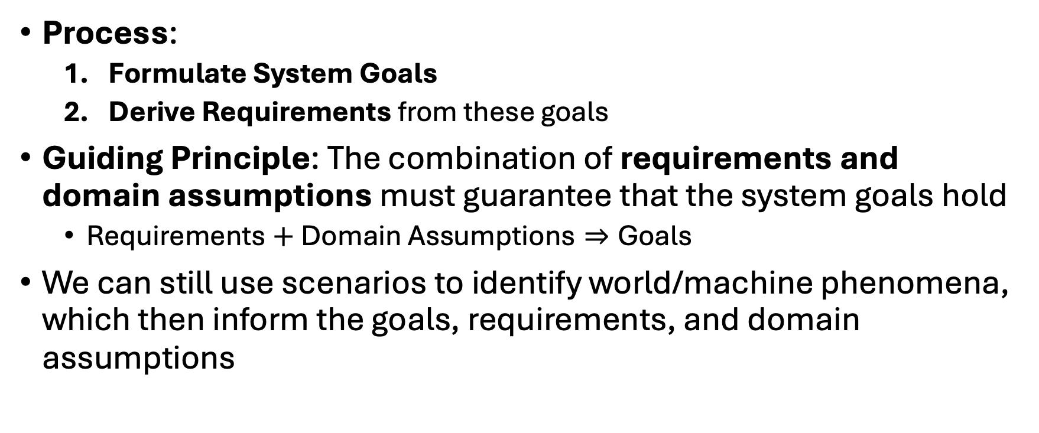
From Goals to Requirements
Process:
  Formulate System Goals
  Derive Requirements from these goals
Guiding Principle: The combination of requirements and domain assumptions must guarantee that the system goals hold
  $\text{Requirements}+\text{Domain} \text{Assumptions}⇒\text{Goals}$
We can still use scenarios to identify world/machine phenomena, which then inform the goals, requirements, and domain assumptions

Slide 14
Case Study: Physical Access Control System
System Purpose: Regulate the flow of people accessing a "restricted" area (e.g., a museum or metro barrier)
  Allows paying customers to enter, prevents others
  People use "tokens" for single entry, scanning them to open doors
Example Scenario:
  Alice, a visitor, wants to enter an exhibition space. To do so, she first buys a token at the counter installed at the entrance of the exhibition area. Then, she approaches the barrier and scans the token. The token is valid, so Alice pushes the doors of the barrier, which swing open. Finally, Alice enters the area, and the doors close.

Slide 15
Case Study: Physical Access Control System
Some Phenomena:
  WP1: Visitor buys a token (World-only)
  SWP2: Visitor scans a token (Shared, World-controlled)
  SMP5: The doors swing open (Shared, Machine-controlled)
Some System Goals:
  G1: At any time, entries should never exceed the number of scanned valid tokens
  G2: People who scan valid tokens are allowed to enter

Slide 16
Domain Assumptions
Some Domain Assumptions:
  DA1: Visitors only enter the exhibition area when the doors are open
  DA2: If a visitor pushes the barrier and the doors open, they enter the exhibition area
  DA3: When doors are open, only one visitor can enter within a specified time (d_{e} time units, needed for doors to close)
  DA4: The time the mechanical system takes to open and close the doors is negligible
Importance of Correct Assumptions:
If assumptions are faulty (e.g., people jump over barriers, making DA1 false), the reasoning that requirements guarantee goals becomes faulty
Guaranteeing assumptions (e.g., taller barriers) is outside the scope of the software system being developed

Slide 17
Derived Requirements
To satisfy Goal G1 (entries never exceed scanned tokens), combined with Domain Assumptions DA1-DA4, the following requirements are identified:
R1: When a visitor pushes the barrier doors, if (doors_opened < valid_tokens_scanned), then the system shall open the doors
R2: When a visitor pushes the barrier doors, if (doors_opened = valid_tokens_scanned), then the system shall keep the doors closed
R3: The system shall open the doors only if a visitor pushes them
R4: After the doors open, the system shall close the doors within d_{e} time units
R5: Initially, the system shall close the doors

Slide 18
Show that G1 holds
We show that R1, R2, R3, R4, R5, DA1, DA2, DA3, DA4 guarantee G1
  R1, R2, R3, R4, R5, DA1, DA2, DA3, DA4 ⊨ G1
First, we show that number_entries ≤ doors_opened
  From R5 and DA1, initially no one can enter the exhibition area, unless the doors open
  From DA2 and R3, each new opening of the doors corresponds to a visitor entering the exhibition area, where the opening occurs before the entering
  From R4, DA3 and DA4, only one visitor enters when the doors open
  Thus, number_entries ≤ doors_opened holds at any time

Slide 19
Show that G1 holds
Second, we show that doors_opened ≤ valid_tokens_scanned
  Tokens can be scanned only after the system starts, so initially valid_tokens_scanned = 0
  From R3, the doors do not open if there is no push
  R1, R2 and R3 together entail that the doors open if, and only if, a visitor pushes the doors and doors_opened < valid_tokens_scanned holds
  Hence, doors_opened ≤ valid_tokens_scanned holds at all times
Finally, number_entries ≤ doors_opened ≤ valid_tokens_scanned holds, which entails that G1 is satisfied

Slide 20
Wrap-up
Requirements Elicitation is the first and critical stage of the Requirements Engineering workflow
It involves addressing significant challenges such as implicit knowledge, conflicting stakeholder views, and complex environments
Key Approaches Covered
  Scenarios and Use Cases: Provide a bottom-up, concrete way to describe interactions and derive requirements
  Goal-Driven Approach: Offers a top-down method, deriving requirements from system goals, validated by domain assumptions

