Slide 1
Chapter 7:
Requirements Specification
Summary slides from
M. Camilli, E. Di Nitto, A. Fuggetta,
A. Margara, M.G. Rossi, D.A. Tamburri. Software Engineering: a Structured Journey from Inception to Delivery. BUP 2025.

Slide 2
The Role of Modeling in RE
Models are not just abstract representations; they are essential tools for reasoning, communication, verification, and construction
  They bridge the gap between informal understanding and formal development structures
Goals of modeling
  Capture requirements and domain knowledge precisely
  Reduce ambiguity and provide a reference point for stakeholders
  Identify relevant objects, agents, phenomena, goals, and domain assumptions

Slide 3
The Spectrum of Modeling Languages
The utility of a model depends on the choice of language
  Natural Language: Accessible and simple but inherently ambiguous and context-sensitive
  Formal Languages: Mathematical precision (e.g., automata, logics) allows for automated verification but requires expertise
  Semi-formal Notations: Graphical/textual syntax like UML limits ambiguity while remaining accessible, though it lacks full rigor for automated verification
Hybrid Approach: Use UML for core structures, informal text for context, and formal methods for critical components

Slide 4
Formulating Natural Language Requirements
The ISO/IEC/IEEE 29148 standard provides guidelines for disciplined natural language formulation
Desirable Properties of Requirements
  Necessary: Direct contribution to system goals
  Appropriate: Right level of detail; avoids design/implementation constraints
  Unambiguous: Only one possible interpretation; avoids subjective terms
  Correct & Complete: Accurately states needs without missing info
  Singular: Focuses on a single feature
  Feasible: Possible to implement
  Verifiable, Understandable

Slide 5
Structured Formulation Template
To assess quality properties, the IEEE 29148 standard suggests specific sentence structures:
  [Condition] [Subject] [Action] [Object] [Constraint of Action]
  [Subject] [Action] [Constraint of Action]
Examples:
  When the system receives a new position [Condition], it [Subject] shall update [Action] the recorded position [Object] within 2 seconds [Constraint of Action].
  The system [Subject] shall display resources [Action] in ascending order of identifier [Constraint of Action].

Slide 6
Identifying Poorly Formulated Requirements
Non-Singularity: “The system shall validate and accept credit cards and cashier’s checks with high priority.”
  Conflates two features
Ambiguity/Unverifiability: “The system shall process all mouse clicks very quickly to ensure that users do not have to wait.”
  Subjective; needs a metric like “within 100ms”.
Unfeasibility: “The system should guarantee that the reserved taxi picks up the user.”
  Fulfillment relies on human drivers/domain assumptions, making it a goal rather than a requirement

Slide 7
UML in Requirements Engineering
UML supports RE through various diagram types:
  Use Case Diagrams: Identify actors and provide functional overviews.
  Sequence Diagrams: Detail interactions between actors and the system.
  Activity Diagrams: Model workflows and alternative execution paths.
  Class Diagrams: Model domain entities and their relationships.
  State Machine Diagrams: Model state-dependent behaviors of domain entities.

Slide 8
Modeling Actors
Use Case (UC) Diagrams: Represent system functions at a high level. Actors can have associations labeled «Initiate» or «Participate»

Slide 9
Modeling Interactions
Sequence Diagrams: Represent UCs as interactions between lifelines. At the RE level, the system is treated as a “black box”, omitting internal components

Slide 10
Modeling Interactions
Activity Diagrams: Use swimlanes to group activities by actor or system, modeling complex workflows and signals

Slide 11
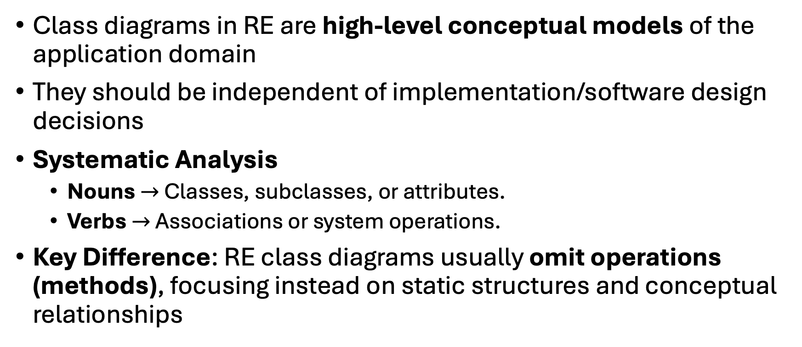
Domain Models (Class Diagrams)
Class diagrams in RE are high-level conceptual models of the application domain
They should be independent of implementation/software design decisions
Systematic Analysis
  Nouns $→$ Classes, subclasses, or attributes.
  Verbs $→$ Associations or system operations.
Key Difference: RE class diagrams usually omit operations (methods), focusing instead on static structures and conceptual relationships

Slide 12
Example of Domain Model

Slide 13
Example of Domain Model with Operations

Slide 14
Advanced Domain Modeling
State Machine Diagrams: Essential when domain entities (like an “Incident” or “Problem”) experience meaningful changes over time via transitions between states

Slide 15
Wrap-up
Modeling is a central activity enabling clarity, precision, and collaboration
Selection of the right strategy (natural language vs. UML vs. formal) depends on risk and complexity
Structured formulation ensures requirements meet quality standards (Singular, Unambiguous, Verifiable, etc.)
UML diagrams provide complementary views—functional, behavioral, and structural—of the system requirements

