Slide 1
Chapter 8:
Requirements Engineering in Practice
Summary slides from
M. Camilli, E. Di Nitto, A. Fuggetta,
A. Margara, M.G. Rossi, D.A. Tamburri. Software Engineering: a Structured Journey from Inception to Delivery. BUP 2025.

Slide 2
The Iterative Nature of RE
In practice, RE is not a linear sequence but an iterative interplay
  Engineers start with existing documents, interviews, and legacy knowledge
  This identifies scenarios and phenomena
  These insights lead to more precise use cases, goals, domain assumptions, and eventually requirements
  Insights from modeling often prompt a revisit and refinement of earlier artifacts

Slide 3
Case Study: The TelePlus System
TelePlus is a streaming platform for TV series designed for families
Key Feature: Allows multiple members to share a plan while maintaining individual preferences
Constraints: Strict limits on concurrent streaming sessions and detection of fraudulent plan sharing (e.g., logins from different geographic locations)
Enforcement: The system tracks device activity and suspends plans if violations occur

Slide 4
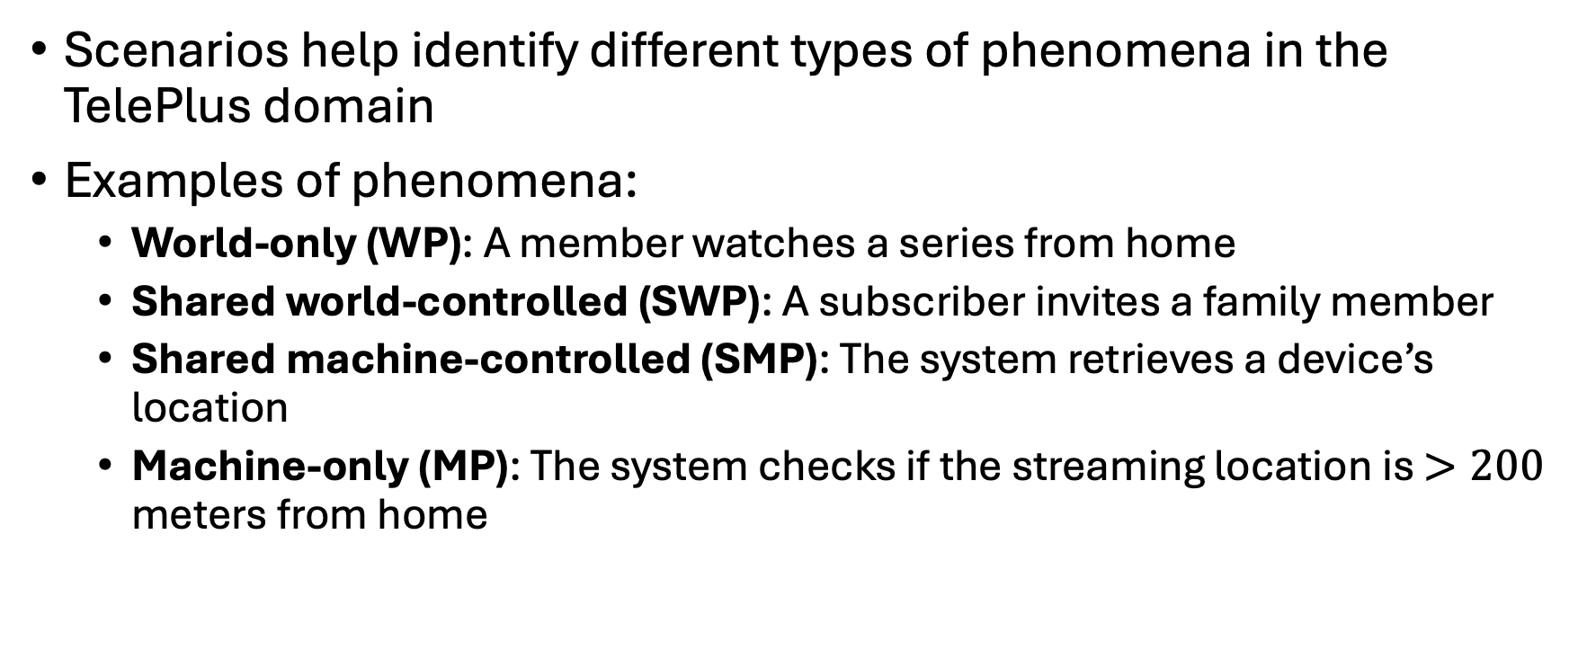
Categorizing Phenomena
Scenarios help identify different types of phenomena in the TelePlus domain
Examples of phenomena:
  World-only (WP): A member watches a series from home
  Shared world-controlled (SWP): A subscriber invites a family member
  Shared machine-controlled (SMP): The system retrieves a device’s location
  Machine-only (MP): The system checks if the streaming location is $>200$ meters from home

Slide 5
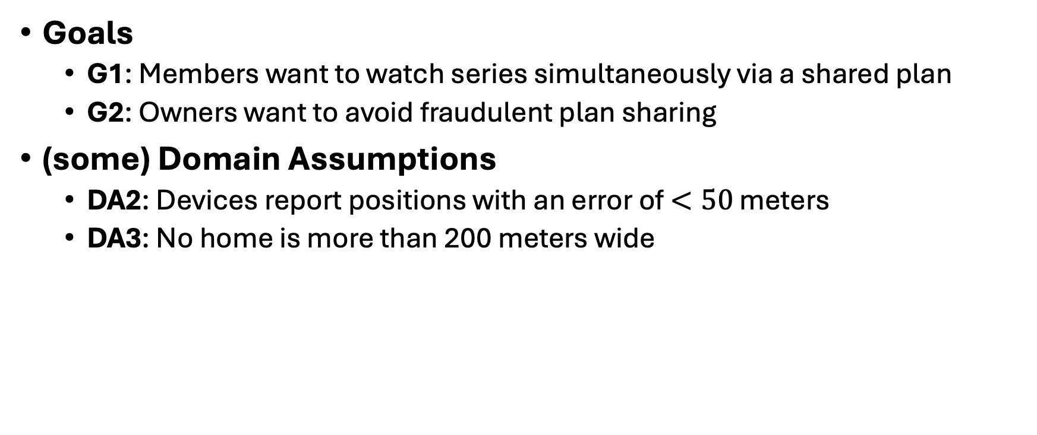
Goals vs. Domain Assumptions
Goals
  G1: Members want to watch series simultaneously via a shared plan
  G2: Owners want to avoid fraudulent plan sharing
(some) Domain Assumptions
  DA2: Devices report positions with an error of $<50$ meters
  DA3: No home is more than 200 meters wide

Slide 6
Use Case Modeling
UML Use Case (UC) diagrams provide a functional overview
Primary Actors: Family Member, Main Subscriber, Device, and Customer Service Operator
Key UCs:
  Stream TV series: The central function including limit and violation checks
  Check violation: Specifically monitors location and suspends plans if necessary
  Reactivate plan: Handled by operators after suspension

Slide 7
Use Case Diagram

Slide 8
Structural Models
Domain Model (Class Diagram): Captures conceptual entities like RegisteredUser, FamilyPlan, and StreamingSession

Slide 9
Behavioral Models
Sequence Diagrams: Stream TV series and Check violation

Slide 10
Behavioral Models
State Machine Diagrams: Model the lifecycle of entities, such as a Plan transitioning from Active to Suspended

Slide 11
Formulating Requirements
Requirements are derived from goals and UCs to specify what the system shall do:
  R9: When a request exceeds the maximum number of simultaneous streams, TelePlus shall deny the stream request and show an error message stating that the limit has been reached
  R12: If TelePlus detects that the position of the streaming device is more than 200 meters away from the main location, it shall suspend the plan
  Technical Requirements (TR14): TelePlus shall be able to interact with common mobile devices, and in particular those built on the Android and iOS operating systems

Slide 12
The RASD: Purpose
The Requirements Analysis and Specification Document (RASD) serves three main roles:
Communication: Bridges the gap between technical and non-technical stakeholders regarding system objectives and the domain
Contractual Foundation: Acts as the definitive legal agreement on what must be delivered
Development Baseline: Used for project planning, cost estimation, and as a reference for verification and validation

Slide 13
Target Audience of the RASD
The RASD is a multi-purpose document for various profiles:
Customers/Users: Validate that high-level goals and workflows are met
Systems Analysts: Define interfaces and manage dependencies
Developers: Use it as a blueprint for implementation
QA Teams: Design tests to verify functional and non-functional requirements
Project Managers: Track progress and manage risks/scope

Slide 14
RASD Structure (ISO/IEC/IEEE 29148)

Slide 15
Traceability and Quality
Traceability Matrix: A structured table mapping requirements to scenarios, UCs, and goals to ensure all needs are addressed
Quality Properties: A high-quality RASD must be Complete (no placeholders like TBD), Precise, Unambiguous, Pertinent (every requirement traces to a goal), and Consistent
It must also be Feasible, Understandable, and Modifiable to support evolution

Slide 16
Requirements Engineering Tools
Software tools enhance efficiency and quality throughout the RE life cycle
Dedicated RE Tools (e.g., IBM DOORS): Support authoring, complex traceability, and NLP-based quality checks
Modeling Tools (e.g., Enterprise Architect): Focus on visual UML modeling and architectural design
Verification-centric Tools (e.g., ReqTest): Align requirements with test cases and responsibility allocation
Agile Tools (e.g., Jira, Azure DevOps): Use “User Stories” and “Epics” for more lightweight settings

Slide 17
Wrap-up
RE in practice is an iterative, modeling-heavy process
The RASD is the critical artifact that binds stakeholders, developers, and testers to a shared vision
While tools are powerful enablers for traceability and management, the core of RE remains critical thinking and stakeholder engagement

